Slide 1

Newegg Laptop Web Scraping
By: Jayce Jiang

Slide 2
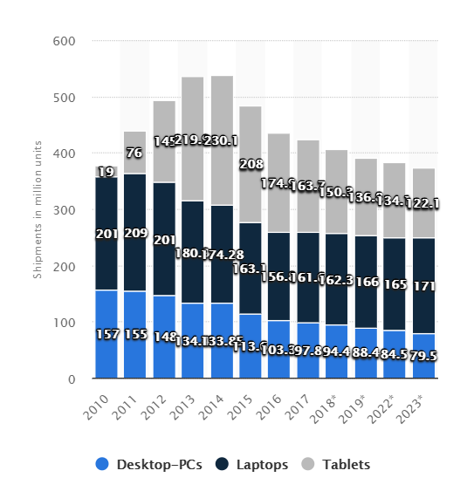
Background Introduction
Nowadays, Laptop is one of the most important item in our daily life.
Estimable of 166 million units of laptop were sold and shipped in 2019. (International Data Corporation(IDC))
The laptop/notebook are expected to take 46% of all personal computing device market by 2023.

Slide 3
The Problem:
With total’s overwhelming collection of laptop and a variety of specs from each laptop, finding the best laptop that fit our demanding work are difficult.
There are so many Laptop manufacturer in the market and the specs of Laptops look similar to each other, However, the price could have a huge difference.
With that said, I am using web scrapy in Python to get the data I needed for futher analysis.

Slide 4
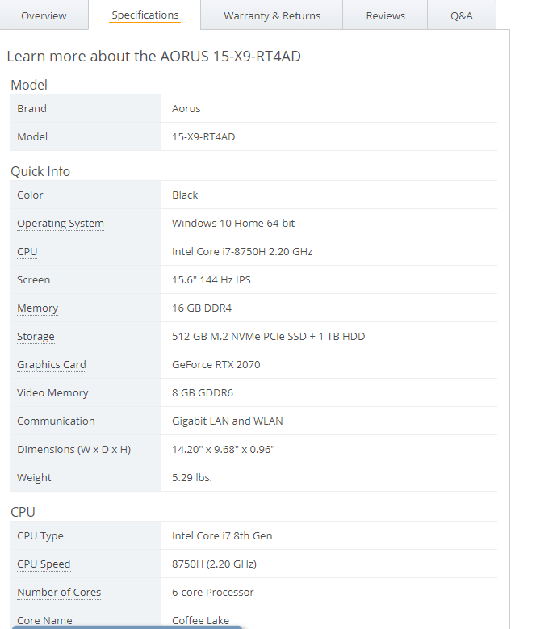
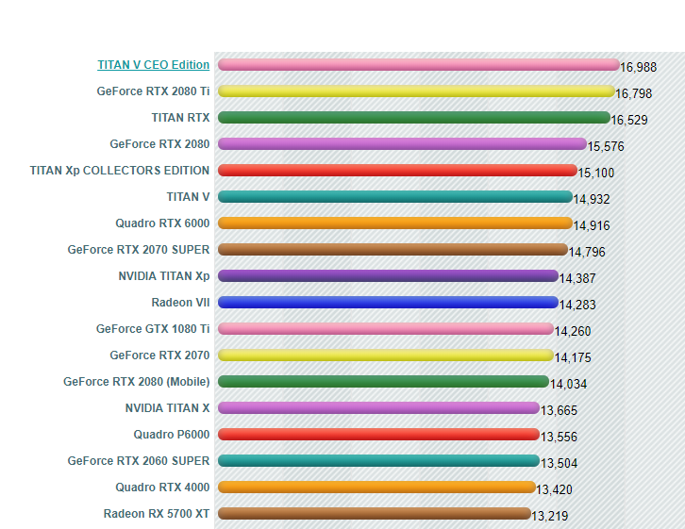
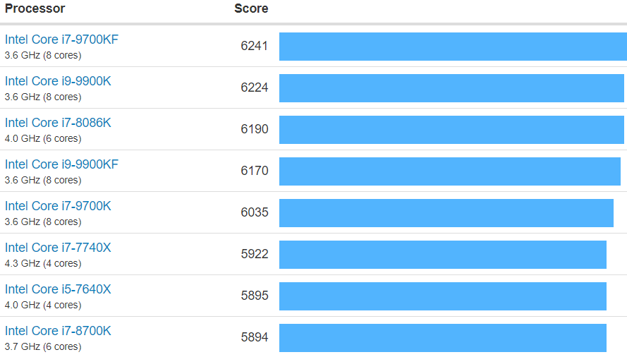
Data Scraped
The laptop data I scraped was from Newegg
The CPU and GPU Benchmarks data was taken from GeekBench and PassMark SoftWare

Slide 5
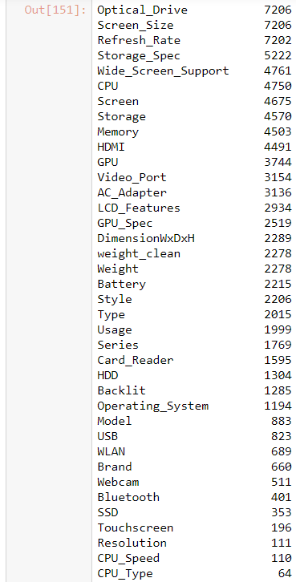
Data Checking and Cleaning
Total rows contains was around 12000 rows and 40 columns, but a lot of duplicates for same specs but different colors.
Then I check for null and missing values and replace the columns with either 0 or NAN depending on the situation.
Create new columns for cpu benchmark scores and gpu benchmark scores.
The final DataFrame includes overall 48 Columns and 7000 rows.

Slide 6
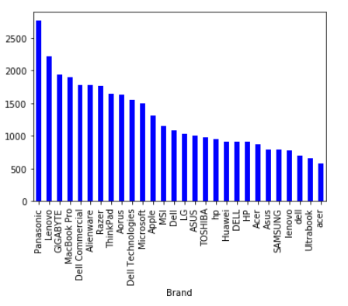
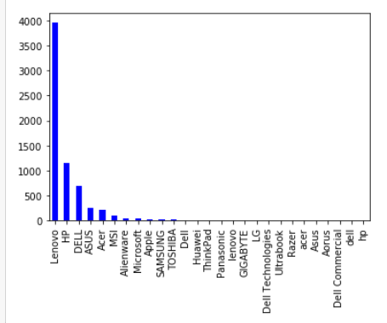
Data Analysis(Part I)
Price is the most important metrics when we comparing different laptop. It is strange that Panasonic, lenova, Gigabyte, and Dell Commercial are so expensive.
Further investigation on the total number of rows per brand shows us a few key points.
Panasonic, Gigabyte, and Dell Commercial both has less than 5 dataset and those few dataset are expensive laptops
Also, Lenovo and Thinkpad are part of the same company. The “Lenovo” brand is way more expensive, because it only included it high-end commercial laptop. The “lenovo” brand is cheaper, because it only included its low-end commercial laptop.
Based on the graph and the above points, MacBook Pro, Dell Alienware, Razer Blade, ThinkPad, and Aorus Laptop are the 5 most expensive average laptops, while Acer, Lenovo, Asus, Dell, and Huawei offer the lowest average laptops.

Slide 7
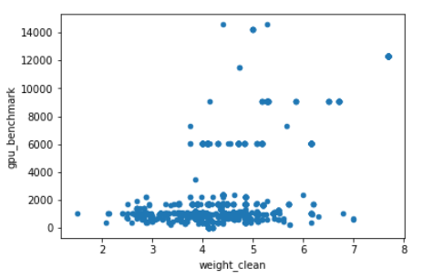
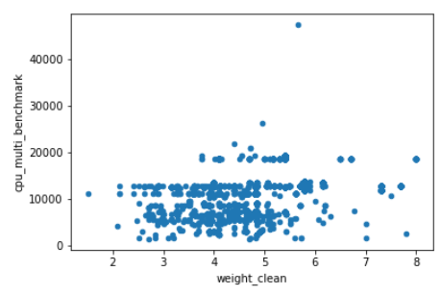
Data Analysis(Part II)
Weight vs performance was a surprising one.
Obviously, gpu performance tend to go up as weight increase. For any performance above a 3400 benchmark, the minimal weight was around 4 lbs. Which I believe is the current limitation of portable powerful laptops.
However, cpu performance was fairly consistent throughout the weight. CPU are the core and small sizes. You can see all type of powerful CPU above 5000 benchmark at all weights.

Slide 8
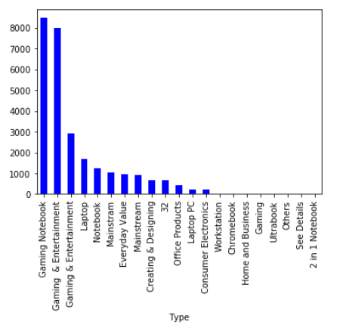
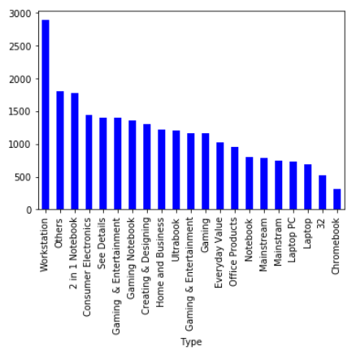
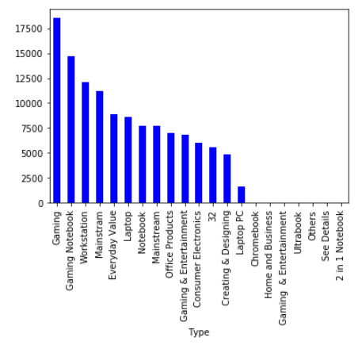
Data Analysis(Part III)
GPU Benchmark Price CPU Benchmark
Type Analysis for different categories of laptops.

Slide 9
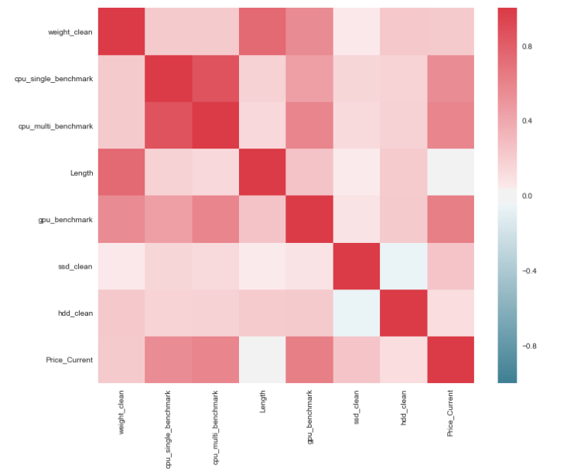
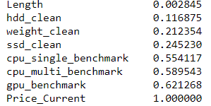
Data Analysis(Part IV)
Plotting Pearson Correlation matrix, one can see there are a close direct relationship between GPU and CPU performance vs price. Next, weight and SSD storage are also closely relative to price.

Slide 10
Future Work
Use Machine Learning to Predict Laptop price with given combination of Specs.
Finishing up cleaning the other specs dataset and add in sentimental analysis for the review data.
Scrape more data from BestBuy, Amazon, and B&H Photo, so I can fill up all the missing and NAN data from the begining

