Slide 1
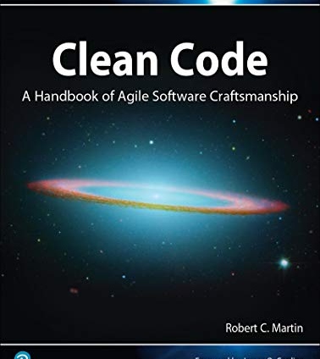
Clean Code
by Robert C. Martin

Slide 2
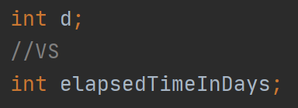
Meaningful names

Slide 3
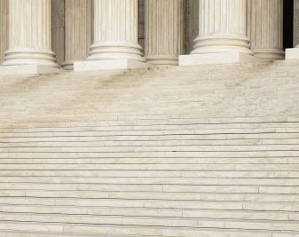
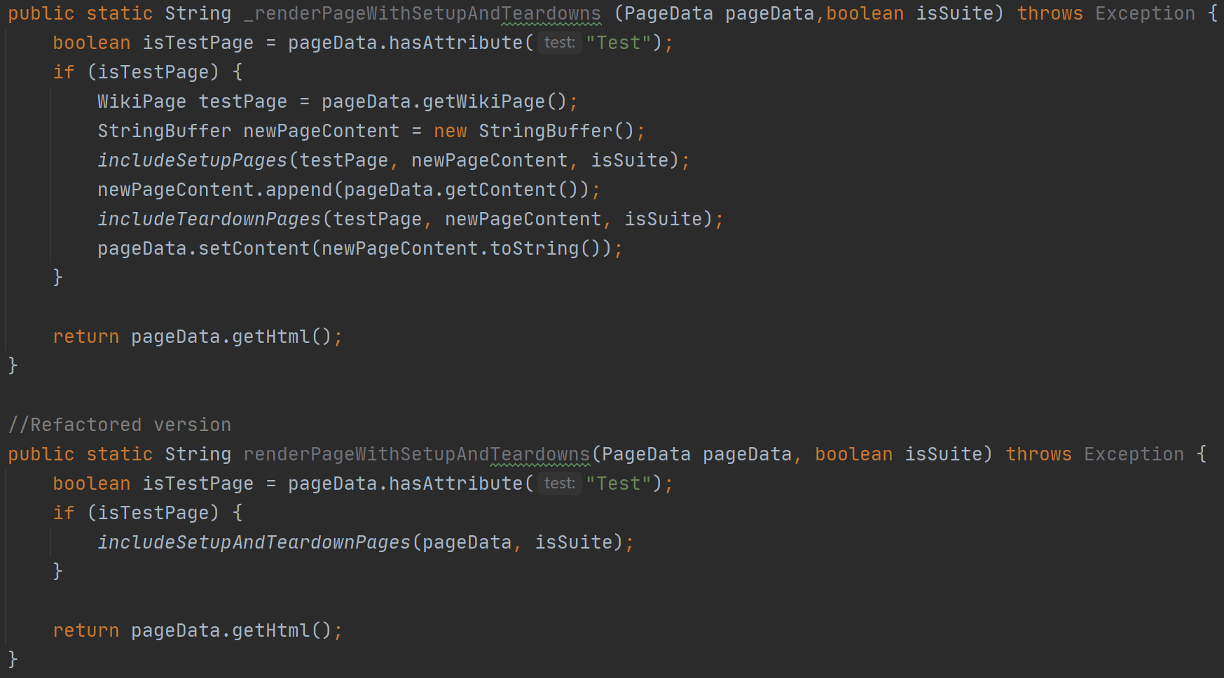
Functions

Slide 4
Comments

Slide 5

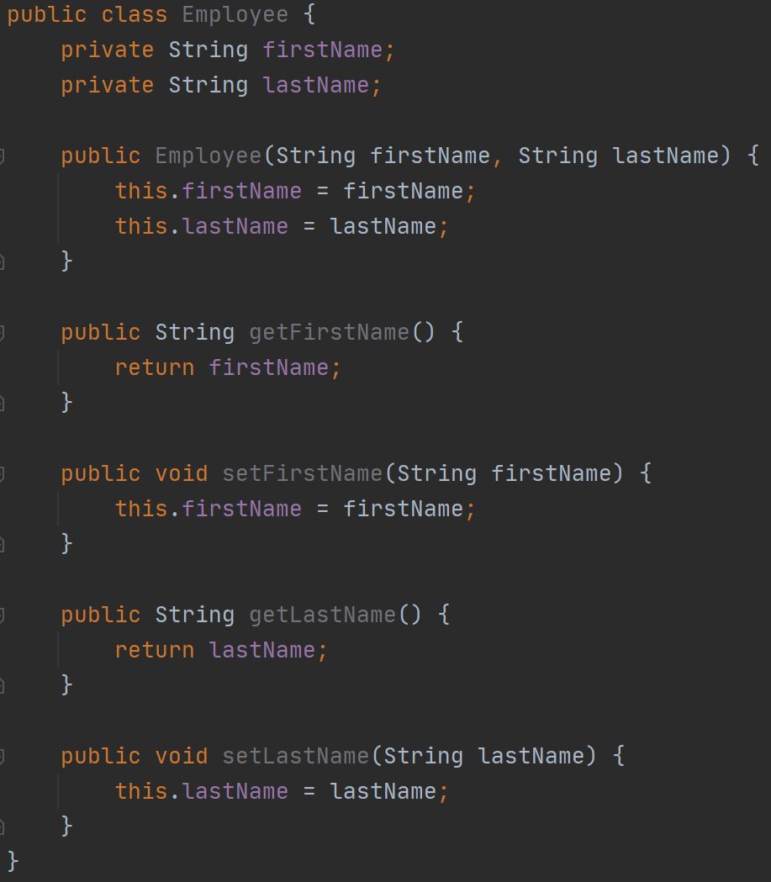
Formatting

Slide 6
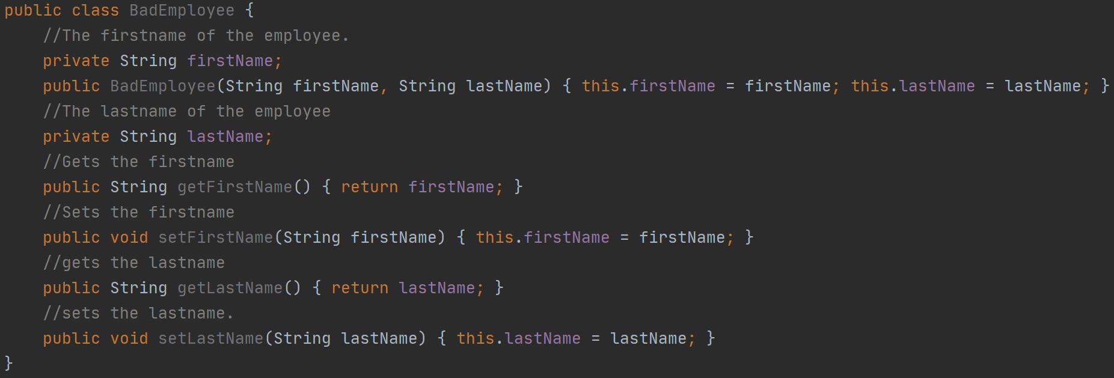
Formatting

Slide 7

Objects and data structure
Law of Demeter (LoD): Principle of least knowledge

Slide 8
Error handling
Use Exceptions
Create messages with information about the error
Avoid returning or passing null

Slide 9
Boundaries
- Study the documentation and test the third party API before you start using it.
- Check which features you are going to use.

Slide 10
Unit tests
Test Driven Development (TDD)
You may not write production code until you have written a failing unit test.
You may not write more of a unit test than is sufficient to fail.
You may not write more production code than is sufficient to pass the current failing test.
F.I.R.S.T rule:
Fast
Independent
Repeatable
Self validating
Timely

Slide 11
Classes
Single Responsibility Principle
(SRP)
Open Closed Principle
(OCP)
Dependency Inversion Principle
(DIP)

Slide 12
Systems
POJO: Plain Old Java Object:
Are mainly data classes that hold information without any logic.

Slide 13
Emergence
Kent Beck‘s four rules for good design:
Runs all tests and nothing fails.
Contains no duplication.
Expresses the intent of the programmer.
Minimizes the number of classes and methods.

Slide 14
SOLID
Single Responsibility Principle (SRP)
Open Closed Principle (OCP)
Liskov Substitution Principle (LSP)
Interface Segregation Principle (ISP)
Dependency Inversion Principle (DIP)

Slide 15
I hope you enjoyed my presentation

