Slide 1
基于HBase实时数仓 探索实践
上海久耶--武基鹏

Slide 2
About me 武基鹏，现就职于上海久耶供应链 主要从事大数据平台的技术工作

Slide 3
1.第一代离线数仓
2.第二代实时数仓
3.业务场景
4.业务开发
5.集群调优监控
6.分享2个生产案例

Slide 4
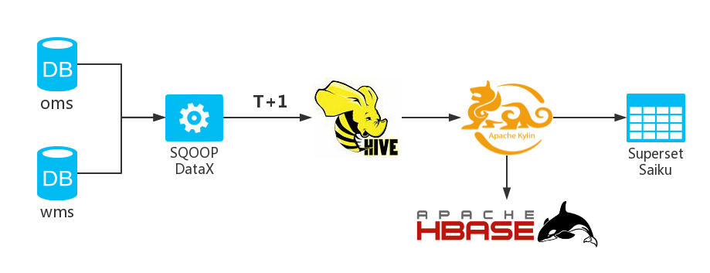
1.第一代离线数仓

Slide 5
2.第二代实时数仓
实时采集：
Maxwell
数仓存储：
HBase

Slide 6
2.1 为什么会选择Maxwell
Can do SELECT * from table (bootstrapping) initial loads of a table.
supports automatic position recover on master promotion.
flexible partitioning schemas for Kafka - by database, table, primary key, or column.
Maxwell pulls all this off by acting as a full mysql replica, including a SQL parser for create/alter/drop statements (nope, there was no other way).

Slide 7
2.2 为什么会选择HBase
Apache HBase™ is the Hadoop database,
a distributed, scalable, big data store.
2. Use Apache HBase™ when you need random, realtime read/write access to your Big Data.
3. This project's goal is the hosting of very large tables -- billions of rows X millions of columns.

Slide 8
2.3 为什么会选择Phoenix
Support SQL
Salted Tables
Secondary Indexes
Support Spark

Slide 9
2.4 基于CDH HBase版本构建Phoenix
版本历程: phoenix-for-cloudera-4.9-HBase-1.2-cdh5.9 +apache-phoenix-4.11.0-HBase-1.2
----------》phoenix-for-cloudera-4.10-HBase-1.2-cdh5.12
Notes:
在2017年6月，Apache Phoenix是仅支持Apache HBase平台的，但是不支持CDH HBase的， 因为我们的环境恰恰是CDH平台，故我们需要将Phoenix源代码改造支持CDH。
虽然近期官方已经支持CDH，但这不影响我们单独构建特定版本。

Slide 10
为什么要编译？ 1. 支持特定版本CDH 2. 支持特定版本Spark 3. PHOENIX-3826 4. PHOENIX-3333 5. PHOENIX-3603

Slide 11
6. 修复SYSTEM.MUTEX表在分布式的计算时， 多次创建错误 7. QueryServicesOptions.java文件修改参数 DEFAULT_IS_NAMESPACE_MAPPING_ENABLED=true

Slide 12


8. 修改DateUtil.java文件timezone为”Asia/Shanghai”
PHOENIX-4629

Slide 13
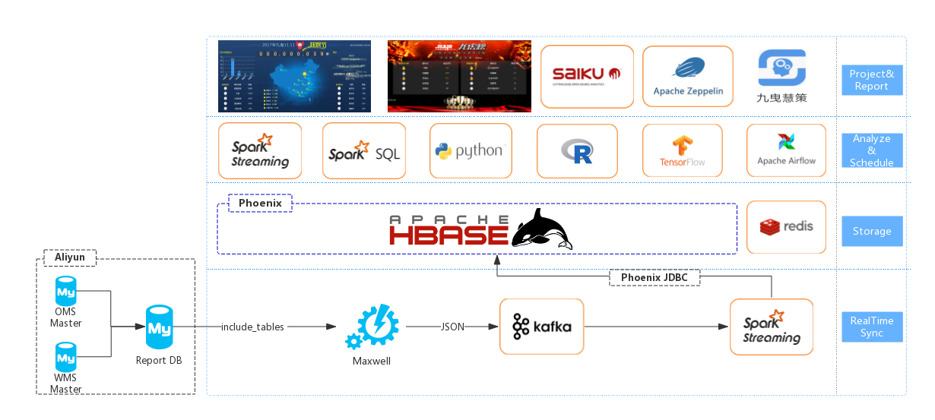
2.5 基于HBase实时数仓架构

Slide 14
2.5.1 数据仓库:
模型建设:
第一层: 基础表
第二层: 事实表 维度表
第三层: 领域表
B.数据校验: 数据量比对

Slide 15
2.5.2 当前只采集OMS、WMS的18库:
QPS: 2000
1条数据: 平均60列 495b

Slide 16
3. 业务场景
1.业务报表(客诉妥投、ABC订单、商业季度等)
2.BI自助分析(saiku)
3.双十一大屏、龙虎榜
4.BMS清分系统
5.慧策IDSS(钉钉应用)

Slide 17
4. 业务开发
Build Phoenix Table
Kafka+Spark Streaming+Phoenix
Spark Develop Read
Spark Develop Write
Use DBeaver

Slide 18
4.1 Build Phoenix Table
CREATE TABLE JYDW.BIGDATA(
id bigint(20) NOT NULL,
warehouse_no varchar(10) NOT NULL,
a_col varchar(256),
.............
.............
cretime timestamp,
CONSTRAINT pk PRIMARY KEY (id, warehouse_no)
) SALT_BUCKETS = 36, COMPRESSION = 'SNAPPY’;

Slide 19
4.2 Kafka+Spark Streaming+Phoenix
dstream.foreachRDD { rdd =>
rdd.foreachPartition { partitionOfRecords =>
val connection = createNewConnection()
partitionOfRecords.foreach(
record => connection.send(record)
)
connection.close()
}
}

Slide 20
4.3 Spark Develop Read
val bigdataDF = spark.sqlContext.phoenixTableAsDataFrame( "JYDW.BIGDATA", Array(”ID", ”WAREHOUSE_NO”,”A_COL”), predicate = Some( """ |CRETIME > CAST(TO_DATE('2018-02-10 00:00:01', 'yyyy-MM-dd HH:mm:ss') AS TIMESTAMP) """.stripMargin), conf = configuration )

Slide 21
4.4 Spark Develop Write
bigdataDF.write
.format("org.apache.phoenix.spark")
.mode(SaveMode.Overwrite)
.option("table", "JYDW.OMS_ORDER")
.option("zkUrl",zkUrl)
.save()

Slide 22
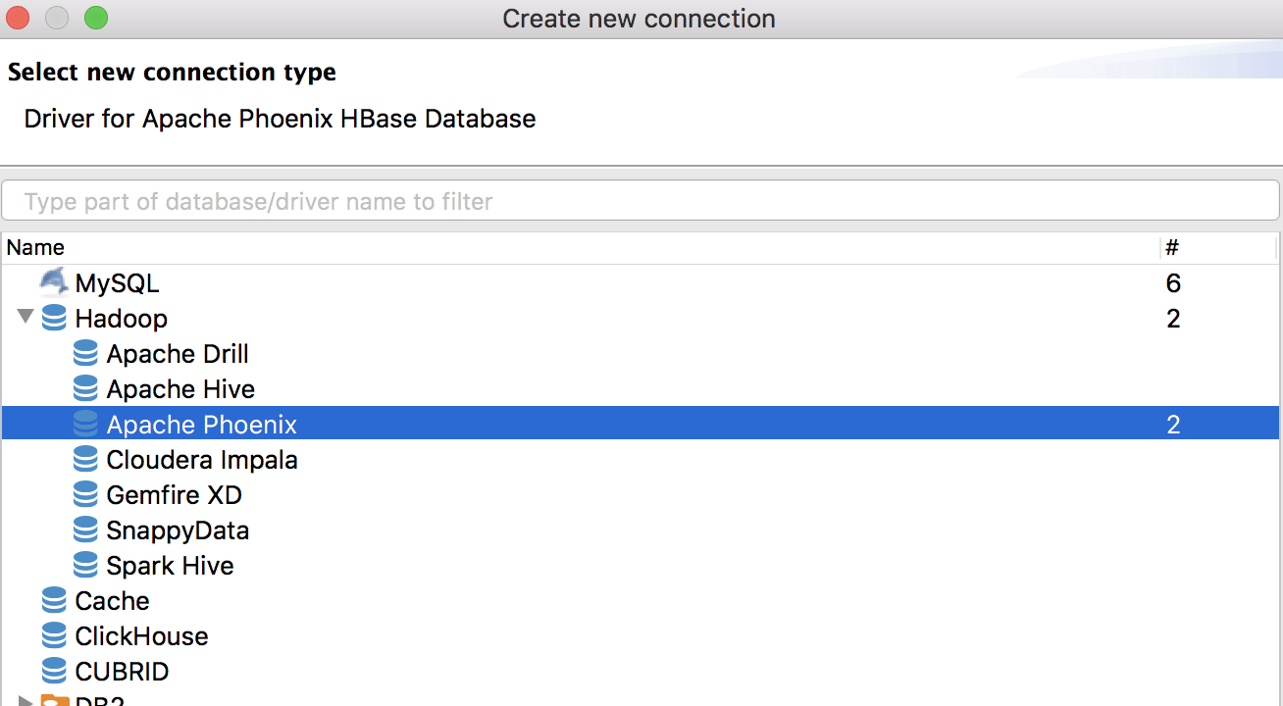
4.5 Use DBeaver

Slide 23
5. 集群调优监控
Linux parameters
HDFS parameters
HBase parameters
GC parameters
Monitor
Bug

Slide 24
5.1 Linux Parameters
5.1.1.句柄数 文件数 线程数
echo "* soft nofile 196605" >> /etc/security/limits.conf
echo "* hard nofile 196605" >> /etc/security/limits.conf
echo "* soft nproc 196605" >> /etc/security/limits.conf
echo "* hard nproc 196605" >> /etc/security/limits.conf
重新登录,检查是否生效
# ulimit -a
open files (-n) 196605
max user processes (-u) 196605

Slide 25
5.1.2.网络、内核、进程能拥有的最多内存区域
echo net.core.somaxconn=32768 >> /etc/sysctl.conf
echo "kernel.threads-max=196605" >> /etc/sysctl.conf
echo "kernel.pid_max=196605" >> /etc/sysctl.conf
echo "vm.max_map_count=393210" >> /etc/sysctl.conf
#生效
sysctl -p

Slide 26
5.1.3.swap
more /etc/sysctl.conf | vm.swappiness
echo vm.swappiness = 10 >> /etc/sysctl.conf
#生效
sysctl –p
5.1.4.关闭大页面
echo never > /sys/kernel/mm/redhat_transparent_hugepage/defrag
echo 'echo never > /sys/kernel/mm/redhat_transparent_hugepage/defrag' >> /etc/rc.local

Slide 27
5.2 HDFS Parameters
5.2.1 handler参数
dfs.datanode.handler.count 64
dfs.datanode.max.xcievers,
dfs.datanode.max.transfer.threads 12288
dfs.namenode.handler.count 256
dfs.namenode.service.handler.count 256
4.2.2 timeout参数
dfs.socket.timeout 1800000ms

Slide 28
5.2.3 HDFS-12936
2017-12-17 23:58:14,422 INFO org.apache.hadoop.hdfs.server.datanode.DataNode:
PacketResponder: BP-1437036909-192.168.17.36-1509097205664:
blk_1074725940_987917, type=HAS_DOWNSTREAM_IN_PIPELINE terminating
2017-12-17 23:58:31,425 ERROR org.apache.hadoop.hdfs.server.datanode.DataNode:
DataNode is out of memory. Will retry in 30 seconds.
java.lang.OutOfMemoryError: unable to create new native thread
at java.lang.Thread.start0(Native Method)
at java.lang.Thread.start(Thread.java:714)
at org.apache.hadoop.hdfs.server.datanode.DataXceiverServer.run
(DataXceiverServer.java:154)
at java.lang.Thread.run(Thread.java:745)

Slide 29
5.3 HBase Parameters
5.3.1 handler参数
hbase.master.handler.count 256
hbase.regionserver.handler.count 256
5.3.2 timeout参数
dfs.socket.timeout 1800000ms

Slide 30
5.4 GC Parameters
-XX:+UseG1GC
-XX:InitiatingHeapOccupancyPercent=65
-XX:-ResizePLAB
-XX:MaxGCPauseMillis=90
-XX:+UnlockDiagnosticVMOptions
-XX:+G1SummarizeConcMark
-XX:+ParallelRefProcEnabled
-XX:G1HeapRegionSize=32m
-XX:G1HeapWastePercent=20
-XX:ConcGCThreads=4
-XX:ParallelGCThreads=16
-XX:MaxTenuringThreshold=1
-XX:G1MixedGCCountTarget=64
-XX:+UnlockExperimentalVMOptions
-XX:G1NewSizePercent=2
-XX:G1OldCSetRegionThresholdPercent=5

Slide 31
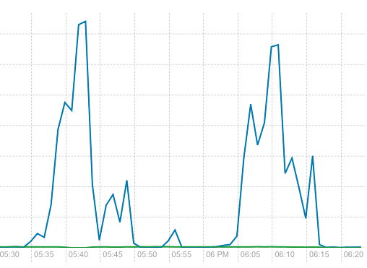
5.5 Monitor
5.5.1 HBase Read and Write Requests Rate Across Regionservers

Slide 32
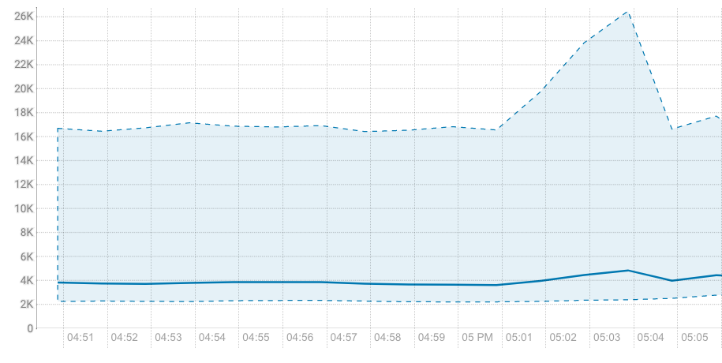
5.5.2 HBase Regionservers FDS

Slide 33
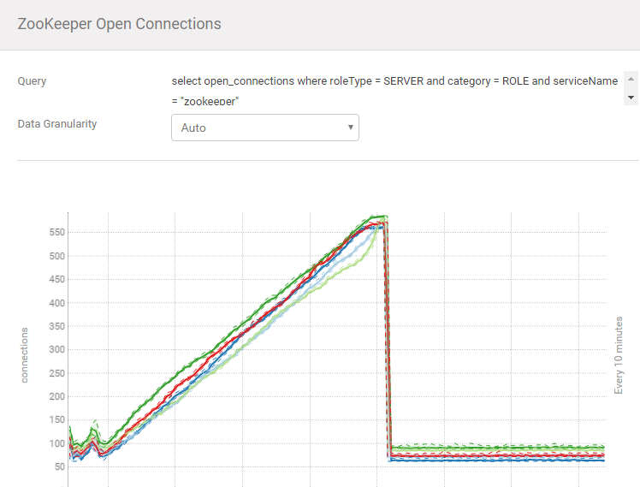
5.5.3 Zookeeper Open Connections

Slide 34
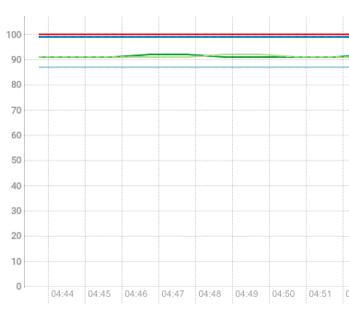

Slide 35
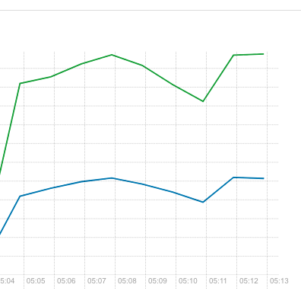
5.5.4 Kafka Received and Fetched

Slide 36
5.6 Bug
PHOENIX-4056:
java.lang.IllegalArgumentException:
Can not create a Path from an empty string
PHOENIX-4319:
Zookeeper connection should be closed immediately
SPARK-22968:
java.lang.IllegalStateException:
No current assignment for partition kssh-2

Slide 37

6 分享2个生产案例
6.1 3次事故的RIT(公众号: hbasegroup 文章已发布)
6.2 三支烟的故事

Slide 38

ThanksQA

