Slide 1



Slide 2

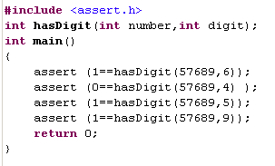
Exercise 2
Write function for verification if the given digit exists in the given number
All implementation details to get from the following asserts

Slide 3
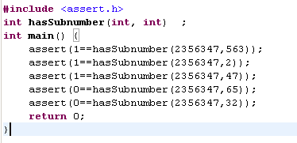
Exercise 3
Write function for verification if the given number exists in the given number as sub-number
All implementation details to get from the following asserts

Slide 4
Array as Set of Variables
int ar[100]; /*array with 100 integer variables, no guarantee about zero values */
int ar1[100] = {1, -3, 100, 80} ; /*array with initialization – first four elements are initialized by the values and other are zero*/
int ar2[] ={1, -3, 100, 80} ; /*array with 4 integer variables initialized by pointed values */
……………………………
Name
Length
N*length of one variable
Array is an object with no l-value
Element of array is variable with name as function from sequential number
ar[i] is an element of array with number i
R-value

Slide 5
Length of array and constant definition
Constant definition
#define MAX 100
  #define is for the macros definition, a macros is a text the compiler will replace with in each place the macros appears, e.g. ar[MAX] will be replaced by compiler as ar[100]. Why is it needed ?
Length of variable
sizeof (<variable>) – operator of the compiler returning length of variable
Length of array
sizeof (<array’s name>)
  Question: how to compute number of elements of the following array
  int ar2[] ={1, -3, 100, 80} ;
Size of the array using sizeof may be got only at function where the array is defined.
Prototype function which receives the array contains int ar[] with empty number of elements. If the function should know the size of the array it should be passed as separate parameter. Function can’t compute size of the array defined in another function

Slide 6
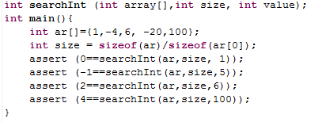
Exercise 4
Write function of searching for the given value in the array
Main function for testing
What will the function receive and return according to the assert testing

Slide 7
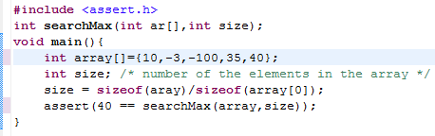
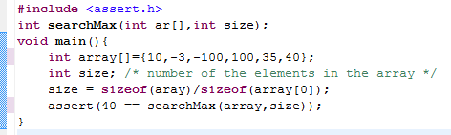
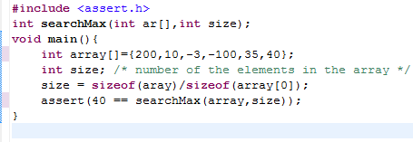
Exercise 5
Write function of searching for the maximal value in the array
Main functions for the testing
Note: we are updating the array but size remains as is. This is exactly idea of the sizeof usage
What should be?

Slide 8
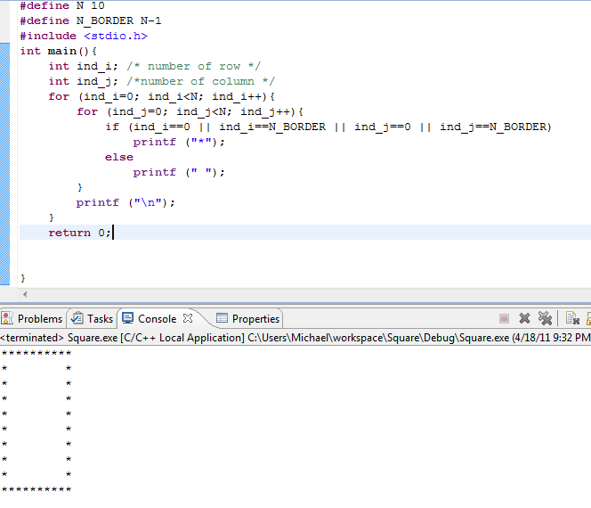
Drawing Examples
Print square using stars

Slide 9


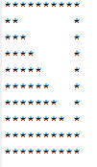

Exercise 6
6.1 Write program printing the square with one diagonal
6. 2 Write program printing the square with two diagonals
6.3 Write the following figure
6.5 Write the following figure

Slide 10
Standard Function rand()
Function rand() returns random integer number in the range from 0 to RAND_MAX
RAND_MAX may be different for each platform
RAND_MAX is the macros defined in the header file stdlib.h
Prototype function is declared in the header file stdlib.h
Print the value of RAND_MAX on your platform

Slide 11
Getting Random Value in a Range
Let’s assume we have the range from Min to Max
  Number = Min + rand()%(Max – Min + 1)
  How to verify the formula correctness?
Standard function srand for setting initial rand number
  How to call this function: srand(time(NULL));
  time standard function for getting time, NULL means current time (no in the scope of this course)
  srand is called only one time at the beginning of the main function
Our range
0
Min
Max
Rand_MAX

Slide 12
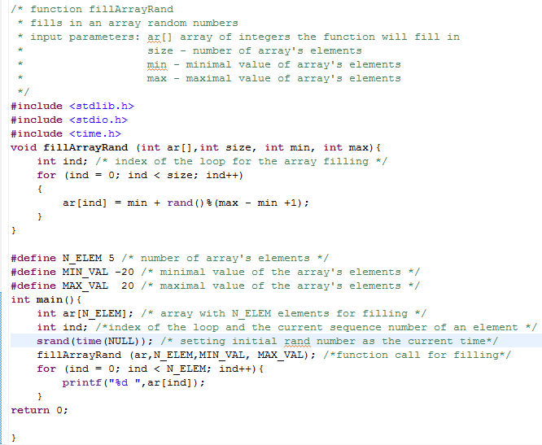
Array Sorting – Test
Filling Array with Rand Values

Slide 13
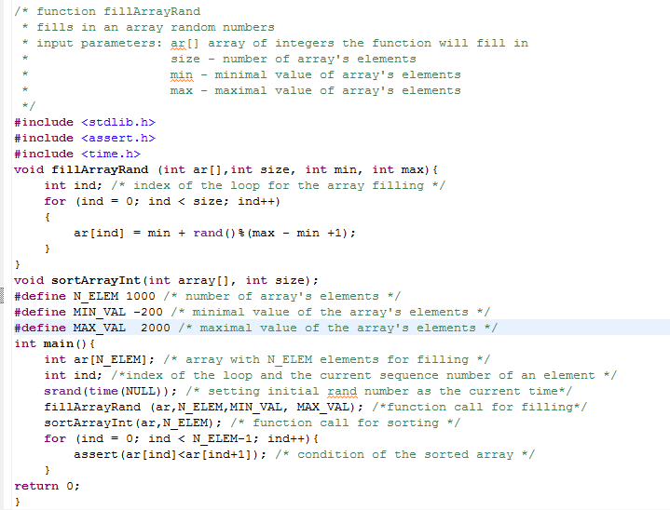
Array Sorting – Test
Sorting Test
No possibility to test it by printing
What should be?

Slide 14
Sorting Algorithm Bubble
Moving (bubbling) maximal/minimal value to the end
Write function for moving maximal value to end
int maxToEnd (int array[], int size); /*The function returns 0 if no moving*/
This function will move the maximal value to end of the array per following:
Size=N
Index=0
Flag=0
Temp = Array[Index]
Array[Index] =Array[Index+1]
Array[Index+1]=Temp
Flag = 1
1
Return Flag
Yes
Index=N?
1
No
Array[Index] > Array[Index+1] ?
Yes
To call maxToEnd function while it returns 1 (not 0) – is Bubble sorting algorithm
Index++

Slide 15
Exercise 7 (Sorting)
Write function for sorting of array with ascending order
Write function for sorting of array with descending order
Write function for the following sorting
  Even number first (Hint: oddToEnd)

Slide 16
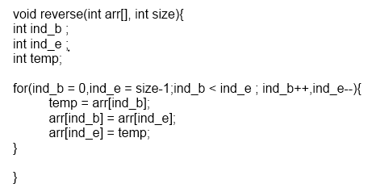
Array Reverse

Slide 17
Exercise 8
Write test for reverse function
  Using assert
  Number of elements is 1000
  Min value is -20
  Maximal value is 2000
  Values are received using standard function rand

Slide 18
Algorithms Complexity
[1] – no loops
Linear - [N] – one loop with N iterations
Quadratic complexity – [N ] – loop inside external loop
Common non-linear – [N ] –( m -1 ) nested loops
Logarithm complexity – [logN]
In the case of polynomial complexity the only member with maximal complexity is considered (question from a interview), all constants are not considered in the complexity estimation
  N + logN => [N]; N + N +5N => [N ]
2
m
2
4
5
5

Slide 19
Algorithm Complexity Exercises
Number of the iterations is 5*N. What is the algorithm complexity
Number of the iterations is N*(N-1)/2. What is the algorithm complexity
What is the algorithm complexity for functions from exercises 4-7
2

Slide 20
Known Algorithms Complexity
Search in a non-sorted array - [N]
Search in a sorted array – [logN]
Quick Sorting – [N*logN]
Bubble Sorting – [N ]
Array reversing – [N]
2

Slide 21
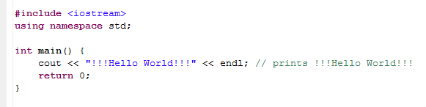
C++ “Hello World”
New -> C++ project
Select “Hello World” project
Typing project name – hellocpp
Finish
Cntrl+F11 => the same “hello world” but…

Slide 22
C++ COUT vs. C printf
Looks the same result but…
Let’s see the example
int A;
/* some computation of A */
printf (“…%d…”,A…); cout <<…<< A<<…
Think of the update int A to float A. This is only one thing but a pretty principle. There are many others we will see in C++ course

Slide 23
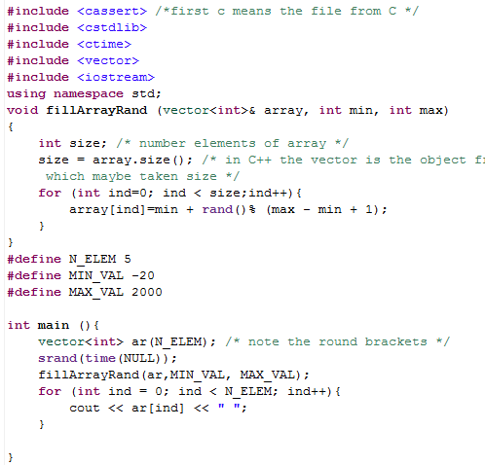
Filling of Array on C++
Much the same as in C except:
Data Type vector<int> instead of int ar[N_ELEM]
Array definition ar(N_ELEM) instead of ar[N_ELEM] because in C++ number of elements may be expression but in C it may be only constant
No need to pass the array size because in C++ vector<int> is object but in C int ar[N_ELEM] is N_ELEM objects and function should know how many objects are available (in C++ array.size gives the array size)
“&” means reference – it is not object itself but only its address

Slide 24
Exercise 9
Write program on C++ allowing estimation of the existing rand generator
Very important that the rand function is able to get truly random numbers (numbers with equal probability of encountering in the given range
Output of the program should be similar to the histogram on the next slide

Slide 25
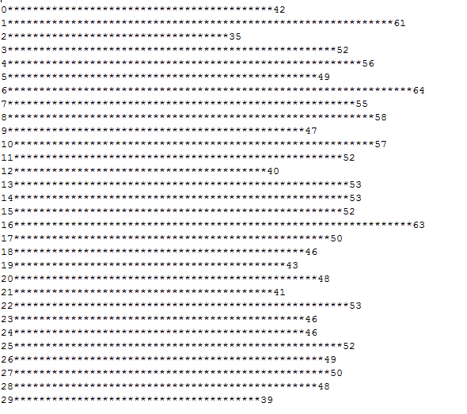
Output for Exercise 9

Slide 26
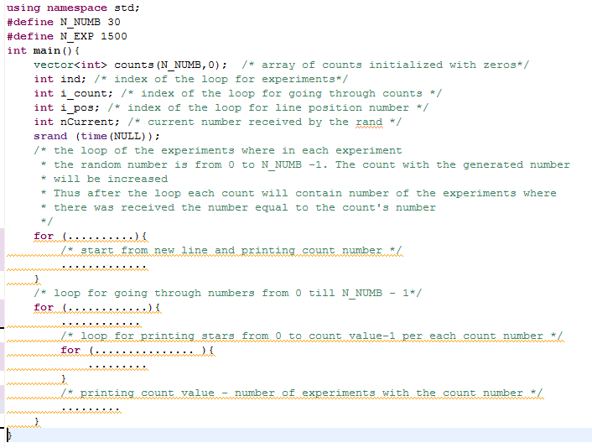
Hints to Exercise 9
Even more than hints
What should be done only is filling the points

Slide 27
Object Oriented Programming OOP
Encapsulation
  Access to the data of object occurs through the methods
Inheritance
  Subclass inherits from Superclass all methods and data
Polymorphism
  Multiple implementation of the same interface
OOP differs C from C++ mainly
Methods
Class – declaration of methods and Data
Object
Data
instantiation
Superclass
Subclass

Slide 28
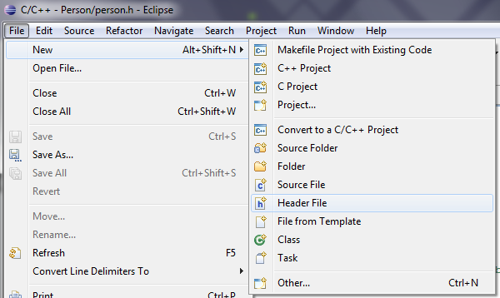
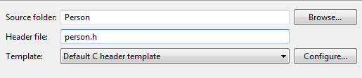
Hello “Person” in C
Header File Creation
Typing file name with .h extension

Slide 29
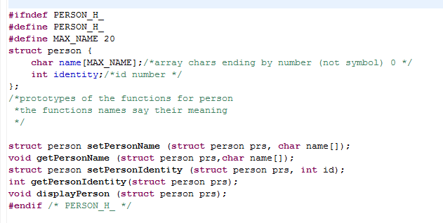
Hello “Person” in C
Header File Content
Structure is aggregative type which may contain any known for compiler data types. Structure length is a sum of all fields included in the structure. In the example sizeof(name) +sizeof(identity)

Slide 30
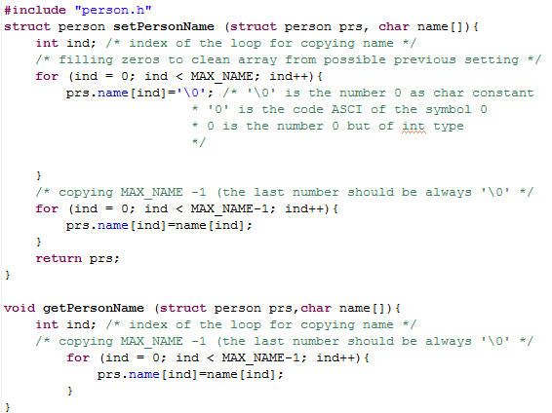
Hello “Person” in C
Writing Person Functions
File person.c
Functions setPersonName and getPersonName
Include person structure declaration
Access to a structure field
It may be as L-value as well as R-value
What should be?

Slide 31
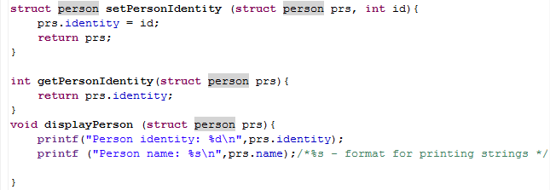
Hello “Person” in C
Writing Person Functions
Continue of the file person.c
Functions setPersonIdentity, getPersonIdentity and displayPerson
Format for printing strings in C

Slide 32
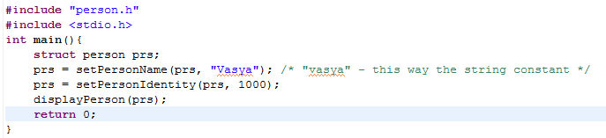
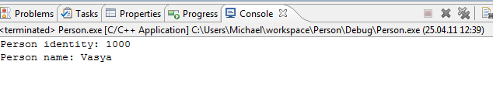
Hello “Person” in C
main Function
File personTest.c
Function main
Output

Slide 33
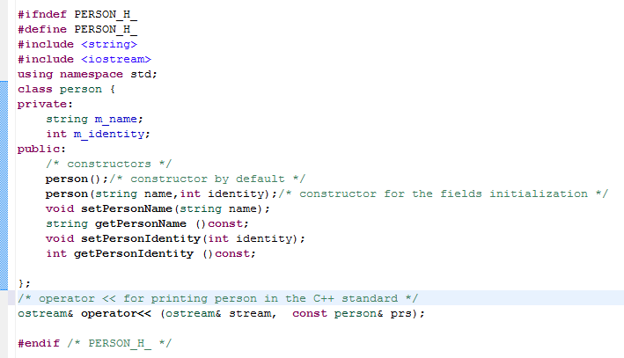
Hello “Person” in C++
person.h Content
Constructor is a function with the same name as class no returning anything which called firs once an object is created
There may be several constructors with different interfaces
Says that the function can’t update object
For printing an object person as “Hello World”

Slide 34
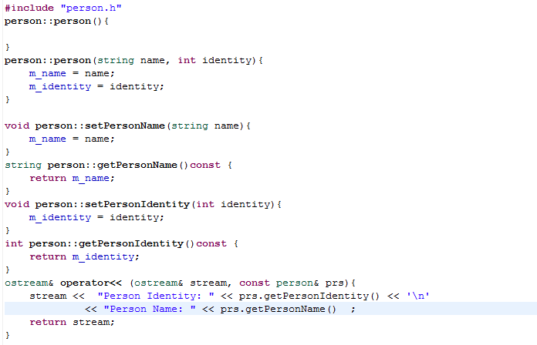
Hello “Person” in C++
person.cpp Content
Example what C++ strings allows the programmer to do comparing with char name[]
Operator<< overloading

Slide 35
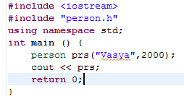


Hello “Person” in C++
personTest.cpp Content
Object creation using the constructor:
Printing Person using the method of overloaded operator <<

Slide 36
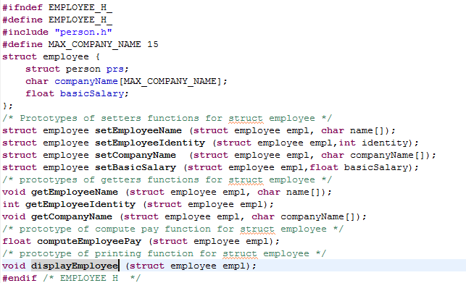
Hello “Employee” in C
employee.h file content
Employee is an extension of person
Compiler has to know struct person

Slide 37
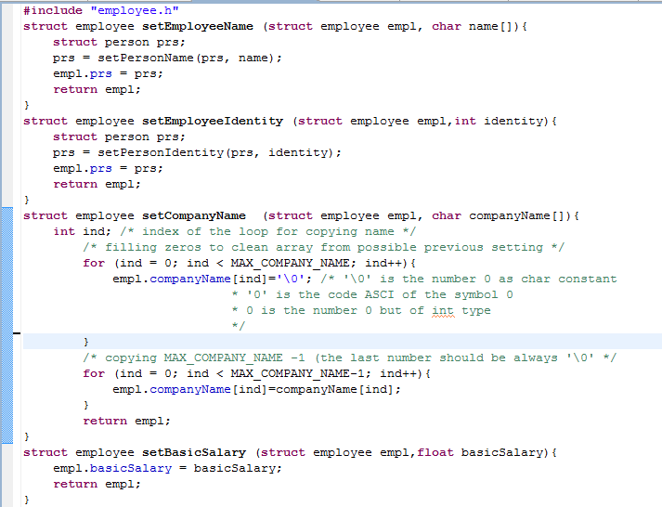
Hello “Employee” in C
employee.c file content – setters functions
Where mistake
Where mistake

Slide 38
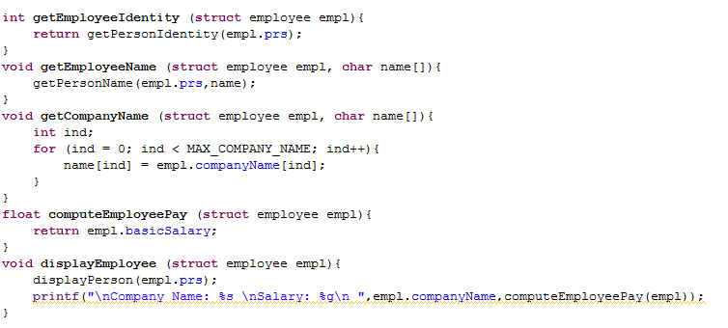
Hello “Employee” in C
Continue employee.c file content – getters and display functions

Slide 39
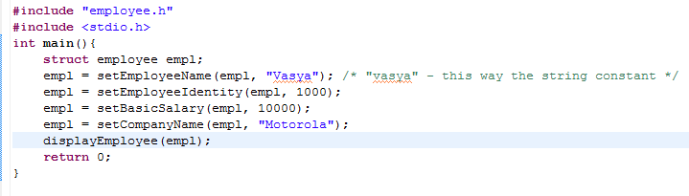
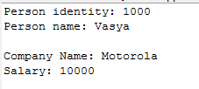
Hello “Employee” in C
employeeTest.c file content
Output:

Slide 40
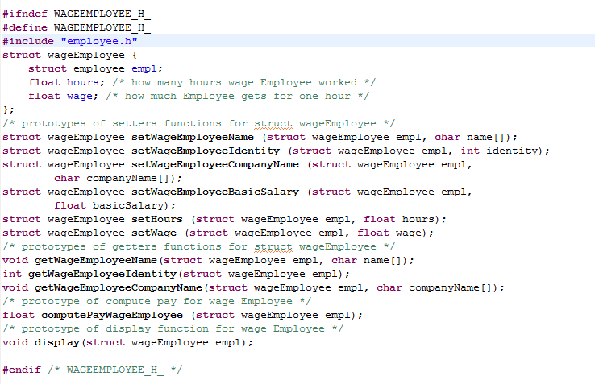
Employee Extension like Inheritance
Content of the file wageEmployee.h

Slide 41
Exercise 10
Write file wageEmployee.c with function definitions according to their prototypes from wageEmployee.h
  Hints: Use the same implementation patterns as in the file employee.c with employee function definitions
Write main function testing the functions of wageEmployee

Slide 42
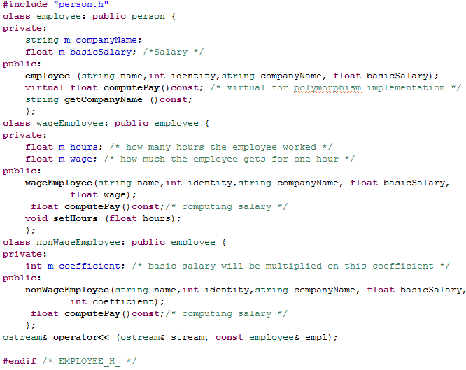
Hello “Employee” and Inheritance
in C++
Employee.h file content – this file contains declaration of 3 classes
Employee
wageEmployee
nonWageEmployee
employee
inheritance
wageEmployee
nonWageEmployee

Slide 43
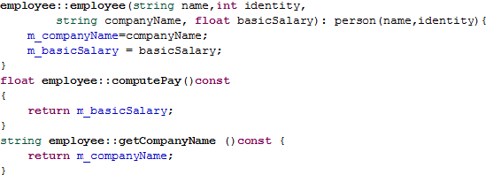
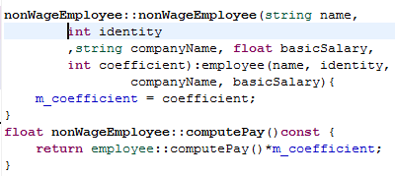
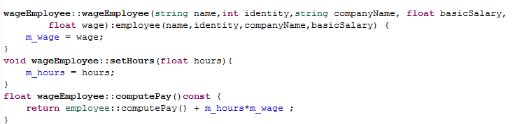
Hello “Employee” and Inheritance
in C++
Content of the file employee.cpp #include "employee.h"
employee methods
nonWageEmployee methods
wageEmployee methods

Slide 44
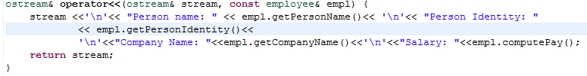
Hello “Employee” and Polymorphism
in C++
computePay method will be called according to the class the object belongs to. Variable empl contains reference to either employee or wageEmployee or nonWageEmployee objects

Slide 45
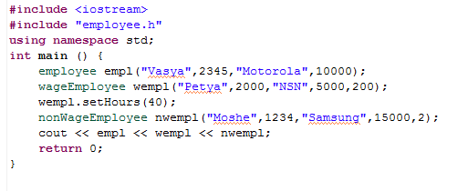
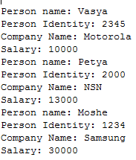
Hello “Employee” , Inheritance and Polymorphism
in C++
Output:

Slide 46
Exercise 11
Using the same main function like in the previous slide, add required methods for printing following additional data
  For wageEmployee: amount hours (field “hours”) and wage of each hour (field “wage”)
  For nonWageEmployee: value of the coefficient (field “coefficient”)
  Hint: Write virtual function void display() const for each class with definition “virtual” in the employee class

Slide 47
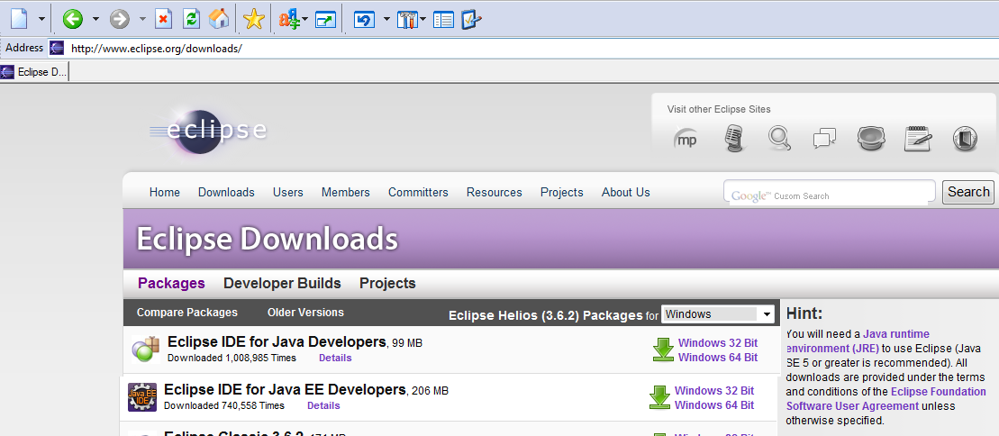
Hello Java
After Downloading you need unzip and “hello Java”

Slide 48
Java Project
Project
Files with extension .java
One class/file should contain method main
Contains
Java code
Java code
Compilation
Java classes
Java classes
Files with extension .class
Class Loading
Running Java classes starting from the method main
Java Virtual Machine

Slide 49

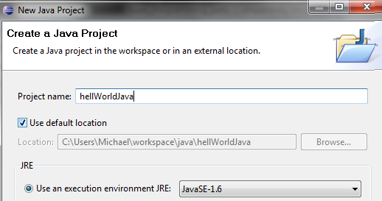
Java Project Creation
Finish

Slide 50
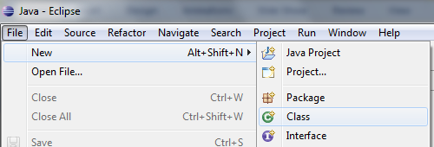
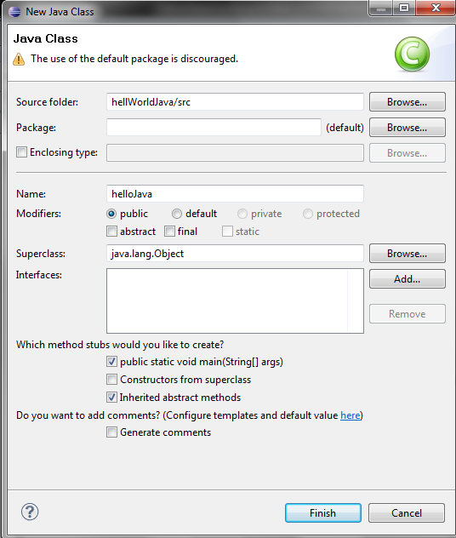
Java Class Creation

Slide 51
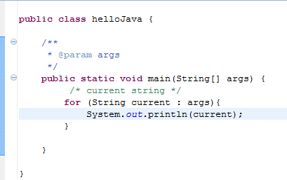

Hello World with Java Style
Parameters passed to JVM
For-each construction
printf for C
cout << for C++
System.out.println for Java
Project ->properties->Run/Debug Setting
If it is a first time for this project ->new->Java Application->Arguments
Strings separated by the blank are considered as arguments

Slide 52
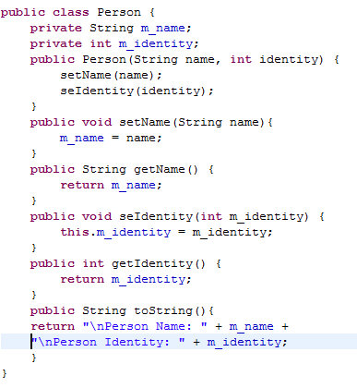
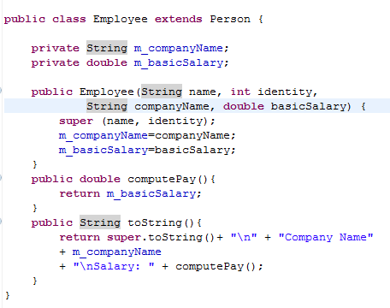
Hello “Person” and “Employee in Java
No need “virtual”
Function toString is for the printing purpose just like operator << in C++ It will be used in the System.out.println(…)

Slide 53
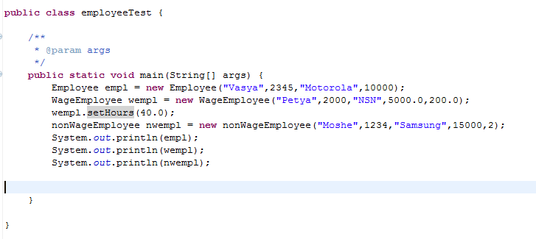
Exercise 12
Write wageEmployee and nonWageEmployee classes with the following class containing method main

Slide 54
Java style – only flavour
Set of classes each of them gives some basic functionality. Programmer writes specific class inheriting existing in Java functionality. For example “Button”, “TestCase”, etc.
Set of classes for Input/Output, Networking, Graphical Interface, Containers, Test Running, etc.
Only Classes and methods
Next slides present the Java style for creation test environment
These all interesting things you may learn on the course Java

Slide 55
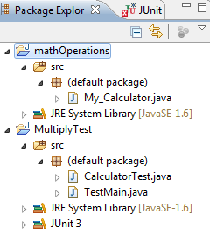
Testing in Java
At least two projects
  One is tested
  Second is test cases
Tested project is the regular Java Project with the class(es) being tested
Test Cases project is the regular Java project with Junit class
My_Calculator.java is the tested class under mathOperations project
CaculatorTest.java is an Java class with test cases under project MultiplyTest
TestMain.java is an Java class with main method for running test cases

Slide 56
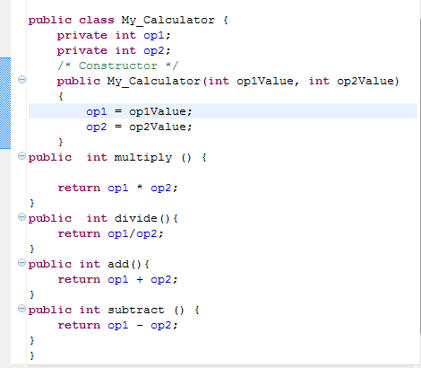
My_Calculator Class
Class fields keeping operand values
Constructor for values initialization
Methods for arithmetic operations

Slide 57
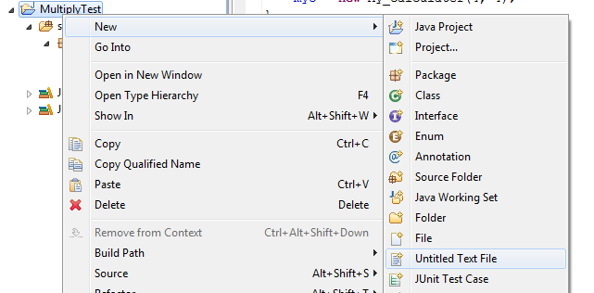
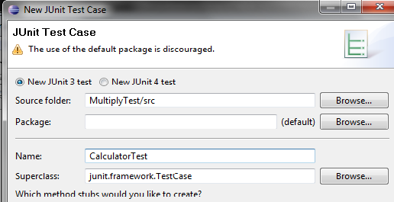

Creation of Java Unit Test
Create Junit Test Case (Screen Junit Test Case)
Type CalculatorTest as Test Case name
OK for adding Junit 3 library in the build path

Slide 58

CalculatorTest Class
Inherits all methods from unit test framework
Constructor initializing test name (test functions) and operand values;
Test name should be passed to the framework
Right test functions
Wrong test function – only for failure illustration

Slide 59

TestMain Class
TestRunner is the class for the test running
TestSuite is the class for tests definition
Tests adding into tests suite
Tests suite running

Slide 60


ResultsRunning Test
4 tests was running: 3 are successful and 1 failure

Slide 61


