Slide 1
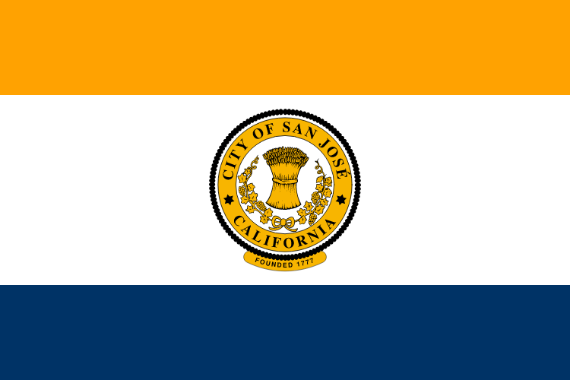
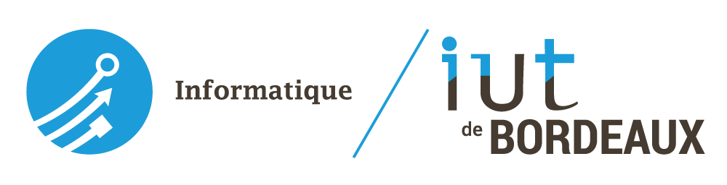
San José
Timothé PAOLINI
Aïssa KAHLOUL

Slide 2
Outline
- City history
- Tech industry
- Latest news
- Winchester Mystery House

Slide 3
City history
Spanish period :
California was claimed as part of the Spanish Empire in 1542.
San Jose became part of the First Mexican Empire in 1821, after Mexico's War of Independence was won against the Spanish Crown.
Foreign settlement in San Jose was rapidly bringing expanding economic opportunities and foreign culture.
American period :
By the end of 1847, the Mexican–American War came to an end.
In 1848, the Treaty of Guadalupe Hidalgo formally ceded California to the United States.
On December 15, 1849, San Jose became the capital of California. On September 9, 1850, San Jose became the state's first capital.

Slide 4
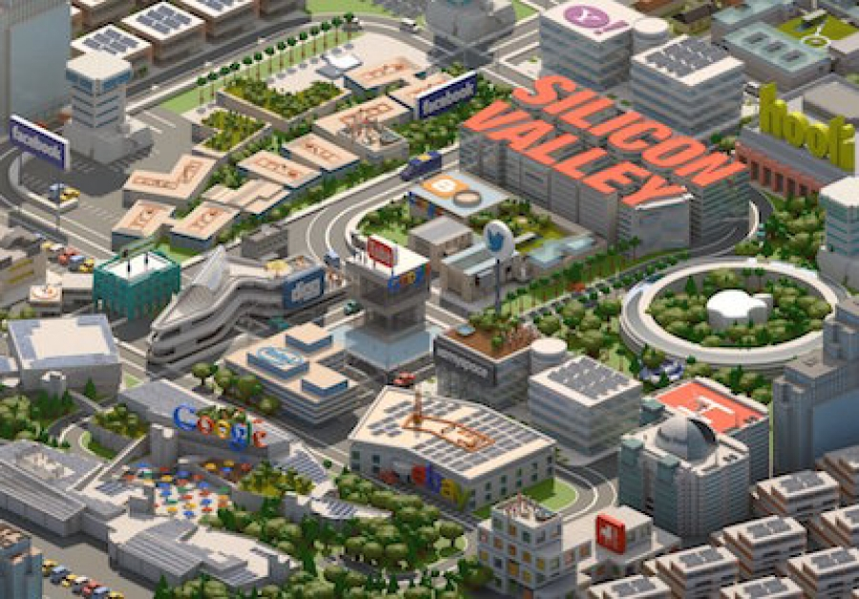
Tech industry
San José is the third most populous city in California and is considered as the capital of the Silicon Valley
- Silicon Valley is home to many of the world's largest high-tech corporations
- This is where the microprocessor, and the microcomputer, among other technologies, were developed.

Slide 5
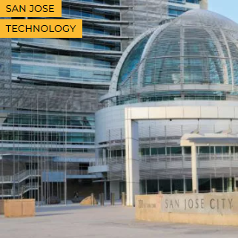
Latest news
The Capital of Silicon Valley struggles with email system
« San José Spotlight last week revealed that Mayor Sam Liccardo relies heavily on his private Gmail account to conduct city business. More than 1,600 pages of records released to San José Spotlight and its attorney Karl Olson show Liccardo sends and receives hundreds of city-related messages every month through his private account. »

Slide 6
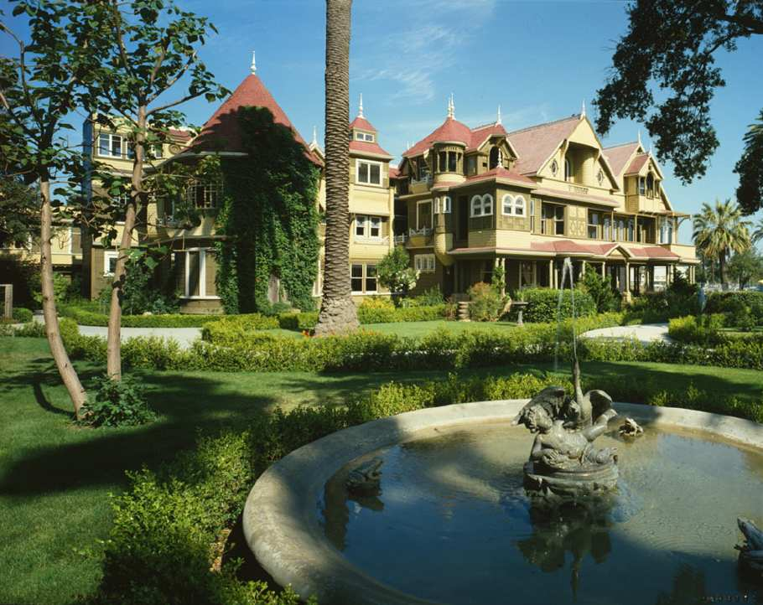
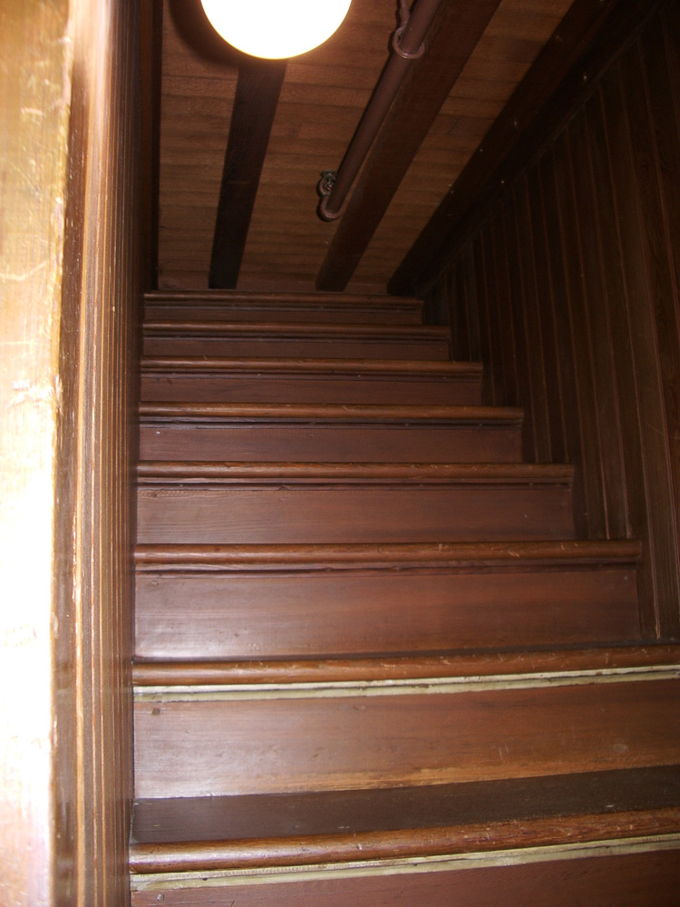
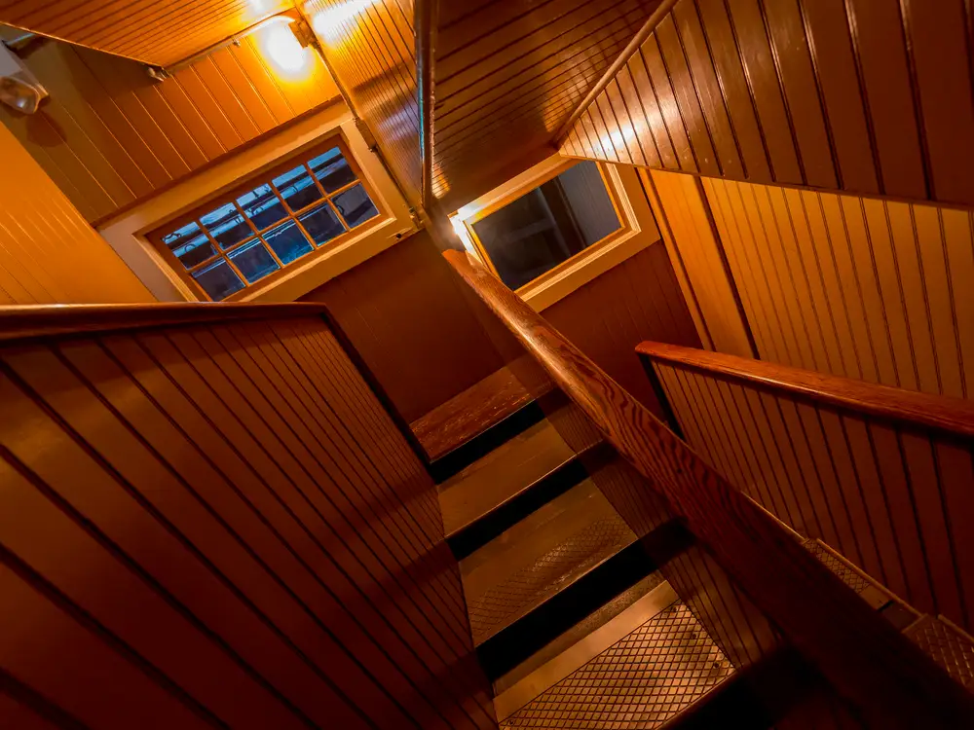
Winchester Mystery House
Since its construction in 1886, the property and mansion were claimed by many to be haunted by the ghosts of those killed with Winchester rifles.
The Winchester House was Walt Disney's Inspiration for The Haunted Mansion at the Disney Parks
Winchester Mystery House
Stairs to nowhere

