Slide 1
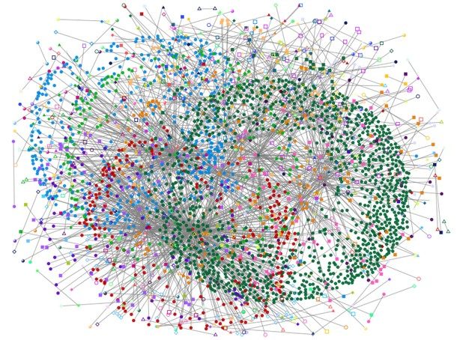
Eskom Resource Resolver
Introducing graph theory using concepts that solve problems in everyday life

Slide 2
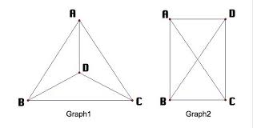
Conceptualizing the resource problem
Solving Resource management using graph theory
Power-Stations get coal from suppliers:
Suppliers have a total weight
We establish the distances the suppliers and the power-station
Also, we establish distances between each supplier

Slide 3


What about the path connecting the power-station and suppliers?
We notice the more suppliers, an arbitrary amount of connections occur, the formula that deduces these connections is:

Slide 4
Each connection has a cost, depending on that cost we establish if a path is acceptable
 | Power-Station | Supplier 1 | Supplier 2
Power-Station | 0 | 1 | 1
Supplier 1 | 1 | 0 | 1
Supplier 2 | 1 | 1 | 0

Slide 5
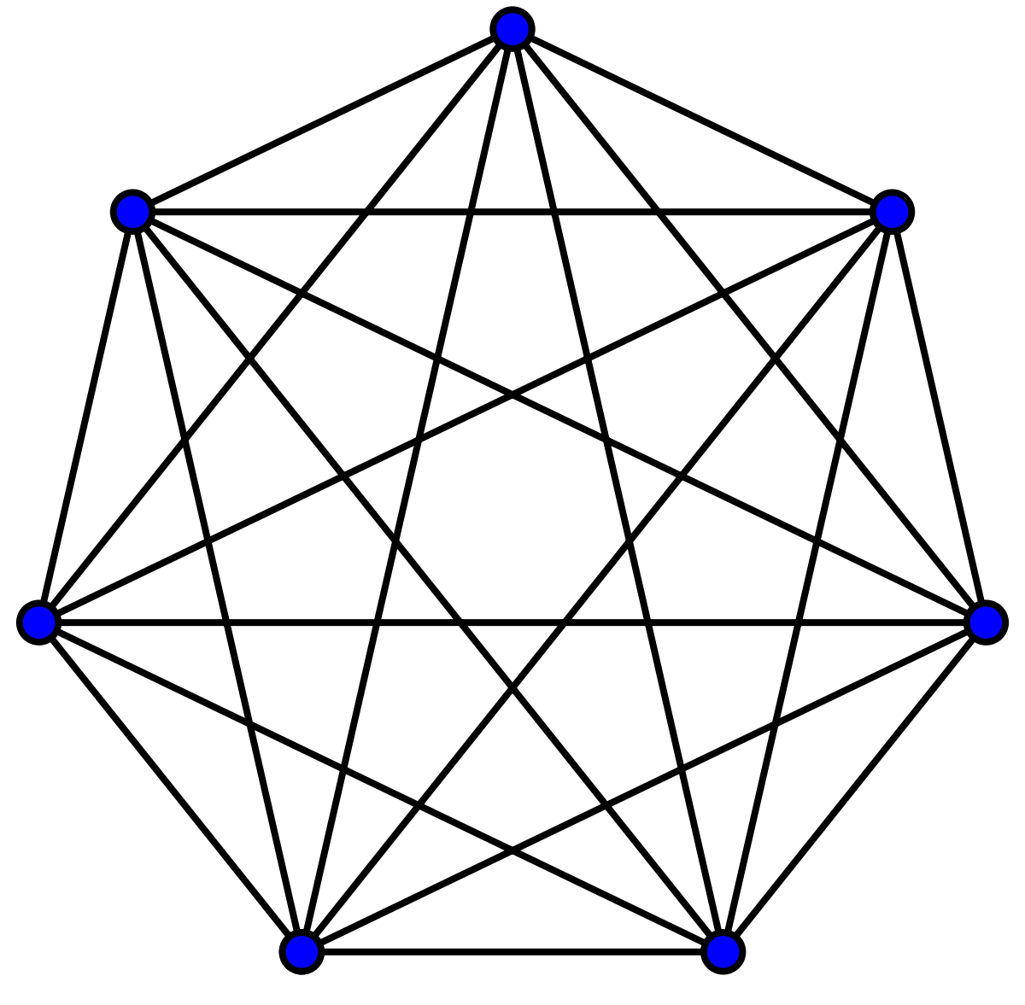
MAPS
Power Station

Slide 6
Conclusion
Multiple suppliers have something in common, the shortest relative path.
Using the connections with reference to the shortest relative path, we can get a shortest path route from power plant to last node
6

Slide 7

It was a great journey discovering learning the data structures storing the neural networks that solve the problems of tomorrow Thank you for you time

Slide 8
References
Presentation images:
-slide 1: https://miro.medium.com/max/610/1*fU-p02bvUT4BvKXqfUFR9g.jpeg
-slide 3: https://betterexplained.com/wp-content/plugins/wp-latexrender/pictures/50a6a49c8e40eebf7ba08b5289aa4d56.png
-slide 4: https://lh3.googleusercontent.com/proxy/P7LzD_Spybkg50qUxnMBKJVDIrdL7CxYAMHLSu3sKDXwuYWSbQ0sZDy07LBt0Ywl_zeRwyV_PBrJzaK4QLA7Ph33IgAA0rikodWfllkdjmyW7I8xIeauDSRdNA
-slide 5: https://upload.wikimedia.org/wikipedia/commons/thumb/9/9e/Complete_graph_K7.svg/1200px-Complete_graph_K7.svg.png
-Graph ADT
https://github.com/phishman3579/java-algorithms-implementation/blob/master/src/com/jwetherell/algorithms/data_structures/Graph.java

Slide 9

Free templates for all your presentation needs
https://www.slidescarnival.com/juliet-free-presentation-template/3373
For PowerPoint and Google Slides
100% free for personal or commercial use
Ready to use, professional and customizable
Blow your audience away with attractive visuals

