Slide 1
Scientific Conference Organization Tool
DA – Turma 13
Francisca Silveira
Tiago Botelho
Tiago Su

Slide 2
Scientific Conference Organization Tool
Description
Set of articles with domains
Set of reviewers with expertise in certain domains
Find the best or one of the best distributions
Reviewers can only review a maximum amount of articles
An article needs at least a minimum amount of reviewers
If not all articles can be assigned reviewers, the program prints the unassigned articles.
Feature to find critical reviewers, that is: the reviewers that, if failing to do their assignment, will cause a failure.

Slide 3
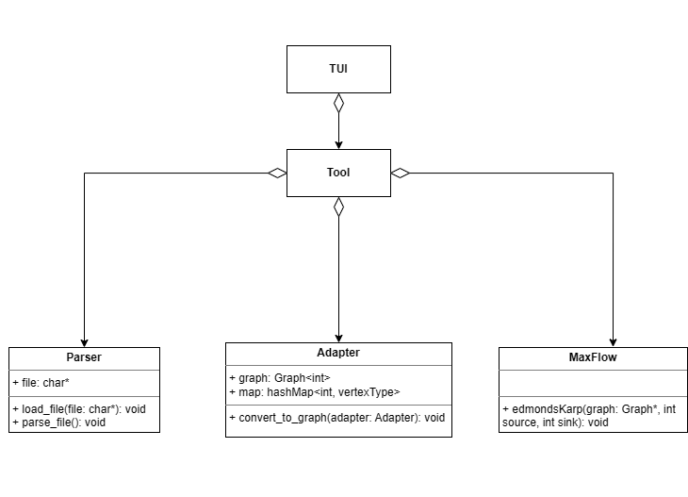
Scientific Conference Organization Tool
Project structure

Slide 4
TUI

Slide 5
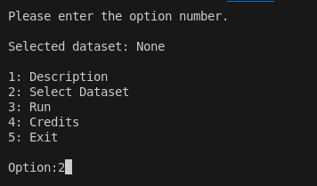
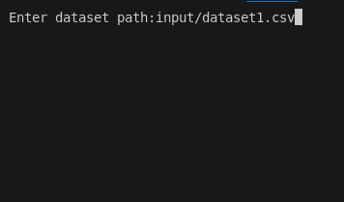
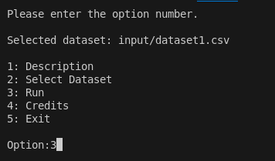
TUI walkthrough
1º Press 2 in the main menu to select the dataset
2º Write the relative path to the dataset
3º Press 3 to run

Slide 6
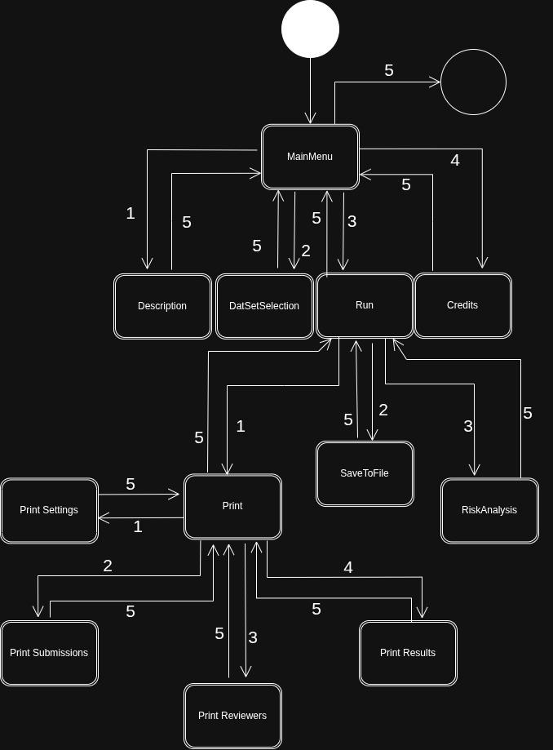
TUI
Responsible for the terminal interface
Handles user inputs
Calls the respective tool methods for running the algorithms and showing outputs

Slide 7
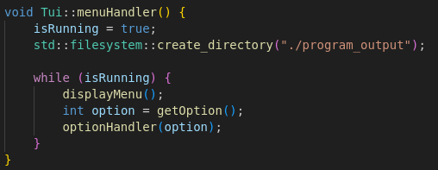
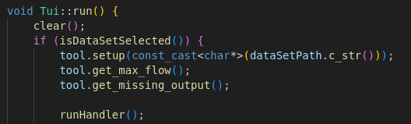
TUI
How it works
The menuHandler() is the method responsible for creating the program_output folder, displaying the current menu and handling user input.
The getOption() method waits for user input, and then the optionHandler() method handles the chosen option.
The run() method is responsible for calling the max_flow algorithm implemented in the Tool class, and calling the runHandler() method that will determine the option that is chosen by the user.

Slide 8
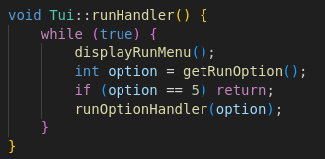
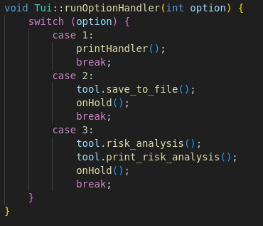
TUI
How it works
runHandler()
Responsible for displaying the run menu and handling user input, that is, calling a specific method depending on what option the user chose.
Options
Print
Save to file
Risk analysis

Slide 9
Parser

Slide 10
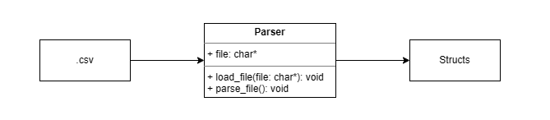
Parser How it works
Responsible for reading and extracting structured data from the input file
Input file is divided into clearly marked sections (#Submissions, #Reviewers, #Parameters, #Control)
Parser reads each section to populate the corresponding internal data structures to be later handled by algorithms

Slide 11
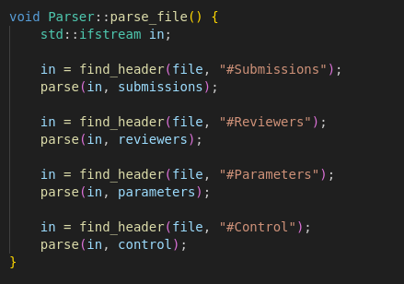
Parser
Uses line by line reading and tokenization (std::strtok) to convert CSV input into structured objects
Helper functions handle string to integer conversion
The main entry point, parse_file(), locates each section in the file and calls the appropriate parsing function
Trimming whitespace and quotes, and validating input values.
Ensuring that all data is loaded and ready for further processing.

Slide 12
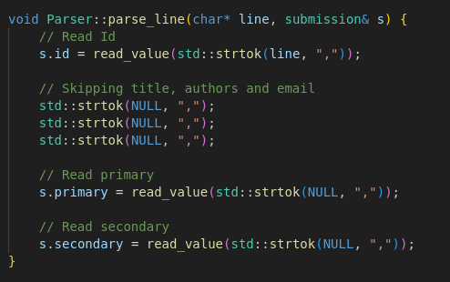
Parser
Submissions
Non essential fields like title, authors, and email are ignored.
Relevant information of valid submissions is stored in a submission structure, which is then stored in a vector of submissions.
Each reviewer’s ID and expertise domains are extracted similarly and stored in a reviewer structure and then in a vector.
When it comes to parameters, workflow parameters are read and then stored in a parameters_ structure.
Control
To handle the submissions info, each line is tokenized to extract the submission ID and domain (primary and secondary).
Reviewers
Parameters
Lastly, to handle control settings, control information is read, trimming any surrounding spaces or quotation marks and saving the relevant info in a control_ structure.

Slide 13
Parser Responsibilities
Modular parsing for each data type (submission, reviewer, parameters, control)
01
Handling invalid entries adequately
02
Preparing all data for subsequent algorithms (Maximal Bipartite Matching, etc...) and menu-based interfaces
03

Slide 14
Parser
Why it needs to read the file from the start for each header
Some irregularities in the dataset file (e.g. An '#' between Submissions and Reviewers)
Some doubts about the .csv structure (e.g. Can the topics have a different order)
Create the most generic parser to avoid problems in the future.

Slide 15
Parser
Time complexity
Let l be the number of lines and h be the number of headers, the upper bound can be defined to be O(l * h). So in this project, the time complexity to parse the dataset is O(4 * l) = O(l)

Slide 16
Adapter

Slide 17
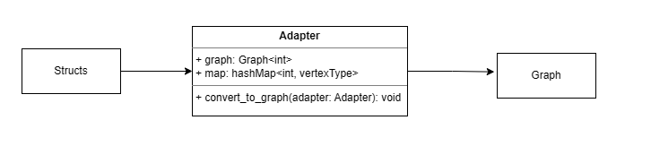
Adapter
Responsible for transforming the data processed by the parser into a graph structure
The data in the parser is divided into 4 different attributes: reviewers, submissions, parameters and control.
The adapter's goal is to create a bipartite graph which separates the reviewers and the submissions, to be later handled by a max flow algorithm.
How it works

Slide 18
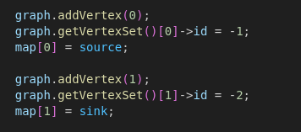
Adapter
First of all, the adapter adds a source and a sink nodes to the graph, so it can be used by the max flow algorithm.
Then, it adds a node to the graph for each reviewer, adding an edge between the source node and each of the reviewer nodes, with weight equal to the maxReviews parameter.
It also creates an auxiliar map of each reviewer node id and the reviewers expertise, accounting on the parameters primaryRev and secondaryRev, that determine which of the domains are to have in account.

Slide 19
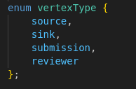
Adapter
How it works
After that, it adds a node to the graph for each submission, adding an edge between each of the reviewer nodes and the sink node, with weight equal to the minReviews parameter.
It also adds an edge between each reviewer node, and each submission node that has a common domain to have in account, using the reviewers expertise auxiliar map, with weight 1 because each reviewer can only review each submission once.
The parser has a map attribute, that maps every node to its type (source, sink, reviewer, submission), so that it is easier to read the graph's information after running the max flow algorithm, specially for showing the output.

Slide 20
Adapter
What it is responsible for
Converting parsed data into a bipartite graph structure (reviewers and submissions)
01
Assigning and managing node types (source, sink, reviewer, submission)
02
Establishing the appropriate connections between nodes for the max flow algorithm
03
Preparing the graph for subsequent algorithms (Max Flow, Risk analysis, etc...)
04

Slide 21
Adapter
Time complexity
Because it creates the graph, the time complexity is O(V + E)
V: number of vertices
E: number of edges

Slide 22

MaxFlow How it works
Implements the Edmonds-Karp algorithm, an implementation of the Ford-Fulkerson method that uses a BFS, and, consequently, is shortest path "oriented", to compute the maximum flow in a directed graph.
This maximum flow is used to generate the assignments in the system by modeling the assignment problem as a bipartite graph

Slide 23
Max Flow – How it works
One set of vertices represents submissions and the other represents reviewers, and edges encode assignment possibilities with capacity constraints.
In this context, computing the maximum flow is equivalent to solving a maximal bipartite matching problem.
Each unit of flow along an edge represents an assignment of a reviewer to a submissiothe maximum flow guarantees that as many submissions as possible receive the required number of reviewers while respecting all reviewer and submission constraints.

Slide 24
MaxFlow
Time complexity
Because it creates the graph, the time complexity is O(V * E²)
V: number of vertices
E: number of edges

Slide 25
Tool

Slide 26
Tool
How it works
The Tool class is responsible for executing the core workflow of the system, meaning:
Transforming parsed input data into a graph representation,
Running the assignment algorithm, and the corresponding outputs.
It is responsible for data preparation, algorithm execution, and result generation.

Slide 27
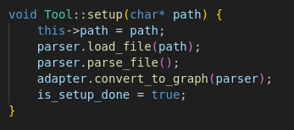
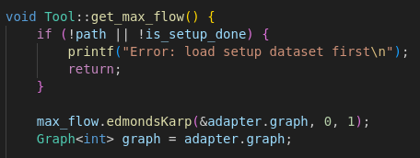
Tool How it works
The setup() function loads the input file, parses its contents using the Parser, and converts the data into a graph structure through an adapter.
The main processing step is performed by get_max_flow(), which applies the Edmonds-Karp algorithm to compute a maximum flow on the graph.
This corresponds to finding an optimal assignment between reviewers and submissions.
The resulting flow is then interpreted and stored as matching outputs for both submissions and reviewers.

Slide 28
Tool How it works
The get_missing_output() function identifies submissions that did not receive the required number of reviewers by inspecting edges whose flow does not meet their capacity. These are stored and sorted for reporting.
The class supports printing results to the console or saving them to a file. Outputs include the assignment results, missing assignments, and risk analysis.
The risk_analysis() function identifies critical reviewers whose removal would compromise the assignment. It performs a breadth-first search on the residual graph to determine which vertices are not reachable and derives the set of critical reviewers from this structure.

Slide 29
Tool
What it is responsible for
Integrating parsing, graph construction, and algorithm execution
01
Computing assignments using maximum flow algorithm (Edmonds-Karp)
02
Detecting incomplete assignments and reports missing allocations
03
Perfoming a risk analysis for k=1
04
Supporting console output and file-based result storage
05

Slide 30
Risk Analysis

Slide 31
Risk analysis (k = 1)
Risk analysis is the search for the set of reviewers in which are critical for the final result, i.e. if the reviewers in which if they fail to accomplish their work will result in one or more articles not having sufficient reviews.
For k = 1, we need to find which reviewers alone could cause in failure.

Slide 32
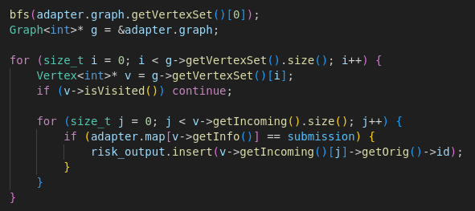
Risk analysis (k = 1) How it works
The key to find the critical reviewers is to analyse the residual graph.
If we traverse the residual graph (using the augmented paths) from a node, we will have two types of nodes: visited and unvisited
And the key for the success is in the unvisited ones that tells us that all paths which are able to reach that node are saturated and there is no other path to reach it that starts from the starting node.
That means if we remove one incoming edge from the node, the maximum flow would decrease.
With that idea in thought, we just need to traverse the graph from source through the residual graph, then we filter from all unvisited nodes the articles and we know that all reviewers who are reviewing the article are critical.

Slide 33
Risk analysis (k = 1)
Time complexity
The BFS takes O(V + E) and then we search for unvisited submissions and for their edges (O(V * E)). We can define our algorithm as O(V * E).
But because the number of edges in this project is smaller or equal to 2, i.e. it is constant, the BFS is the part which takes more time.
Overall: O(V + E)

Slide 34
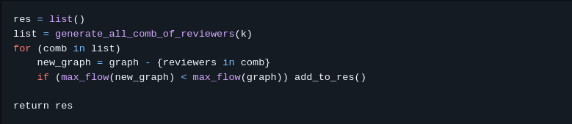
Risk analysis (k > 1)
Pseudo-code

Slide 35
Risk analysis (k > 1)
Time complexity
We would need to generate all combinations with k nodes, so we would need O(combinations of r choose k), let r be the number of reviewers.
And for each combination, we would need to recalculate the maximum flow thus taking in the end O(combiations of r choose k * V * E²)

Slide 36
Credits
This program was made by
Francisca Baldaia da Silveira
Tiago Alexandre Rodrigues Botelho
Tiago Su

