Slide 1
Step by step instructions to use the Rmarkdown template hosted at
https://github.com/TiagoAMarques/RMarkdownTemplate

Slide 2
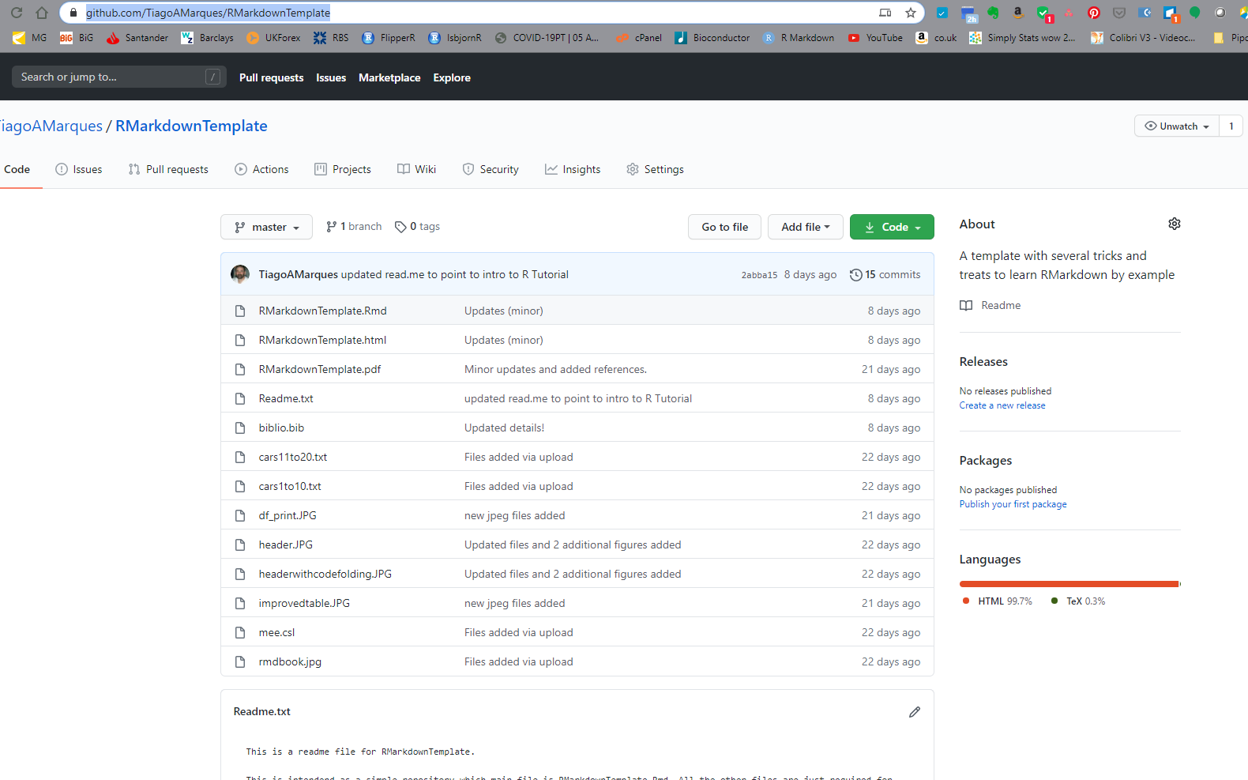
Go to the website
https://github.com/TiagoAMarques/RMarkdownTemplate

Slide 3
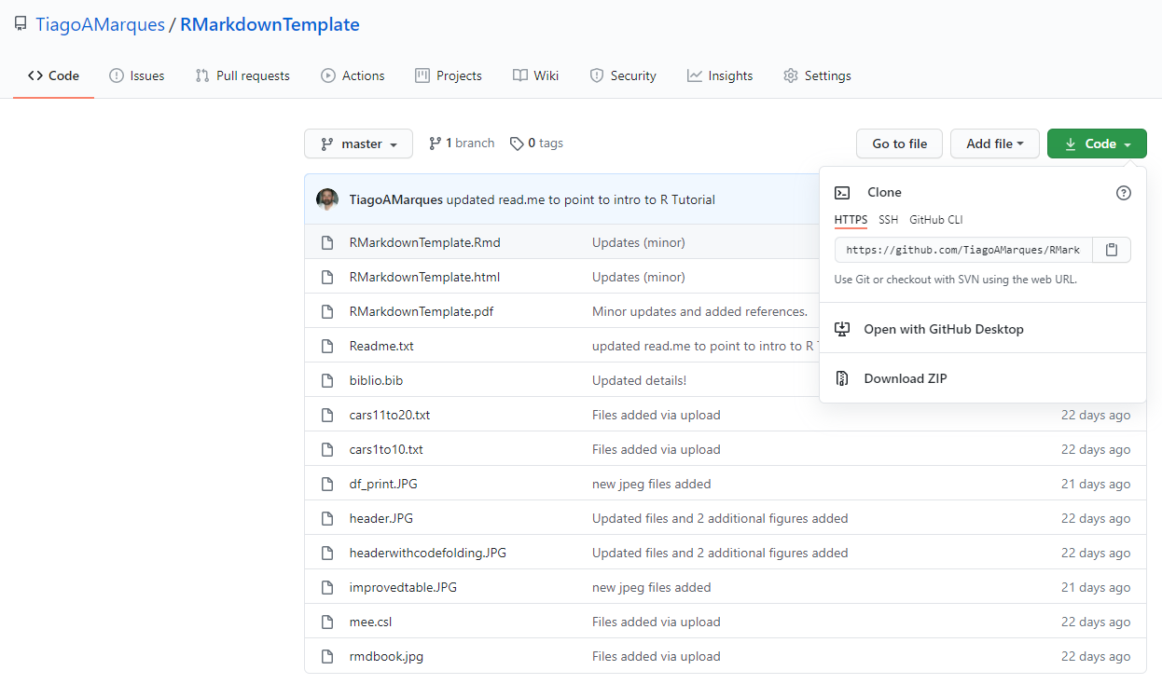
Download all the material into a folder
1
2

Slide 4
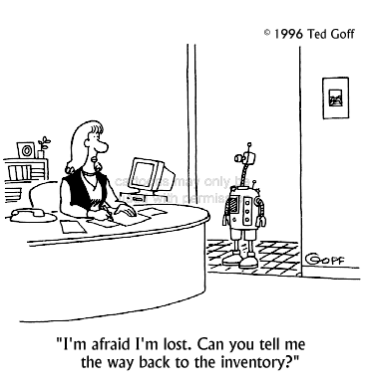
Extract the material into a folder
No screenshot here as the unzipping/extracting depends on your platform. If you do not know how to unzip your file, consider taking something like “Using a computer 101” first!

Slide 5
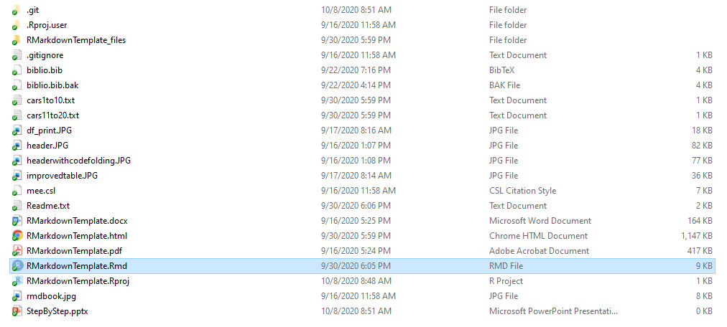
Open the .Rmd
An example .bib file
A class for formatting bibliographies
What you should have read already!
This pptx file

Slide 6
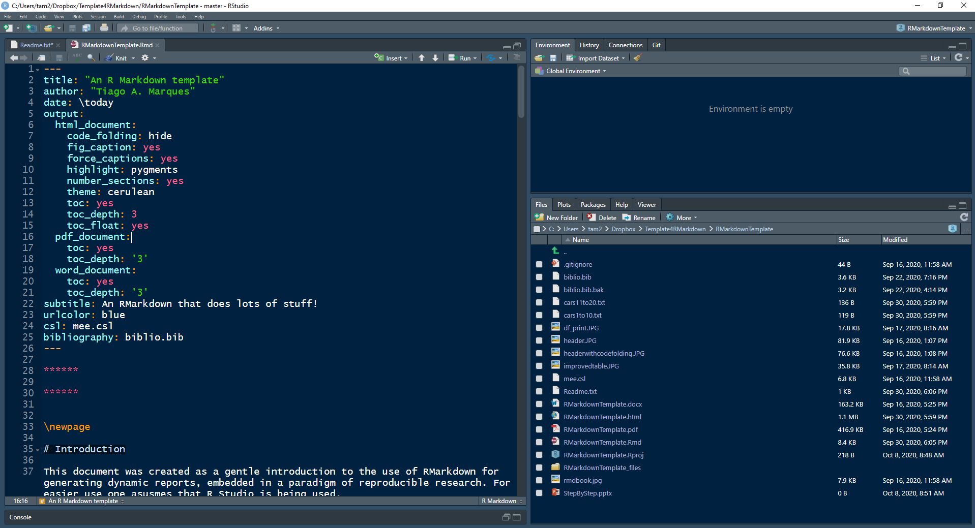
Knit the .Rmd

Slide 7
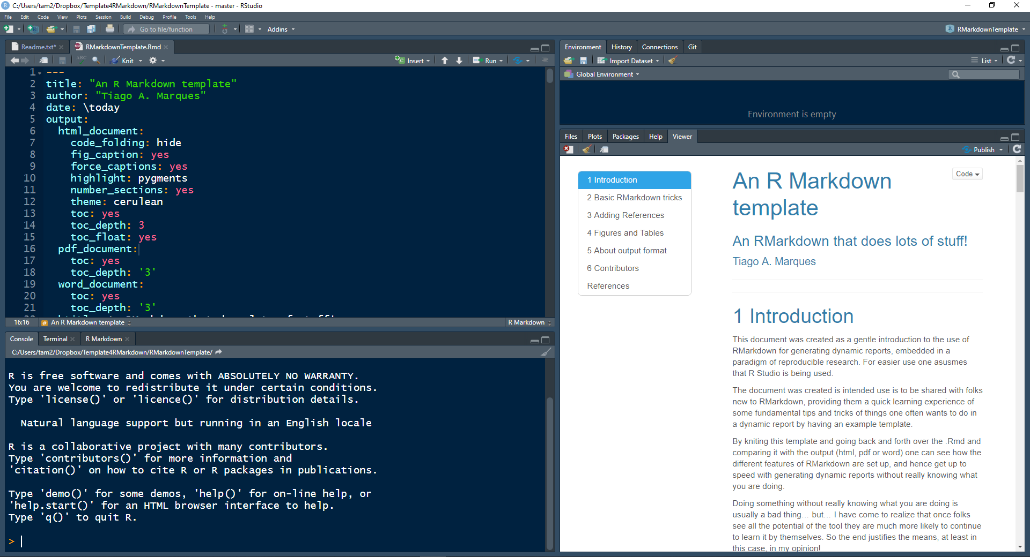
The template should have compiled. Edit and use at will

Slide 8
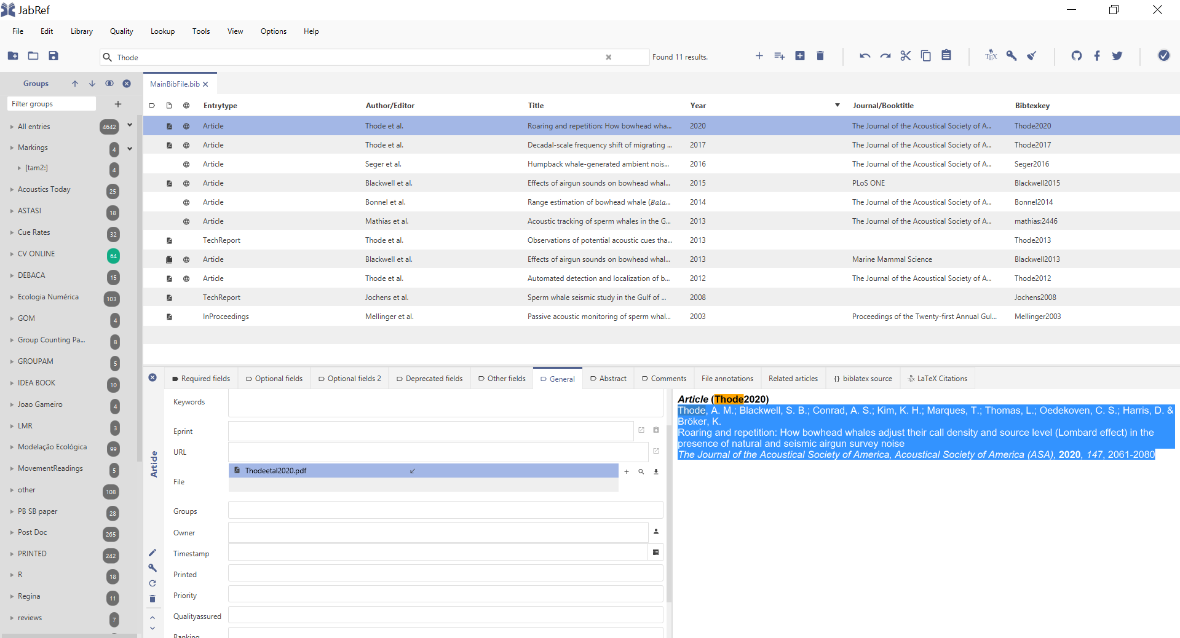
How to include add entries to .bib and use them
You don’t need to use this software but here I am using JABREF (https://www.jabref.org/)
Don’t need to start a new file, just use the biblio.bib provided to begin with

Slide 9
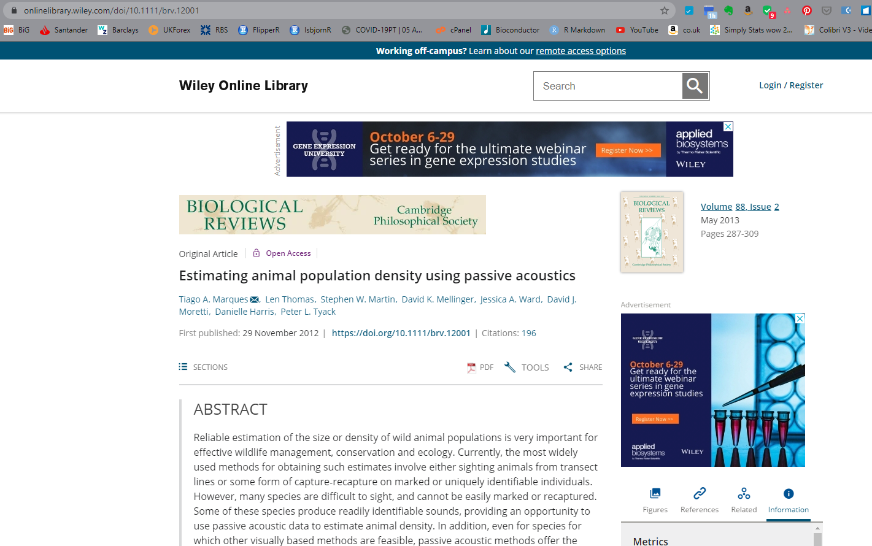
Find the paper you want to include
This is an example, assuming you have a specific paper you want to include. First, look for the DOI of the paper
In this example that is 10.1111/brv.12001
Copy that doi!

Slide 10
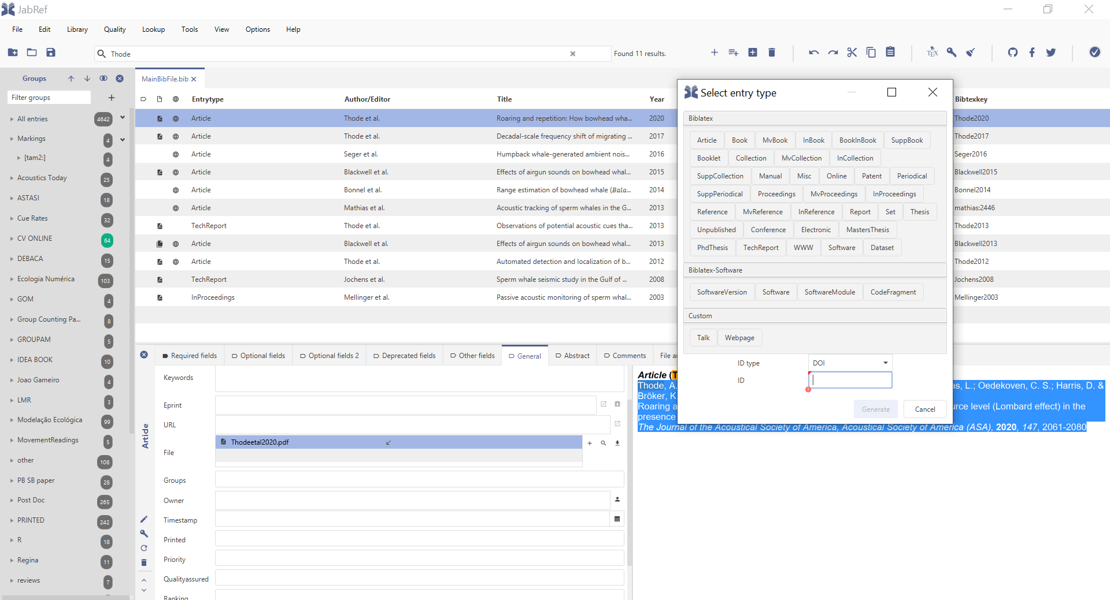
Import it to JabRef
1. Press here to open the dialog window
Open the file biblio.bib (already has a few example references), then…
2. Paste the DOI here
3. press “Generate”

Slide 11
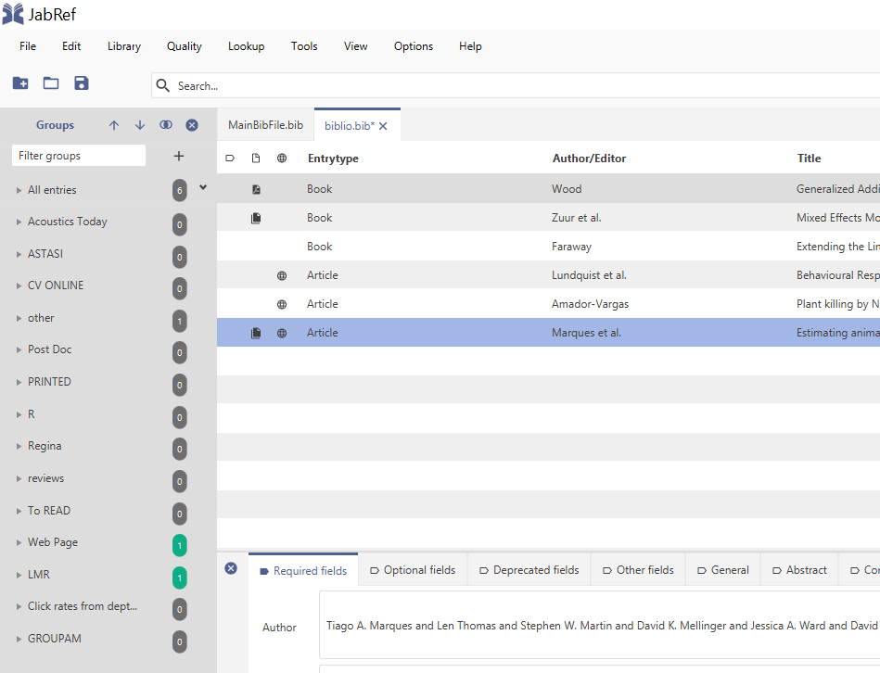
Save the fil (this is key!)
The asterisk here means the file is not saved yet. The procedure will not work before you save!

Slide 12
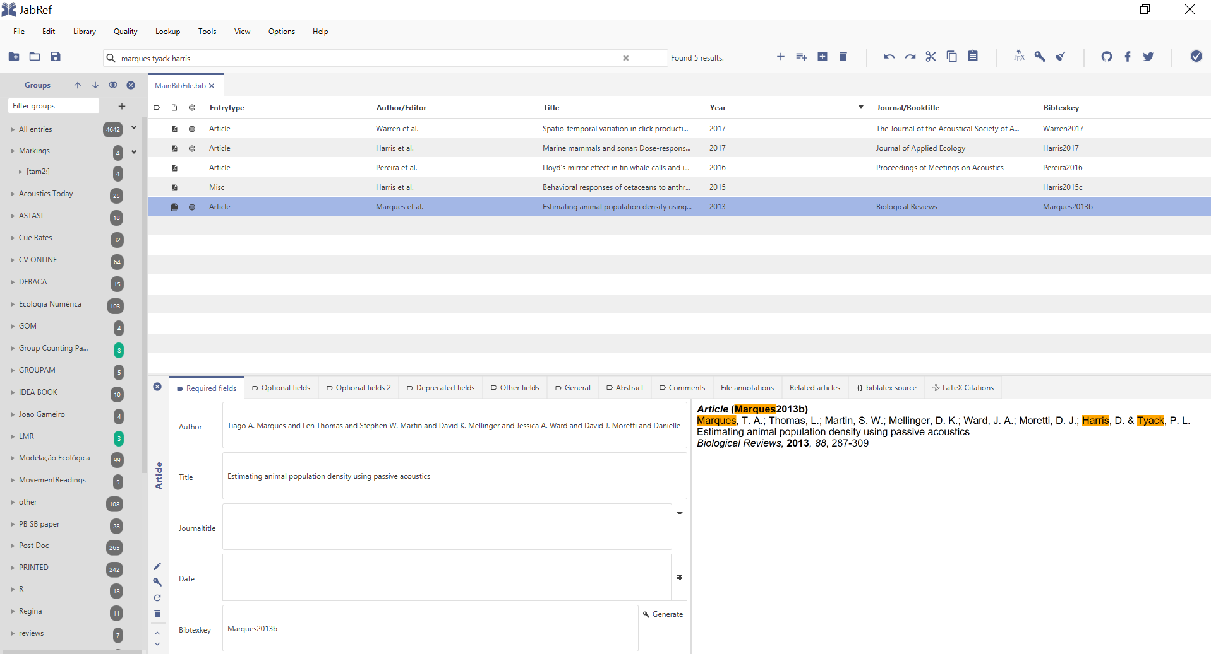
Get what the .Rmd need to identify reference
Copy the bibtex key (Marques2013b in this example)

Slide 13
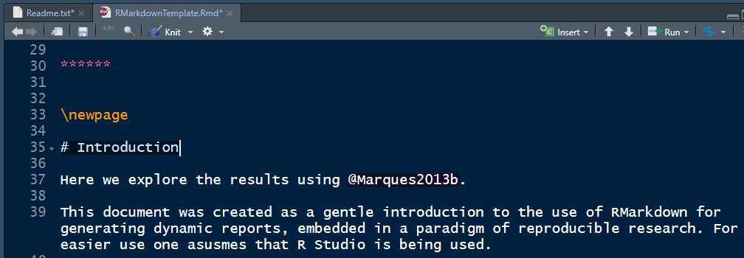
Insert the citation in the .Rmd using @

Slide 14
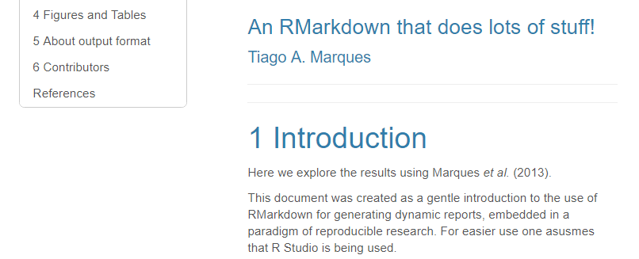
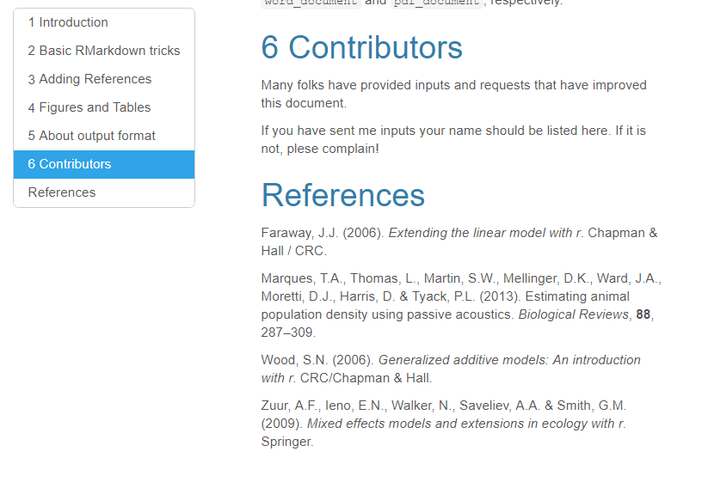
Compile document and see results
A properly formatted reference! Master this process and you will never ever again have to correct a reference list manually for content and/or format. If you do it often, learn this. That will save you days of life in the end.

Slide 15
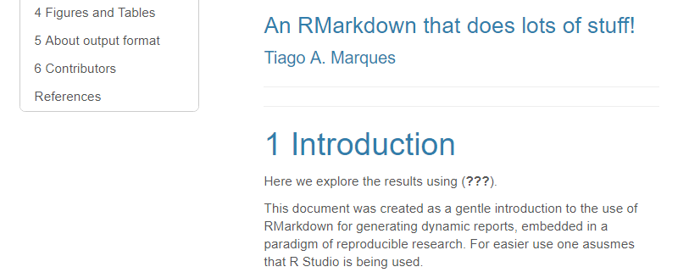
If you have not saved the .bib file properly
You just see this

Slide 16
What defines references source & format
format
source
The file biblio.bib needs to be in the same folder as the .Rmd. These settings, names and files can be changed, but only do it if you really know what you are doing. Otherwise, you’ll break delicate things!

Slide 17
For more on references in RMarkdown
https://rmarkdown.rstudio.com/authoring_bibliographies_and_citations.html
https://bookdown.org/yihui/rmarkdown-cookbook/bibliography.html
https://rmd4sci.njtierney.com/citing-articles-bibliography-styles.html
https://m-clark.github.io/Introduction-to-Rmarkdown/appendix.html

