Slide 1
The Gamma GLMM issues
Comparing results from Nimble with lme4::glmer
(see also glmmTMB and Nimble-with-Laplace approximation)
See also: list here other relevant files.

Slide 2
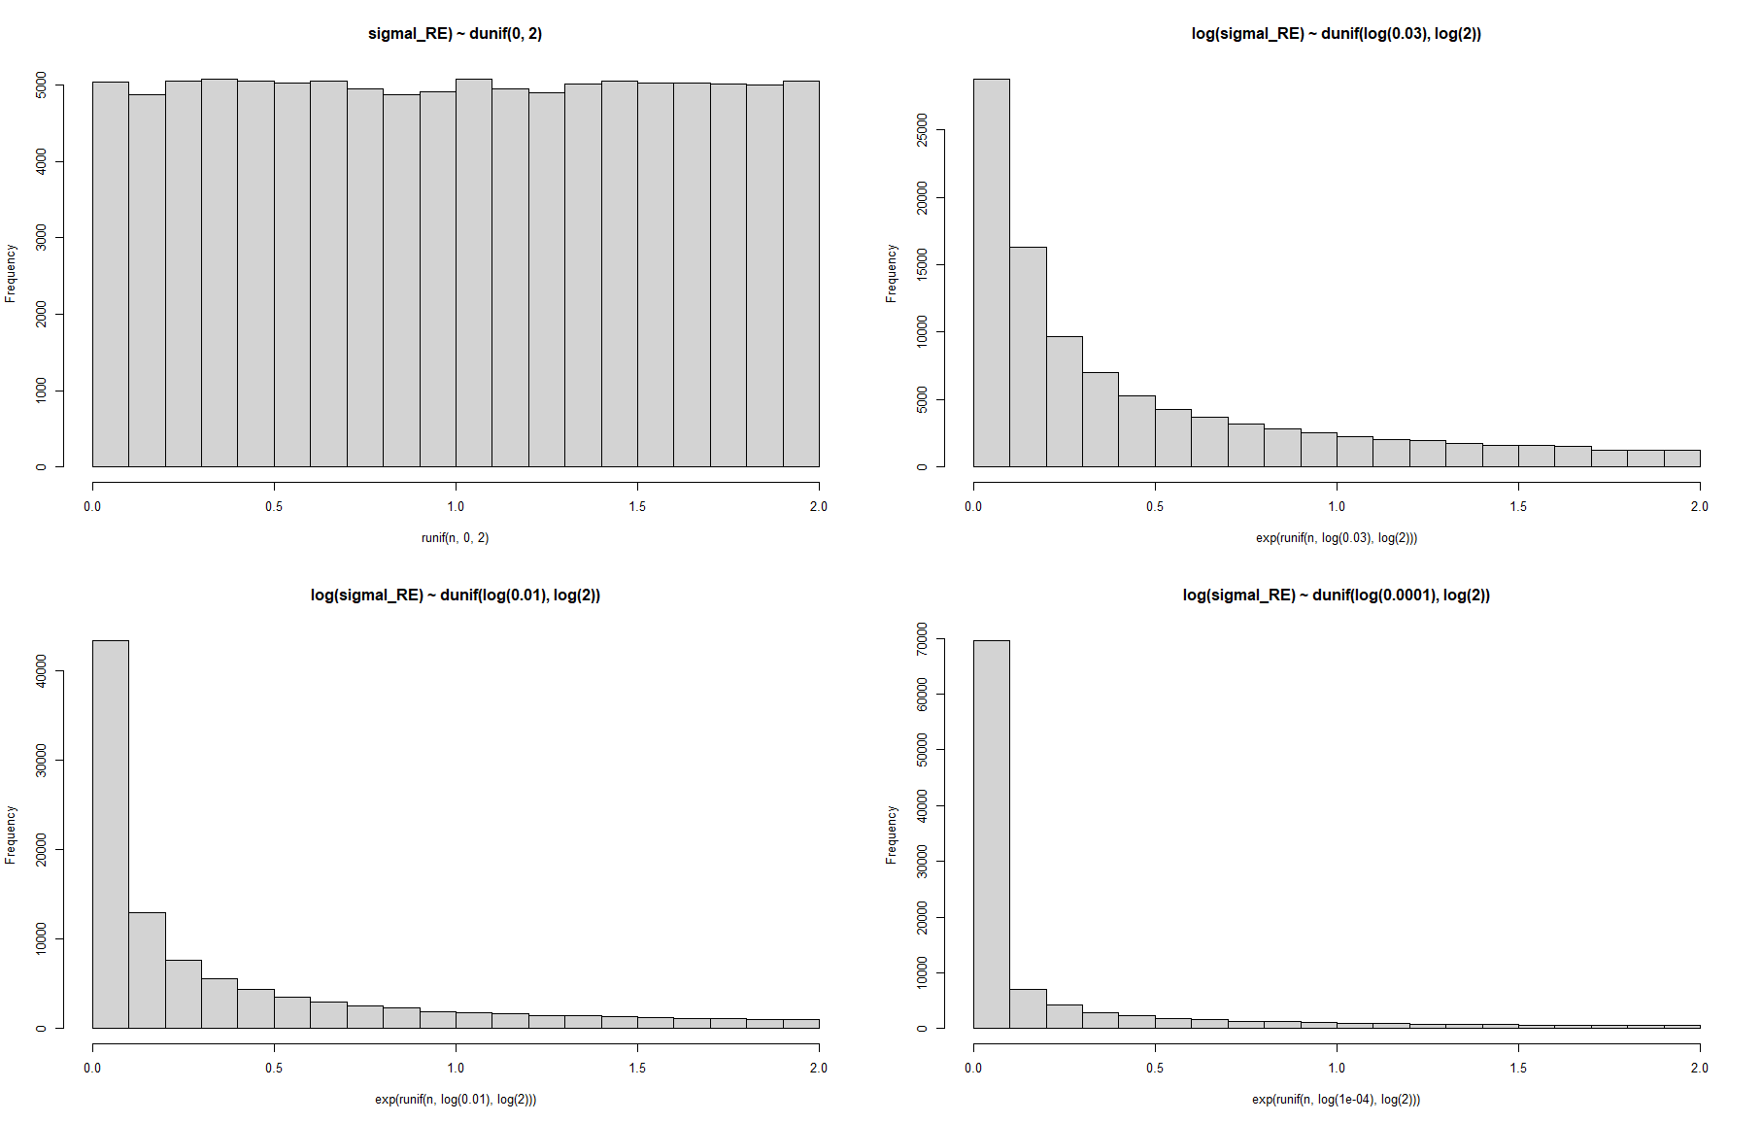
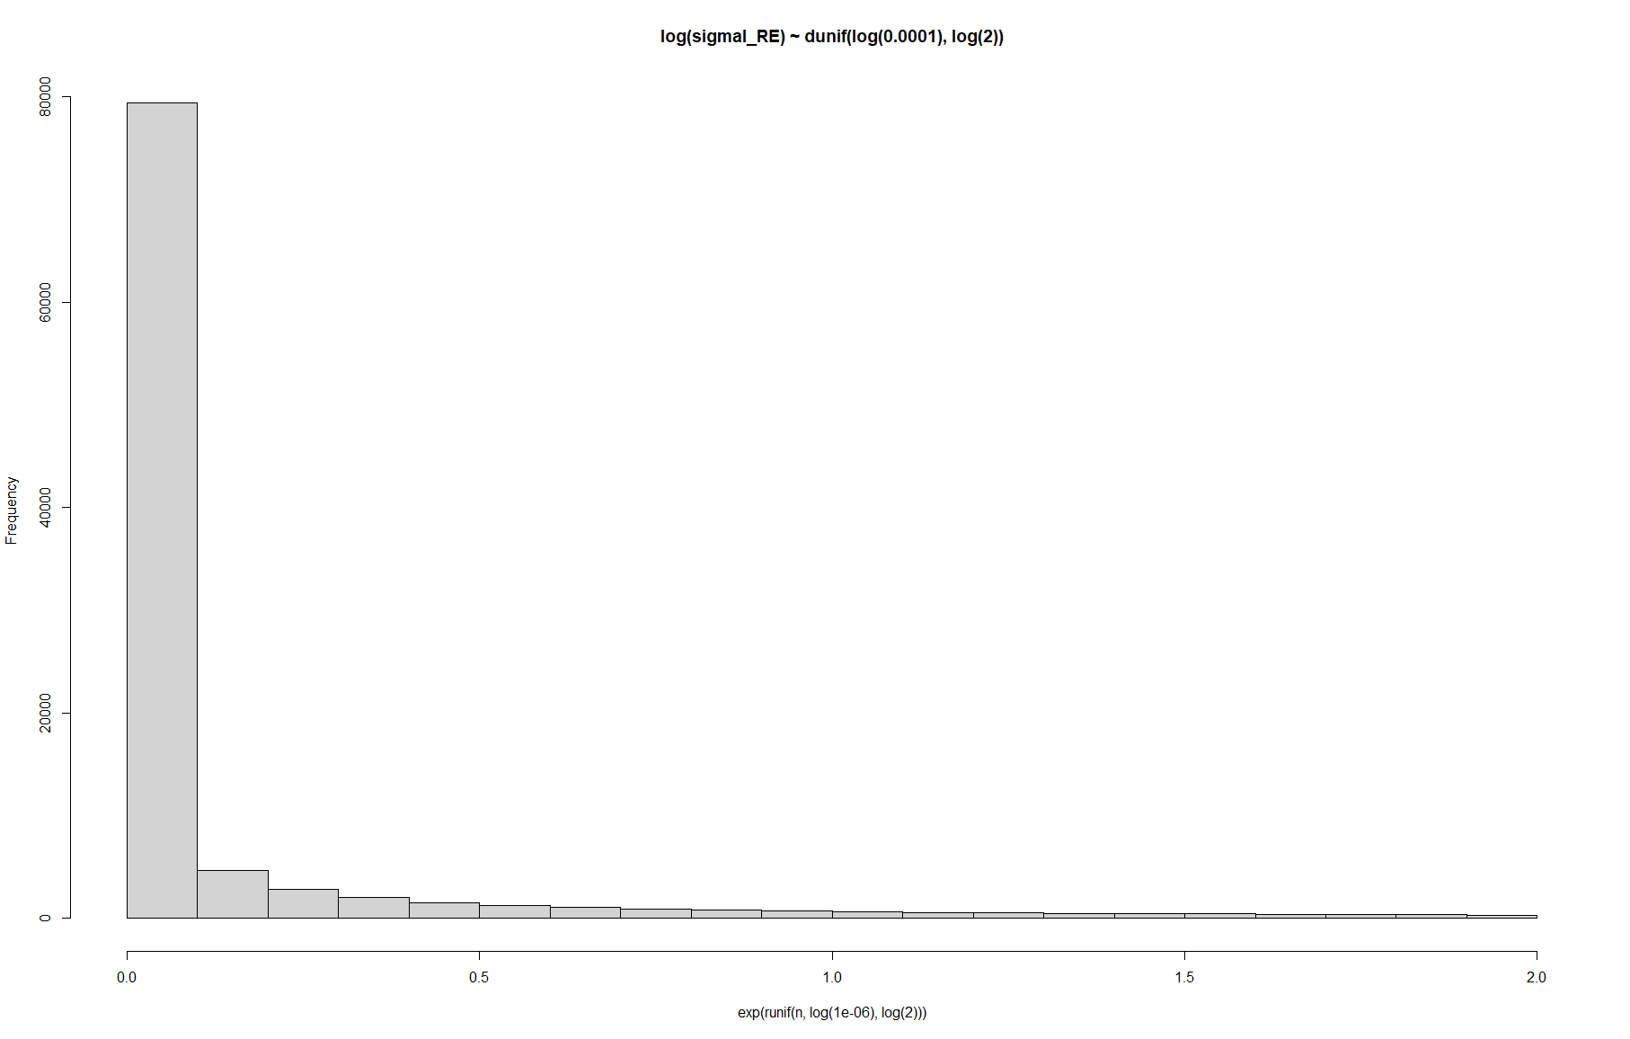
Priors for sigma RE
Not that matching lme4::glmer estimates is necessarily a sensible target, but I tried changing prior until I would kind of match those values for the random effects sd’s and the next few plots show the posterior distributions for those attempts

Slide 3
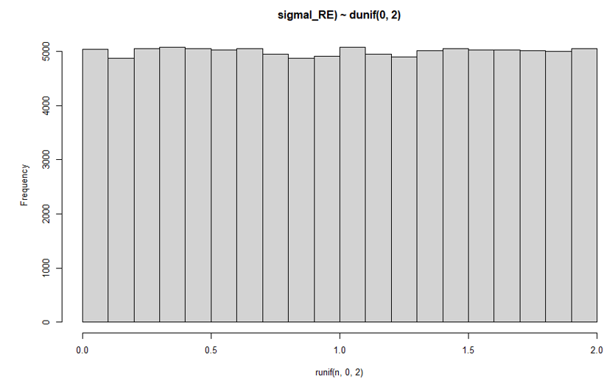
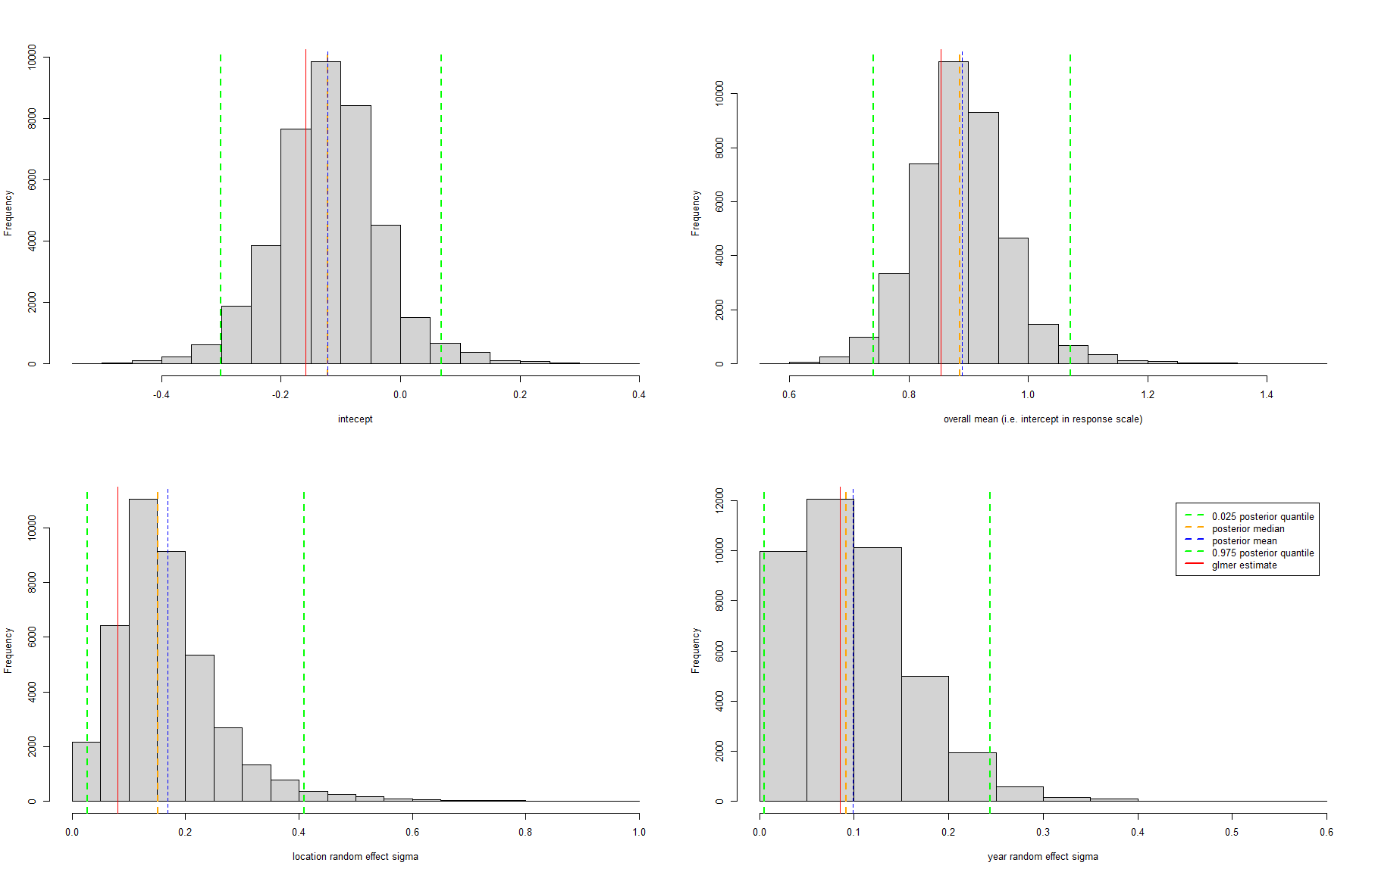

Prior for sigma RE
Results for the year RE sd are close enough, but not for location, considering the uniform prior for the RE sd

Slide 4
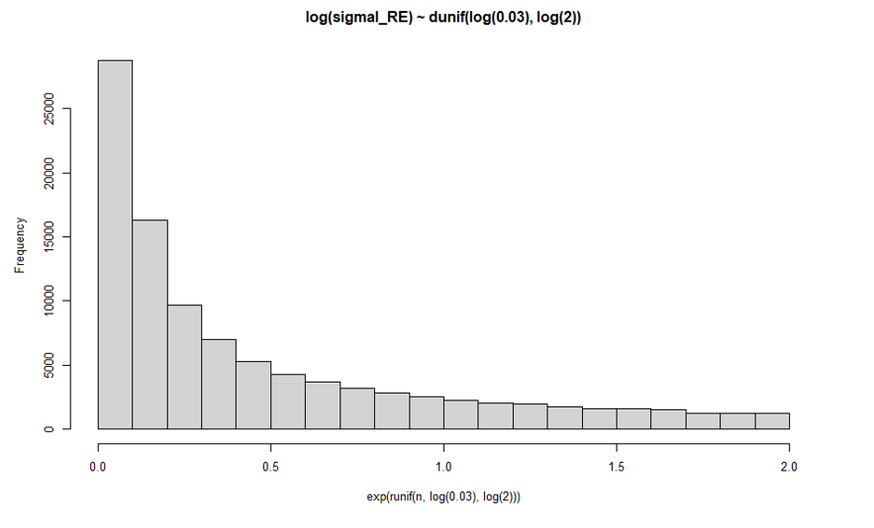
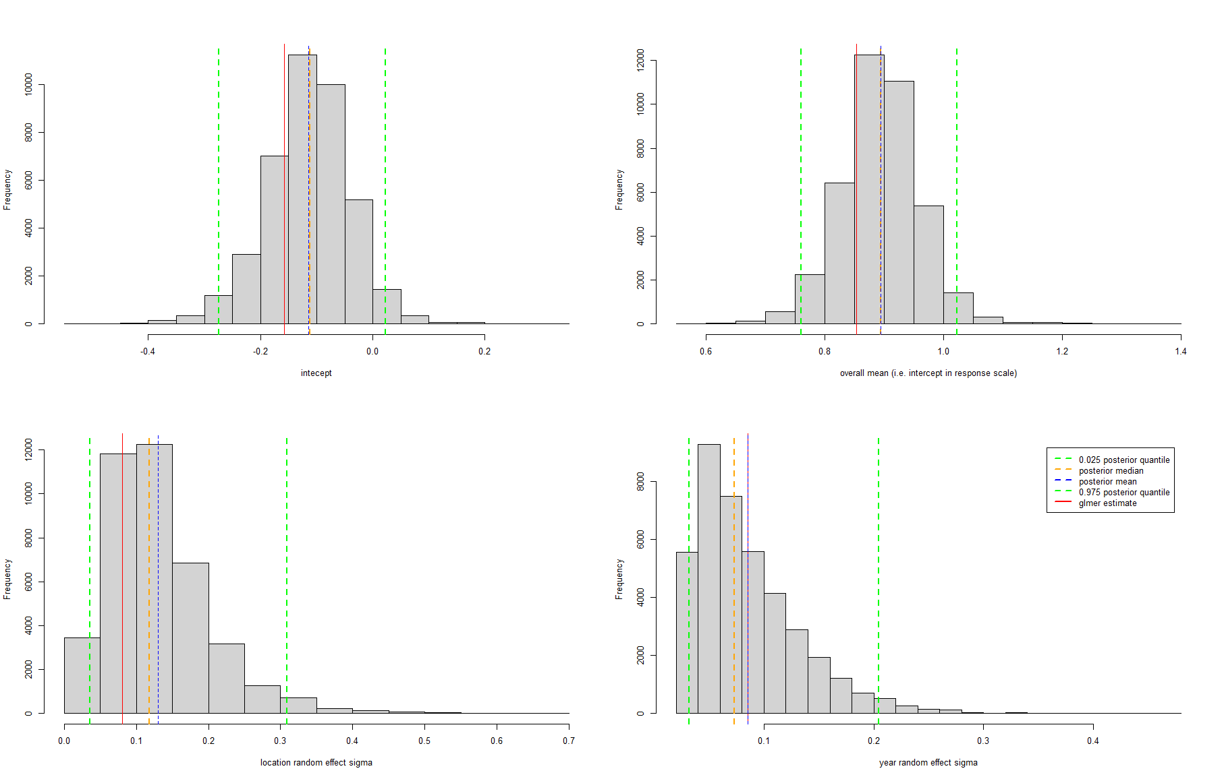
Prior for sigma RE

Slide 5
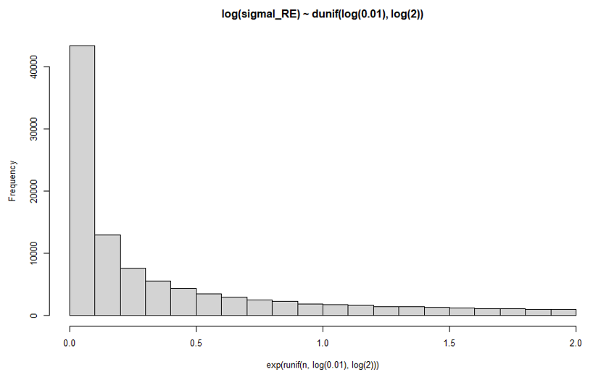
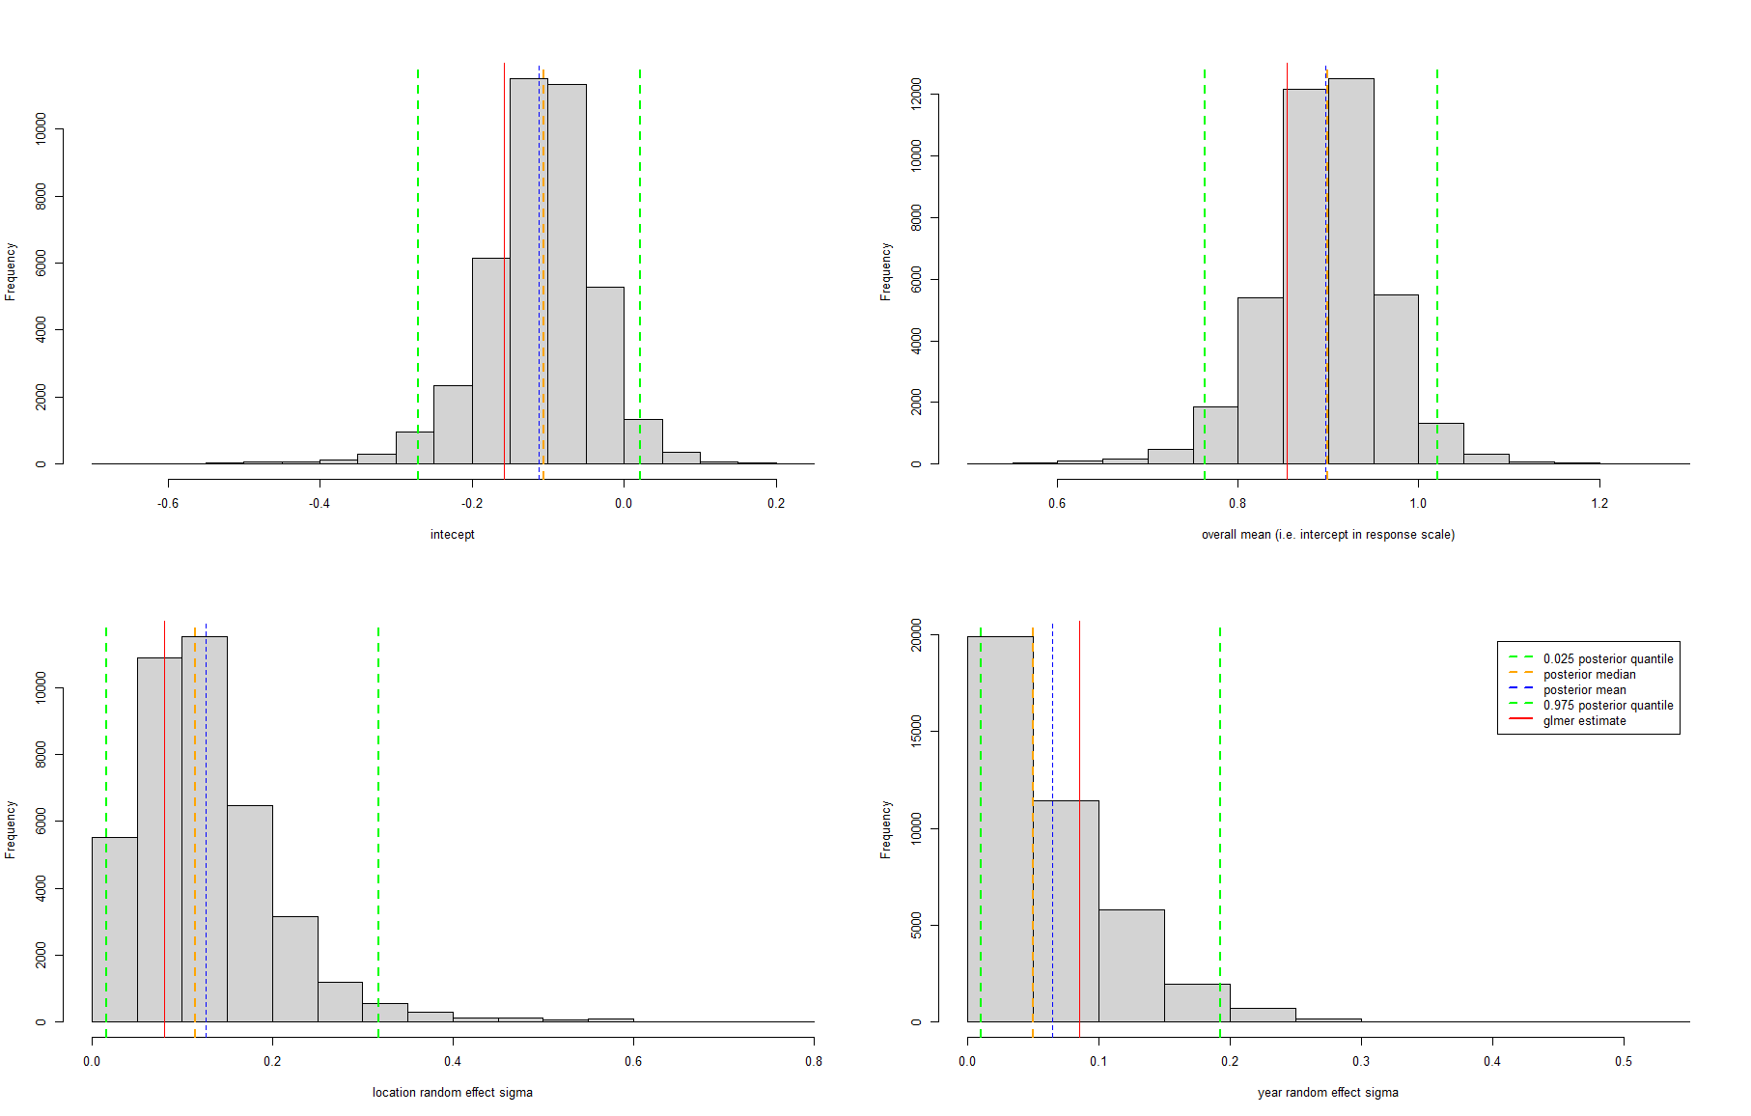
Prior for sigma RE

Slide 6
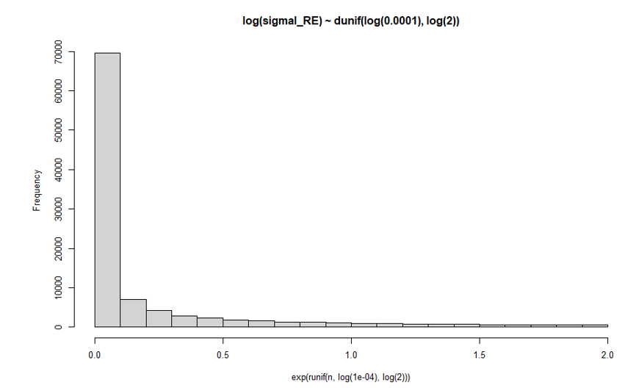
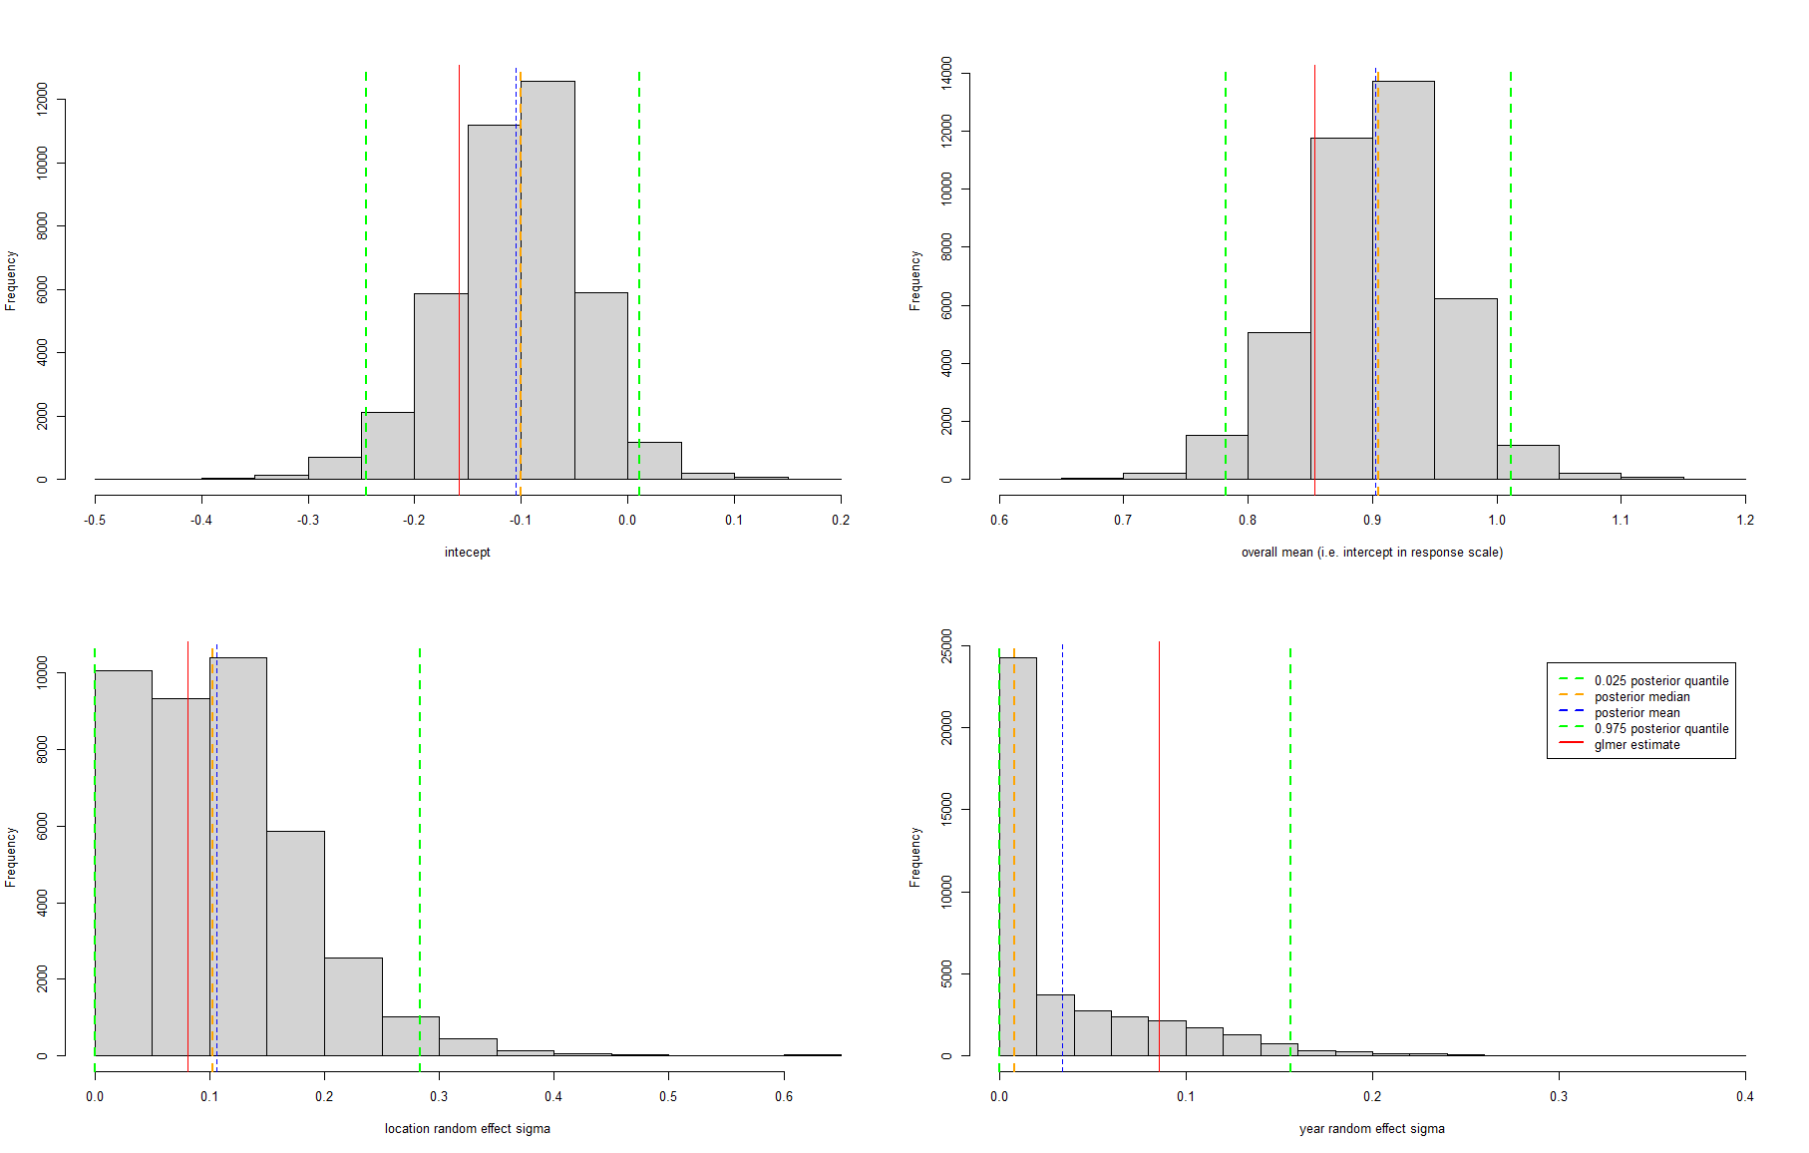
Prior for sigma RE

Slide 7
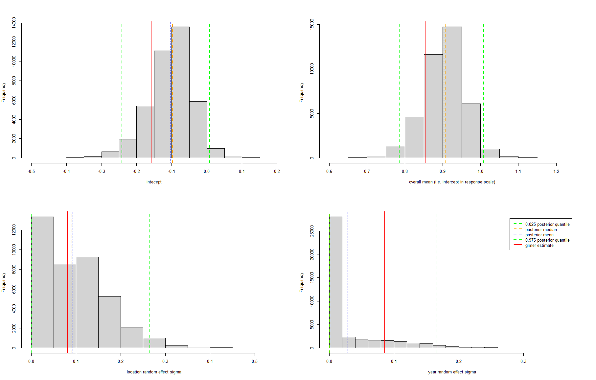
Prior for sigma RE
But this is now essentially just prior, no data...
And I really feel uncomfortable with all this prior tweaking, which shows me that what I assume a priori about the variance of the random effects really changes my inferences, especially given that I don’t have much prior knowledge about what that variance should be

Slide 8
The gamma parametrization should be OK and the random effects formulation too
Since things seem to work fine when I fit:
A Gamma GLM in Nimble (slide 9 and 10)
A LMM in Nimble (slide 11)
See also consequence of Wei Zhang’s email (slide 12)

Slide 9
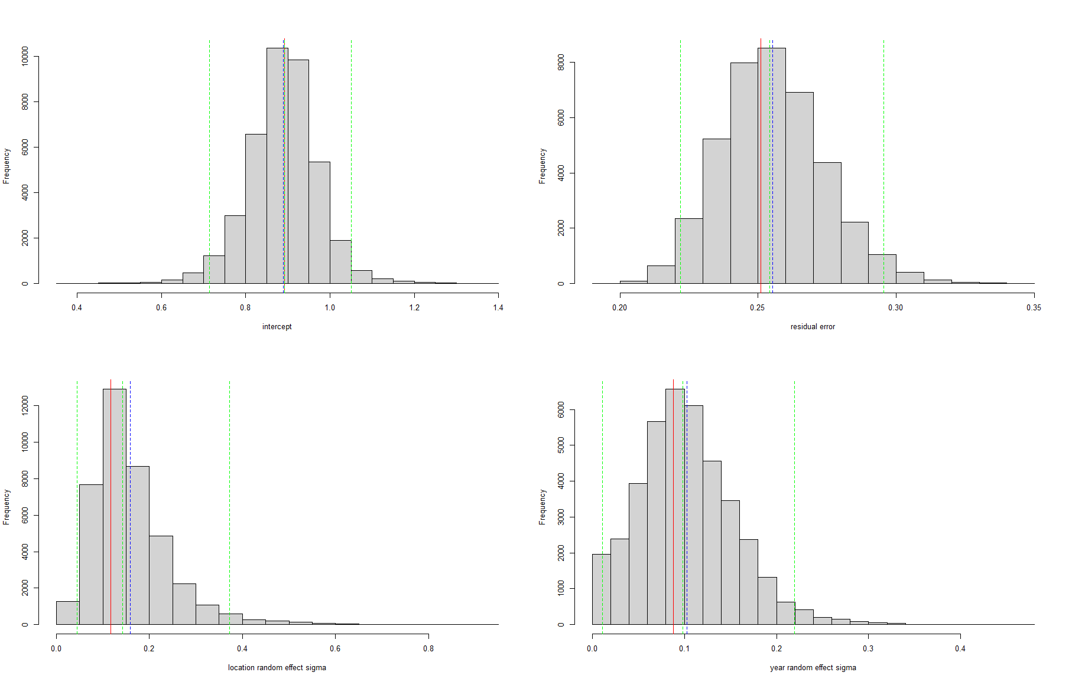
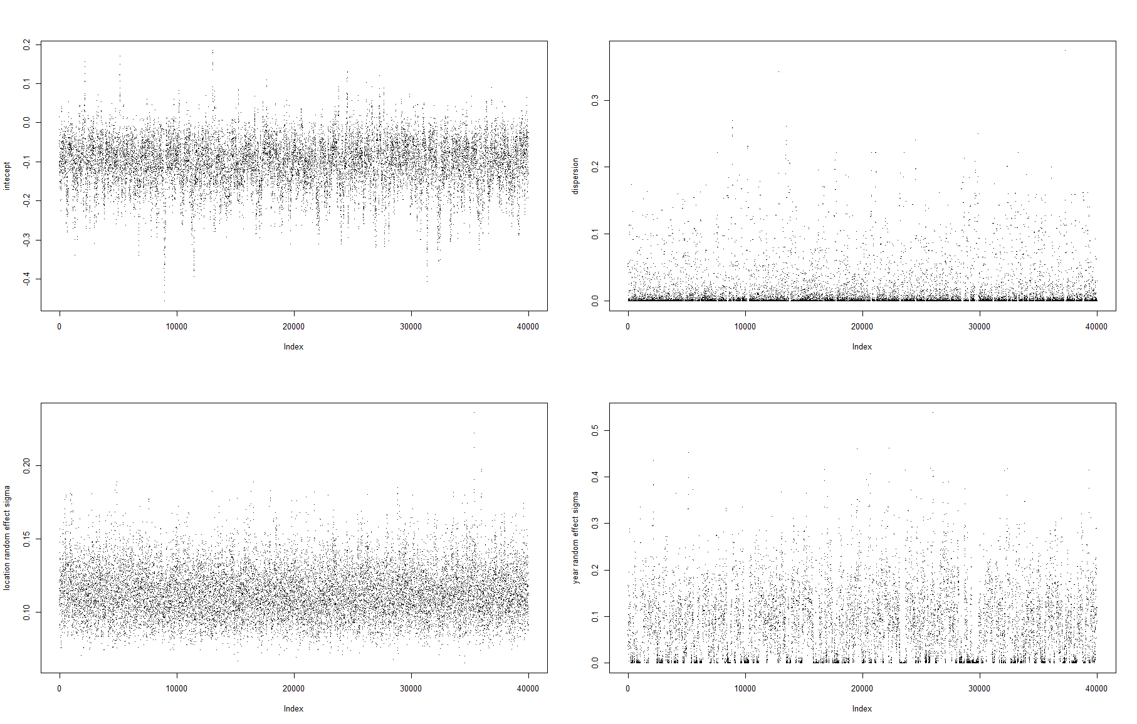
Fitting LMMinNimble.R – random effects sd’s already “overestimated” as compared to lmer... Is that a thing?
sigmal_RE ~ dunif(0, 2)
sigmay_RE ~ dunif(0, 2)
errorsd ~ dunif(0, 100)
Interesting how the mixing for the year random effect is quite “strange” (as is also for the residual error sd) – I guess that might not be unusual for a parameter which has a hard boundary (at 0 in this case)?

Slide 10
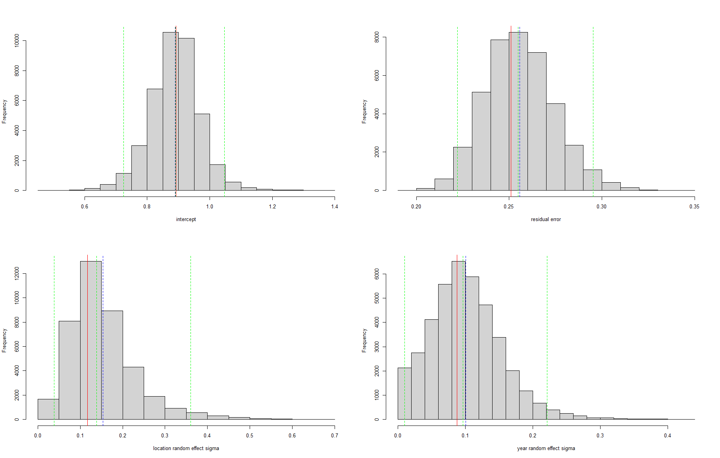
sigmal_RE ~ dunif(0, 1)
sigmay_RE ~ dunif(0, 1)
errorsd ~ dunif(0, 10)
Almost the same as previous slide: so here results seem rather insensitive to priors used

Slide 11
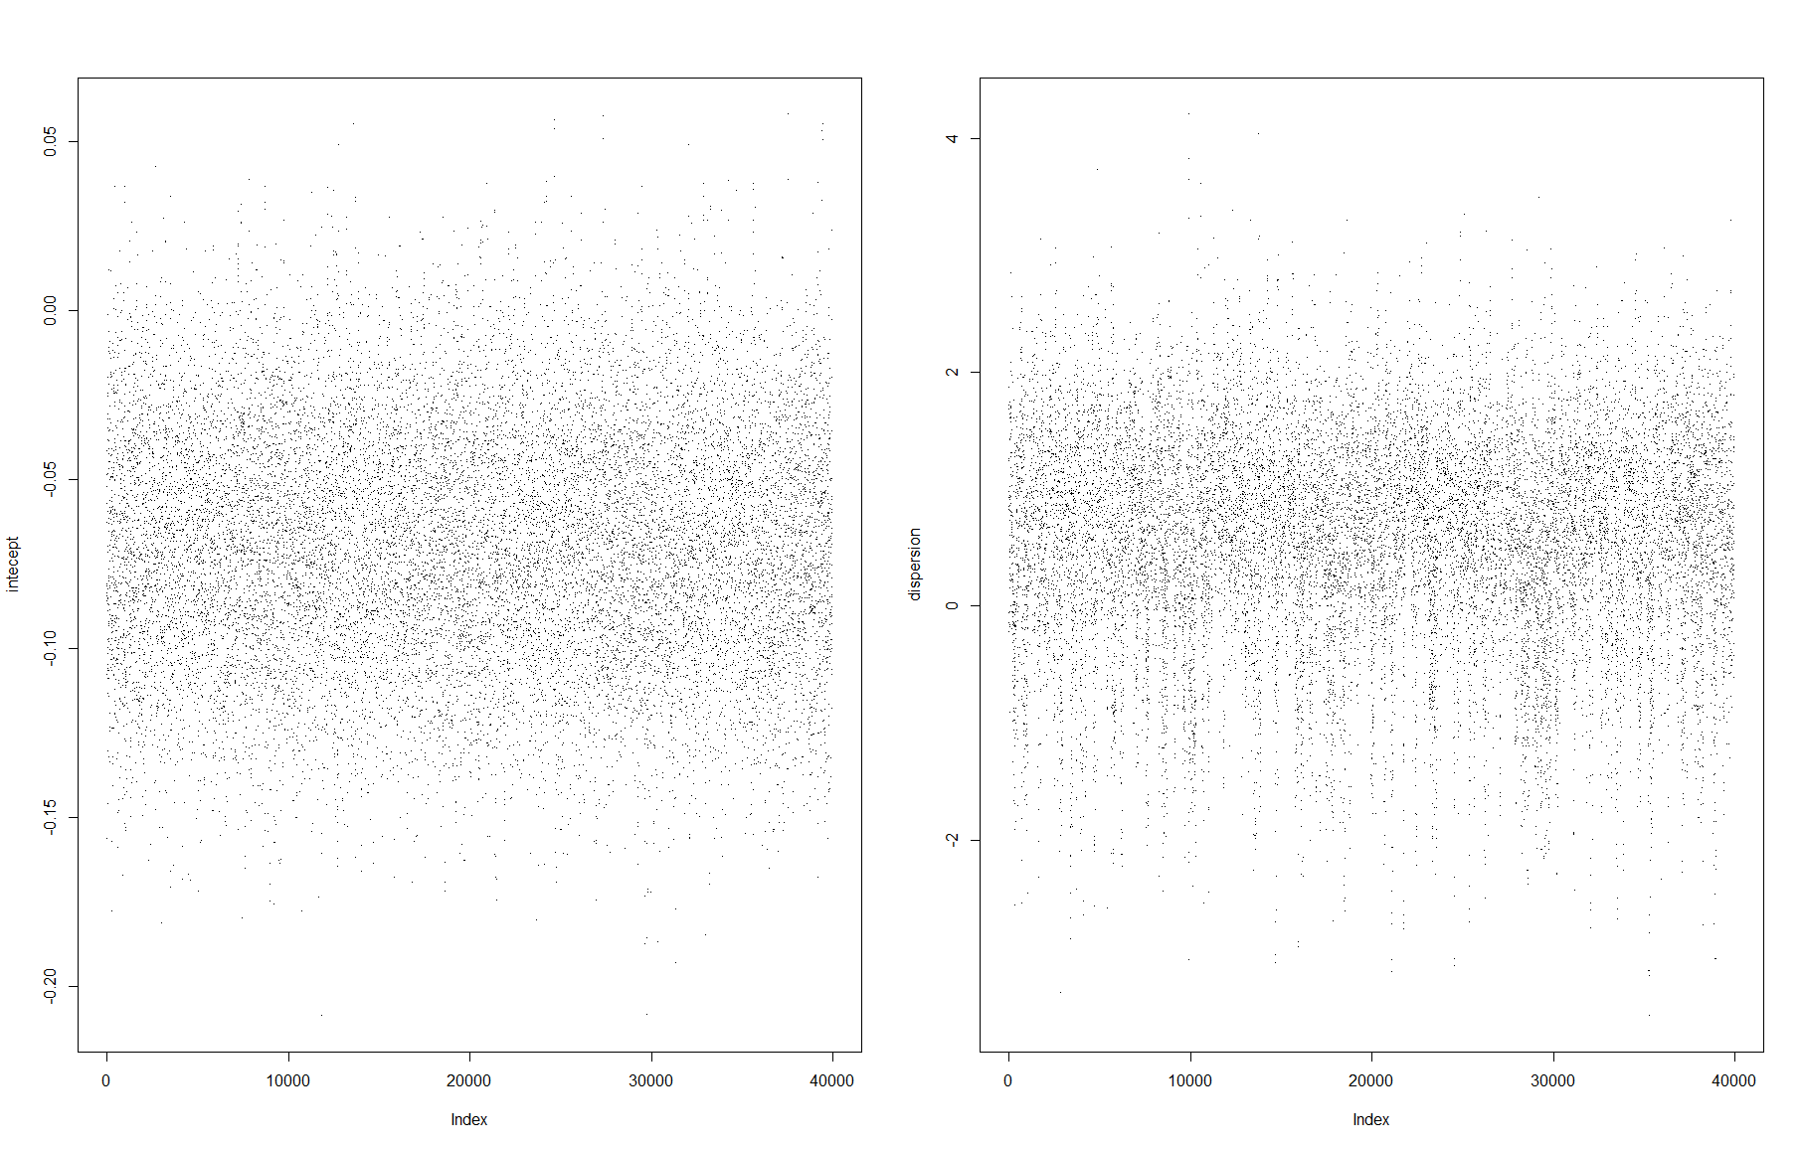
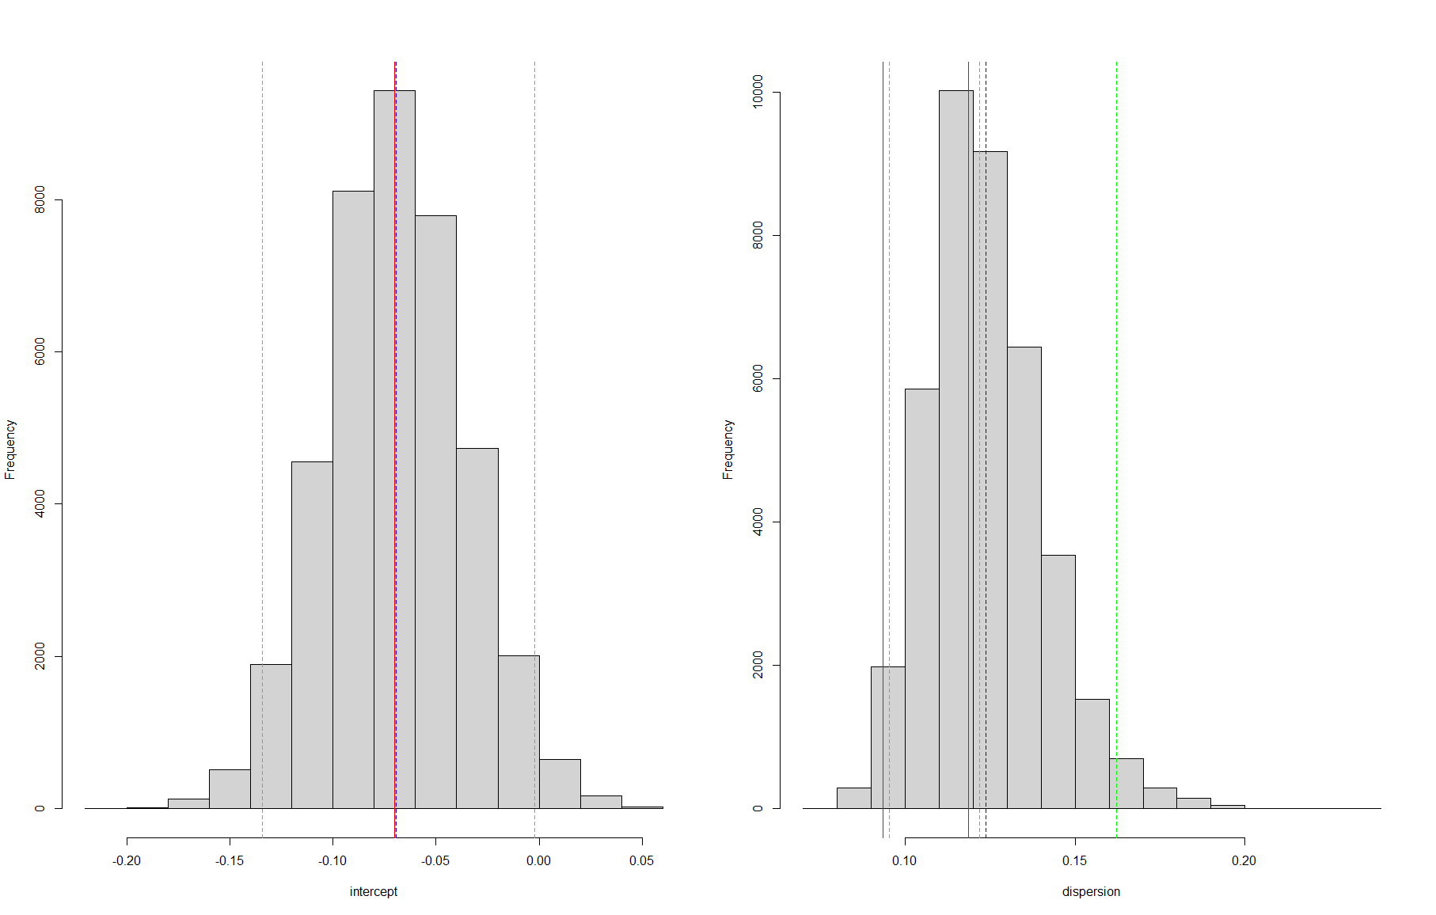
Fitting GLMinNimble.R – seems OK
Estimate via
glm
Estimate via
MASS::gamma.dispersion

Slide 12
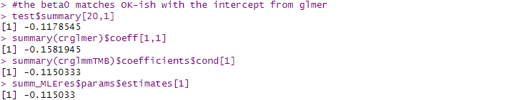
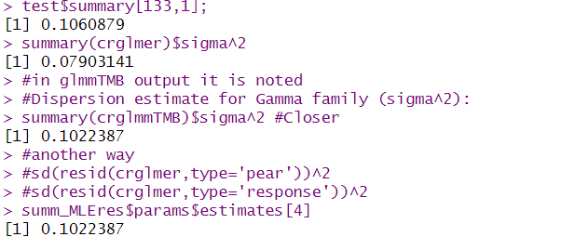
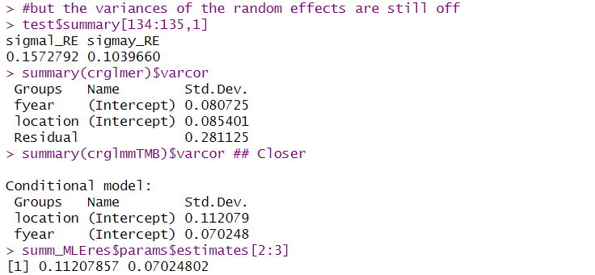
Intercept (on the link scale)
Dispersion
Nimble
glmer
glmmTMB
Nimble Laplace
Random effects standard deviation
As Len predicted, by the so called “law of total variance” ;) the dispersion parameter is lower for glmer, where the random effects sds were higher

Slide 13
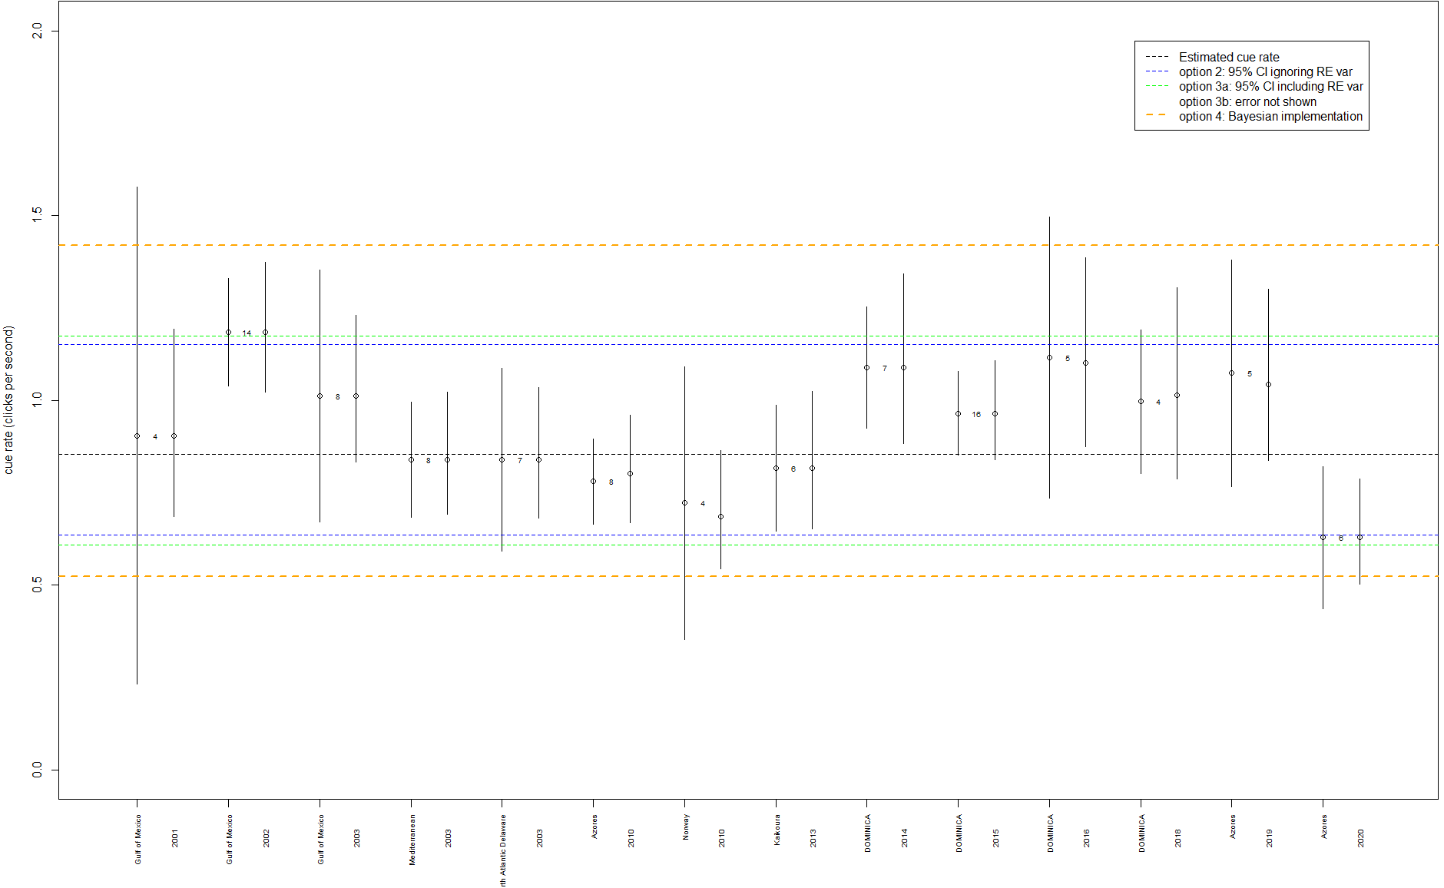
Interesting how we end up with considerably larger confidence intervals when we consider the Bayes way...
Is it just a more honest accounting of the variability?
Am I still doing something weird?
Note to self: add year as a nested effect in location, that might be a more sensible representation of the variability

