Slide 1
The Gamma GLMM issues
Comparing results from Nimble with lme4::glmer
See also:

Slide 2
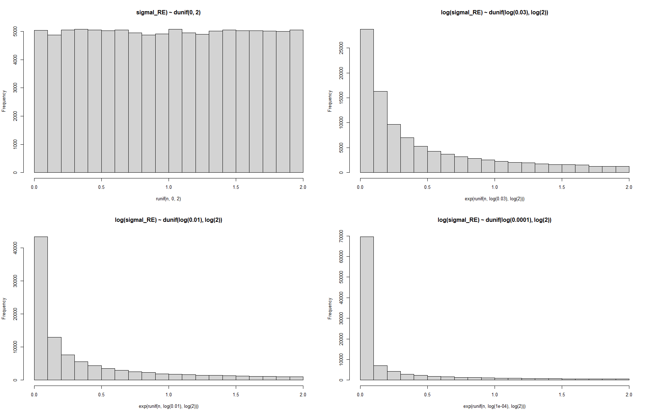
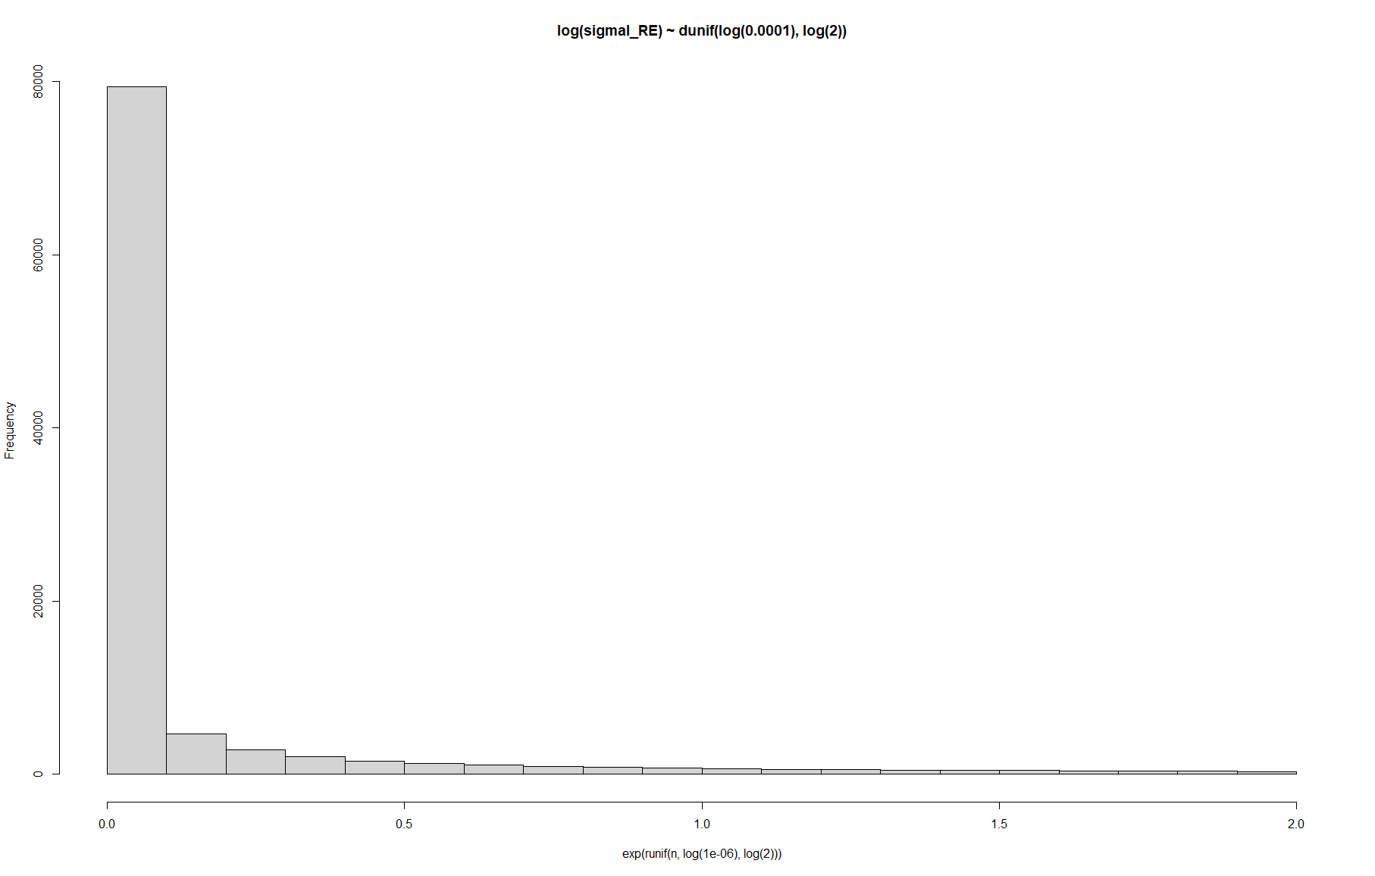
Priors for sigma RE
Not that matching lme4::glmer estimates is necessarily a sensible target, but I tried changing prior until I would kind of match those values for the random effects sd’s and the next few plots show the posterior distributions for those attempts

Slide 3
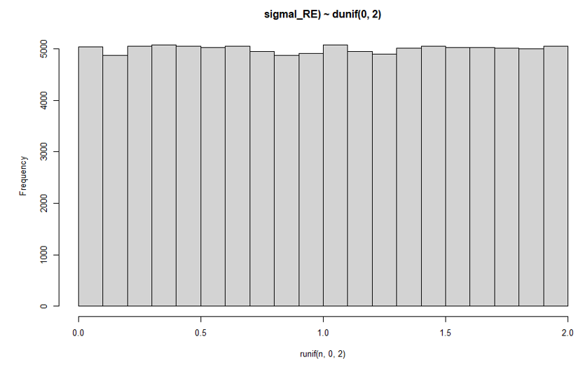
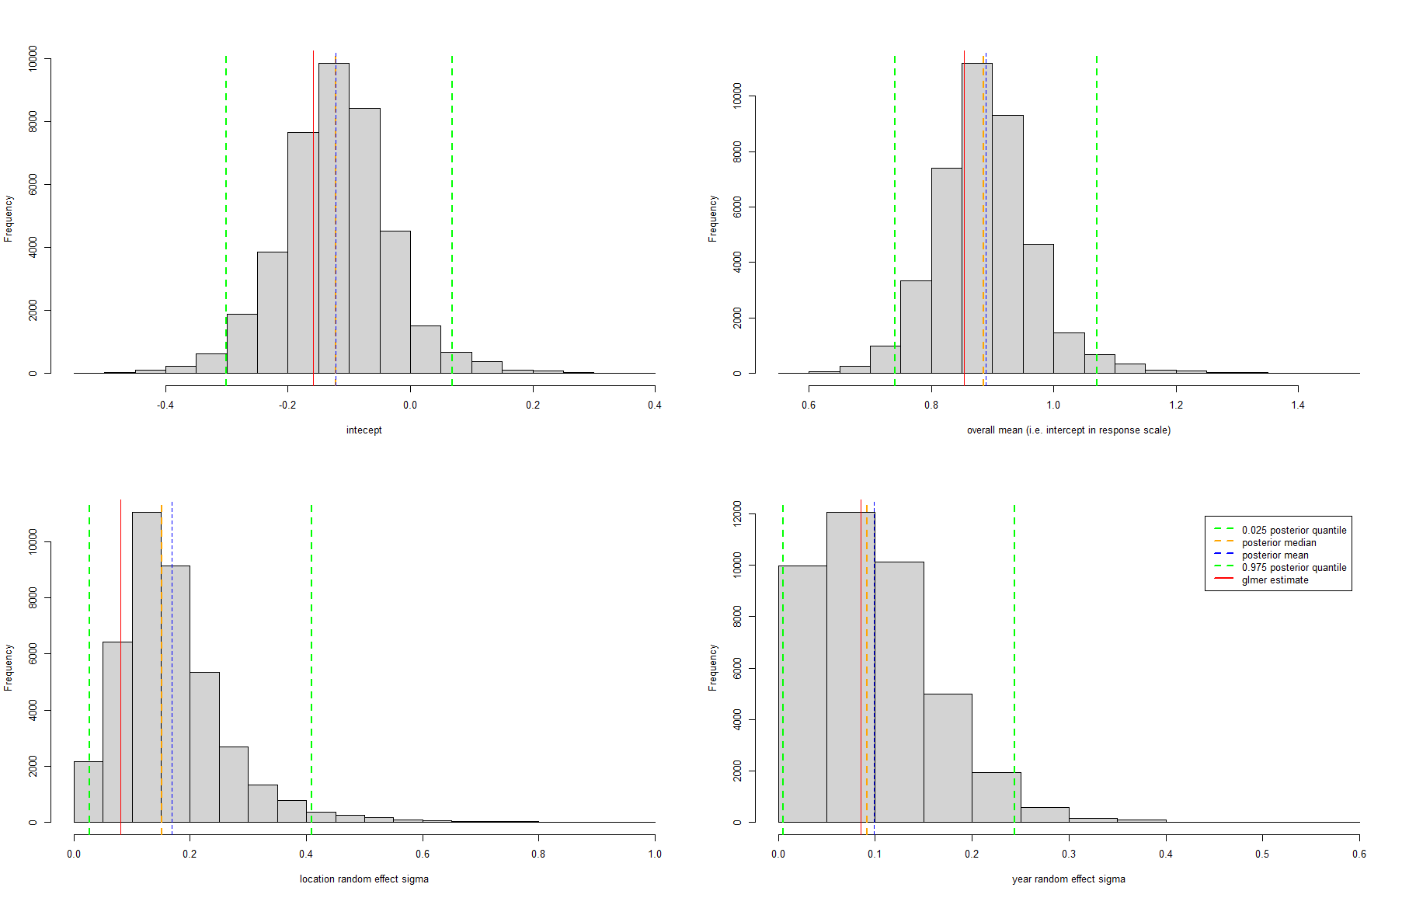

Prior for sigma RE
Results for the year RE sd are close enough, but not for location, considering the uniform prior for the RE sd

Slide 4
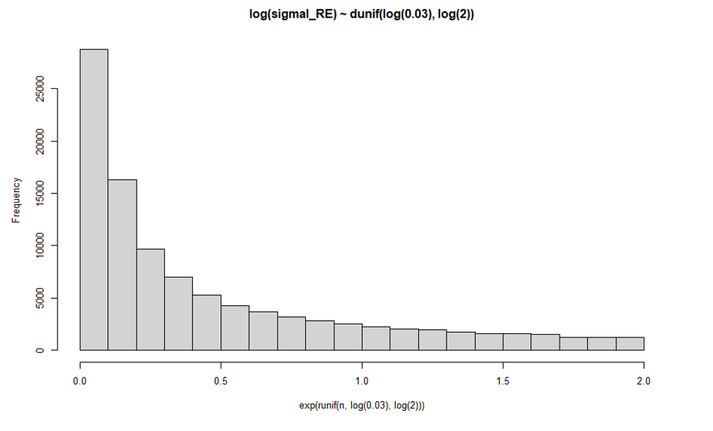
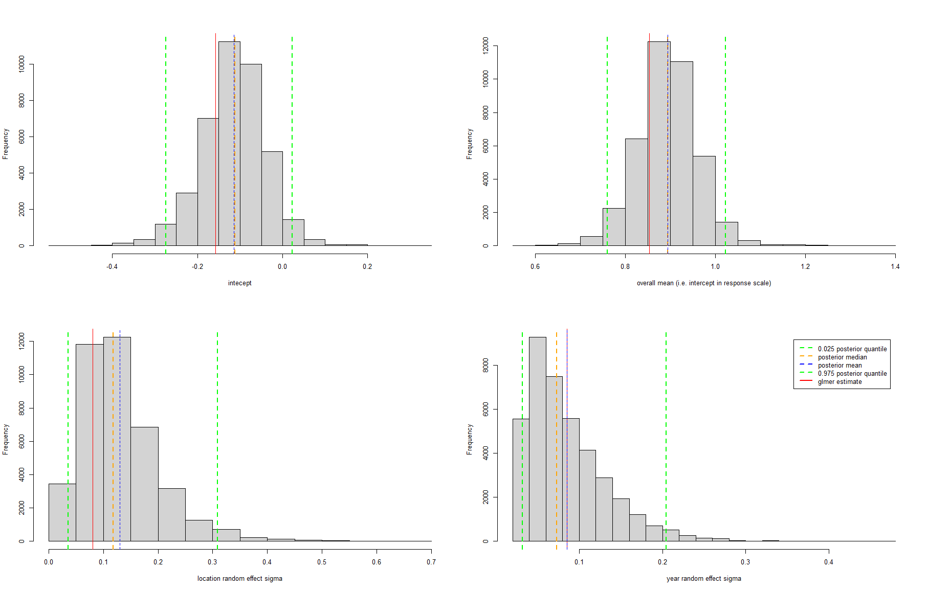
Prior for sigma RE

Slide 5
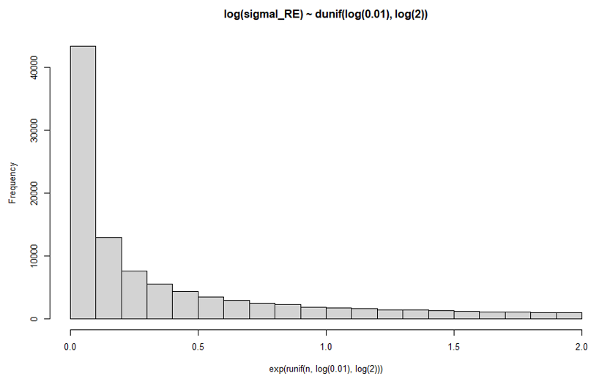
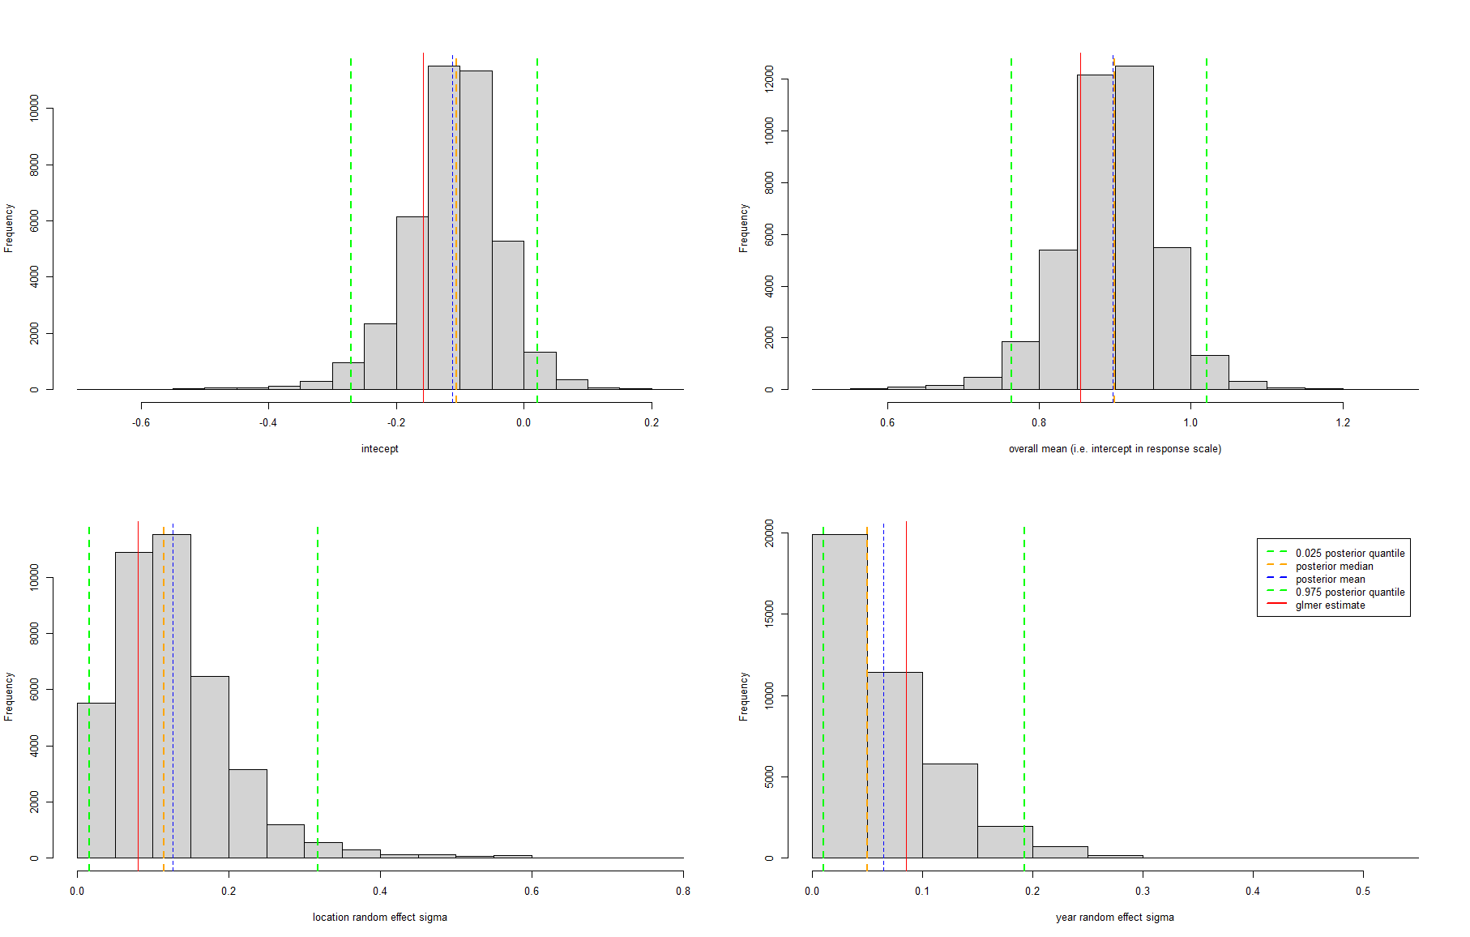
Prior for sigma RE

Slide 6
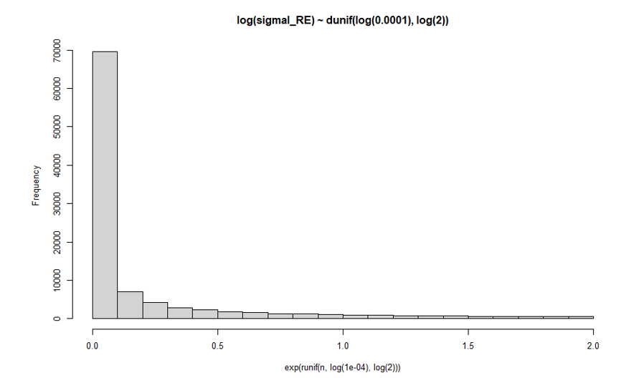
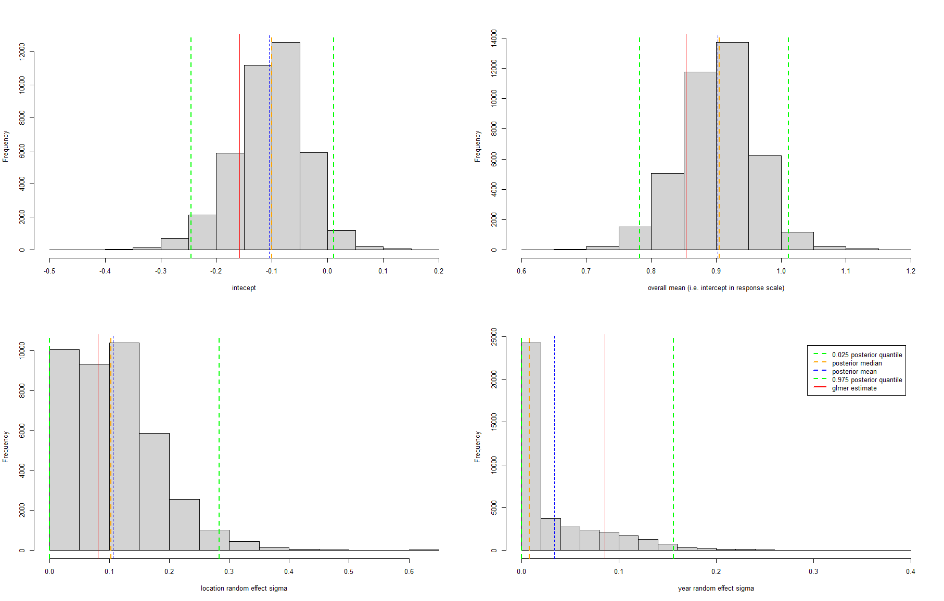
Prior for sigma RE

Slide 7
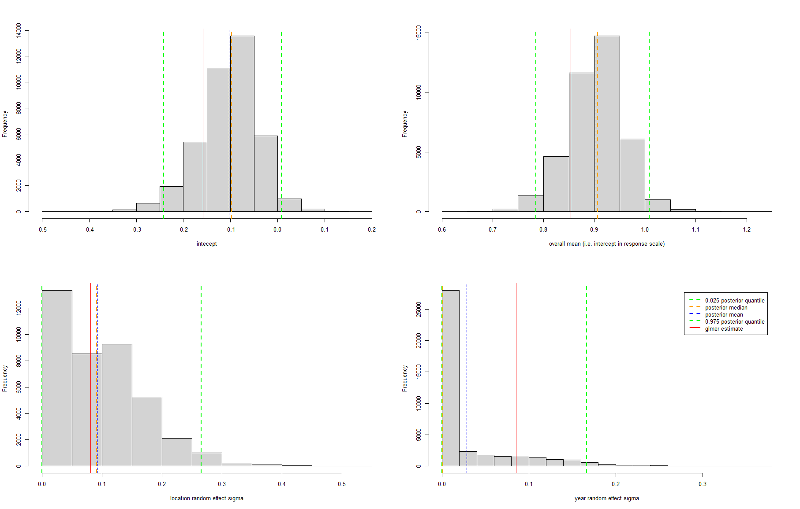
Prior for sigma RE
But this is now essentially just prior, no data...
And I really feel uncomfortable with all this prior tweaking, which shows me that what I assume a priori about the variance of the random effects really changes my inferences, especially given that I don’t have much prior knowledge about what that variance should be

Slide 8
The gamma parametrization should be OK and the random effects formulation too
Since things seem to work fine when I fit:
A Gamma GLM in Nimble (slide 9 and 10)
A LMM in Nimble (slide 11)
See also consequence of Wei Zhang’s email (slide 12)

Slide 9
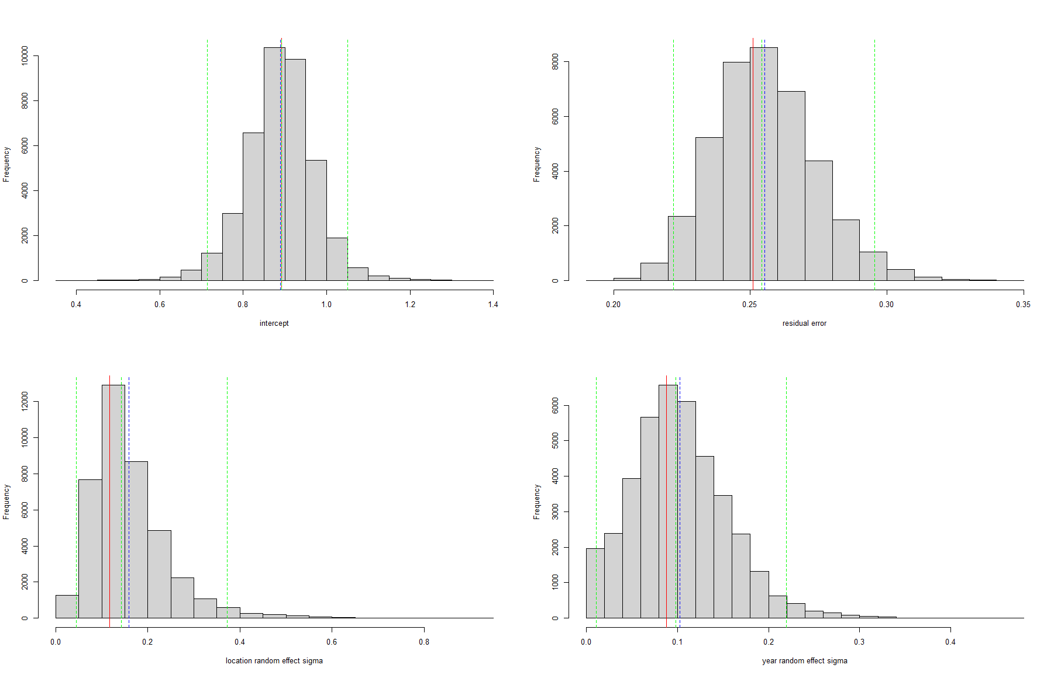
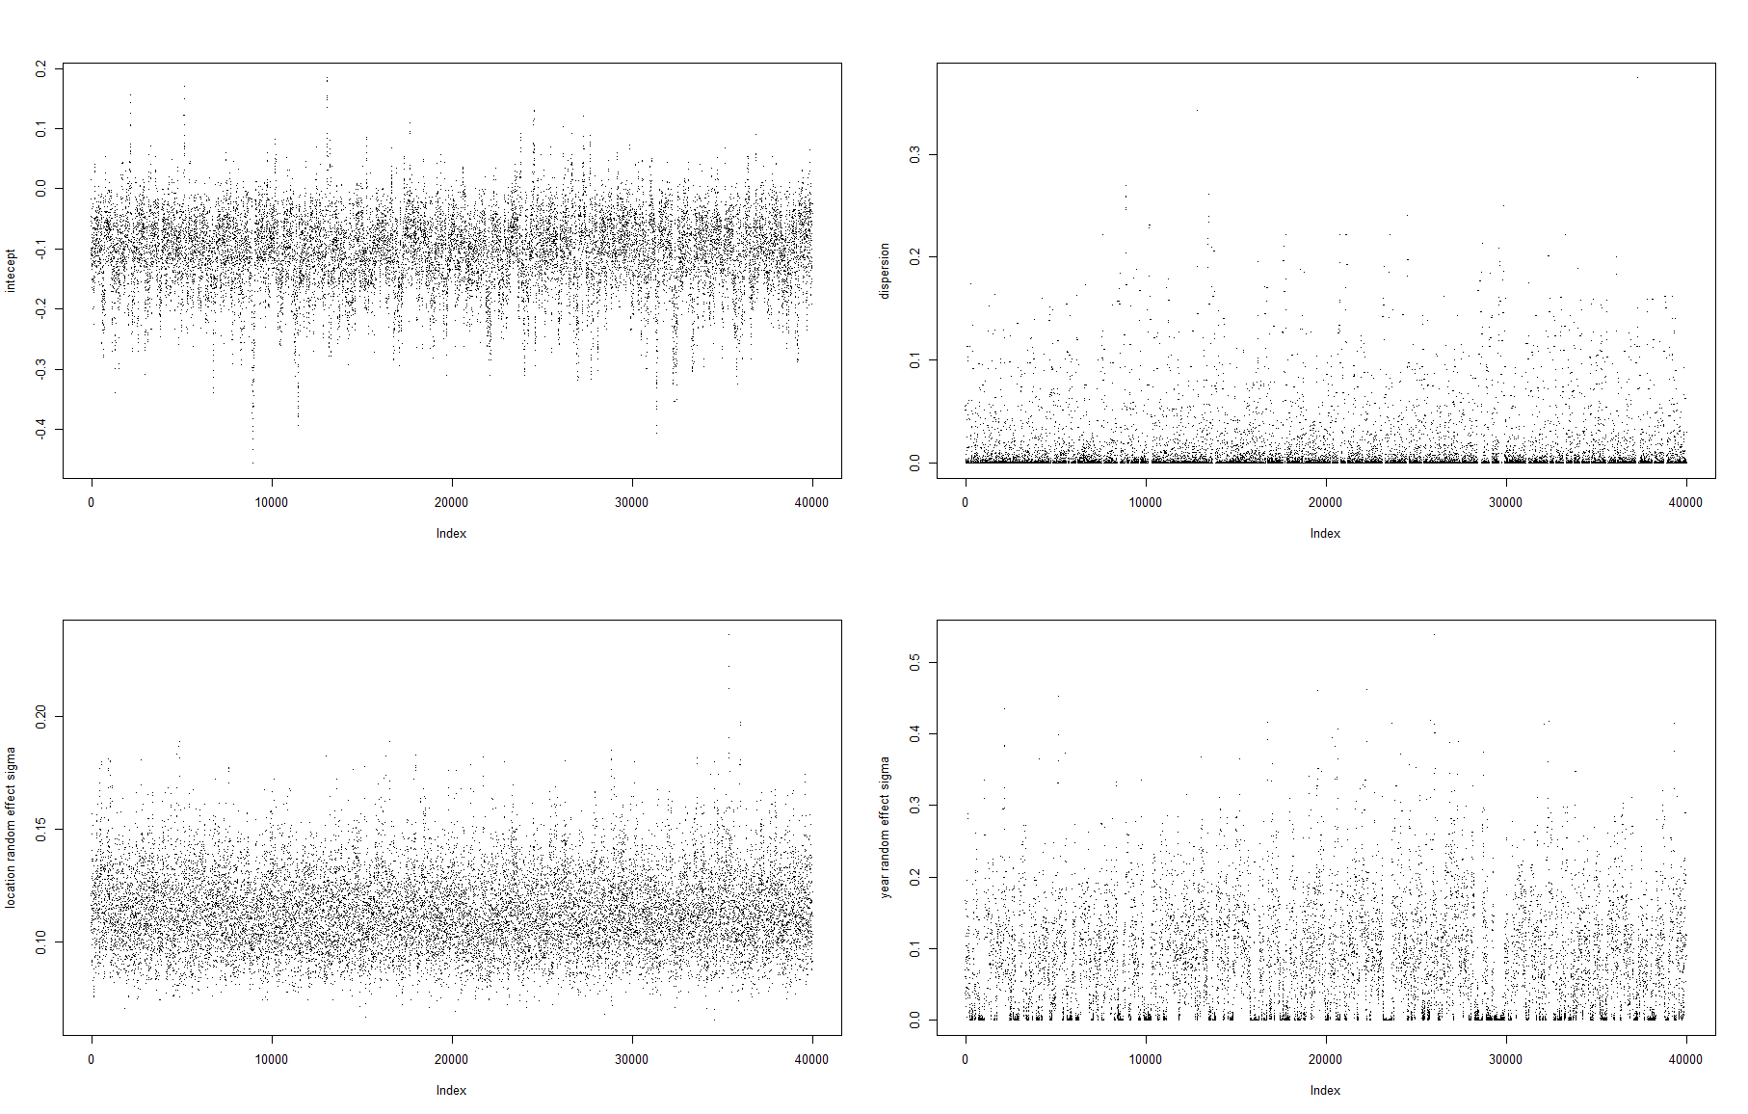
Fitting LMMinNimble.R – random effects sd’s already “overestimated” as compared to lmer... Is that a thing?
sigmal_RE ~ dunif(0, 2)
sigmay_RE ~ dunif(0, 2)
errorsd ~ dunif(0, 100)
Interesting how the mixing for the year random effect is quite “strange” (as is also for the residual error sd) – I guess that might not be unusual for a parameter which has a hard boundary (at 0 in this case)?

Slide 10
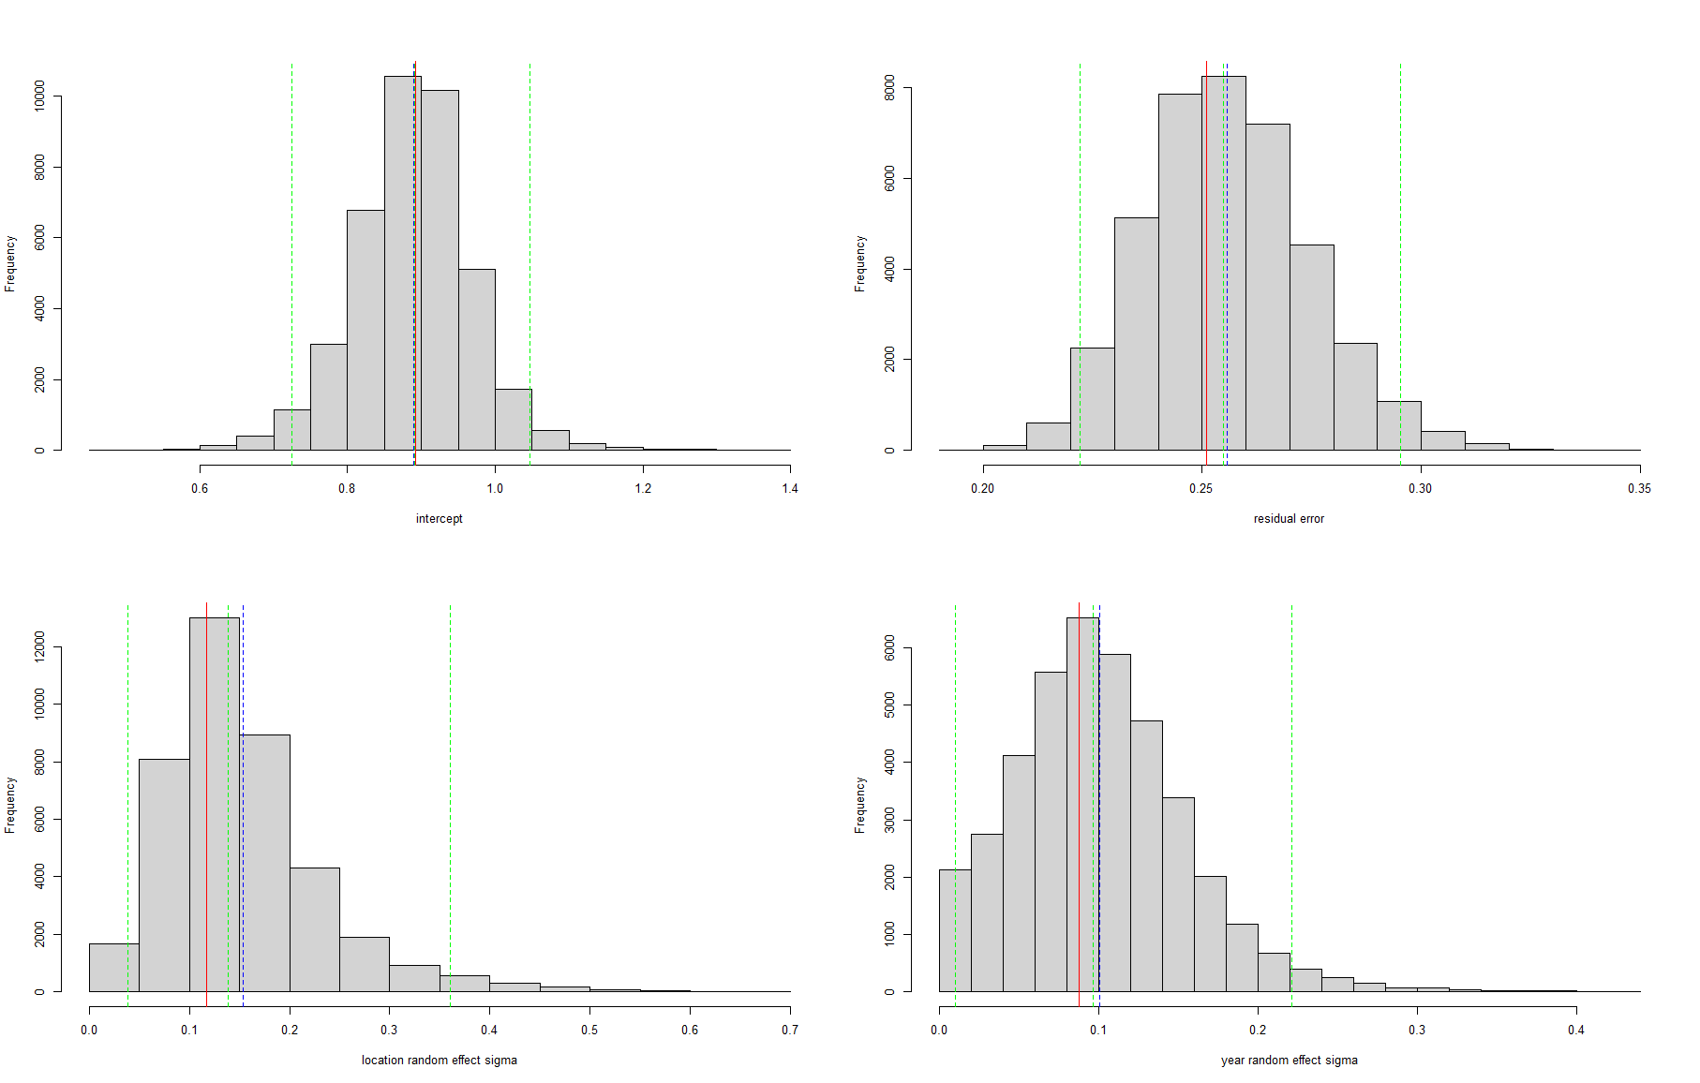
sigmal_RE ~ dunif(0, 1)
sigmay_RE ~ dunif(0, 1)
errorsd ~ dunif(0, 10)
Almost the same as previous slide: so here results seem rather insensitive to priors used

Slide 11
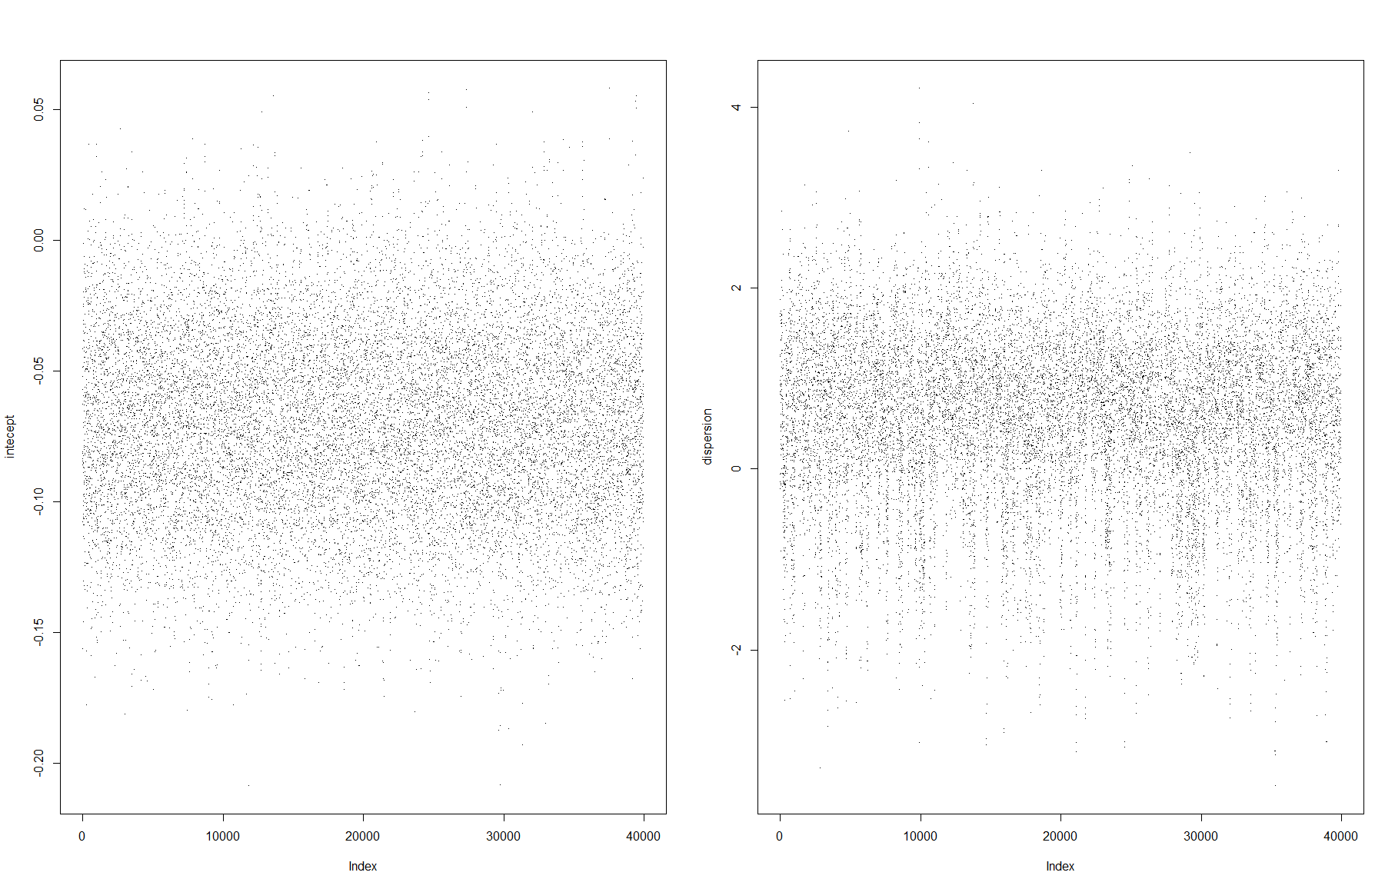
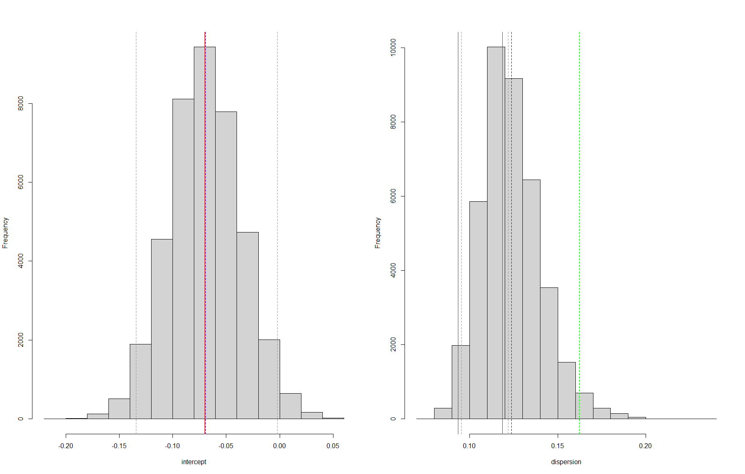
Fitting GLMinNimble.R – seems OK
Estimate via
glm
Estimate via
MASS::gamma.dispersion

Slide 12
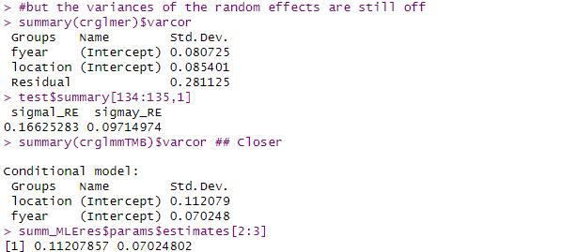
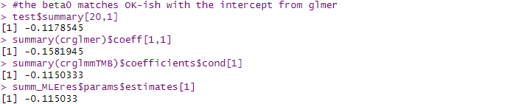
glmer
Nimble
glmmTMB
Nimble Laplace

