Slide 1

Twitter Social Circles - SNAP
Tiago Garcia - 54938, Miguel Seabra - 56344

Slide 2
Introduction
Objective: For this project, we focus to study the Twitter Social Circles dataset from the Stanford Large Network Dataset Collection (SNAP), which contains a set of ego-networks, each centered on a specific Twitter user (referred to as the "ego")
To study this we first did a literature review of the paper learning to discover social circles by J.McAuley and J.Leskovec.
Then we calculate the metrics of the dataset followed by a community detection along with a feature identification within the communities.

Slide 3
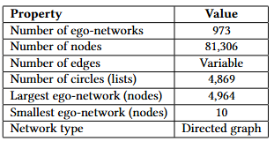
Dataset Composition
This dataset consists of 'circles' (or 'lists') from Twitter. Twitter data was crawled from public sources. The dataset includes node features (profiles), circles, and ego networks
The files with data consisted of :
Edges from all the egonets combined, twitter_combined.txt;
Twitter data with 973 networks, twitter.tar:

Slide 4
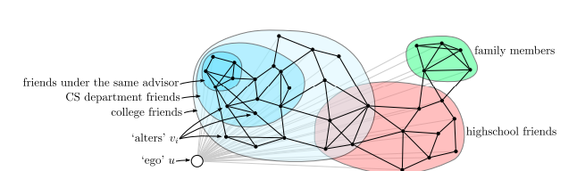
Literature Review
For this review we studied the paper Learning to Discover Social Circles in Ego Networks.
This paper addresses the challenge of automatically discovering social circles within users personal networks on social media platforms. They use an unsupervised model of discovering social circles are user-specific categories where each user organizes their network of friends independently. The purpose of the paper is to identify these circles, each being a subset of friends of a user.
Notes:
The proposed method consistently outperforms baselines across datasets, leveraging both network structure and profile data. It is particularly effective in detecting hierarchical and overlapping circles and provides interpretable insights into the social dimensions that drive the formation of circles. The method is robust to variations in data quality, as shown by its performance on partially labeled Google+ and Twitter datasets.

Slide 5
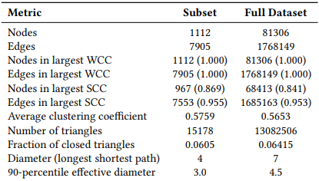
Network Analysis

Slide 6
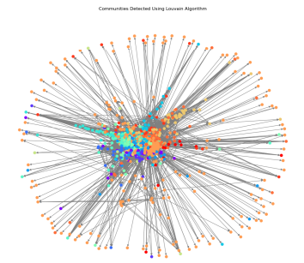
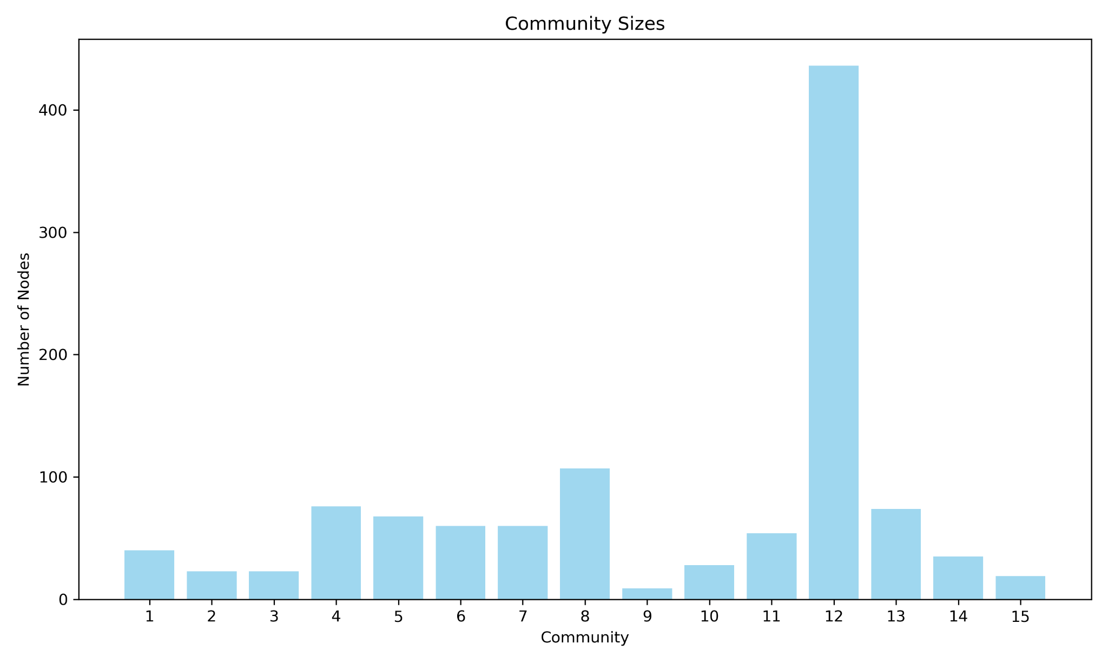
Community Detection

Slide 7
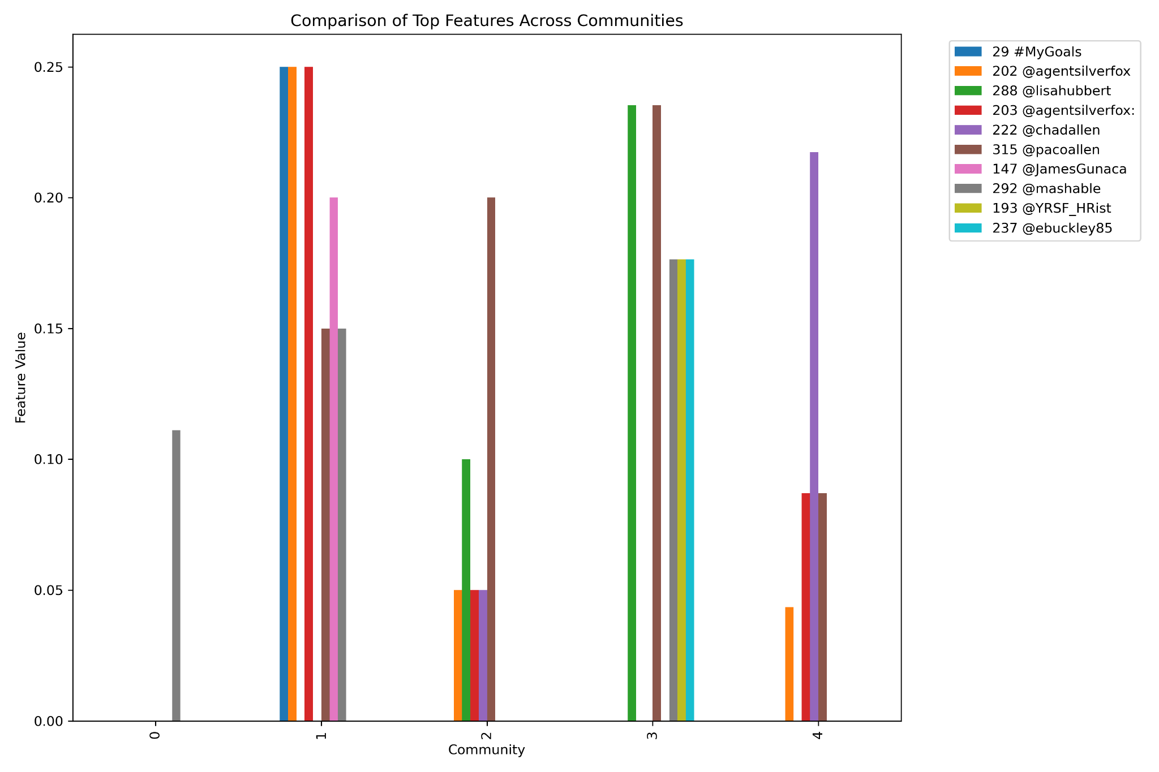
Feature Identification

Slide 8
Conclusion
The Louvain community detection algorithm revealed overlapping and hierarchical community structures within the subset. This further supports the claim from the literature that user-specific social circles can be effectively detected using this unsupervised approach, providing insights into how different user groups are organized based on common interests or behaviors

