Slide 1

RetroTune AI
The Expert Retrogaming QA Assistant
Powered by RAG & Google Search
By Tiago Borges

Slide 2



Reviving Classics, Modernized
The Challenge
Optimizing retrogaming emulators for modern displays and high frame rates is a complex process requiring intricate, hardware-specific configuration settings.
The Solution
RetroTune AI is a specialized expert that combines a curated technical knowledge database with real-time web search to deliver tailored tuning advice for your specific PC, Mac, or Console setup.

Slide 3



Technical Architecture
Core Components
Knowledge Retrieval
The system is built on LangChain, which orchestrates advanced tools, and uses GPT-3.5-turbo as the "Brain" for optimal speed and reasoning.
The user interface is a web link deployed via Gradio, ensuring a user-friendly chat experience.
ChromaDB as local Vector Store to persistently hold embeddings (generated by text-embedding-ada-002) of our curated technical dataset.
External, real-time knowledge is fetched dynamically using the Google Search API integrated via LangChain's search wrapper.

Slide 4










The Hybrid Flow Logic
1. User Query
2. Agent Decision
3. Tool Execution
"Best PCSX2 settings for Jak 2 on an i7 CPU?"
The router evaluates: Do I have this in my vector DB? Or do I need the web?
Executes RAG (Vector Search) OR Google Search, then synthesizes the final answer.

Slide 5
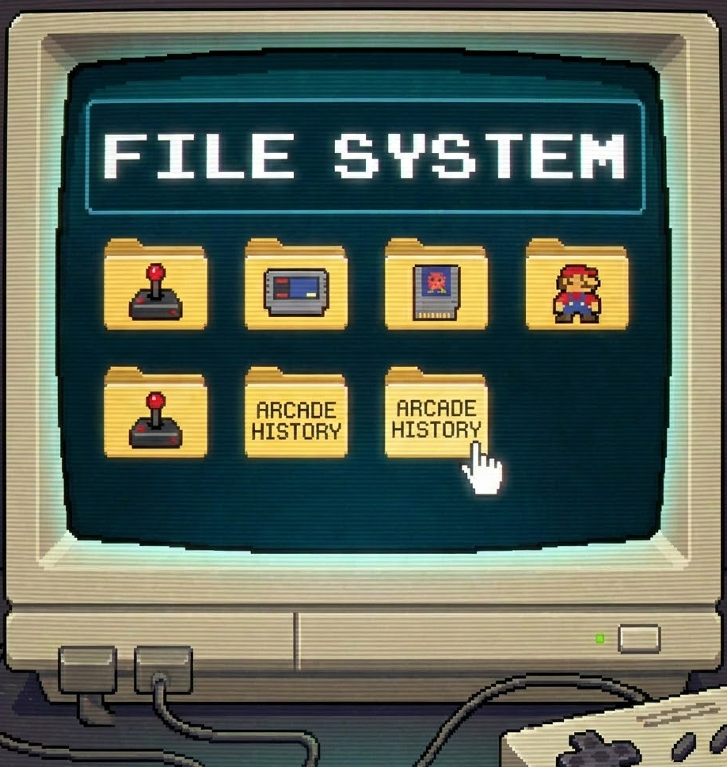
The Knowledge Base
✓
YouTube Transcripts: Using `YoutubeLoader` and `YouTubeTranscriptApi`,for content of technical guides from retro-tech channels.
✓
Official Documentation: Using `WebBaseLoader`, scraped configuration wikis for major emulators like PCSX2, Dolphin, and RetroArch.
✓
Processing: Data was cleaned and chunked using `RecursiveCharacterTextSplitter` before embedding.

Slide 6


The Agent's "Brain"
System Prompt Engineering
Memory & Context
A strictly engineered system prompt enforces a logical flow:
Type: ConversationBufferWindowMemory
•
If PC/Mac: It strictly demands hardware specs (CPU/GPU) before advising.
Window Size: k=3
This allows the agent to remember context (e.g., "I have an Nvidia 3080") across multiple turns of conversation without overloading the token limit.
•
If Console: It advises on scalers and cables (OSSC, Retrotink).

Slide 7









Tools & Integrations
Vector Search
Google Search
LangSmith
Internal Tool
External Tool
Tracing
Retrieves high-fidelity, specific configuration data from our curated ChromaDB instance.
Used as a fallback for "latest" info (2024/2025 updates) or niche games not in the vector DB.
Provides real-time visibility into agent reasoning steps, token usage, and latency.

Slide 8

Evaluation & Quality
Methodology
The evaluation process was significantly advanced beyond simple qualitative assessment by implementing an automated pipeline that utilized LangSmith and the LLM-as-a-Judge methodology (powered by GPT-3).
✓
Correctness: Validating technical accuracy against ground truth.
✓
Relevance: Measuring if the answer directly addresses the user's specific hardware.
✓
Similarity: Lexical overlap with expert human answers.

Slide 9


Ready to Play?
RetroTune AI bridges the gap between nostalgia and modern technology.
Future Work: Expanding the dataset to include handheld FPGA consoles and integrating local LLMs for offline usage.

