Slide 1
Dapper.Net
Eric marx
Tiago graf

Slide 2
Introduction
A Micro ORM (Object Relational Mapping) tool that simplifies data access while ensuring that your application is high-performance.
Dapper.NET is an Open-Source library available in NuGet.
It was created by the developers of Stack Overflow, it was started because of the N+1 and other performance issues with Entity framework.
Dapper is NOT a SQL query generator, it will map the result to POCOS (Plain Old CLR Objects) and parameters for CRUD operations.
Support for Stored Procedures, parametrized queries and transactions.

Slide 3
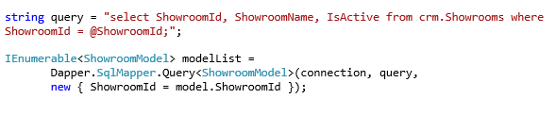
How do we use it?
You can execute a raw SQL query and map the results to a strongly typed List or a dynamic object. The query parameters could be also mapped to a typed or dynamic object.

Slide 4
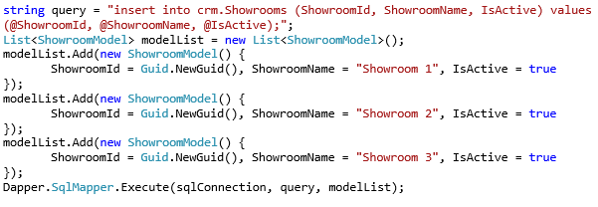
Execute a Command multiple times
The same signature also allows you to conveniently and efficiently execute a command multiple times (for example to bulk-load data)

Slide 5
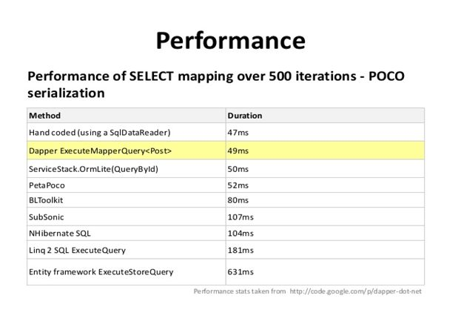
Benefits
Similar performance to a raw SqlCommand with DataReader and parsing.
No need to roll your own conversion layer for the DataReader.

Slide 6
Other features
Buffer true(default)/false
True: all the rows are read before anything is yielded.
False: you can iterate each row to avoid memory issues.
Query caching.
Dapper caches information about every query it runs, this allow it to materialize objects quickly and process parameters quickly.

Slide 7

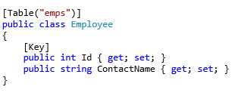
Extensions
Dapper.Contrib contains a number of helper methods for generating the queries for CRUD operations.

Slide 8
Using Dapper at Loop
Incentives Project (under development)
Integration API (In production)
442 000 operations per day

Slide 9
Dapper vs ADO vs Entity Framework
Framework | Lines of Code | AVG Perf. 1º Attempt | AVG Perf. 2º Attempt
Dapper | 52 | 70ms | 14ms
ADO.NET | 76 | 88ms | 15ms
Entity Framework | 52 | 204ms | 65ms
Test Operations for each Framework:
Run 20x
Insert one row
Select one row
Update one row

Slide 10
Q&A

