Slide 1
Titanic Data Visualization
Tiago Harari – tiago.harari@gmail.com

Slide 2
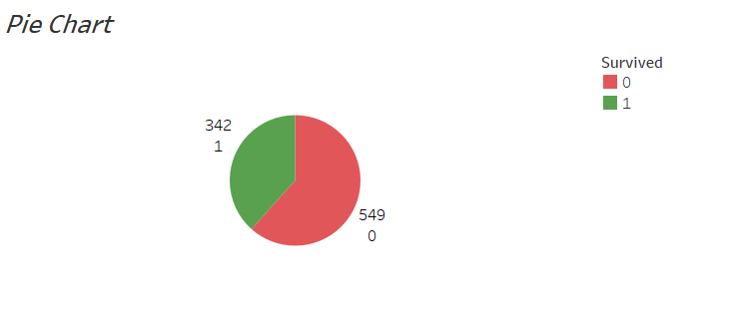

Slide 3
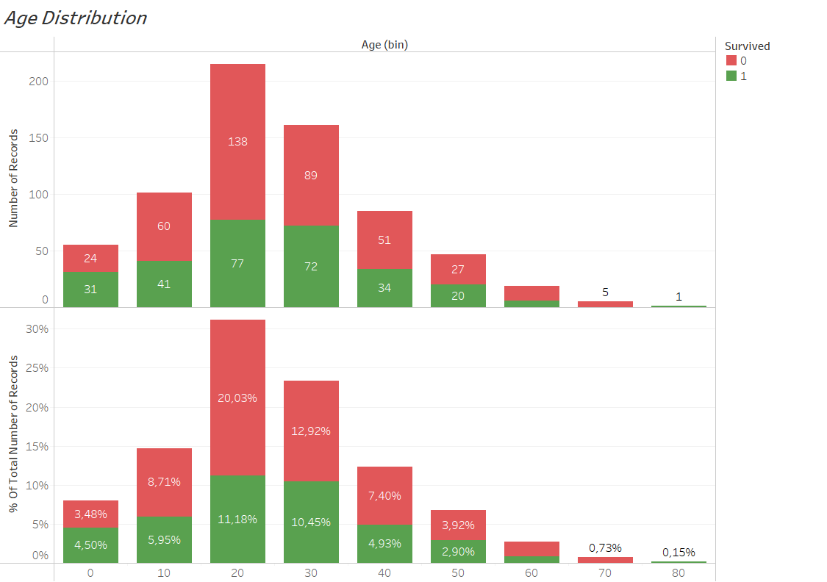

Slide 4
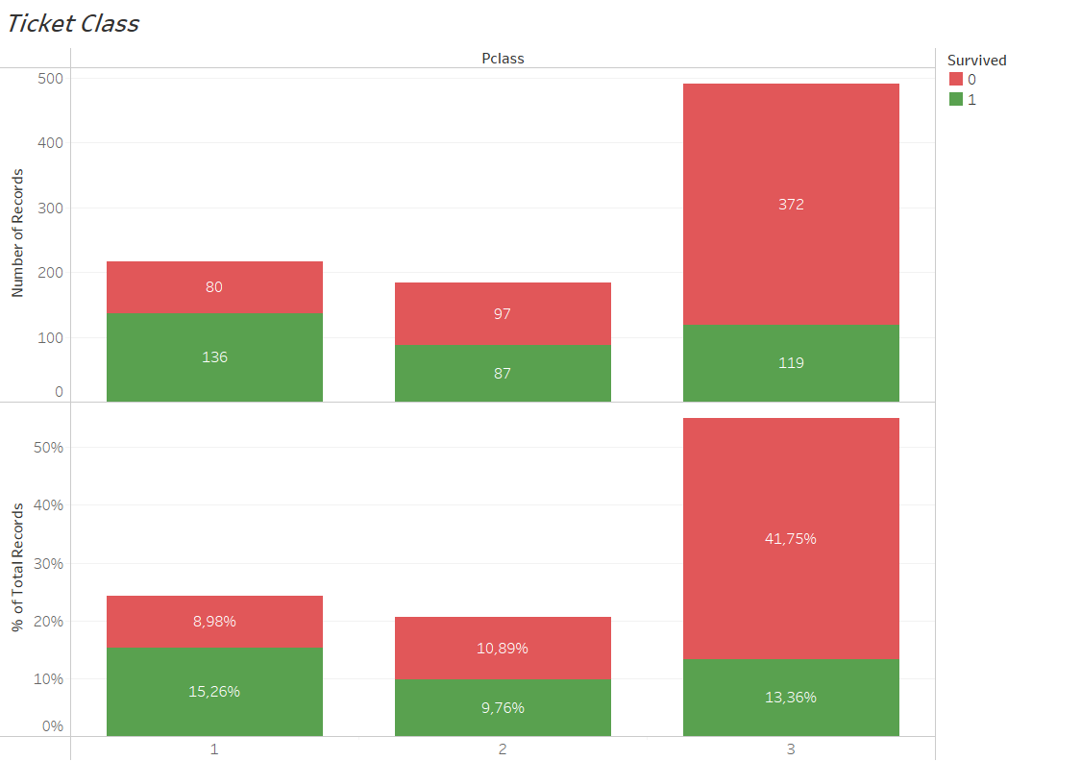

Slide 5
