Slide 1
Anonymity and Onion Routing
Network Security - First Assignment Report
Tiago Almeida - Diogo Leandro - Yves Bonneau

Slide 2
What we will talk about
What is Tor
Brief Tor history
Tor core design
Plan for assignment 2

Slide 3

What is Tor?
Tor means "The Onion Router" network
Tor provides complete anonymity for users
It is a global volunteer-operated relay network

Slide 4
Brief Tor history
Began in mid-1990s as U.S. Naval Research project
Goal was protecting online communication against traffic analysis
Concept of onion routing was introduced in a 1996 paper
First public version of Tor released in 2002 by key researchers
Tor Project became a nonprofit organization in 2006

Slide 5
Tor core design
There are alot of components that make Tor what it is.
Onion Proxy and Onion Router
Relay and Control Cells
Circuits and Streams
Directory Servers
Hidden Services

Slide 6
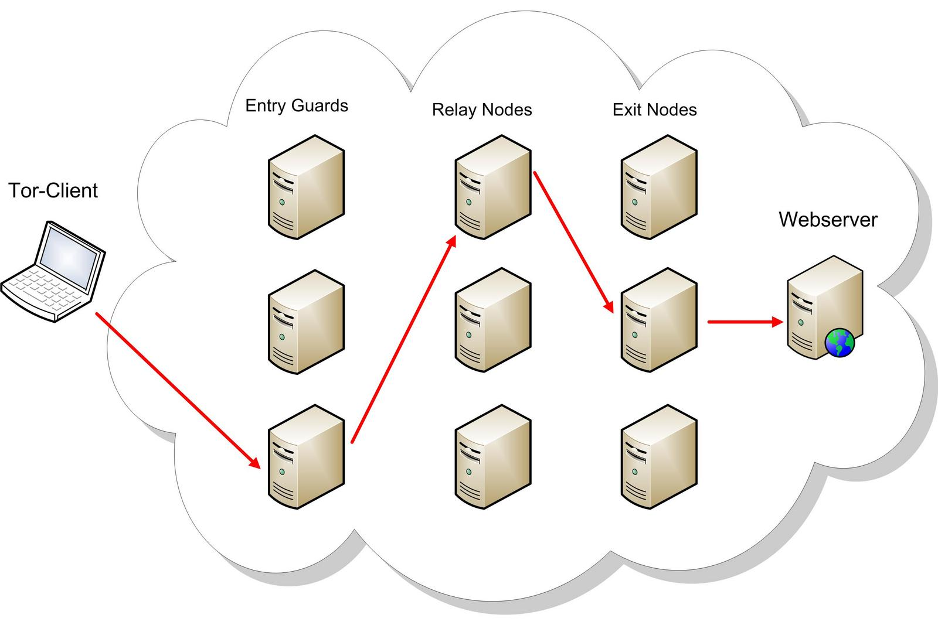
Tor core design
Onion Proxy and Onion Router
The Onion Proxy is the client-side Tor software that users run to connect to the network.
The Onion Router, also called a relay or node, is a volunteer-operated server responsible for forwarding Tor traffic.

Slide 7
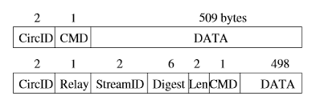
Tor core design
Relay and Control Cells
Control Cells
Used to communicate with nodes
In Tor communication, two types of cells are exchanged, each with a fixed size of 512 bytes.
Relay Cells
Used to exchange data with the destination

Slide 8
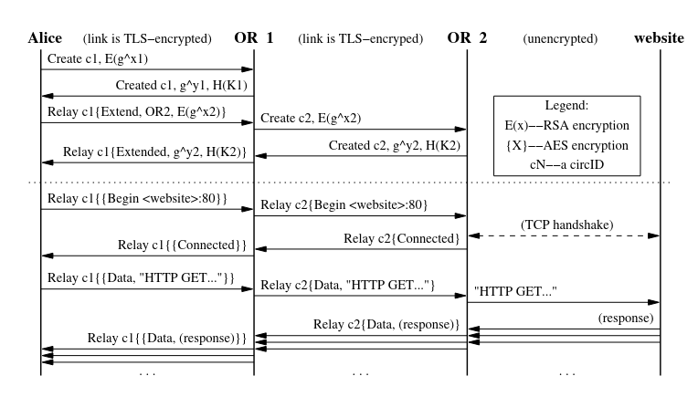
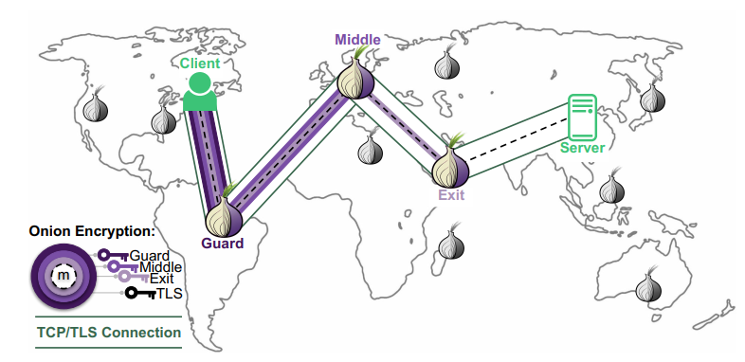
Tor core design
Circuits and Streams
A circuit consists of an encrypted path over 3 relays:
Entry Relay - Middle Relay - Exit Relay
Nodes only know their neighbours
A stream is a data flow over a circuit
One circuit can have multiple streams

Slide 9
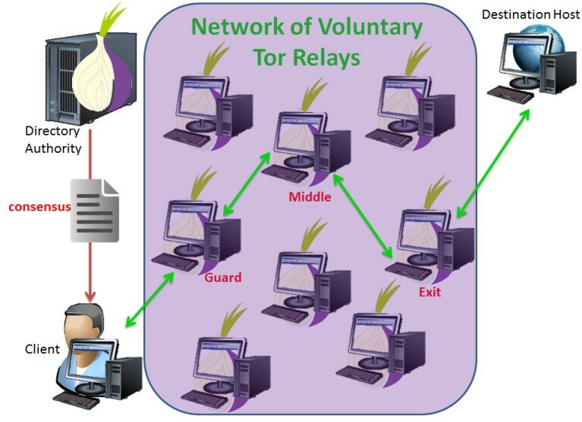
Tor core design
Directory Servers
Directory Servers are long term members and trusted entities who maintain a list of all available and reliable Onion Routers
Clients download a consensus document to know what are the available Relay Nodes
Ensures network safety, integrity and organization

Slide 10
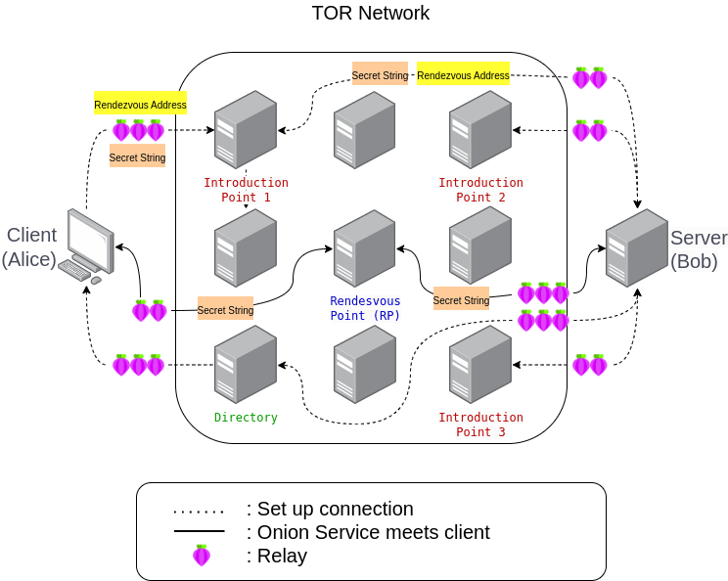
Tor core design
Hidden Services
Allow for servers to stay anonymous
The hidden service uses multiple nodes to advertise it self. These nodes are called Introduction Points
Both client and server connect through Tor circuits
The node where the Client and Server connect is called Rendezvous Point
Used for services who require privacy

Slide 11
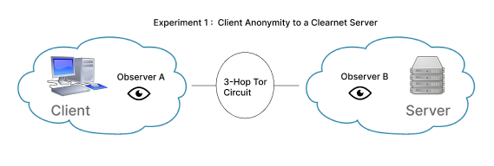
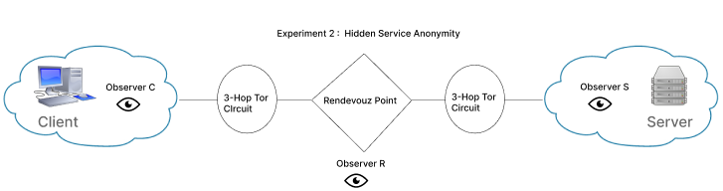
Plan For Assignment 2
Experiment 1: Client Anonymity to a Clearnet Server
- 1 Client - 1 Clearnet Server - 2 Observers
Experiment 2: Hidden Service Anonymity
- 1 Client - 1 Hidden Server - 3 Observers

Slide 12


