Slide 1

Lab02
Distributed SysTEM

Slide 2
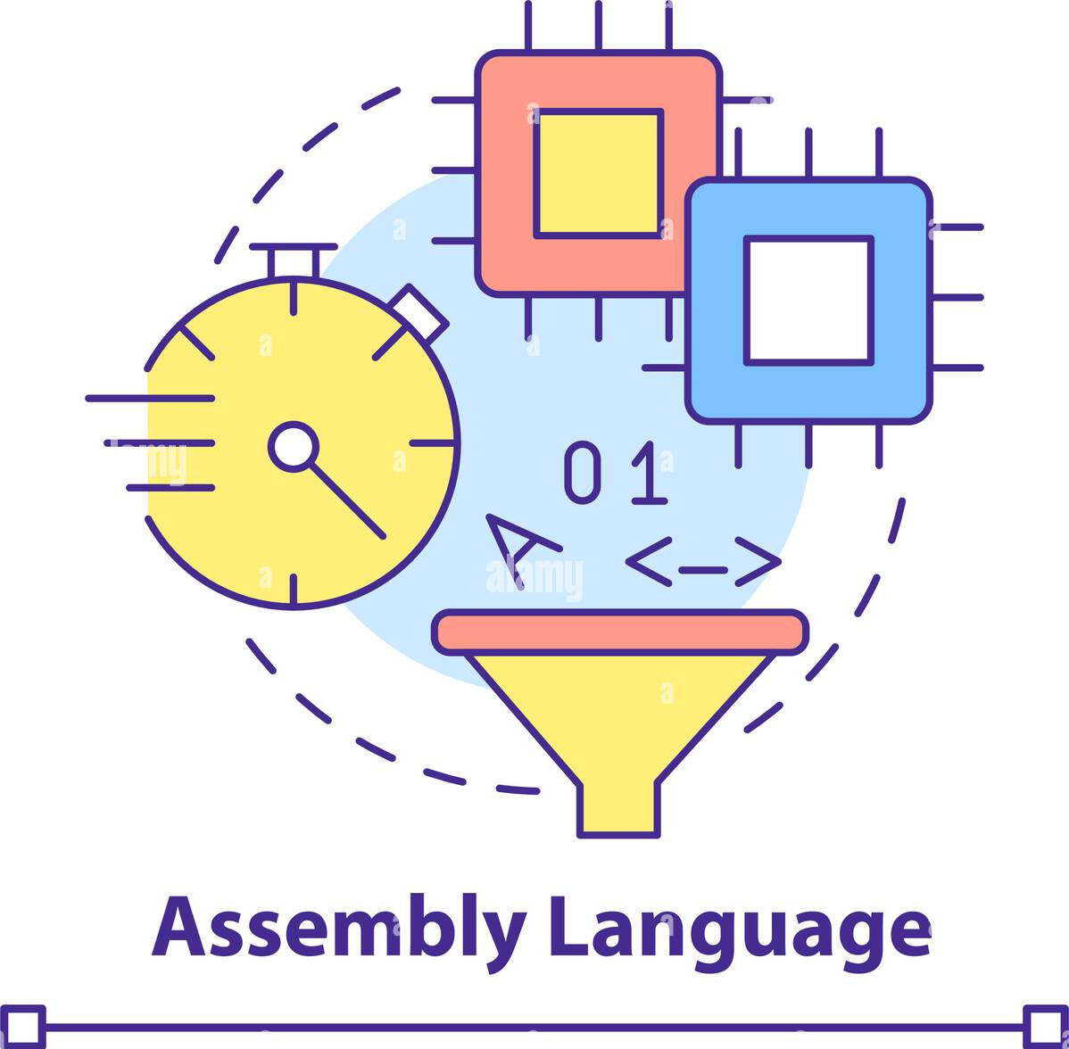
Assembly Code
Assembly language is a low-level programming language that directly corresponds to a computer’s machine code. It allows precise control over hardware, making it useful for system programming, embedded systems, and performance-critical applications.

Slide 3
What is Assembly Code?
Human-readable version of machine code.
01
Each instruction translates to one machine instruction.
02
Written using mnemonics (e.g., MOV, ADD, SUB).
03
Architecture-dependent (x86, ARM, RISC-V, etc.).
04

Slide 4
Basic Components
Instructions – Commands executed by the CPU (e.g., MOV, ADD).
Registers – Small storage inside CPU (AX, BX, CX, DX in x86).
Memory Access – Load/store values from RAM.
Flags – Status indicators for operations (ZF, CF, OF).

Slide 5
Example of Code
section .data ; Data section msg db "Hello, World!", 0 ; Define a string section .text global _start ; Entry point _start: mov eax, 4 ; syscall: sys_write mov ebx, 1 ; file descriptor: stdout mov ecx, msg ; message address mov edx, 13 ; message length int 0x80 ; call kernel mov eax, 1 ; syscall: sys_exit xor ebx, ebx ; return 0 int 0x80 ; call kernel

Slide 6
Change the message to “Hello IMS”
Easy!
Assembly Online Compiler & Emulator

Slide 7
Print two things in separate lines
Let us see!
Assembly Online Compiler & Emulator

Slide 8
section .data hello: db 'Hello, World!',10 ; 'Hello, World!' plus a linefeed character helloLen: equ $-hello ; Length of the 'Hello world!' string message: db 'I am at school!',10 messageLen: equ $-message ; Length of the second string section .text global _start _start: mov eax,4 ; The system call for write (sys_write) mov ebx,1 ; File descriptor 1 - standard output mov ecx,hello ; Put the offset of hello in ecx mov edx,helloLen ; helloLen is a constant, so we don't need to say ; mov edx,[helloLen] to get it's actual value int 80h ; Call the kernel mov eax,4 ; The system call for write (sys_write) mov ebx,1 ; File descriptor 1 - standard output mov ecx,message ; Put the offset of message in ecx mov edx,messageLen ; helloLen is a constant, so we don't need to say ; mov edx,[helloLen] to get it's actual value int 80h ; Call the kernel mov eax,1 ; The system call for exit (sys_exit) mov ebx,0 ; Exit with return "code" of 0 (no error) int 80h;

Slide 9
Registers
Register | Purpose
EAX | Accumulator (math, I/O)
EBX | Base register
ECX | Counter (loops)
EDX | Data register
ESI | Source index (string operations)
EDI | Destination index
ESP | Stack pointer
EBP | Base pointer

Slide 10
Basic Operations
MOV EAX, 5 ; Load 5 into EAX MOV EBX, EAX ; Copy EAX to EBX
ADD EAX, EBX ; EAX = EAX + EBX SUB EAX, 2 ; EAX = EAX - 2 MUL EBX ; EAX = EAX * EBX DIV EBX ; EAX = EAX / EBX, remainder in EDX

Slide 11
Logic Operators
AND EAX, EBX ; Bitwise AND OR EAX, EBX ; Bitwise OR XOR EAX, EBX ; Bitwise XOR NOT EAX ; Bitwise NOT

Slide 12
Doing a comparison
section .data x dd 10 ; x = 10 y dd 5 ; y = 5 section .text global _start _start: ; Load values into registers mov eax, [x] ; Load x into EAX mov ebx, [y] ; Load y into EBX ; Compare x and y cmp eax, ebx ; Compare EAX with EBX jle not_greater ; Jump if x <= y (less or equal)
; Code executed if x > y ; (this is where you would place your action) mov ecx, 1 ; Example action: set ECX = 1 not_greater: ; Exit mov eax, 1 ; syscall: exit xor ebx, ebx ; status 0 int 0x80 ; call kernel

Slide 13
Let us see some operations in Disk and Memory
Let us open the notebooks
Ufa!!

