Slide 1
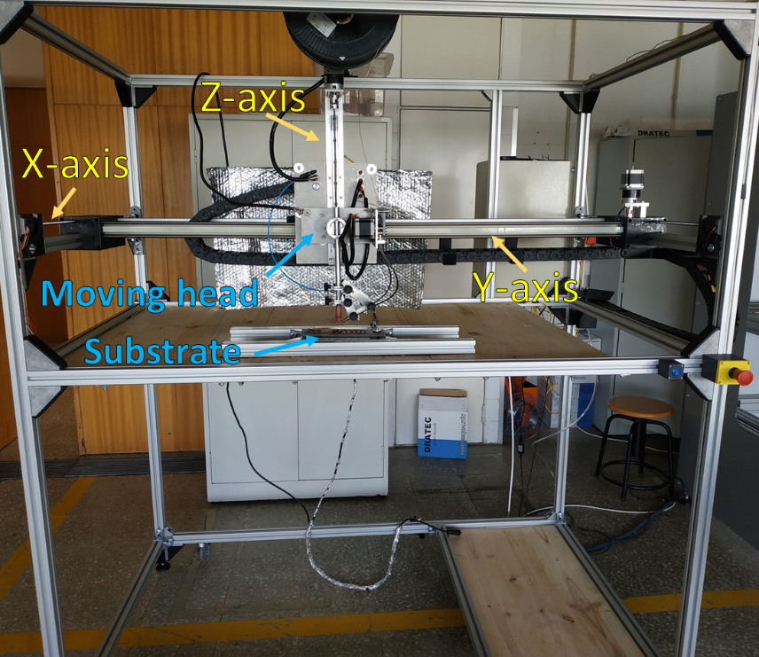
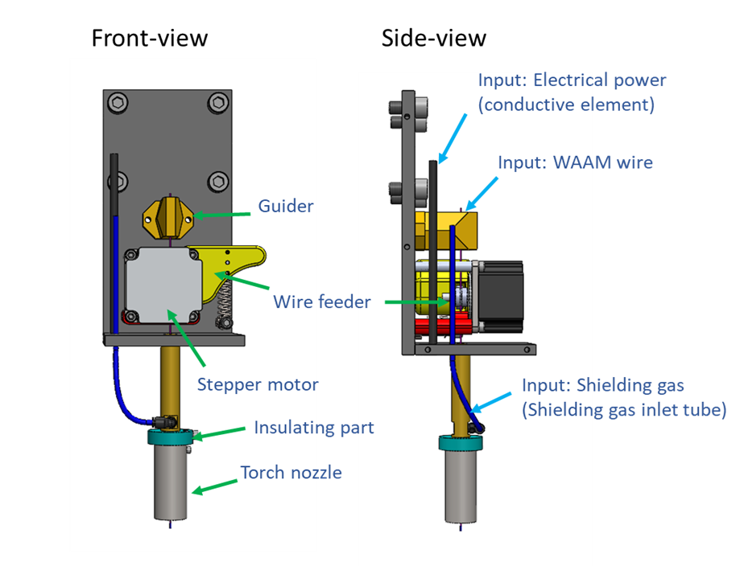
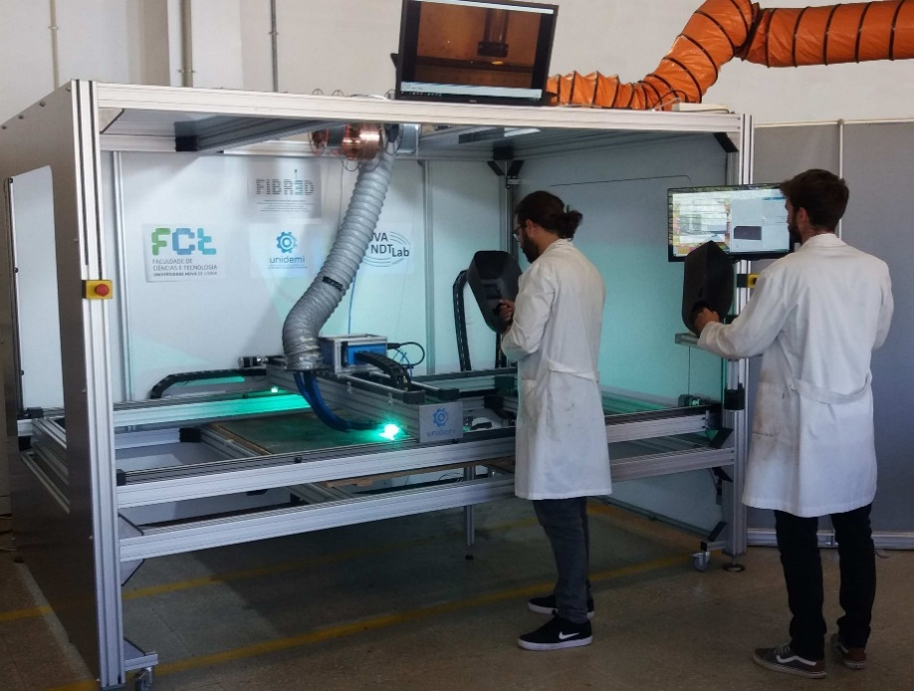
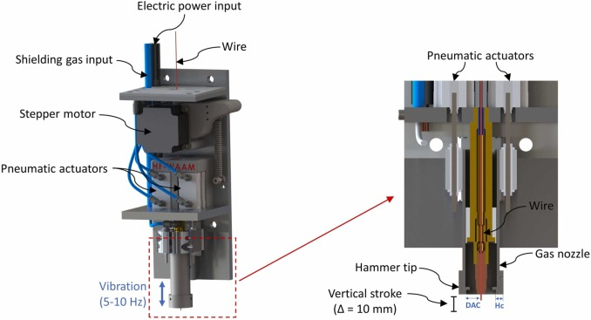
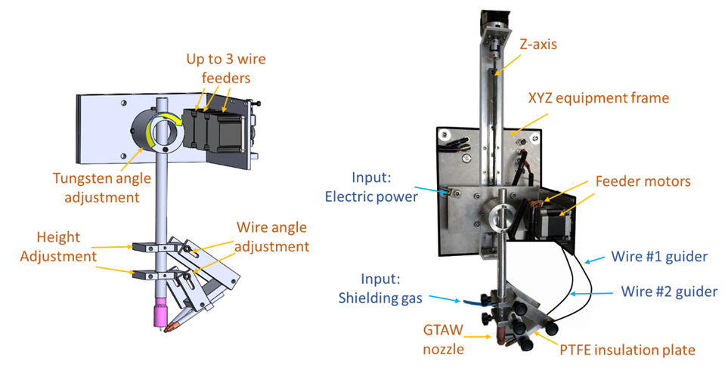
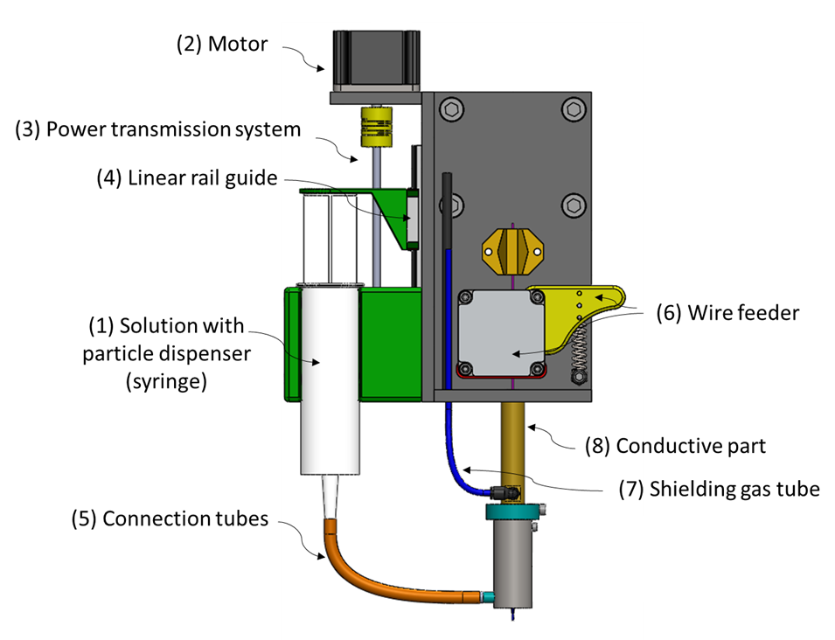
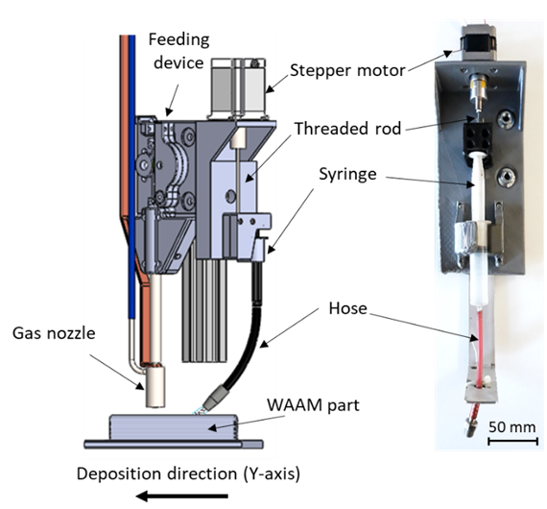
Prototypes
2x XYZ Positioning systems
GMAW-based torch for Wire And Arc Additive Manufacturing
Hot Forging WAAM (patent nr: EP3990207A1)
GTAW-based torch for Wire And Arc Additive Manufacturing
Devices for particle addition during WAAM

