Slide 1


Slide 2
FADO
A Reaction Controller for Fairness-Aware
Online Learning Under Concept Drift
Tiago Silva
CISUC · Data-Centric AI Lab
Department of Informatics Engineering, University of Coimbra

Slide 3
FADO: A Reaction Controller for Fairness-
Aware Online Learning Under Concept Drift
Outline
01/20
Outline
1. Motivation & Problem
2. FADO: Base Learner
3. Intersectional Fairness
4. The Reaction Controller
5. Experimental Design
6. Results
7. Takeaways & Next Steps

Slide 4
1. Motivation & Problem

Slide 5
FADO: A Reaction Controller for Fairness-
Aware Online Learning Under Concept Drift
1.Motivation & Problem
03/20
Concept drift degrades fairness, not only accuracy
Fairness-aware learners are trained assuming a stationary distribution.
Real streams drift: P(y | x) and base rates move with policy, behavioural and economic change.
Drift breaks the statistical relationships fairness rests on — so bias can grow while accuracy looks stable.
RQ1
To what extent does drift affect group-fairness metrics online?
RQ2
Can adaptive detection & response preserve fairness while keeping performance?
Notes:
Drift is usually studied as an accuracy problem; my premise is that it's also a fairness problem. RQ1 measures the effect, RQ2 asks whether adaptation fixes it.

Slide 6
FADO: A Reaction Controller for Fairness-
Aware Online Learning Under Concept Drift
1.Motivation & Problem
04/20
Keep the in-processing fairness; add the drift machinery
In-processing fair
Drift-adaptive
Drift-aware fair
e.g. Aranyani, RFR
e.g. ARF
prior attempts
Fair during training
No drift detection
Regulariser is static
Detect & react to shift
Accuracy-driven only
No fairness mechanism
Shift as fixed perturbation
Worst-case, not streaming
No online controller
FADO = retain Aranyani's node-level fairness regulariser, then wrap it in an online detector + reaction controller.
Aranyani is inherited, not contributed — the novelty is the drift-detection-and-response layer.
Notes:
Three prior families each solve half the problem. Rather than build a new learner, I keep an in-processing fair learner and add the missing adaptive layer. Aranyani is not my contribution — say that explicitly.

Slide 7
2. FADO: Base Learner

Slide 8
FADO: A Reaction Controller for Fairness-
Aware Online Learning Under Concept Drift
2.FADO: Base Learner
06/20
Why a soft-routed oblique forest
Oblique nodes split on a linear combination of features (an angled hyperplane) — far more expressive per node than axis-aligned splits.
A temperature-scaled sigmoid makes routing soft and differentiable, so the whole forest trains by gradient descent, online — and each node acts as a per-step prediction, letting fairness be imposed at every node.
nj(x) = σ( (wjᵀx + bj) / τ ) ∈ (0, 1)
f(x) = (1/K) Σk softmax( fk(x) )
Parameter isolation → cheap per-step gradient · O(W) streaming memory · temperature τ is the controller's lever (τ=1 smooth learning; τ→0 decisive recovery).
Notes:
Oblique gives expressive splits; soft routing makes it differentiable; each node is a probabilistic prediction so DP applies node-wise. Parameter isolation keeps it cheap and memoryless. Critically, τ is exactly the knob the controller sharpens on drift.

Slide 9
FADO: A Reaction Controller for Fairness-
Aware Online Learning Under Concept Drift
2.FADO: Base Learner
07/20
A per-node DP gap, smoothed by a Huber surrogate
At each routing node, compare the group-conditional mean routing to the cross-group mean — the per-node analogue of the demographic-parity gap — and sum the penalty over every node in every tree.
Fa = n̄ − n̄a
ℒ = ℒCE + λ Σnodes (1/K) Σa φδ( Fa )
φδ′(z) = z if |z| < δ , sign(z) if |z| ≥ δ
Quadratic near 0 (smooth gradient) · linear tail (bounded outlier influence) · unit-slope tail → firmer correction past δ. DP defined as deviation-from-mean to match the regulariser exactly.
Notes:
Per-node DP gap, Huber-smoothed: quadratic near zero for a clean gradient, linear tail so outliers don't dominate, but unit slope for a firmer correction past delta. DP is defined to match what the regulariser optimises.

Slide 10
3. Intersectional Fairness

Slide 11
FADO: A Reaction Controller for Fairness-
Aware Online Learning Under Concept Drift
3.Intersectional Fairness
09/20
Marginal parity is provably gameable
Four joint cells
Enforcing parity on each attribute separately is defeatable (Kearns et al., 2018): a model can be perfectly fair on sex and on race, yet badly unfair on a joint subgroup — fairness gerrymandering.
FADO optimises parity over the Cartesian-product subgroups. The regulariser already supports arbitrary K ≥ 2 — the learner needed no change.
a1=0, a2=0
a1=0, a2=1
a1=1, a2=0
a1=1, a2=1
a = 2·a1 + a2 ∈ { 0, 1, 2, 3 }
One 4-valued composite index replaces two binary axes.
Notes:
The main new work this cycle. Marginal-only fairness is a known loophole; collapsing two binary attributes into a four-valued composite closes it, and because the node regulariser is written for arbitrary K, no learner code changed — only the group index in the loaders.

Slide 12
4. The Reaction Controller

Slide 13
FADO: A Reaction Controller for Fairness-
Aware Online Learning Under Concept Drift
4.The Reaction Controller
11/20
Two detectors, three phases, one temperature
WARN
CONFIRM
RECOVER
pre-warm
spike + sharpen
anneal back
Sensitive D_w trips
LR × β_w (=5)
arm — don't commit
Strict D_c confirms
LR × β_c (=10)
τ → τ_drift = 0.1
reset detectors
η → η₀ over Δ
τ → 1
cooldown C = 200
εcut = √( (1/2m) · ln(4/δ) )
δ calibrated to stream length (ε ∝ 1/√m). Label-noise guard (ν=0.7) excludes confident-but-wrong points, so noise can't fire the controller.
Notes:
Two ADWIN detectors on the error stream — sensitive pre-warm, strict confirmation. Warn raises LR; confirm spikes LR and sharpens temperature; recover anneals both back. ADWIN's bound scales with stream length, which is why the deltas differ between the long Folktables and short COMPAS streams. The label-noise guard prevents thrashing. This is also the part I most want to ablate.

Slide 14
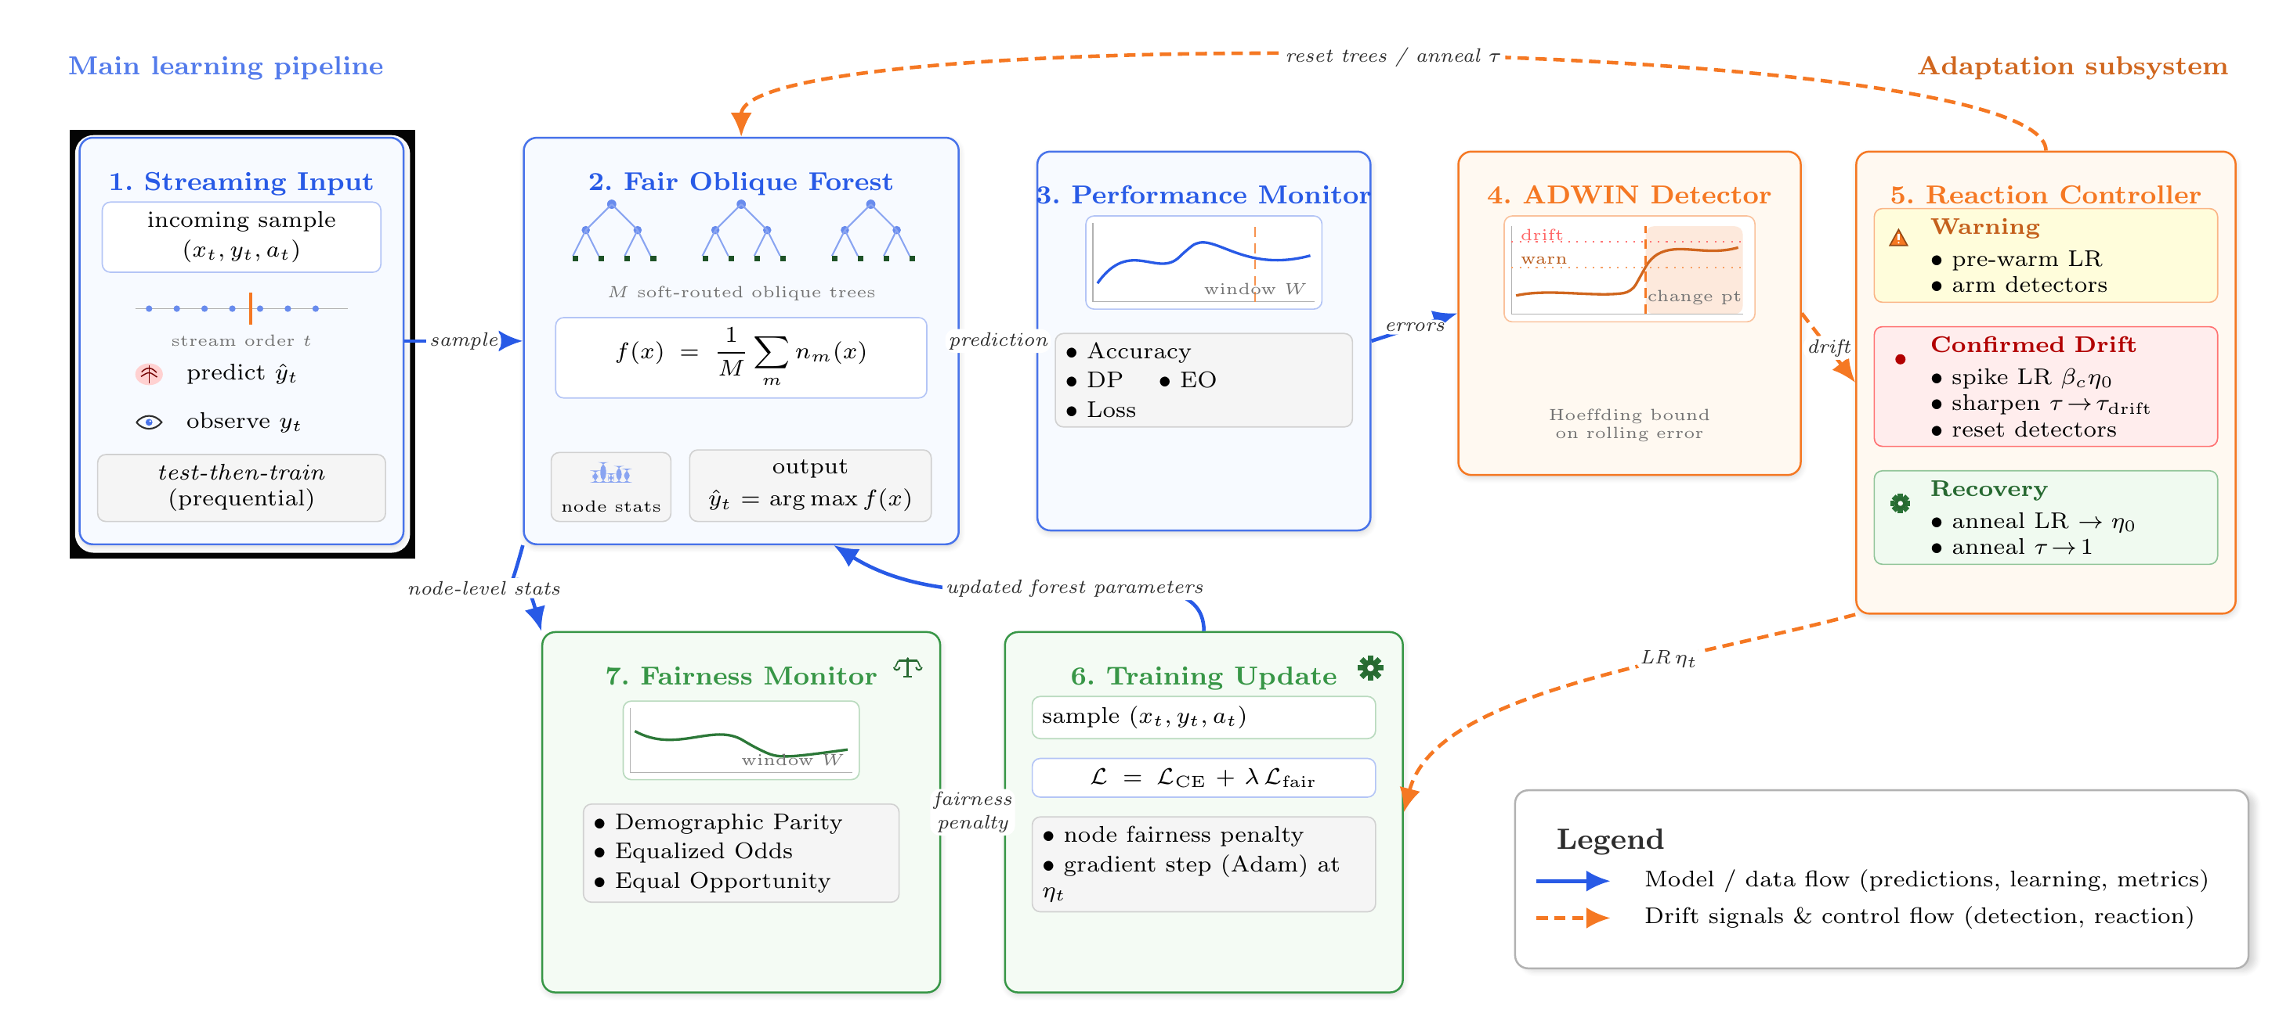
FADO: A Reaction Controller for Fairness-
Aware Online Learning Under Concept Drift
4.The Reaction Controller
12/20
The prequential loop
Blue = data flow through the fair forest. Orange = drift signals & control flow: detector → controller → retuned gradient step.
Notes:
Test-then-train per sample. Blue path is the forest; orange path is the detector firing the controller, which modulates the learning rate and temperature into the gradient step.

Slide 15
5. Experimental Design

Slide 16
FADO: A Reaction Controller for Fairness-
Aware Online Learning Under Concept Drift
5.Experimental Design
14/20
Two complementary drift regimes
Folktables — natural, gradual
COMPAS — synthetic, abrupt
Protocol
ACS Income (CA), ~187k rows
Real cross-year shift
2015 train → 2017–18 stream
Group = sex × race (joint)
7.2k rows, controlled testbed
Symmetric race swap +
Bernoulli(0.5) label flip
no_drift vs abrupt_race
Prequential test-then-train
Batch 1 · 30 pinned seeds
Paired Wilcoxon + Holm
Welch t-test cross-check
Baselines (held fixed): ARF (adaptive, unfair), RFR (fair, static), and a controller-free Aranyani ablation sharing learner, loss, window and seed-pinned data order — so any FADO–Aranyani gap is the controller alone.
Notes:
Two regimes on purpose: a real but gradual Folktables shift, and a short sharp synthetic COMPAS shift with known ground truth. The controller-free ablation isolates the controller's effect.

Slide 17
6. Results

Slide 18
FADO: A Reaction Controller for Fairness-
Aware Online Learning Under Concept Drift
6.Results
16/20
Marginal DP/EO — drift erodes fairness; controller helps on abrupt shift
Dataset
Model
Acc ↑
DP ↓
EO ↓
Reading the table
Folktables
FADO
0.8033
0.0284**
0.0281
RQ1. Both external baselines carry ~2× FADO's DP on both regimes (all p<0.001).
Regime-dependent. On abrupt COMPAS the controller cuts DP 0.68pp and EO 0.56pp (both p<0.001).
On gradual Folktables it ties the base learner — a smooth shift needs no spike.
Aranyani
0.8053
0.0299
0.0257
ARF
0.7447
0.0722
0.0743
RFR
0.7780
0.0733
0.0586
COMPAS
FADO
0.6434
0.0611***
0.0923***
Aranyani
0.6451
0.0679
0.0979
ARF
0.6313
0.0808
0.1053
RFR
0.6404
0.0813
0.1067
Bold = best per metric within dataset; ** p<0.01, *** p<0.001 (Wilcoxon, Holm) vs every baseline; EO monitored, not optimised.
Notes:
Submitted single-attribute result. RQ1: both ARF and RFR carry roughly double FADO's DP on both datasets. And the controller is regime-dependent: clear gain on abrupt COMPAS, a tie on gradual Folktables. Saying the tie out loud builds credibility.

Slide 19
FADO: A Reaction Controller for Fairness-
Aware Online Learning Under Concept Drift
6.Results
17/20
Intersectional grouping surfaces the controller's contribution
Model
Acc ↑
DP ↓
DP sex ↓
DP race ↓
The controller now measurably wins
FADO
0.7979
0.0688
0.0234
0.0243
vs the controller-free forest: DP −0.38pp, significant under both Wilcoxon (p<0.001) and Welch (p<0.01) — where the marginal view was only a tie.
Aranyani
0.8005
0.0727
0.0283
0.0294
ARF
0.7446
0.1497
0.0735
0.0620
RFR
0.7779
0.1427
0.0724
0.0591
Gerrymandering, confirmed
DP = joint violation over the four cells (optimised); DP sex / DP race = marginal diagnostics. Bold = best mean.
Intersectional-to-worst-marginal DP ratio ≈ 2.8 (FADO), 2.5 (Aranyani), ~2.0 (ARF/RFR): the fairest learners hide the largest joint gap.
Notes:
The new result. Under the joint objective the controller's edge over the controller-free forest becomes significant under both tests, where the marginal view only saw a tie. It's a small gap (0.38pp) but consistent and now measurable. And the gerrymandering ratio shows fair learners concentrate residual unfairness in the joint cells marginal metrics miss.

Slide 20
7. Takeaways & Next Steps

Slide 21
FADO: A Reaction Controller for Fairness-
Aware Online Learning Under Concept Drift
7.Takeaways & Next Steps
19/20
What we learned — and what's next
Takeaways
Next
RQ1. Drift is a fairness problem — it inflates the DP of accuracy-only and static-fair baselines alike.
RQ2. An adaptive fair learner keeps both utility and fairness; the controller earns its keep on abrupt shift.
Design. The fairness objective must match the harm: node-level DP + a joint group index makes the penalty cheap and the controller's gain measurable.
Controller ablation — isolate each phase; the most targetable point.
Optimise EO directly (wire the existing EO regulariser into the gradient).
Finish the COMPAS intersectional sweep and re-verify gerrymandering.
Notes:
Three takeaways mapped to the questions and the design lesson. The next priority I want to defend is a full controller ablation — the weakest, most attackable part and the biggest lever for a stronger resubmission.

Slide 22
Fairness that adapts
A drift-aware controller keeps an intersectionally-fair oblique forest fair as the distribution moves.
Thank you — questions & discussion
Tiago Silva · CISUC Data-Centric AI Lab · FADO (submitted to ICDM 2026)

