Slide 1
MEDBRA AI LABS - AMD HACKATHON ACT II
MedBra Hybrid Router
An AI orchestration platform for Portuguese-speaking healthcare -
routing medical conversations between local and cloud LLMs.
Gemma on AMD
Fireworks
Live telemedicine startup
medbra.tech
github.com/Tiagogee/medbra-hybrid-router

Slide 2
THE PROBLEM
Getting sick abroad is a financial trap
A simple US urgent-care visit costs $500-$2,000. So 4.5M+ Brazilians abroad postpone care, self-diagnose, and suffer through symptoms in a language they do not fully master.
$1,847
a real ER bill for a sore throat

Slide 3
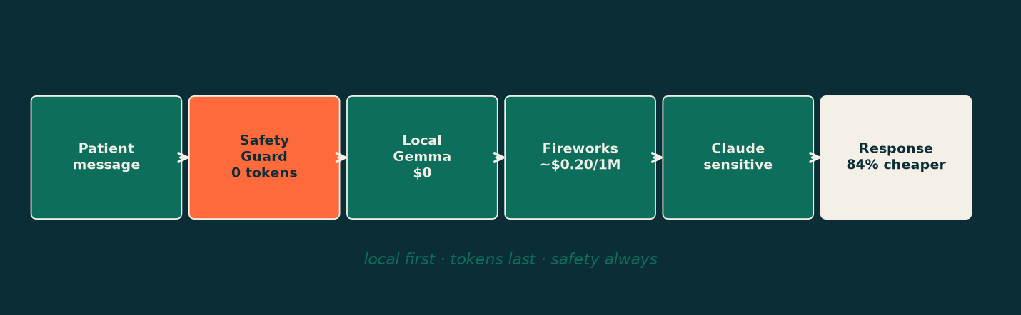
THE SOLUTION
$39 doctor, in Portuguese - powered by smart routing
MedBra is a live telemedicine service. Its brain is the Hybrid Router: every message goes to the cheapest model that is still accurate enough - and safety never touches a paid model.

Slide 4
HOW IT WORKS
Local first - tokens last - safety always
0
Medical Safety Guard - deterministic, 0 tokens. Emergency -> 911 + human. Prescription ask -> safe refusal.
1
Local Gemma on the AMD GPU pod - $0.
2
Fireworks (Gemma-2 / Llama, AMD-hosted) - a 1-token judge decides if it is confident enough.
3
Claude - only for complex + sensitive health.

Slide 5
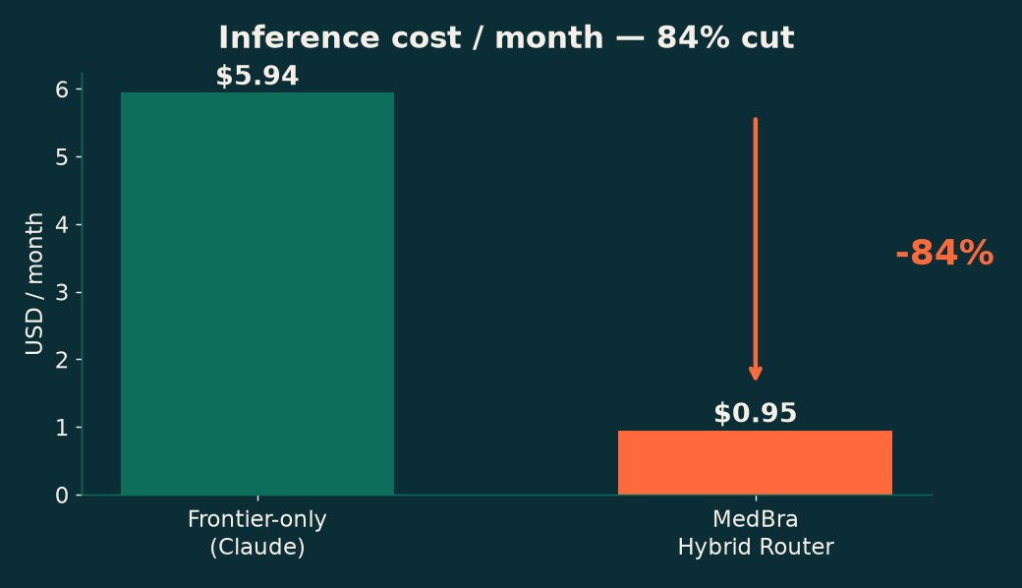
IMPACT
84% cheaper - safety intact
15% of messages stay on the top tier on purpose. We optimize FAQs, never clinical judgment.
-84%
0
cost / msg
tokens on emergencies

Slide 6
PROOF - REAL INFERENCE, TODAY
Not a mock: local Gemma-class model, $0, 3/3 correct
qwen2.5 (local, AMD-pod-compatible)
MedBra lead-intent classification - 3/3 correct - ~2.4s warm - $0.00 marginal
vs Claude same task: ~200 tokens @ ~$0.002/msg.
The local tier handles classification at zero marginal cost - proven on real hardware, ready for the AMD pod.

Slide 7
MARKET
4.5M Brazilians abroad - and every diaspora after
2M+
$39
$0
Brazilians in the US (beachhead)
per consult - ~$29 margin
marginal cost to 150 lives
Same core -> per-country modules: Portugal, Canada, UK, Spain. The router makes each new market cheap to serve.

Slide 8
TRACTION
Not a demo - a running company
OK
Live pay-first pipeline: Stripe -> activation -> doctor on screen in <30 min (real $39 charges settled)
OK
Official WhatsApp Cloud API + Chatwoot attendant (Bia)
OK
Cinematic content engine, brand, CRM, automations (n8n)
>>
Hybrid Router = the v2 brain of Bia

Slide 9
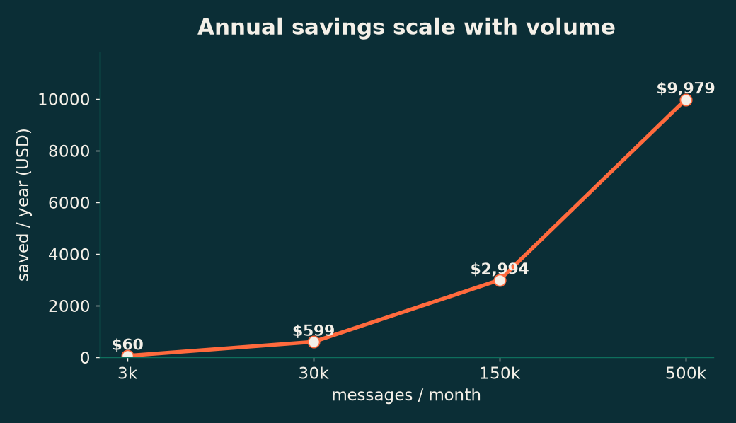
WHY IT SCALES
Cost stays flat while volume explodes
~$10k/yr saved at 500k msgs/mo - margin that compounds as we add countries.

Slide 10
THE VISION
An operating system for Portuguese-speaking healthcare
The patrimony is not the AI - it is the system that uses any AI in the best way. Model-agnostic by design: survives Claude 6, GPT-6, Gemini Ultra.
"Onde tiver um brasileiro, tem um medico brasileiro."
MedBra AI Labs - Tiago (CEO) + Axis (AI CTO)
Criciuma -> Orlando -> the world

