Slide 1
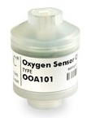
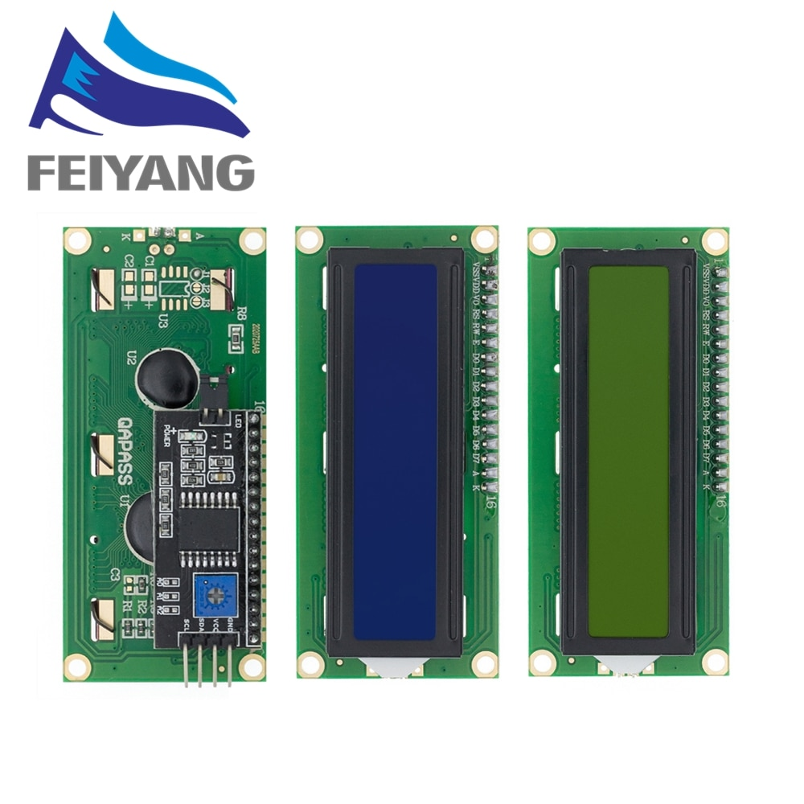
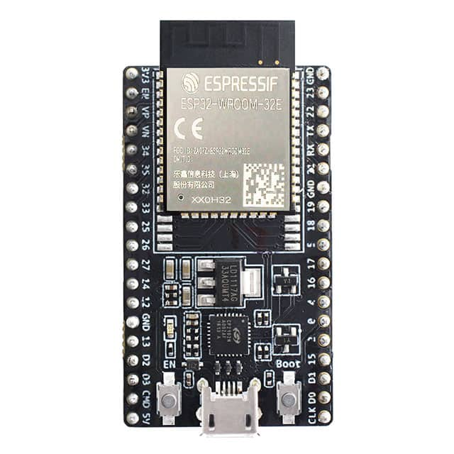
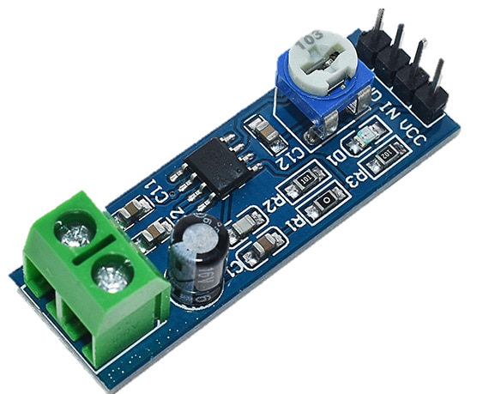
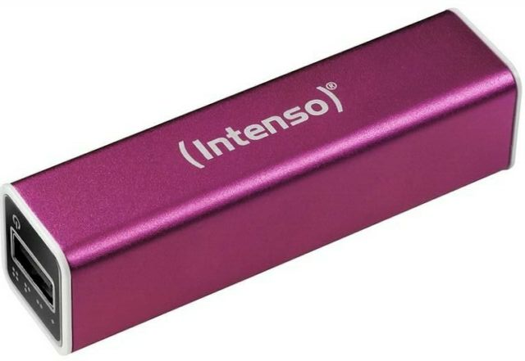
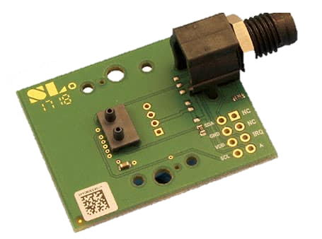
ENVITEC Oxiplus
00A101
LCD1602
ESP32 WROVER
Oxygen In:
On Sensor: Pin 1, Pin 3
On OPAMP: IN, GND
LM386
Analog:
On OPAMP: VCC, GND, Out
On ESP: 3V3, GND, GPIO15
I²C
On Display/Sensor: 5V, GND, SDA, SCL
On ESP: 5V, GND, GIO22, GPIO21
USB Powerbank,
2200mAh
Sensirion SDP3x
USB:
USB-Micro Cable (5V, GND)

Slide 2
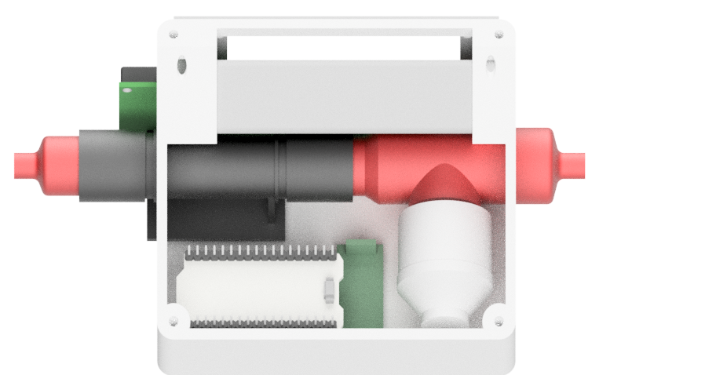
LC-Display
Housing
USB Powerbank
S-Connector (output)
T-Connector (input)
Flow-rate sensor
ESP32 microcontroller
Oxygen Sensor

