Slide 1

Big Data Analytics
Business
Intelligence
Business
Intelligence

Slide 2
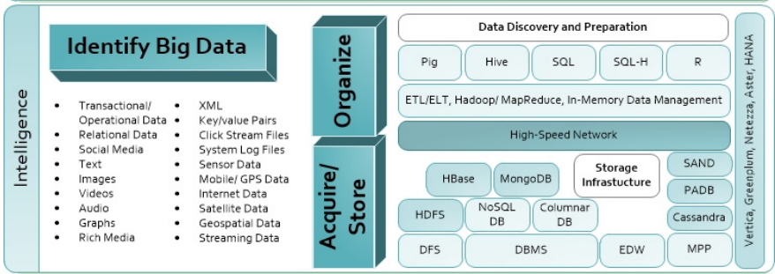

Slide 3
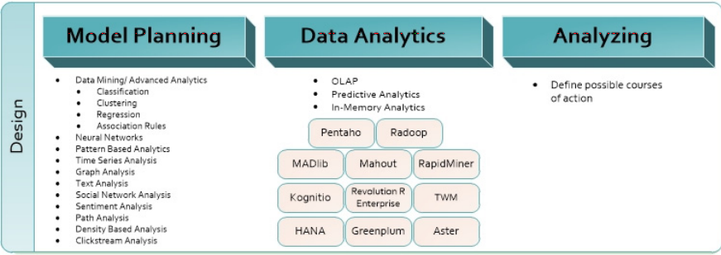

Slide 4
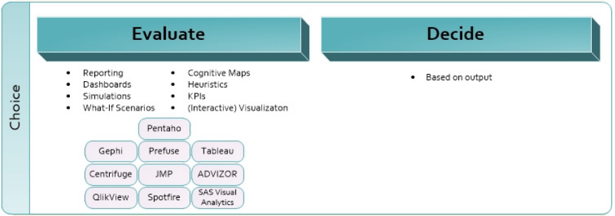

Slide 5


