Slide 1
FoodLink: A Smart Recipe Finder
Allen Lin, Alvin Zhu, Tian Herng Tan, Ziliang Wang, Zhuohan Wang

Slide 2
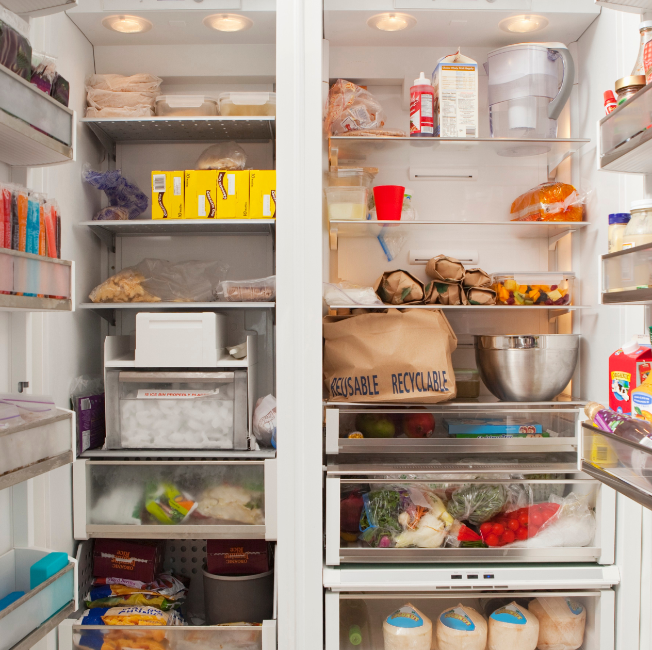
Problem
Full refrigerator but don’t know what to cook?
Don’t know what recipes suit your diet?
Want to eat smarter?

Slide 3
Solution: FoodLink

Slide 4

Features
Access to over 2.3 million recipes via API developed by Edamam
Ingredients and image
Calorie information displayed with every recipe
Food Bank Finder & Food Access Programs

Slide 5
Demo

