Slide 1
Individualized Dynamic Latent Factor Model for Multi-resolution Mobile Health Data in Deep Learning
Annie Qu
Jiuchen Zhang
Ruxi Zheng, Zhuojiao Dong, Haochen Tan

Slide 2
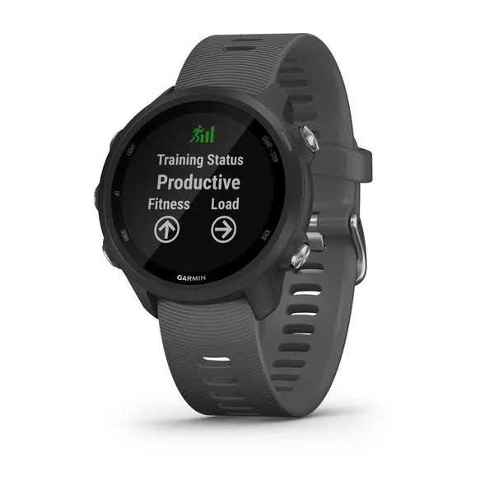
Mobile Health
Technology development makes personalized treatment more convenient.
Longitudinal data makes monitoring and management possible.
“Multi-resolution”, “Heterogeneity”, “Non-linear” makes new statistical models and methods are needed. (Zhang et al.)

Slide 3
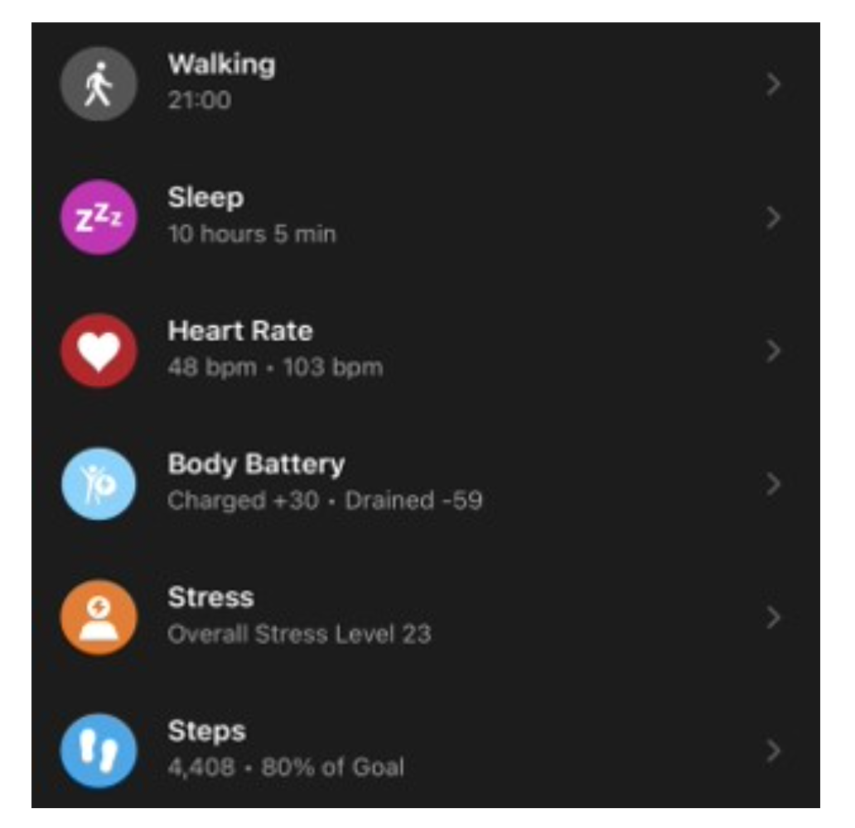
Datasets
Garmin smart watches as real datasets.
Caregivers of dementia patients
Four data types: “Daily movement data, heart rate data, stress level data and the daily wellness data” (Zhang et al.)

Slide 4
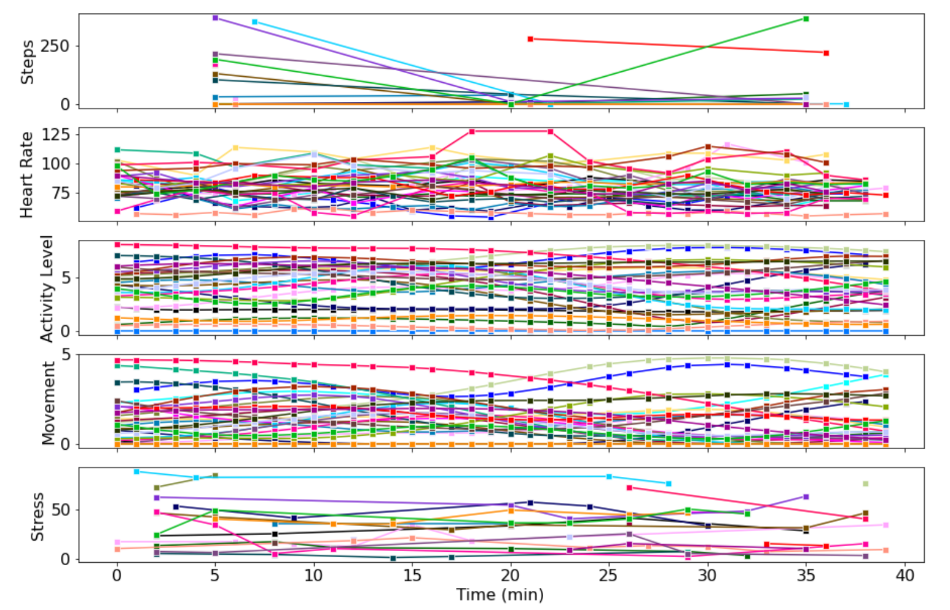
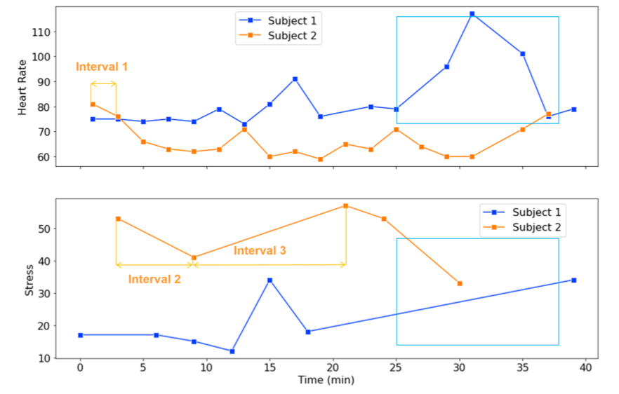
Multi-resolution
Different time of observation
Different frequency of observation

Slide 5
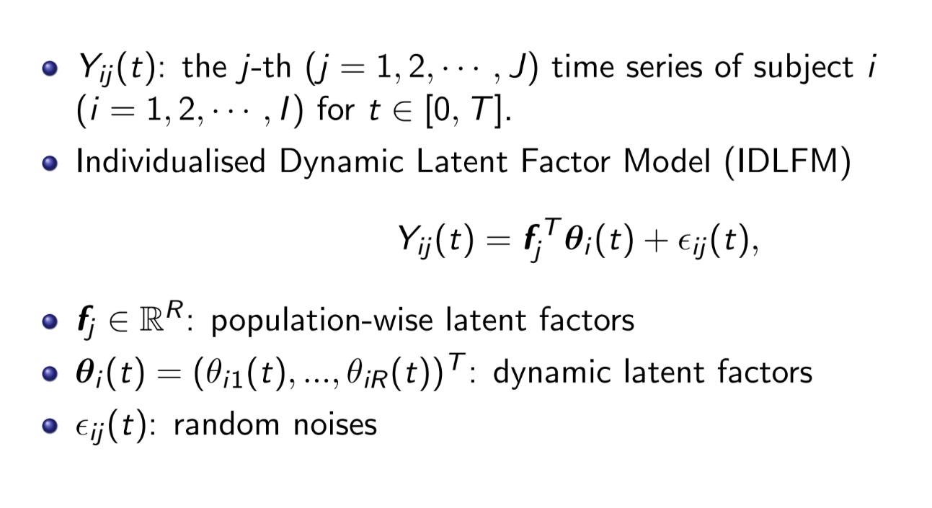
Individualized Dynamic Latent Factor Model (IDLFM)

Slide 6
Dynamic Latent Factor Estimation
Statistical Model
B-Spline Approximation
Deep Learning Model
Recurrent Neural Network(RNN)
Cons: Only 33 patients as sample size
Feedforward Neural Network(MLP)

Slide 7
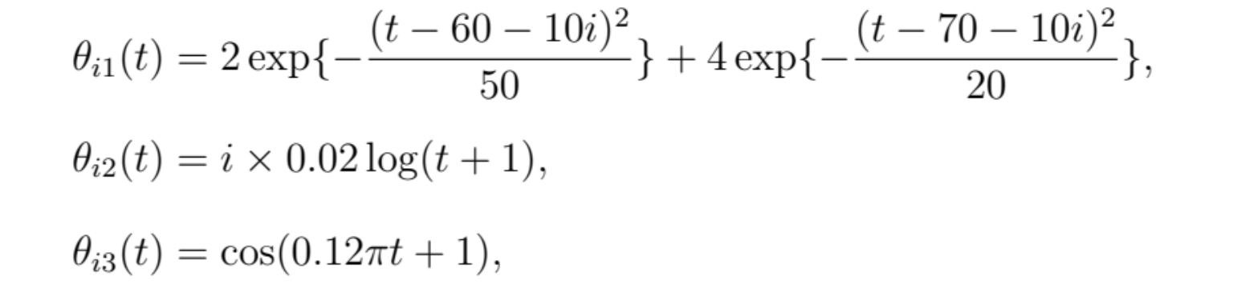
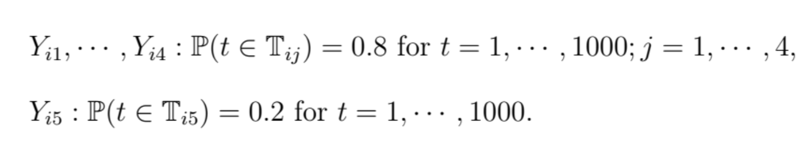
Simulation settings
Generate dynamic latent factors
Setting:

Slide 8
Feedforward Neural Network(MLP)
Layer A

Slide 9
Feedforward Neural Network(MLP)
Layer B

Slide 10
Evaluation & Proposal

Slide 11
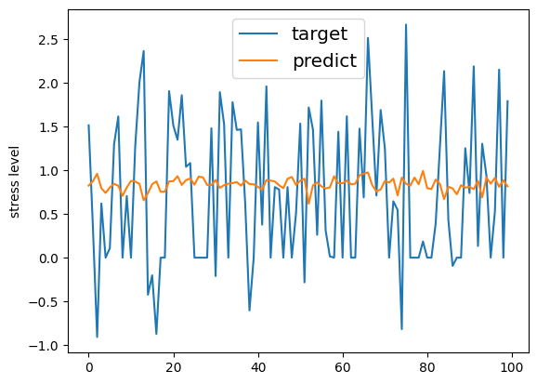
Model performance:
The proposed MLP model:
For one particular short term on test data 50 times average MSE (Zhang, P 17, Table 1)
MSE | MLP (Proposed) | IDLFM | SS | RNN | DRNN
Train | 1.3292 (1.486) | 0.209 (0.041) | 0.602 (0.257) | 8.131 (7.767) | 5.016 (5.525)
Test | 5.1946 (5.903) | 0.415 (0.161) | 2.983 (10.453) | 8.130 (7.830) | 5.018 (5.578)
IDLFM: the proposed individualized dynamic latent factor model, SS: smoothing spline, RNN: recurrent neural network, DRNN: deep RNN

Slide 12
Drawback about MLP model
Overfitting: Based on the given training data, the model easily find that rely on the given stress, it can perform well, but these data are not given in the test.
Not fulfill the purpose of prediction data based on time series. The proposed mlp model only based on current state of given data.

Slide 13
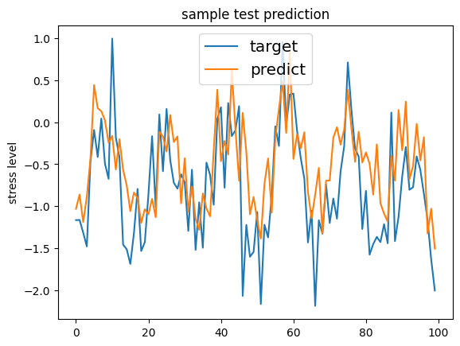
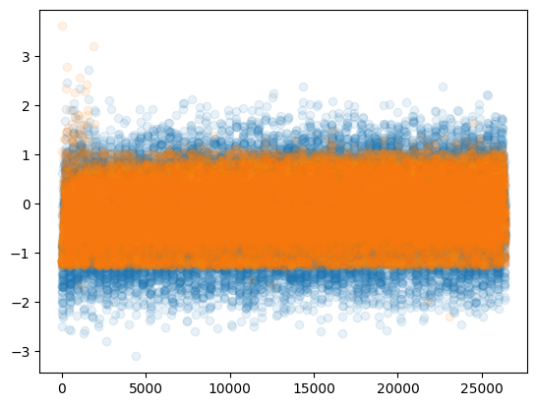
Simple MLP (Solve for overfitting)
To resolve the overfitting issue: cutoff the ambiguous data from input (ignore the stress level data).
MSE(50 times average) | Simple MLP
Train | 0.4851 (0.2600)
test | 0.5352 (0.2834)
Overall view of data prediction:

Slide 14
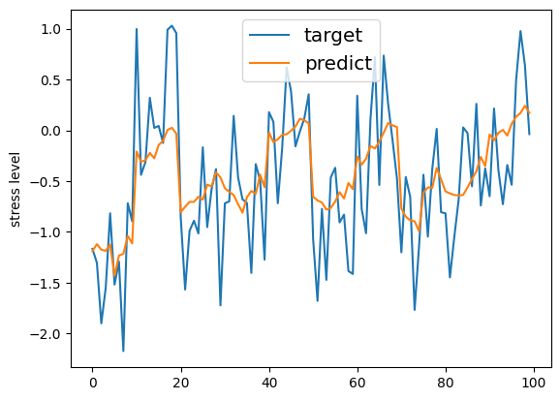
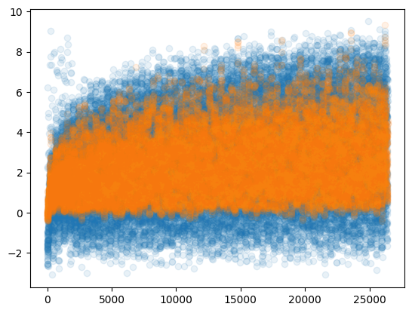
Time period MLP prediction (Simple solution for time series prediction)
Truncate time points into period as one set of data. From 1000 time points to 100 batch of 10.
MSE(50 times average) | Time period MLP
Train | 0.4853 (0.6425)
test | 0.8595 (1.2414)
Overall view of data prediction:

Slide 15
Review and Proposal
Simple MLP do not satisfy the time series prediction.
The performance is great. Be a standard judgement for performance check.
Time period MLP model is smoother. Considering the real world situation, time period MLP fit better.
Time period model training efficiency is much faster than Simple MLP. This might be a trade off consider in the future study.
Apply time series theories like long short term model(LSTM) to current model.
Simple MLP and time period MLP did not make good prediction on the extreme values. Consider label extreme data for guiding the model.

Slide 16
Thanks for listening…

