Slide 1
INTRODUCTION TO UNIX/LINUX
TIANTIAN ZHENG
Oct 10

Slide 2
INTRODUCTION
A open source, multitasking, multiuser computer operating system (OS);
Allow users and application programs to access system resource (e.g. the CPU, memory, disks etc. ) in a safe, efficient and abstract way.
Unix-based Operating System: Mac OS X (macOS), Windows
Self-contained software system
Mac OS
Access command line terminal: Application – Utilities – Terminal
Windows: numerous ways
Press “Win-R,” type “cmd” and press “Enter”
Click the “Start|Program Files|Accessories|Command
Notes:
Three types of LInux

Slide 3

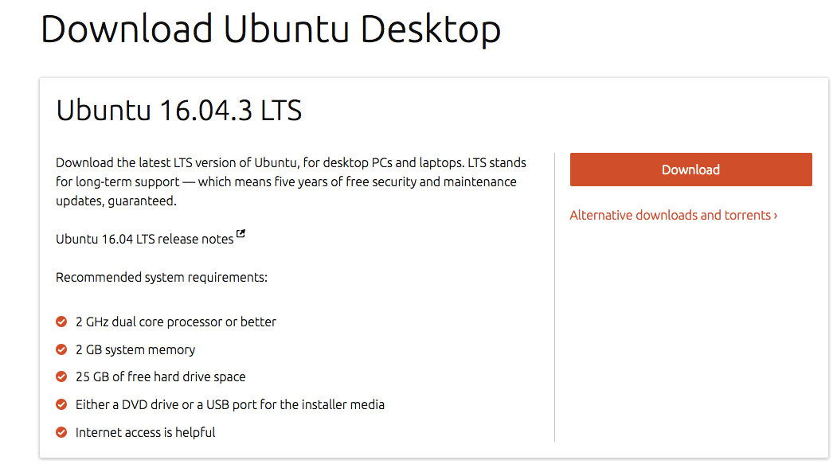

Download Linux OS
Linux Operating System: Ubuntu, Fedora, Debian
Ubuntu: https://www.ubuntu.com/download/desktop
Fedora: https://getfedora.org/
Debian: https://www.debian.org/

Slide 4
ADVANTAGE & DISADVANTAGE
ADVANTAGE
Multi user & multitasking
Efficient virtual memory: many programs can run with a modest amount of physical memory;
Access control & Security: all users must authenticated by a valid account and password. All files are owned by particular account;
Flexibility in tasks: control every aspect of the operating system, not limited to preconfigured combinations or menus, as in personal computer systems;
Cost: free to obtain, can be installed on a wide variety of machines
DISADVANTAGE
Designed for the programmer, not the casual user;
Understanding: take time to familiar with Linux system;
Software & Hardware: limited selection of software and does not support many hardware devices.
Notes:
multiple users can run multiple programs each at the same time;

Slide 5
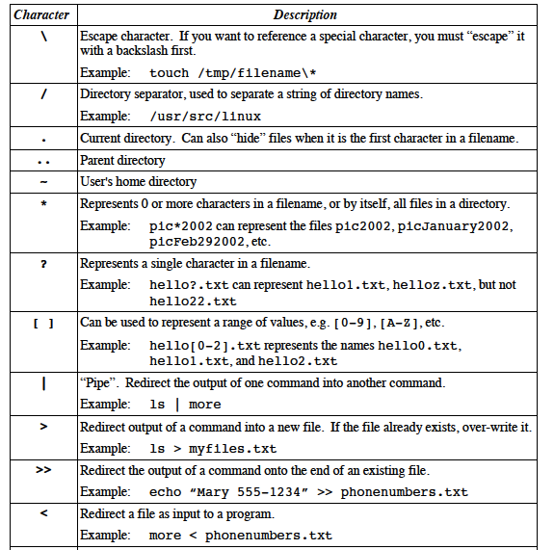
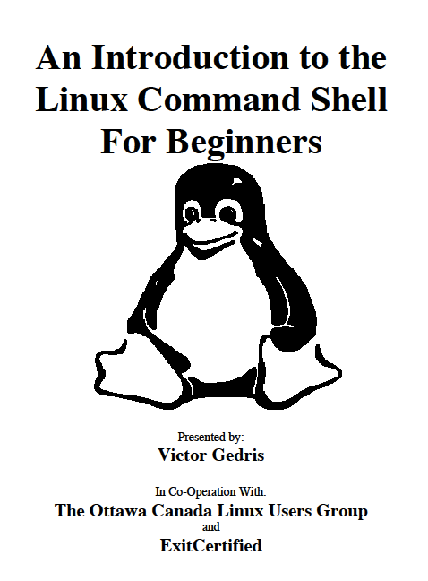
Linux Command
Case sensitive
Periods can be placed at any part of filename

Slide 6
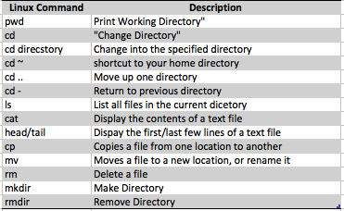
Linux Command

Slide 7

Linux Command
ls command
ls List files in current directory
ls –l List files in “long” format
ls –a Show hidden files
man command: Getting help e.g. man ls
Chmod command: Change file access permission
sudo chmod 444 filename.txt
User, group, others
Apache Web Server: request to access a local webpage
Notes:
Ifconfig: find ip address in interminal

Slide 8

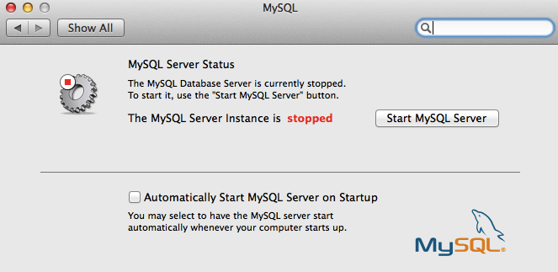
Connect to MySQL using Terminal
MySQL
Download MySQL: https://dev.mysql.com/doc/refman/5.7/en/osx-installation-pkg.html
Under System Preferences find
Connect to local mysql database in terminal
cd /usr/local/mysql/bin; ls
./mysql -u root –p
Notes:
Show databases
Use databasename
Select database()

Slide 9
Connect to R in Terminal
Connect R in terminal: ssh root@IPaddress
ssh tiantian@192.164.7.159
Connect to R in web server:
Port for R: http://<server –ip>:8787 (navigate a web browser)
User name & password are needed (permission)
Results saved in desktop under your server
Simple: type Capital R
Download packages the same as in Rstudio
Majorly used for Rscript
q() to exit R in terminal

Slide 10
Connect to Github/Gitlab from Terminal
Github: an open source project, version control system, manages and stores revisions of projects
Gitlab: provide internal management of git repositories, improve collaboration
Create SSH key: connect to GitHub without supplying username or password at each visit
https://help.github.com/articles/connecting-to-github-with-ssh/
Adding the new SSH to GitHub account
Created repository in Github
Notes:
Github: anyone can see code you push to GitHub and offer suggestion for improvement.
Gitlab: researchers and staff to better collaboration

Slide 11
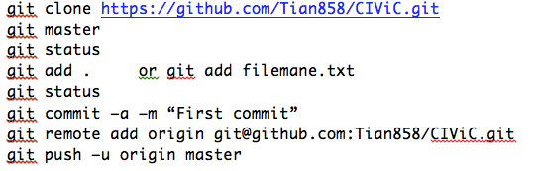
Github codes in termial

Slide 12
THANK YOU!

