Slide 1
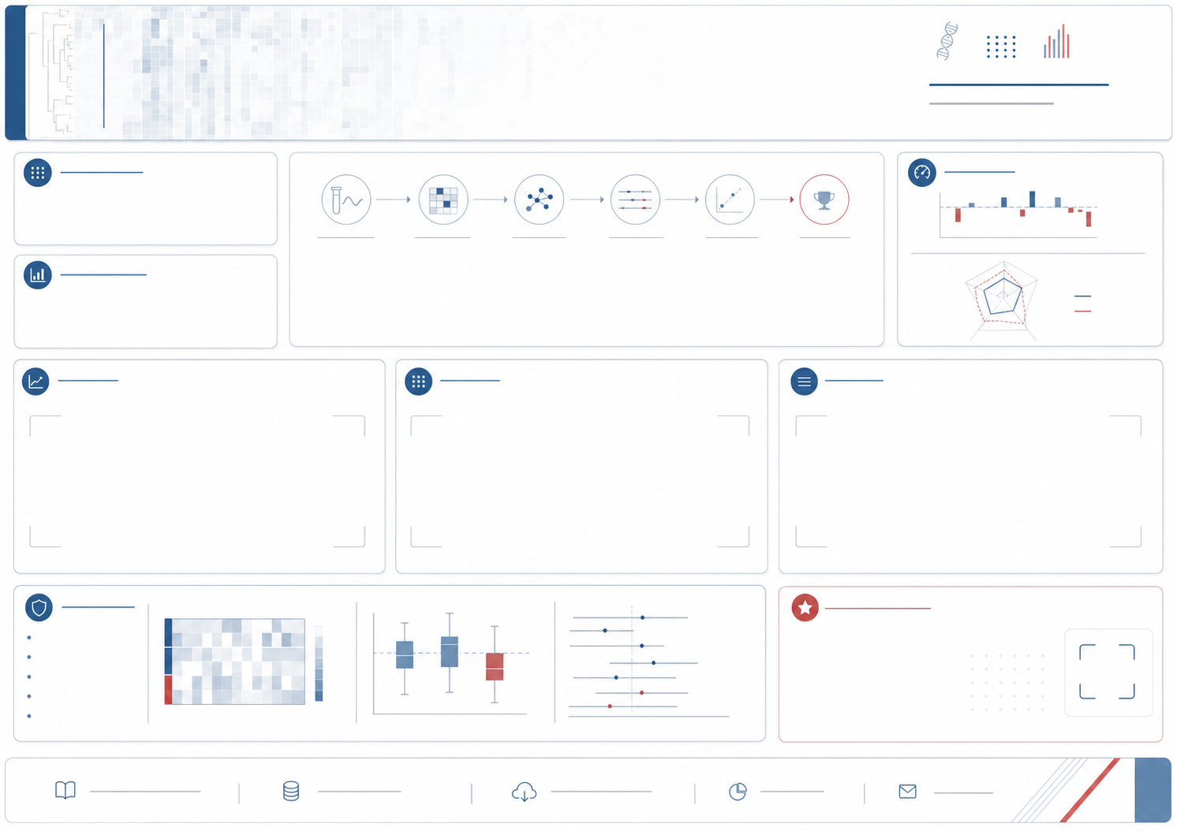
Top genes are not a single answer
Qirui Tian, Johannes Benedikt, Rachel Hargest, Wen G. Jiang, Tracey A. Martin
Leakage-aware repeated random-subspace XGBoost improves top-gene stability in TCGA-BRCA transcriptomic models
CCMRC, Cardiff University, Cardiff, UK
Linkle: Qirui Tian
BACKGROUND / GAP
METHODS: LEAKAGE-AWARE REPEATED RANDOM-SUBSPACE XGBOOST
AT A GLANCE
Transcriptomic biomarker models are often interpreted through a single ranked gene list.
Leakage-prone preprocessing and split-dependent ranking instability can both make top genes appear more definitive than they are.
0.57
0.24
best Top100
Jaccard
full-space
Top100 Jaccard
TCGA-BRCA expression matrix -> five-fold split -> random gene batches -> shallow XGBoost ranking -> fold-specific Top2000 panels -> stability and validation audit
6 / 7
Top30
OBJECTIVE
within 0.005
of full Top2000
panels supplied
for inspection
Test whether repeated, fold-contained local feature competition can make high-ranked genes more reproducible while preserving predictive performance.
1 STABILITY
2 PERFORMANCE
3 PRIOR-GENE RECOVERY
Insert Figure 2A
Insert Figure 2B
Insert Figure 2C
Mean Top100 Jaccard increased from 0.24 to 0.57 with best small-batch or consensus ranking.
The best small-batch Top2000 panel was within 0.005 primary-metric units of full Top2000 in 6 of 7 tasks.
Small-batch screening recovered additional fold-stable BRCA/PAM50 prior genes, with the largest mean gain in TNBC.
BASELINES AND EXTERNAL VALIDATION
EXPLORATORY PROGNOSIS
TAKE-HOME MESSAGE
A high model score does not make one top-gene list definitive.
Fold-contained repeated screening makes ranking instability visible and produces more reproducible candidate panels for biological follow-up.
Insert Figure 3
Insert prognosis supplement
Insert QR code or URL
Study affiliation: CCMRC, Cardiff University
Linkle: Qirui Tian
Poster materials: insert QR or URL
NovoRadiant | independent outreach

