Slide 1
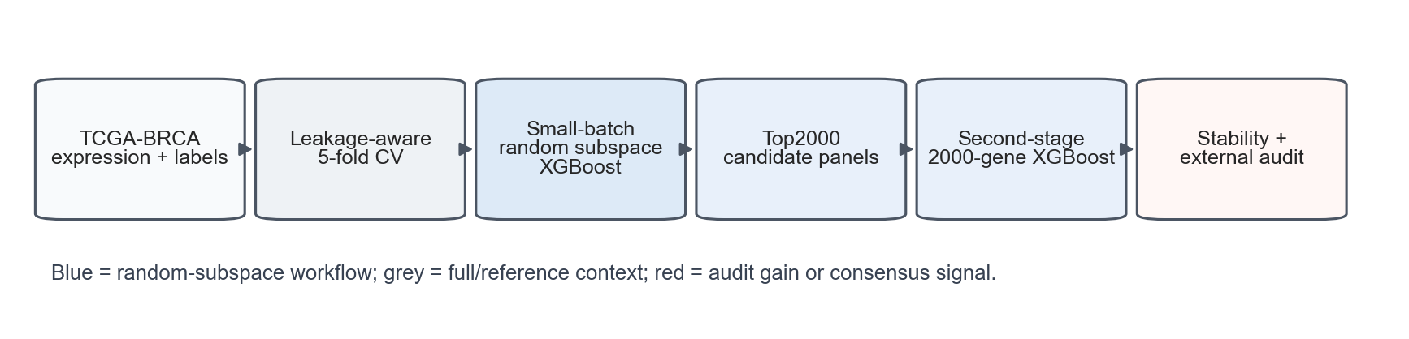
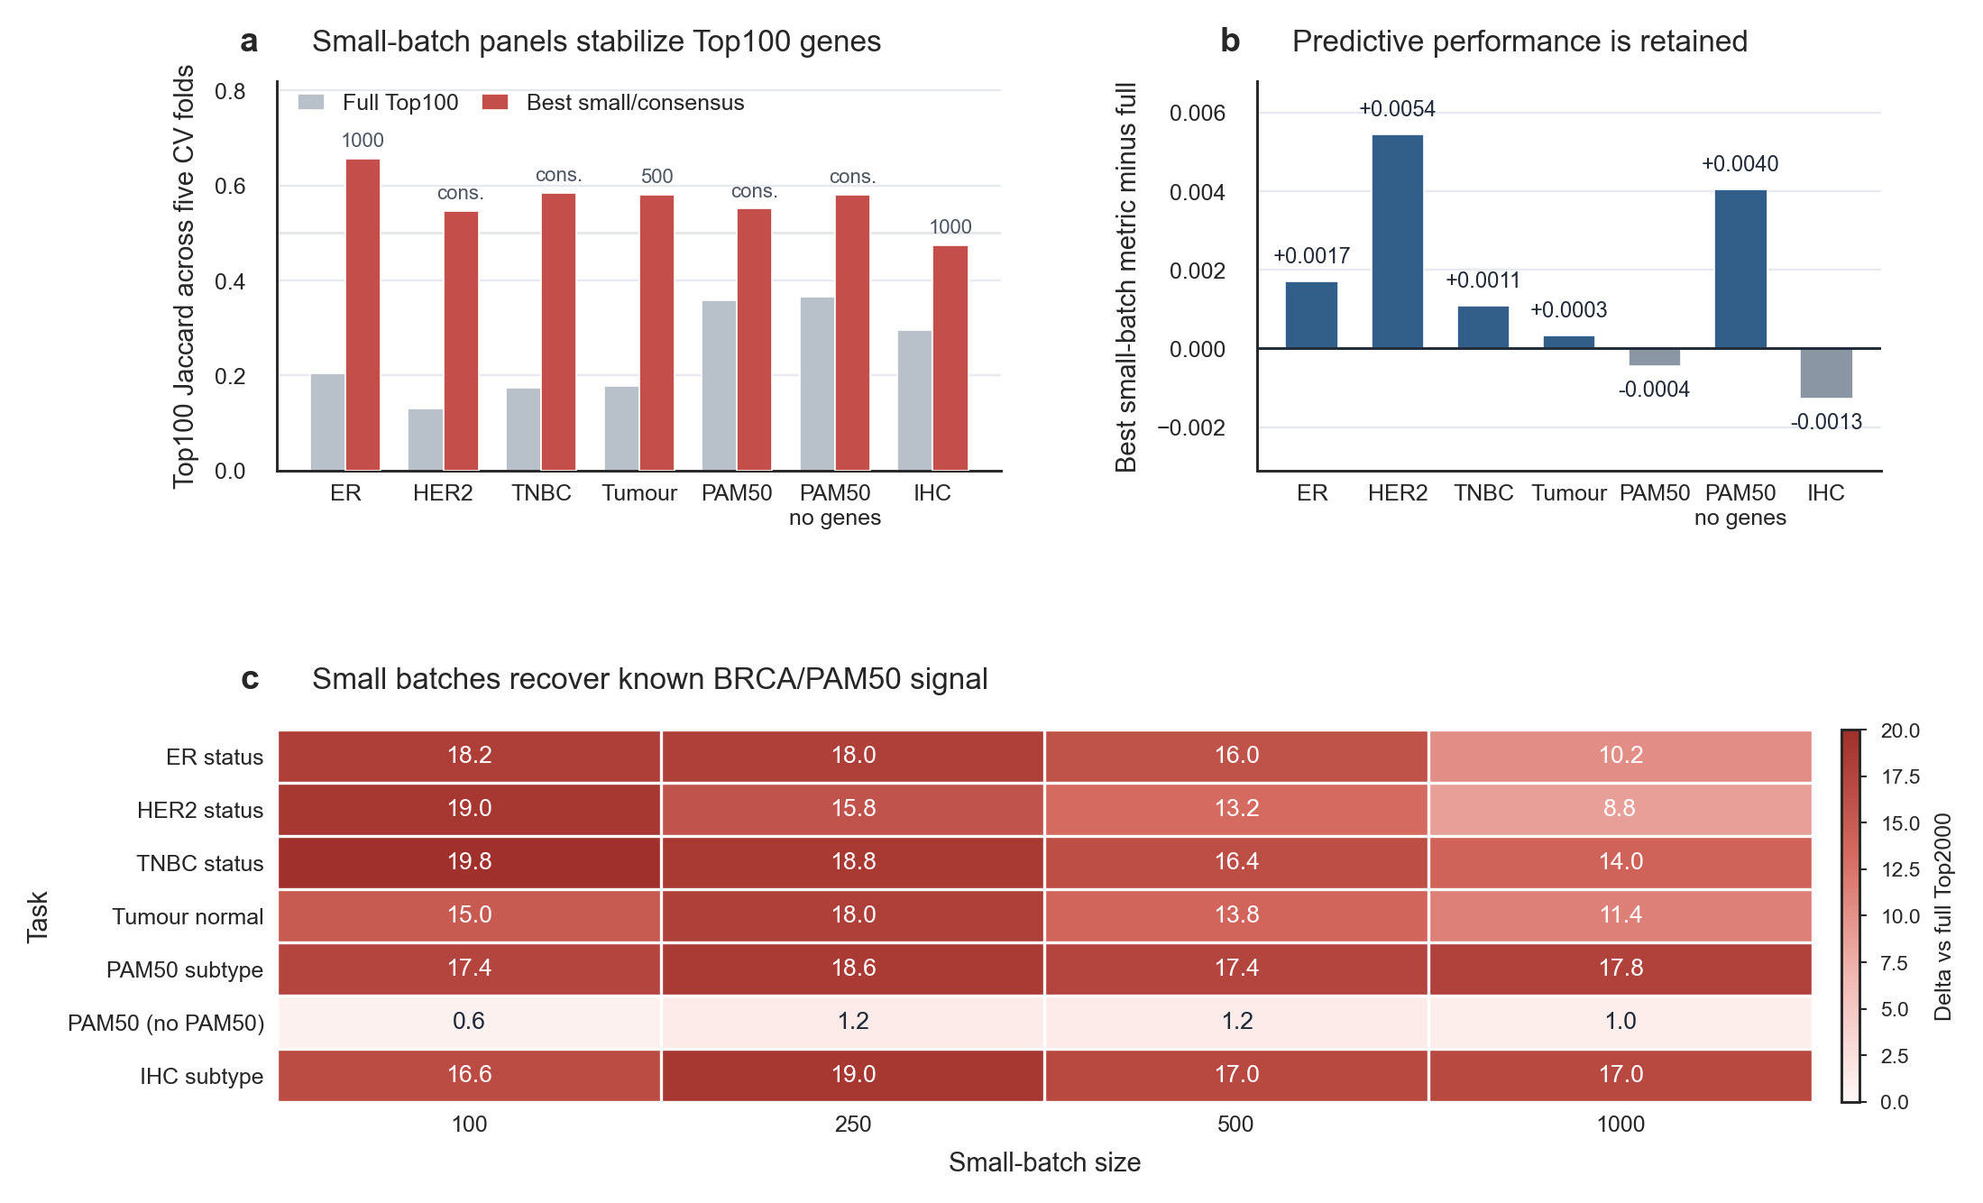
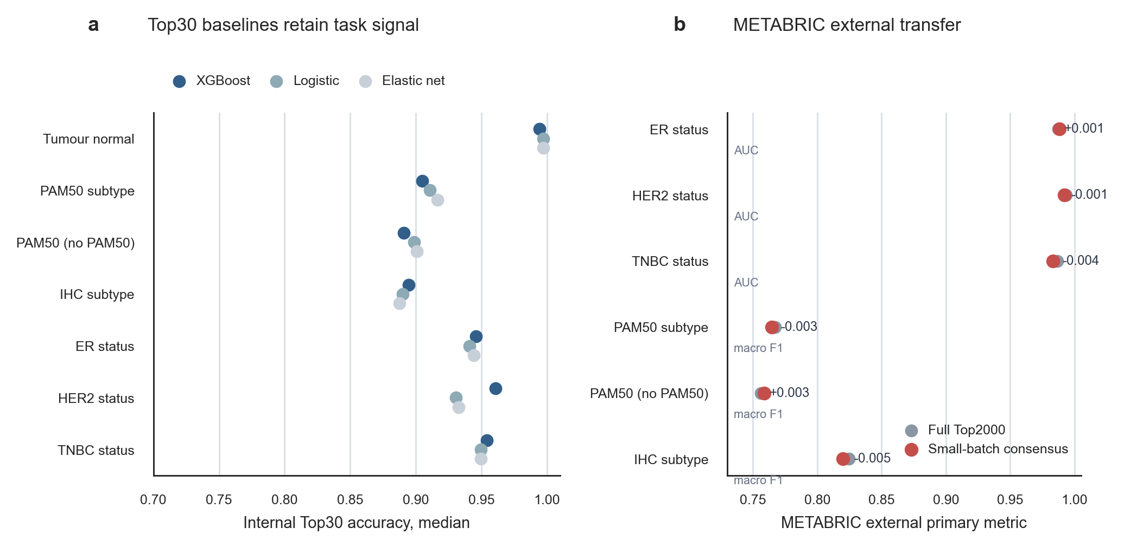

Leakage-aware repeated XGBoost screening audits unstable breast cancer top genes
Take-home message
Author names and affiliations to be confirmed | EACR 2026 Congress, Budapest | Poster: A0 landscape, 1189 x 841 mm
Top genes are not a single answer: fold-contained repeated screening improves reproducibility without claiming causal biomarkers.
Problem
Many transcriptomic biomarker workflows report one ranked gene list from one split or from filters applied before resampling. This can mix leakage risk with split-seed instability.
Key results
Top100 fold stability: mean best small/consensus Jaccard 0.57 vs full 0.24. Best prior-union recovery gain: 19.8 genes (TNBC status, batch 100). Top internal CV5 deltas vs full Top2000: - HER2 status: best batch 100, delta +0.005 - PAM50 without PAM50 genes: best batch 500, delta +0.004 - ER status: best batch 1000, delta +0.002
Figure 1. Fold-contained random-subspace screening workflow.
Audit design
All ranking and panel export are performed inside CV folds. Genes are repeatedly shuffled into local batches (100, 250, 500, 1000), ranked by shallow XGBoost gain, aggregated, and retrained as fixed Top2000 panels.
Interpretation
The method turns feature selection into a stability audit. A gene is more credible when it recurs across folds, split seeds and local feature contexts, not simply because it wins one full-space ranking.
Data and tasks
TCGA-BRCA Xena expression: 1218 samples x 20530 genes. Seven internal tasks were tested. METABRIC primary tumours were used for external transfer where labels were compatible.
Limitations
This is still a candidate-panel workflow. External validation is label-limited, tumour-normal has no METABRIC counterpart, and emerged genes need biological follow-up before mechanistic or clinical claims.
Figure 2. Stability improves while internal CV5 performance is retained.
Prior genes and baselines
BRCA driver/PAM50 genes are interpretation controls only, never training aids. XGBoost is compared with logistic and elastic-net Top30 baselines to avoid presenting accuracy as a model-specific trick.
Source code/data link placeholder Contact: Tianqr18@gmail.com Customer support for printing: customer@postersessiononline.eu
Figure 3. Top30 baselines and METABRIC transfer place the workflow in context.
Poster file format: DIN A0 landscape, 1189 x 841 mm (46.8 x 33.1 in)

