Slide 1
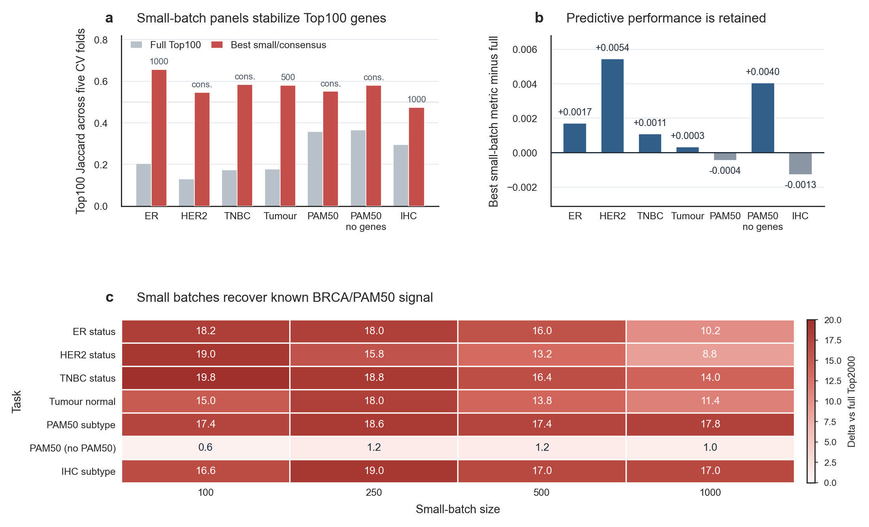
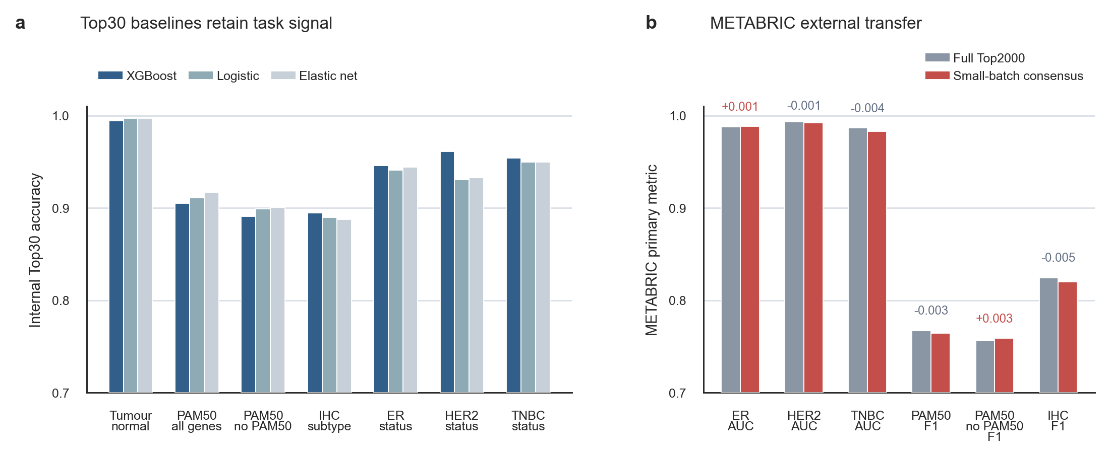
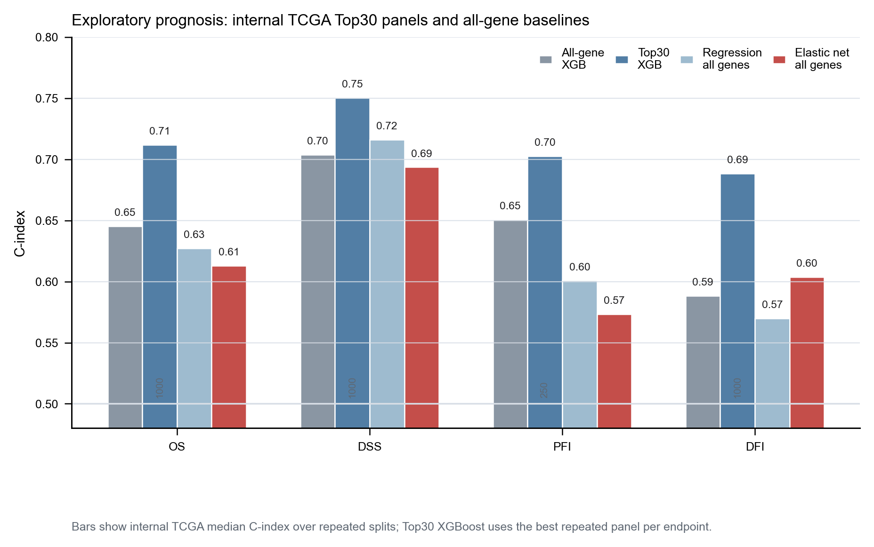
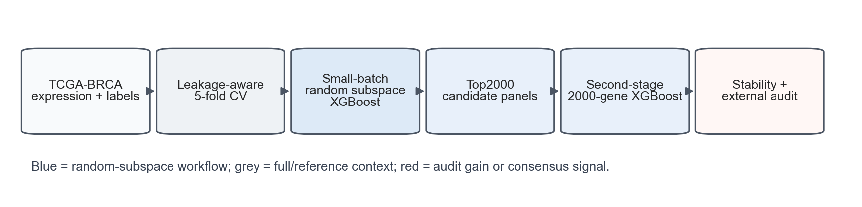

Top genes are not a single answer
Qirui Tian, Johannes Benedikt, Rachel Hargest, Wen G. Jiang, Tracey A. Martin
Leakage-aware repeated random-subspace XGBoost improves top-gene stability in TCGA-BRCA transcriptomic models
CCMRC, Cardiff University, Cardiff, UK
EACR 2026 | Linkle: Qirui Tian
INTRODUCTION
RESULTS
VALIDATION
Transcriptomic biomarker studies often compress a high-dimensional model into a single Top-K gene list. This can make the result look more definitive than it is.
Two risks are especially important: feature selection outside resampling can leak held-out information, and leakage-free rankings can still change when folds or split seeds change because correlated genes compete for similar predictive signal.
Small-batch screening improved high-rank reproducibility while retaining internal CV5 performance.
OBJECTIVE
Top30 panels retained task signal under XGBoost, logistic regression and elastic net, indicating that the classification signal was not restricted to one model family.
METABRIC transfer was evaluated only for label-compatible primary-tumour tasks and used as external context, not as proof of universal superiority.
Test whether repeated, fold-contained local feature competition can make high-ranked genes more reproducible while preserving predictive performance.
METHODS
TCGA-BRCA expression matrix: 1218 samples, 20530 genes and seven classification tasks.
All feature selection was nested inside five-fold cross-validation. Held-out folds were not used for filtering, ranking, scaling or panel construction.
EXPLORATORY PROGNOSIS
Figure 2. Full-space Top100 rankings were less stable than best small-batch or consensus rankings. Performance deltas remained close to zero, and prior-union recovery improved in receptor-status and subtype tasks.
0.57
0.24
6 / 7
19.8
Retained as exploratory evidence because endpoint mapping and cross-cohort calibration add uncertainty.
Pipeline details
1. Genes were repeatedly assigned to local batches of 100, 250, 500 or 1000 genes.
2. Shallow XGBoost models ranked genes within each training fold.
3. Fold-specific Top2000 panels were retrained and compared with fold-matched full Top2000 panels.
Audit controls
Top100 Jaccard measured high-rank reproducibility. BRCA/PAM50 genes were used only as interpretation controls. Logistic, elastic-net and METABRIC analyses constrained model-specific claims.
mean best Top100 Jaccard
mean full-space Top100 Jaccard
tasks within 0.005 of full Top2000
largest mean prior-gene recovery gain
DISCUSSION
Interpretation
Repeated fold-contained screening provides an audit layer for transcriptomic machine-learning studies. It helps distinguish predictive tasks that are accurate from gene rankings that are also reproducible enough to justify biological follow-up.
Limitations
This is a candidate-panel study, not biomarker validation. METABRIC validation is label-limited, tumour-normal transfer was unavailable, and recovered genes require biological follow-up before mechanistic or clinical claims.
Primary findings
1. Stability: best small-batch or consensus rankings increased Top100 fold-stability across all seven tasks.
2. Performance: internal CV5 performance was retained relative to fold-matched full Top2000 panels.
3. Interpretability: prior-gene recovery improved in receptor-status and subtype-related tasks.
4. Boundary: recovered genes are candidate signals for follow-up, not validated biomarkers.
Take-home: a high model score does not make one top-gene list definitive.
Claim boundary: candidate-panel prioritisation, not biomarker validation.
Study affiliation: CCMRC, Cardiff University
Linkle: Qirui Tian
Poster materials: insert final QR or URL
NovoRadiant | independent outreach

