Slide 1
Introduction to Machine Learning
Homework 1 Announcement
Presenter: TA Jui-Che (Ben)
Lastest update: 2023/09/27 13:00
Notes:
‹#›
Good afternoon, everyone. I'm TA Jui-Che, you can also call me Ben. Today I’m going to announce homework 1.
In this course, each homework assignment is a crucial component of your academic score. Please don't hesitate to raise your hand if you have any questions during this announcememt.

Slide 2
Homework 1
Deadline: 23:59, Oct. 10th (Tue), 2023
Coding (50%): Implement linear regression by only using numpy.
Submit your python file (.py).
Answer the questions (by screenshots) in the report (.pdf).
Handwritten Questions (50%): Answer questions about linear regression.
Answer the questions (handwritten, typed, digital, etc.) in the report.
Notes:
You will have two full weeks to complete this assignment, as the deadline is set for October 10th.
This assignment consists of two parts:
The first part is Coding: In this section, you'll implement linear regression only using NumPy. You should submit your code and answer some associated questions in the report.
The second part is Hand-Written Questions: In this section, you'll answer theoretical questions about linear regression. You can choose your preferred method for responses, whether handwritten, typed, or digital, as long as your answers are clear and readable."

Slide 3
Links
Questions: Link
Sample code: Link
Dataset: Link
Report template: Link
Notes:
Here are some links about this assignment, and these links are on E3 system too.

Slide 4
Environment
Python version: 3.8 or newer
Tips
We recommend that you use virtual environments when implementing your homework assignments.
Here are some popular virtual environment management tools:
Conda
Miniconda
virtualenv
Notes:
The following slide covers the topic of the environment. Please use Python 3.8 or a newer versions. We strongly encourage the use of virtual environments when working on your homework assignments. Below are some popular tools for managing virtual environments:

Slide 5
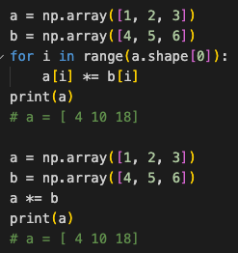
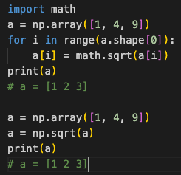
Numpy
Build-in array operations.
Numpy Tutorial: Link
Notes:
As previously mentioned, you will be implementing linear regression using only NumPy. NumPy is a powerful Python library that supports a wide range of array operations. We recommend that you have a basic understanding of NumPy before getting started. For instance, when performing element-wise multiplication, avoid writing code like this and instead utilize NumPy's multiplication function. Similarly, if you need to calculate element-wise square roots, there's no need to use the math library; simply use NumPy's numpy.sqrt() function.

Slide 6
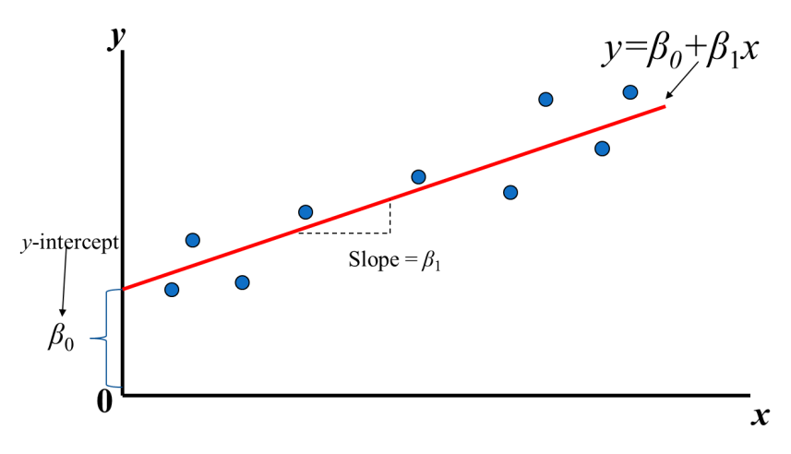
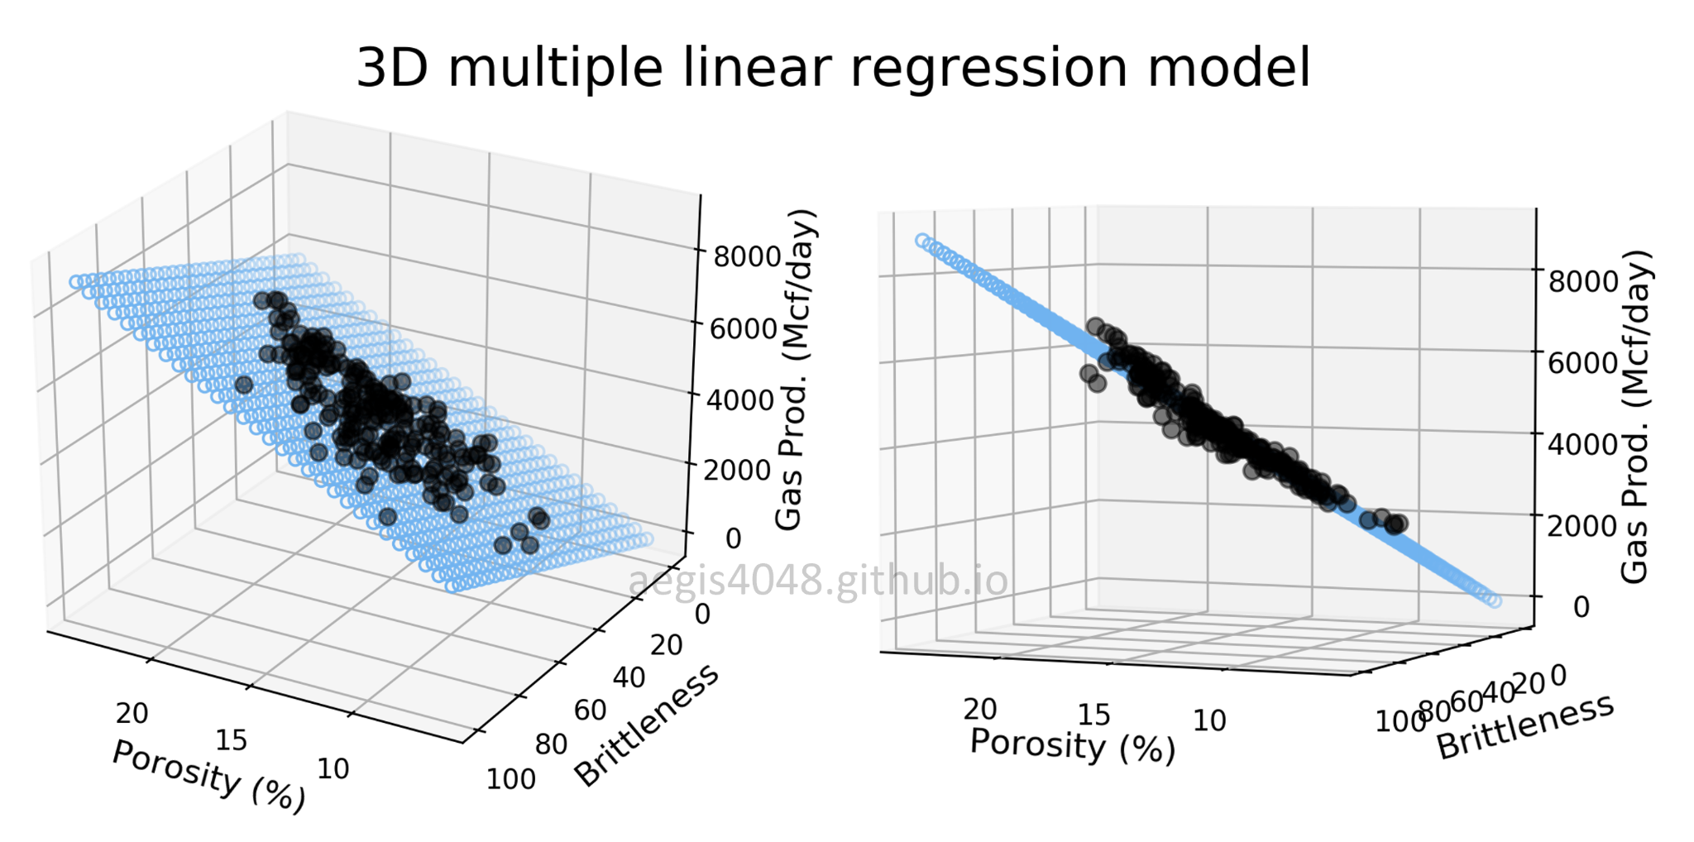
Linear Regression
Find the best value of the weights and the intercept
https://aegis4048.github.io/mutiple_linear_regression_and_visualization_in_python
Notes:
In the course, you learned about linear regression, which is the process of finding the optimal values for the weights and the intercept that can best fit the given data.

Slide 7
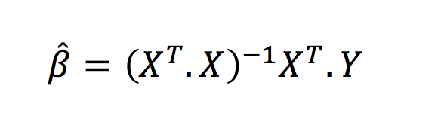
How to find β0 and β1?
Closed-form solution
How about a large dataset?
high dimensional data
huge amount of data
Notes:
You've learned that for linear regression, we can compute the closed-form solution using equations that involve matrix calculations. However, when dealing with a super large dataset, such as high-dimensional data with a huge amount of data points, performing these matrix calculations can become computationally expensive and challenging.

Slide 8
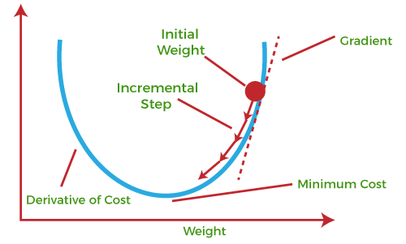
How to find β0 and β1?
Gradient Descent
Notes:
Therefore, the another approach is utilizing gradient descent to solve linear regression.

Slide 9
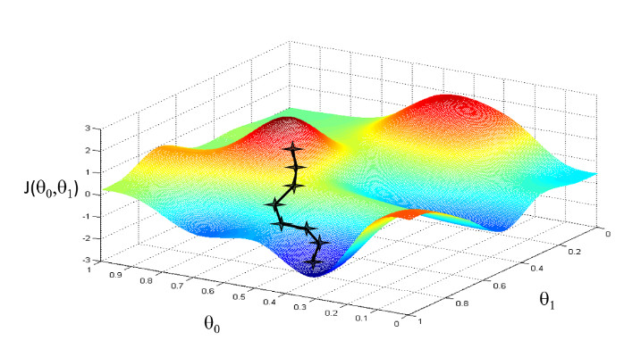
Gradient Descent
x-axis and y-axis: the value of weights
z-axis: the value of loss of the corresponding weights
Goal: Find the weights that minimize the value of loss
https://www.linkedin.com/pulse/gradient-descent-visualization-python-ibrahim-sobh/
Notes:
Gradient descent is an iterative optimization method that use the gradient's direction to incrementally refine the solution.

Slide 10
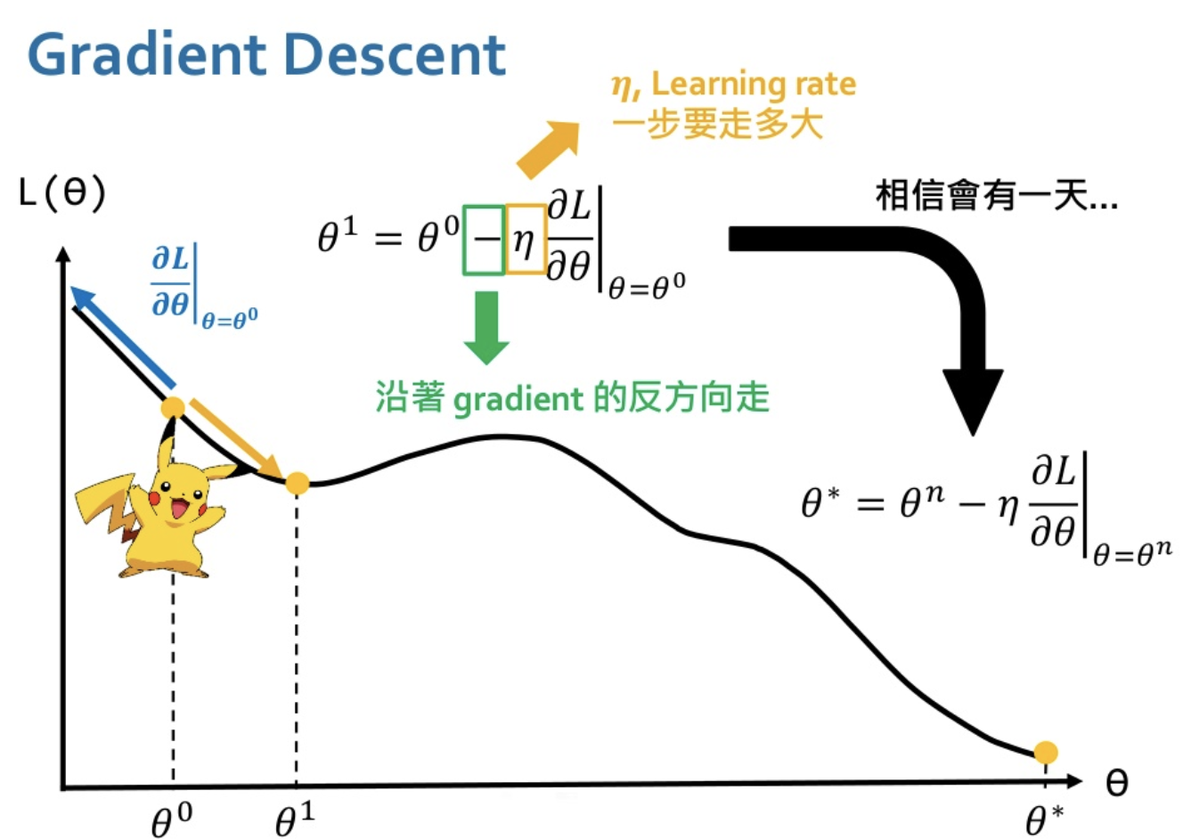
Gradient Descent
Learning rate
Learning rate: How far for one step
Believe that in one day…
Move in the opposite direction of the gradient
https://www.youtube.com/watch?v=yKKNr-QKz2Q
Notes:
This is the update equation of gradient descent and the learning rate eta(η) plays a critical role in controlling the size of each step taken during the gradient descent process.

Slide 11
Dataset
Student Performance Dataset
Features
Hour Studied
Previous Score
Sleep Hours
Sample Question Papers Practiced
Target
Performance Index (higher means better performance)
Notes:
You are going to implement linear regression on this dataset – student performance dataset
Features:
Hour Studied: The number of hours a student has studied.
Previous Score: The student's previous academic performance score.
Sleep Hours: The number of hours the student sleeps.
Sample Question Papers Practiced: The count of practice question papers completed by the student.
Target:
Performance Index: This is the target variable we aim to predict, where higher values indicate better academic performance.

Slide 12
Linear Regression – Closed-form Solution
Requirements
Implement Linear Regression by closed-form solution.
Grading Criteria
(10%) Show the weights and intercepts of your linear model.
Tips
There is only one answer, You can check your answer by yourself using third-party libraries (such as scikit-learn).
Notes:
Your first task is to implement linear regression using the closed-form solution.You must display the calculated weights and intercepts for your linear model. It's important to note that there is a single correct solution for this task.
Here's a helpful tip: To validate the correctness of your implementation, you can cross-check your results using third-party libraries like scikit-learn.

Slide 13
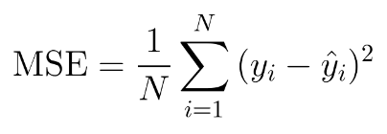
Linear Regression – Gradient Descent
Requirements
Update your weights and intercept by gradient descent (you can implement mini-batch gradient descent or stochastic gradient descent if you want).
Use MSE (Mean Square Error) as your loss function.
Tune the learning rate and epoch hyper-parameters (and batch size if you implement mini-batch gradient descent) to make your testing MSE loss as closed as the closed-form solution.
Notes:
The second task is to implement linear regression using gradient descent. You have to use this provided MSE equation as your loss function and tune learning rate and epoch hyper-parameters to make your testing MSE loss as closed as the closed-form solution.

Slide 14
Linear Regression – Gradient Descent
Grading Criteria
(10%) Show the weights and intercepts of your linear model.
(10%) Plot the learning curve. (x-axis=epoch, y-axis=training loss)
(20%) Show your error rate between your closed-form solution and the gradient descent solution.
error rate: (gradient_descent_loss - closed_form_loss) / closed_form_loss * 100
Points | error rate
20 | < 0.5%
15 | < 1%
10 | < 3%
5 | < 5%
0 | >= 5%
Notes:
The following is the grading criteria for gradient descent. You need to show your result, plot the training curve, and show your error rate between your closed-form solution and the gradient descent solution. The definition of the error rate and the grading criteria are listed.

Slide 15
Linear Regression – Gradient Descent
Tips
Finding suitable hyper-parameters may cost you some time. Be patient!
Notes:
Here's a useful tip: The process of finding suitable hyperparameters may require some time and experimentation. Patience is key during this phase of model development, so take the time to explore and fine-tune your hyperparameters for the best results.

Slide 16

Code Output
Do not modify the main function architecture.
Your code output will look like this:
Notes:
We have already finished the main function, do not modify it and your code output will look like this.

Slide 17
Report
Please follow the report template format.
Link
Notes:
About the report, please follow the report template format.

Slide 18

Submission
Compress your code and report into a .zip file and submit it on E3.
<STUDENT ID>_HW1.zip
<STUDENT ID>_HW1.py
<STUDENT ID>_HW1.pdf (do not submit .doc, .docx or others format)
Notes:
About submission, you have to Compress your code and report into a .zip file and submit it on E3. You should name your files correctly.

Slide 19
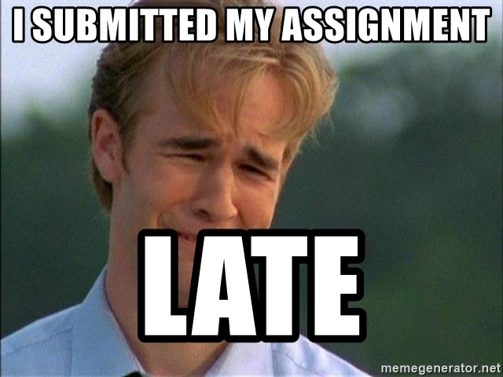
Late policy
We will deduct a late penalty of 20 points per additional late day.
For example, If you get 90 points but delay for two days, your will get only 50 points!
Notes:
The final section is about our late policy. Please be aware that for each additional late day beyond the due date, a late penalty of 20 points will be deducted. For instance, if you earned 90 points but submitted your work two days late, your final score will be reduced to 50 points. Please submit your assignment on time.

Slide 20
FAQs
Why can’t my gradient descent model converge?
Make sure you calculate the gradients correctly.
Use smaller learning rate.
Can I use deep learning frameworks such as TensorFlow, PyTorch or other library such as math?
No! In HW1, you are request using only Numpy to implement linear regression and gradien descent. You can use matplotlib to plot the results.
If you have other questions, ask on E3 forum first! We will reply as soon as possible.
Notes:
Here are some frequently asked questions (FAQs):

Slide 21
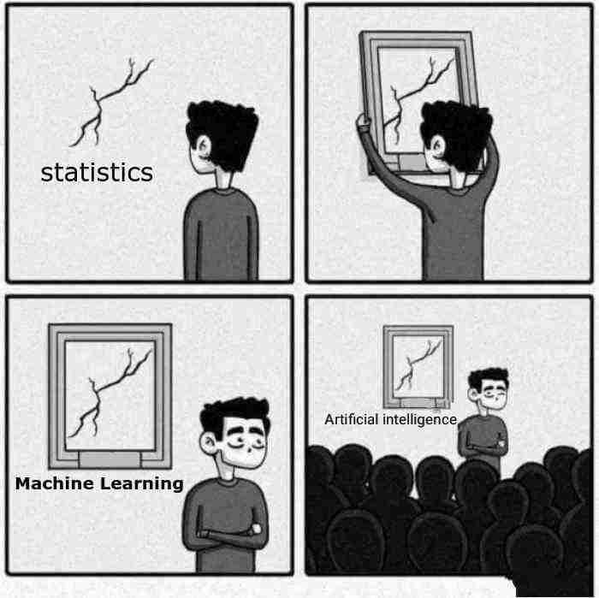
Have Fun!

