Slide 1
Introduction to Machine Learning
Homework 3 Announcement
Presenter: TA Jui-Che (Ben)
Lastest update: 2023/11/14 13:30
Notes:
‹#›
Good afternoon, everyone. I'm Ben. Today I’m going to announce homework 3.
In this course, each homework assignment is a crucial component of your academic score. Please don't hesitate to raise your hand if you have any questions during this announcememt.

Slide 2
Homework 3
Deadline: 23:59, Nov. 28th (Tue), 2023
Coding (50%): Implement ensemble methods by only using numpy.
Part 1: Decision Tree
Part 2: Adaboost
Submit your python file (.py).
Answer the questions (by screenshots) in the report (.pdf).
Handwritten Questions (50%): Answer questions about linear ensemble methods.
Answer the questions (handwritten, typed, digital, etc.) in the report.
Notes:
You will have two full weeks to complete this assignment, as the deadline is set for November 28th.
This assignment consists of two section:
The first section is Coding: In this section, you'll implement ensemble methods only using NumPy. The first one will be Decision Tree and the second one will be Adaboost. You should submit your code and answer some associated questions in the report.
The second section is Hand-Written Questions: In this section, you'll answer theoretical questions about ensemble methods. You can choose your preferred method for responses, whether handwritten, typed, or digital, as long as your answers are clear and readable."

Slide 3
Links
Questions: Link
Sample code: Link
Dataset: Link
Report template: Link (same as HW1)
Notes:
Here are some links about this assignment, and these links are on E3 system too.

Slide 4
Environment
Python version: 3.8 or newer
Tips
We recommend that you use virtual environments when implementing your homework assignments.
Here are some popular virtual environment management tools:
Conda
Miniconda
virtualenv
Notes:
The following slide covers the topic of the environment. Please use Python 3.8 or a newer versions. We strongly encourage the use of virtual environments when working on your homework assignments. Below are some popular tools for managing virtual environments:

Slide 5
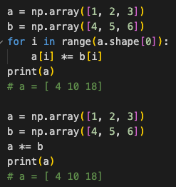
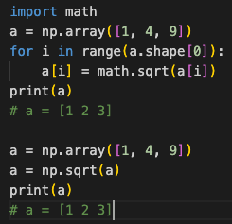
Numpy
Build-in array operations.
Numpy Tutorial: Link
Notes:
As previously mentioned, you will be implementing linear classification methods using only NumPy. NumPy is a powerful Python library that supports a wide range of array operations. We recommend that you have a basic understanding of NumPy before getting started. For instance, when performing element-wise multiplication, avoid writing code like this and instead utilize NumPy's multiplication function. Similarly, if you need to calculate element-wise square roots, there's no need to use the math library; simply use NumPy's numpy.sqrt() function.

Slide 6
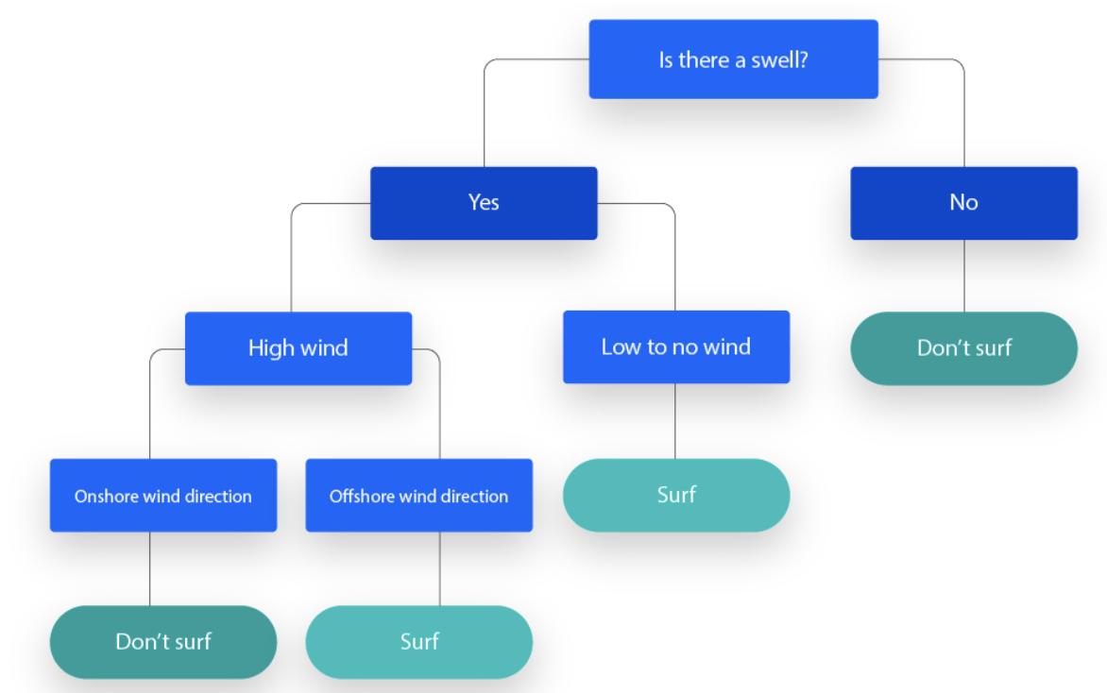
Decision Tree
Decision tree is a non-parametric supervised learning algorithm which has a hierarchical, tree structure, which consists of a root node, branches, internal nodes and leaf nodes.
https://www.ibm.com/topics/decision-trees
Notes:
The first part is about Decision Tree
In the course, you learned about Decision Tree, which is a non-parametric supervised learning algorithm which has a hierarchical, tree structure, which consists of a root node, branches, internal nodes and leaf nodes. At each internal node, a feature is selected, and one of its values is chosen to split the node, aiming to maximize information gain.

Slide 7
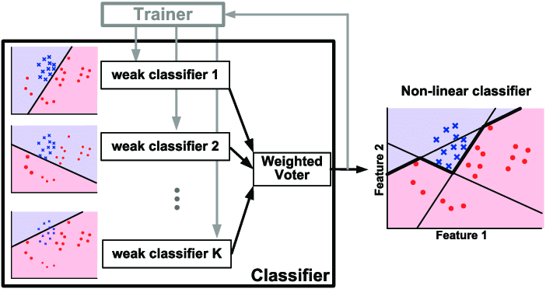
Adaboost
AdaBoost is a boosting technique used as an ensemble method in machine learning. It is called Adaptive Boosting as the weights are re-assigned to each instance, with higher weights assigned to incorrectly classified instances.
https://www.researchgate.net/figure/Illustration-of-AdaBoost-algorithm-for-creating-a-strong-classifier-based-on-multiple_fig9_288699540
Notes:
The second part is Adaboost.
In the course, you learned about AdaBoost, a boosting technique that leverages multiple weak classifiers. It is called Adaptive Boosting as the weights are re-assigned to each instance, with higher weights assigned to incorrectly classified instances.

Slide 8
Dataset
Heart Attack Dataset
Features
age
sex
cp: chest pain type (4 values)
fbs: fasting blood sugar > 120 mg/dl
thalach: maximum heart rate achieved
thal: 0 = normal; 1 = fixed defect; 2 = reversable defect
Target
target (0 = no heart attack, 1 = heart attack)
Notes:
You are going to implement two ensemble methods on the Heart Attack Dataset, the same dataset used in HW2. You are likely to observe a better performance from ensemble methods when compared to linear classification on this dataset.

Slide 9
Decision Tree
Requirements:
Implement gini index and entropy for measuring the best split of the data.
Implement the decision tree classifier with the following two arguments:
criterion: The function to measure the quality of a split of the data. Your model should support "gini" and "entropy".
max_depth: The maximum depth of the tree.
Tips
Your model should produce the same results when rebuilt with the same arguments.
You can use the recursive method to build the tree.
Notes:
For Decision Tree, you have to implement the Gini and Entropy for measuring the "best" splitting of the data. You have to implement the decision tree classifier with the following two arguments:
criterion: The function to measure the quality of a split of the data.
max_depth: The maximum depth of the tree.
Here are some useful tips:
Your model should produce the same results when rebuilt with the same arguments.
You can use the recursive method to build the nodes.

Slide 10
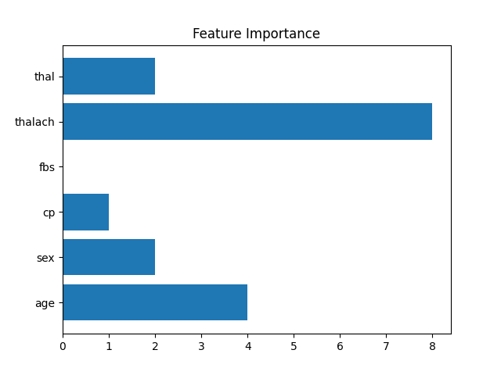
Decision Tree
Criteria:
(5%) Compute the gini index and the entropy of the array [0, 1, 0, 0, 0, 0, 1, 1, 0, 0, 1].
(10%) Show the accuracy score of the testing data using criterion="gini" and max_depth=7.
(10%) Show the accuracy score of the testing data using criterion="entropy" and max_depth=7.
(5%) Train your model using criterion="gini", max_depth=15. Plot the feature importance of your decision tree model by simply counting the number of times each feature is used to split the data.
Notes:
For the scoring criteria of decision tree, you will first compute the gini index and the entropy of a given array.
You have to show the accuracy score of some given arguments.
Finally, you will plot the feature importance by simply counting the number of times each feature is used to split the data.

Slide 11
Adaboost
Requirements:
Implement the Adaboost algorithm by using the decision tree classifier (max_depth=1) you just implemented as the weak classifier.
The Adaboost model should include the following two arguments:
criterion: The function to measure the quality of a split of the data. Your model should support "gini" and "entropy".
n_estimators: The total number of weak classifiers.
Tips
You can set any random seed to make your result reproducible.
Notes:
For Adaboost, you will implement the Adaboost algorithm by using the decision tree classifier (max_depth=1) you just implemented as the weak classifier.
The Adaboost model should include the following two arguments:
criterion: The function to measure the quality of a split of the data. Your model should support "gini" and "entropy".
n_estimators: The total number of weak classifiers.
Here is a useful tip:
You can set any random seed to make your result reproducible.

Slide 12
Adaboost
Criteria:
(20%) Tune the arguments of AdaBoost to achieve higher accuracy than your Decision Trees.
Points | Testing Accuracy
20 points | 0.8 <= acc
15 points | 0.78 <= acc < 0.8
10 points | 0.76 <= acc < 0.78
5 points | 0.74 <= acc < 0.76
0 points | acc < 0.74
Notes:
For the scoring criteria of Adaboost, you have to tune the arguments of AdaBoost to achieve higher accuracy than your Decision Trees.

Slide 13
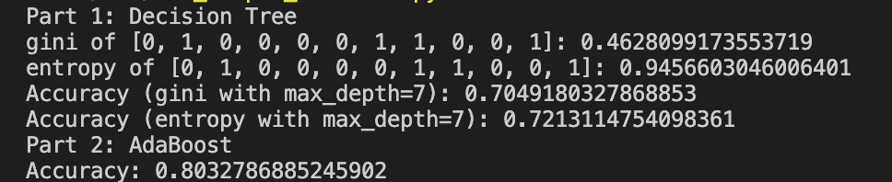
Code Output
Do not modify the main function architecture.
Your code output will look like this:
Notes:
We have already finished the main function, do not modify it and your code output will look like this.

Slide 14
Report
Please follow the same report template format just like HW1.
Link
Notes:
About the report, please follow the report template format.

Slide 15
Submission
Compress your code and report into a .zip file and submit it on E3.
<STUDENT ID>_HW3.zip
<STUDENT ID>_HW3.py
<STUDENT ID>_HW3.pdf (do not submit .doc, .docx or others format)
Notes:
About submission, you have to Compress your code and report into a .zip file and submit it on E3. You should name your files correctly.

Slide 16
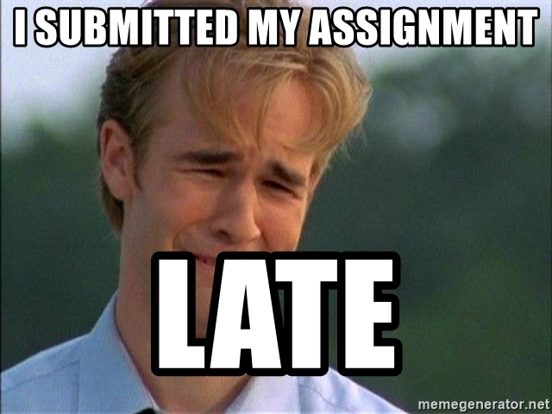
Late policy
We will deduct a late penalty of 20 points per additional late day.
For example, If you get 90 points but delay for two days, your will get only 50 points!
Notes:
The final section is about our late policy. Please be aware that for each additional late day beyond the due date, a late penalty of 20 points will be deducted. For instance, if you earned 90 points but submitted your work two days late, your final score will be reduced to 50 points. Please submit your assignment on time.

Slide 17

Have Fun!
https://www.pinterest.com/pin/409475791116140835/

