Slide 1
Introduction to Machine Learning
Homework 4 Announcement
Presenter: TA Jui-Che (Ben)
Lastest update: 2023/11/28 12:00
Notes:
‹#›
Good afternoon, everyone. I'm Ben. Today I’m going to announce homework 4.
The content of this homework is slightly different from last year’s, so if you have any questions during this annoucement, please feel free to raise your hand.
By the way, dont forget to submit your HW3 before the deadline tonight.

Slide 2
Homework 4
Deadline: 23:59, Dec. 19th (Tue), 2023
Coding (50%): Implement kernel methods by only using numpy.
Submit your python file (.py).
Answer the questions (by screenshots) in the report (.pdf).
Handwritten Questions (50%): Answer questions about kernel methods.
Answer the questions (handwritten, typed, digital, etc.) in the report.
Notes:
You will have three weeks to complete this assignment, as the deadline is set for December 19th.
This assignment consists of two section:
The first section is Coding: In this section, you'll implement kernel methods only using NumPy. You should submit your code and answer some associated questions in the report.
The second section is Hand-Written Questions: In this section, you'll answer theoretical questions about kernel methods. You can choose your preferred method for responses, whether handwritten, typed, or digital, as long as your answers are clear and readable."

Slide 3
Links
Questions: Link
Sample code: Link
Dataset: Link
Report template: Link (same as HW1)
Notes:
Here are some links about this assignment, and these links are on E3 system too.

Slide 4
Environment
Python version: 3.8 or newer
Tips
We recommend that you use virtual environments when implementing your homework assignments.
Here are some popular virtual environment management tools:
Conda
Miniconda
virtualenv
Notes:
The following slide covers the topic of the environment. Please use Python 3.8 or a newer versions. We strongly encourage the use of virtual environments when working on your homework assignments. Below are some popular tools for managing virtual environments:

Slide 5
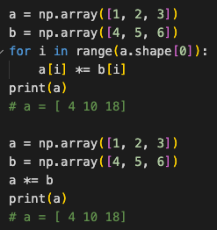
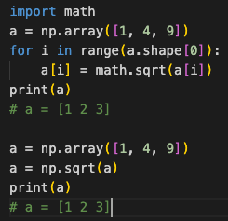
Numpy
Build-in array operations.
Numpy Tutorial: Link
Notes:
As previously mentioned, you will be implementing linear classification methods using only NumPy. NumPy is a powerful Python library that supports a wide range of array operations. We recommend that you have a basic understanding of NumPy before getting started. For instance, when performing element-wise multiplication, avoid writing code like this and instead utilize NumPy's multiplication function. Similarly, if you need to calculate element-wise square roots, there's no need to use the math library; simply use NumPy's numpy.sqrt() function.

Slide 6
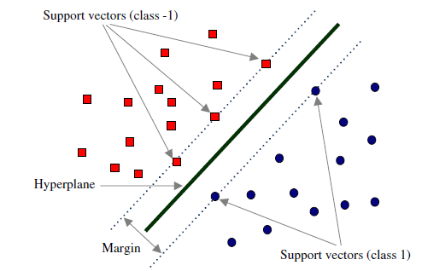
Support Vector Machine
To find the best possible line, or decision boundary, that separates the data points of different data classes.
https://hackmd.io/@kk6333/S1e7M5RGs
Notes:
In the course, you learned about Support Vector Machine, which is to find the best possible line, or decision boundary, that separates the data points of different data classes with the greatest margin.
In this homework, you are going to implement some fundamental parts of support vector machine.

Slide 7
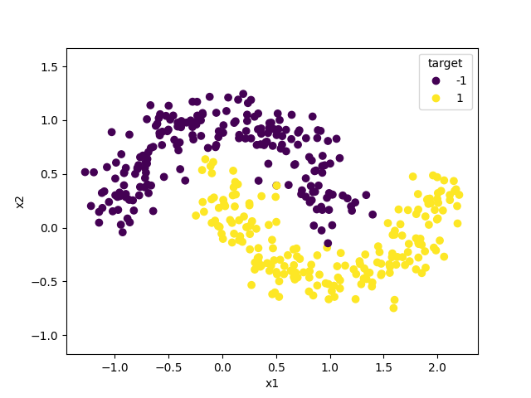
Dataset
Binary Classification in 2D space
Features
x1
x2
Target
target (class label: -1, 1)
Notes:
You are going to implement SVM classifier on this simple dataset. It’s a binary classification problem in 2D space.
There are two features, x1 and x2, your task is to distinguish between the two classes based on the two features.
You can easily observed that this dataset is not linearly separable.

Slide 8
Support Vector Machine
Requirements:
Implement the gram_matrix function to compute the Gram matrix of the given data with an argument kernel_function to specify which kernel function to use.
Implement the linear_kernel function to compute the value of the linear kernel between two vectors.
Implement the polynomial_kernel function to compute the value of the polynomial kernel between two vectors with an argument degree.
Implement the rbf_kernel function to compute the value of the rbf kernel between two vectors with an argument gamma.
Notes:
First of all, you will implement the gram_matrix function to compute the Gram matrix of the given data with an argument kernel_function to specify which kernel function to use.
Then, you will implement three kernel functions: the linear kernel, the polynomial kernel with an argument degree, and the rbf kernel with an argument gamma.

Slide 9
Support Vector Machine
Tips
Your functions will be used in the SVM classifier from scikit-learn like the code below.
svc = SVC(kernel='precomputed')
svc.fit(gram_matrix(X_train, X_train, your_kernel), y_train)
y_pred = svc.predict(gram_matrix(X_test, X_train, your_kernel))
For hyperparameter tuning, you can use any third party library’s algorithm to automatically find the best hyperparameter. In your submission, just give the best hyperparameter you used and do not import any additional libraries/packages.

Slide 10
Support Vector Machine
Criteria:
(10%) Show the accuracy score of the testing data using linear_kernel. Your accuracy score should be higher than 0.8.
(20%) Tune the hyperparameters of the polynomial_kernel. Show the accuracy score of the testing data using polynomial_kernel and the hyperparameters you used.
(20%) Tune the hyperparameters of the rbf_kernel. Show the accuracy score of the testing data using rbf_kernel and the hyperparameters you used.
Points | Testing Accuracy
20 points | 0.98 <= acc
15 points | 0.90 <= acc < 98
10 points | 0.85 <= acc < 0.90
5 points | 0.8 <= acc < 0.85
0 points | acc < 0.8

Slide 11
Code Output
Do not modify the main function architecture.
Your code output will look like this:
Notes:
We have already finished the main function, do not modify it and your code output will look like this.

Slide 12
Report
Please follow the same report template format just like HW1.
Link
Notes:
About the report, please follow the report template format.

Slide 13
Submission
Compress your code and report into a .zip file and submit it on E3.
<STUDENT ID>_HW4.zip
<STUDENT ID>_HW4.py
<STUDENT ID>_HW4.pdf (do not submit .doc, .docx or others format)
Notes:
About submission, you have to Compress your code and report into a .zip file and submit it on E3. You should name your files correctly.

Slide 14

Late policy
We will deduct a late penalty of 20 points per additional late day.
For example, If you get 90 points but delay for two days, your will get only 50 points!
Notes:
The final section is about our late policy. Please be aware that for each additional late day beyond the due date, a late penalty of 20 points will be deducted. For instance, if you earned 90 points but submitted your work two days late, your final score will be reduced to 50 points. Please submit your assignment on time.

Slide 15
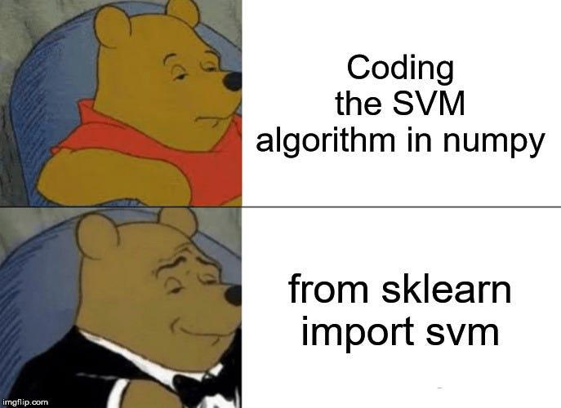
Have Fun
https://towardsdatascience.com/the-complete-guide-to-support-vector-machine-svm-f1a820d8af0b

