Slide 1
AI Flash Card App
Team 1

Slide 2
Motivation
Current apps lack efficient methods for adding word cards, requiring users to input the details themselves.
Our proposed app solves the problem through the power of generative AI, without losing the advantages that other apps offer.
Users can now enjoy language learning with simplicity, fluency, and efficiency.

Slide 3
Feature
Al auto-generating word cards
Generally add via text
Fast add via photo
Voice of pronunciation for each added word card
Learning easier with choice question instead key-in question
Personal learning condition and statistics review

Slide 4
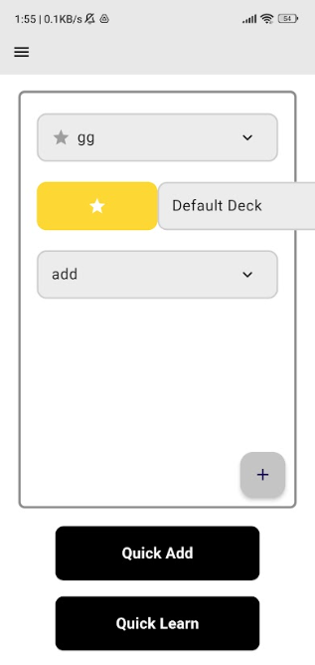
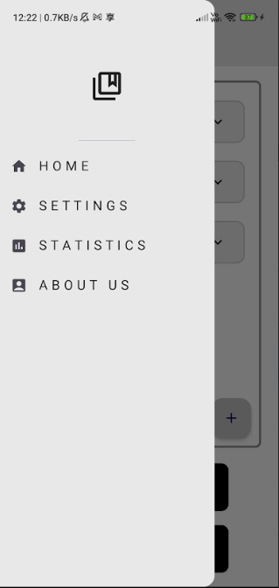
Home
Deck list
Quick add and Quick learn
Favorite

Slide 5
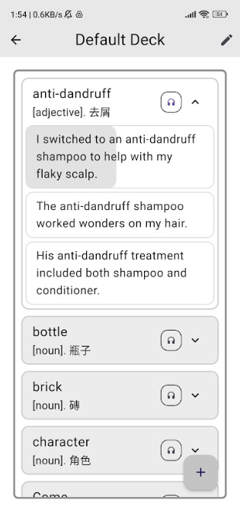
View Deck
Word card information
Word pronunciation
Examples reading

Slide 6
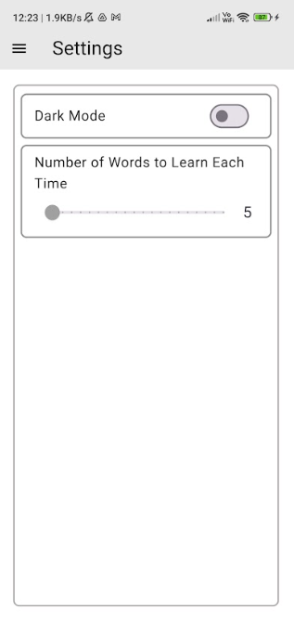
Settings
Dark / Light mode
Number of word to learn

Slide 7
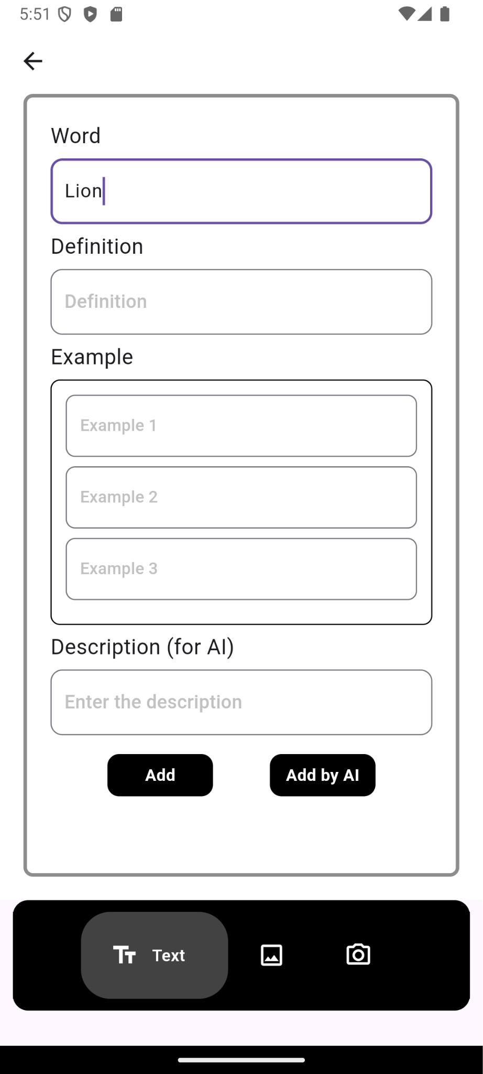
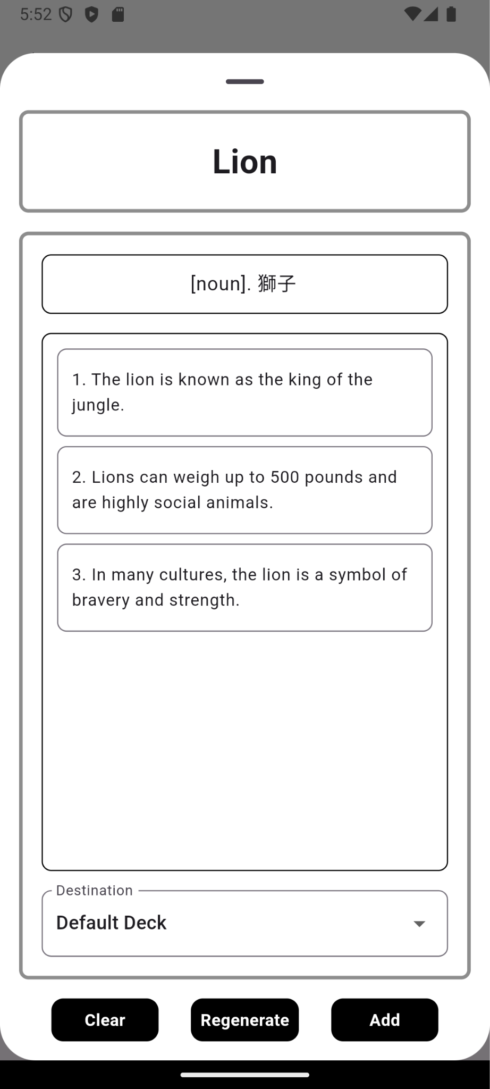
Add from Text
Type in the vocabulary
Then press “Add by AI”
Notes:
home page -> add page

Slide 8
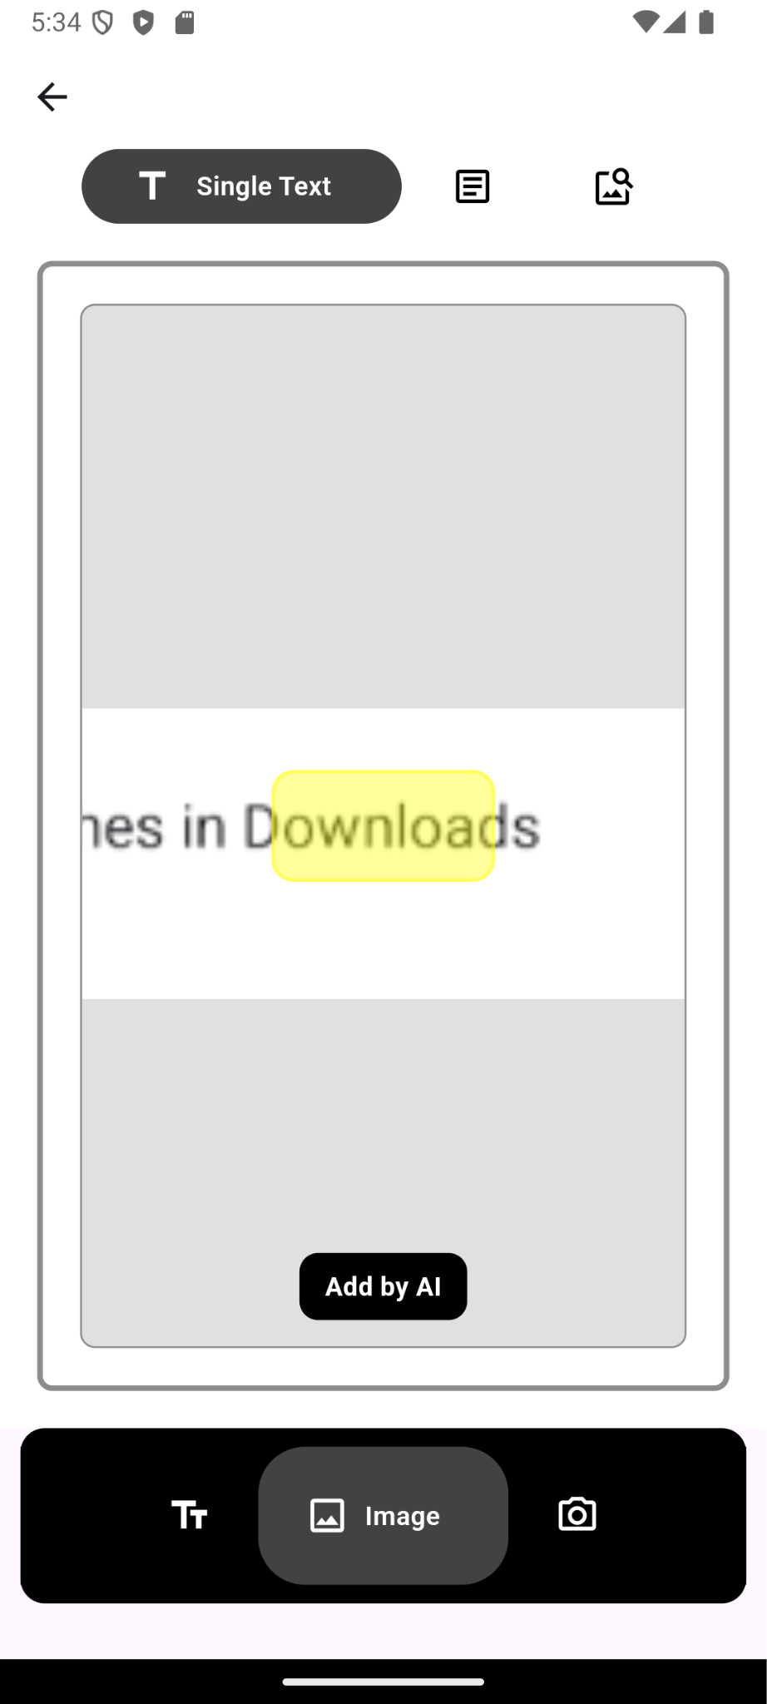
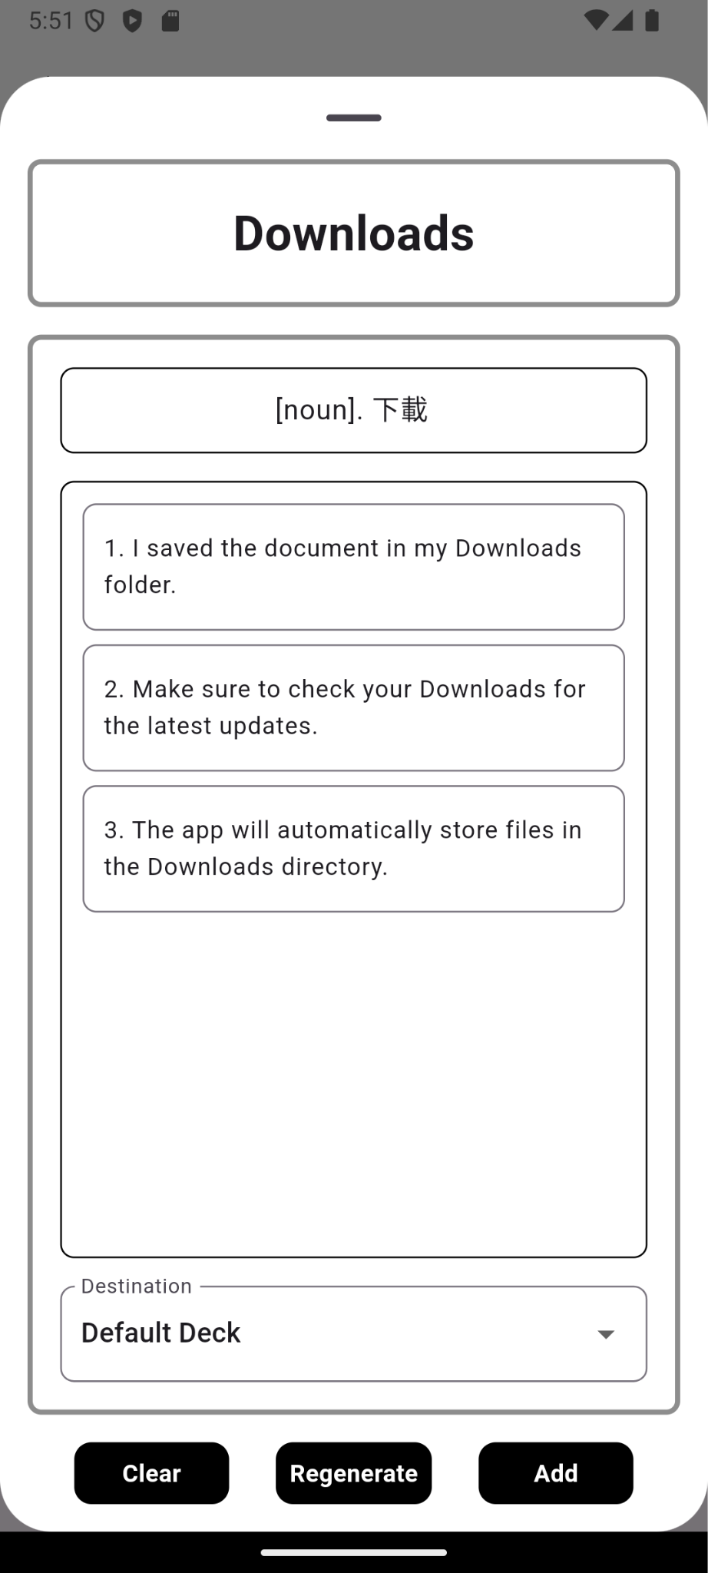
Add from Image (1)
First select image
Choose “Singe Text”
Drag the image
Then press “Add by AI”
Notes:
word add, image add, takeghome

Slide 9
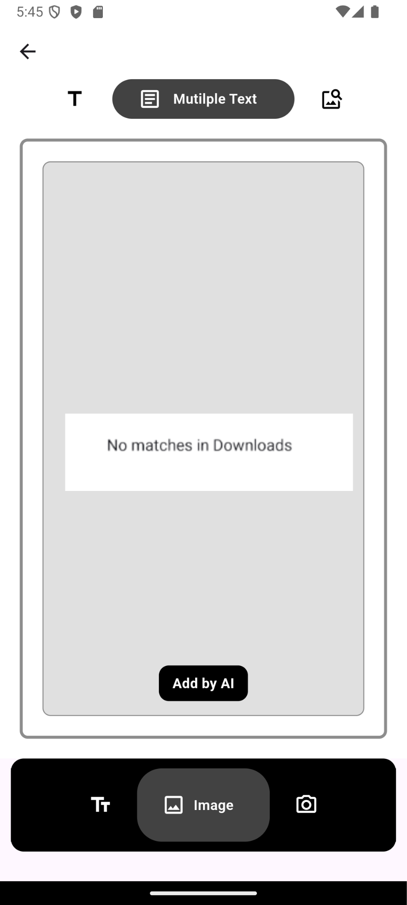
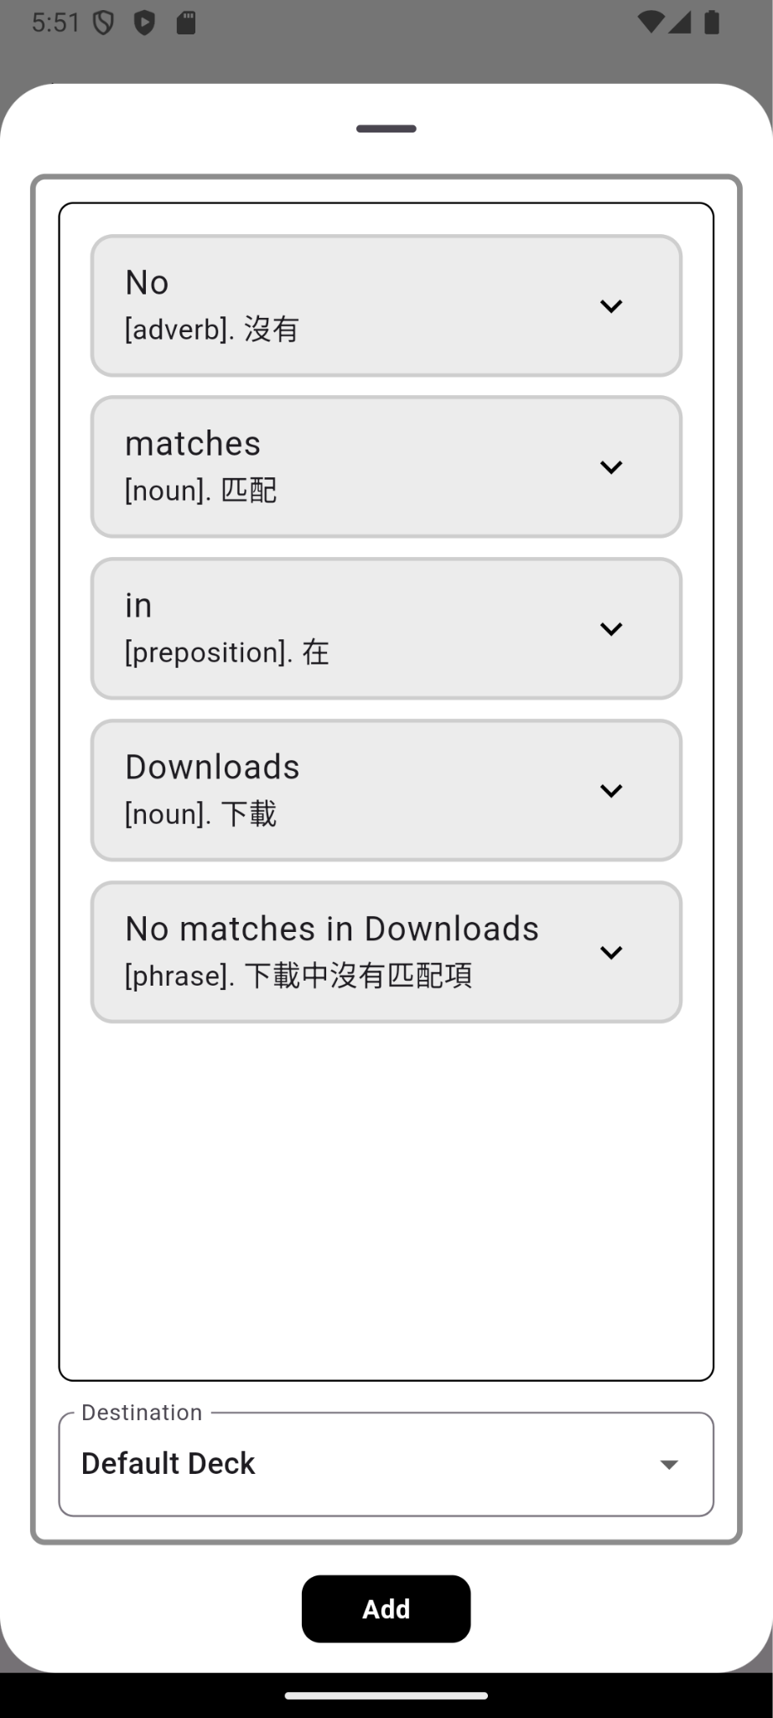
Add from Image (2)
First select image
Choose “Multiple Text”
Then press “Add by AI”

Slide 10
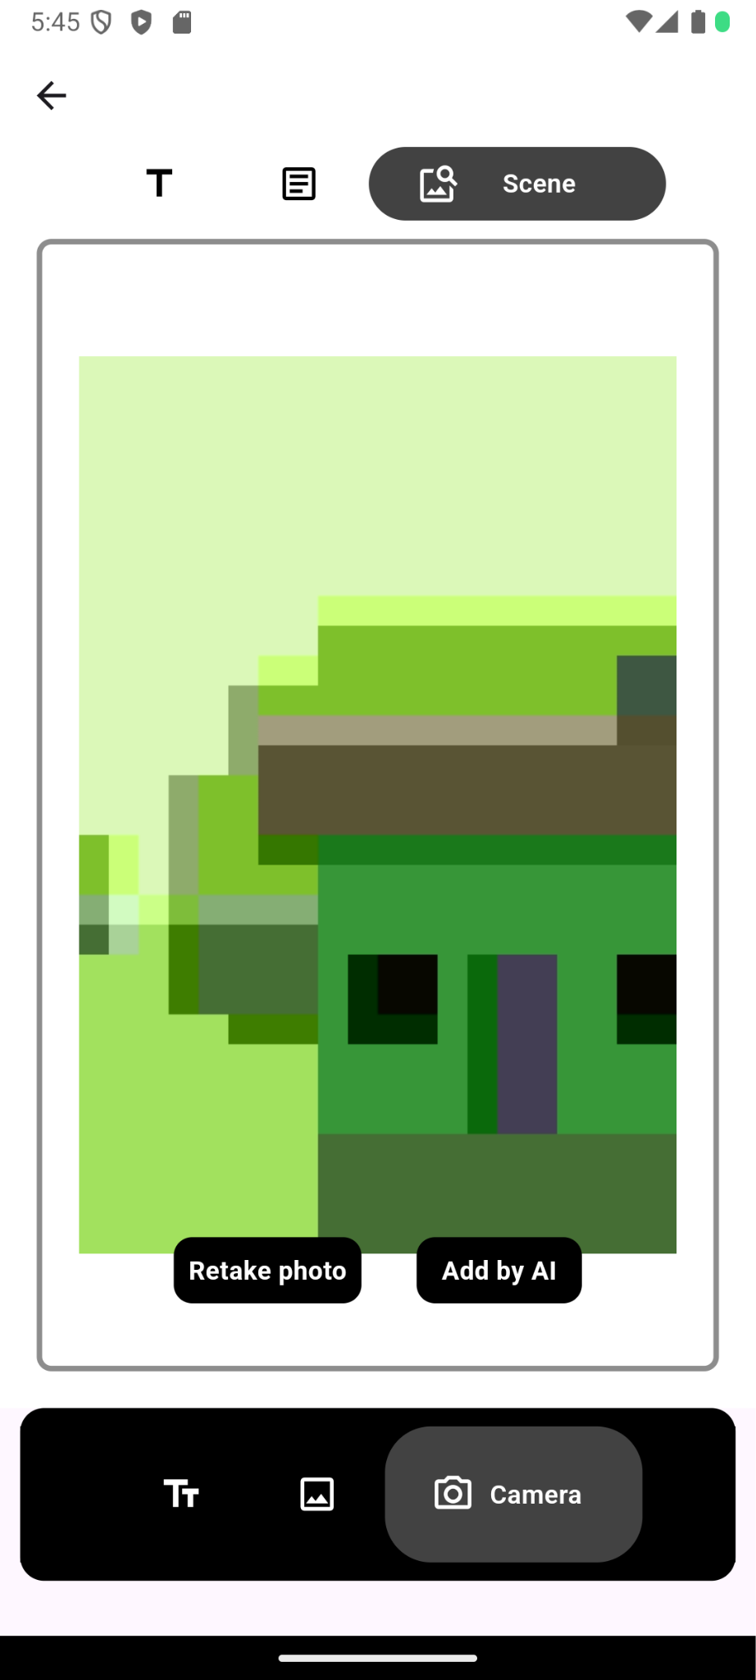
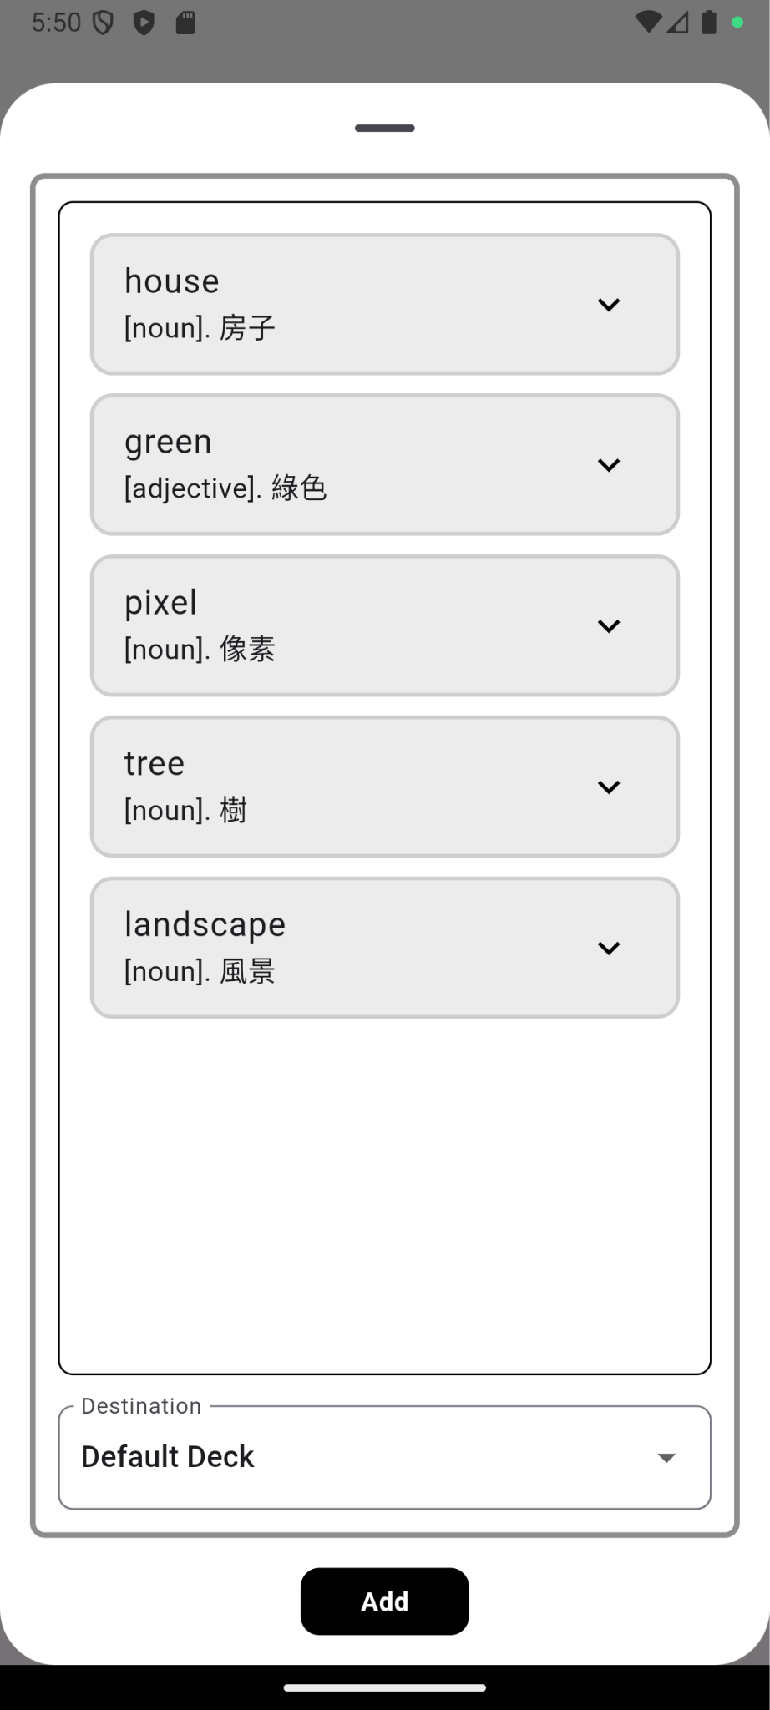
Add from Image (3)
First select image
Choose “Scene”
Then press “Add by AI”

Slide 11
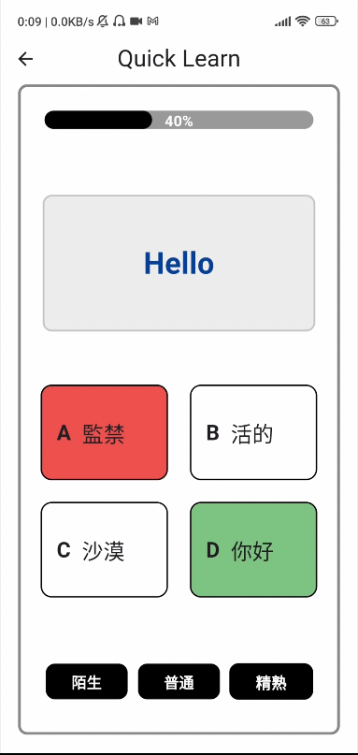
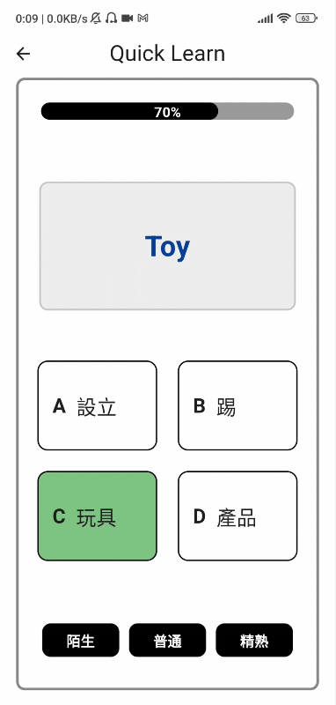
Learn - Mutliple Choice
Self-evaluation
Learn unfamiliar words first

Slide 12
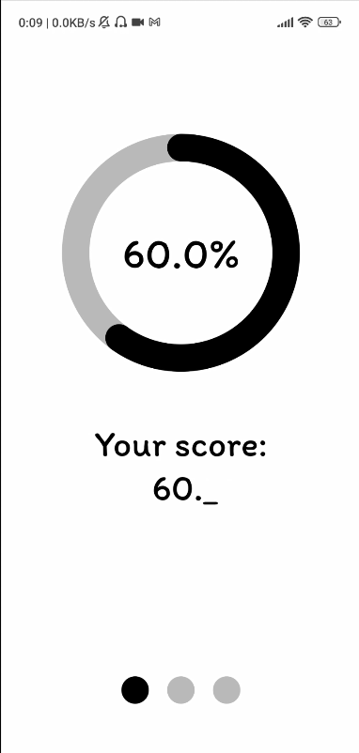
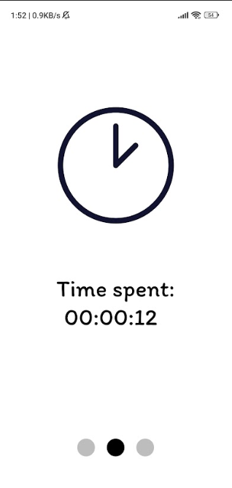
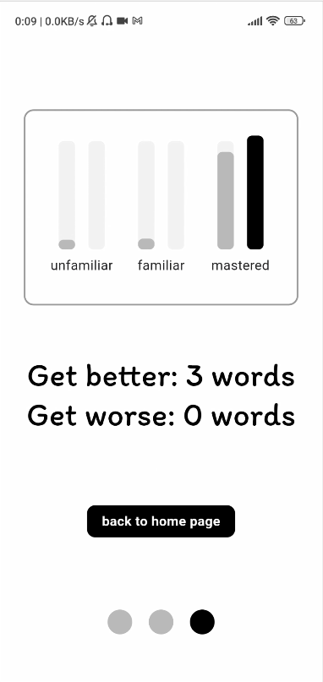
Learn - Statistics
Score
Total learning time
Familiarity statistics

Slide 13
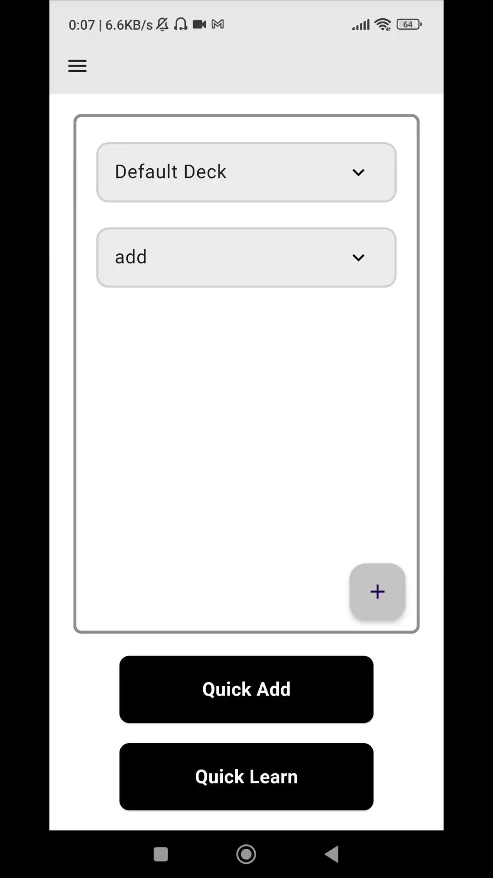
Demo

