Slide 1
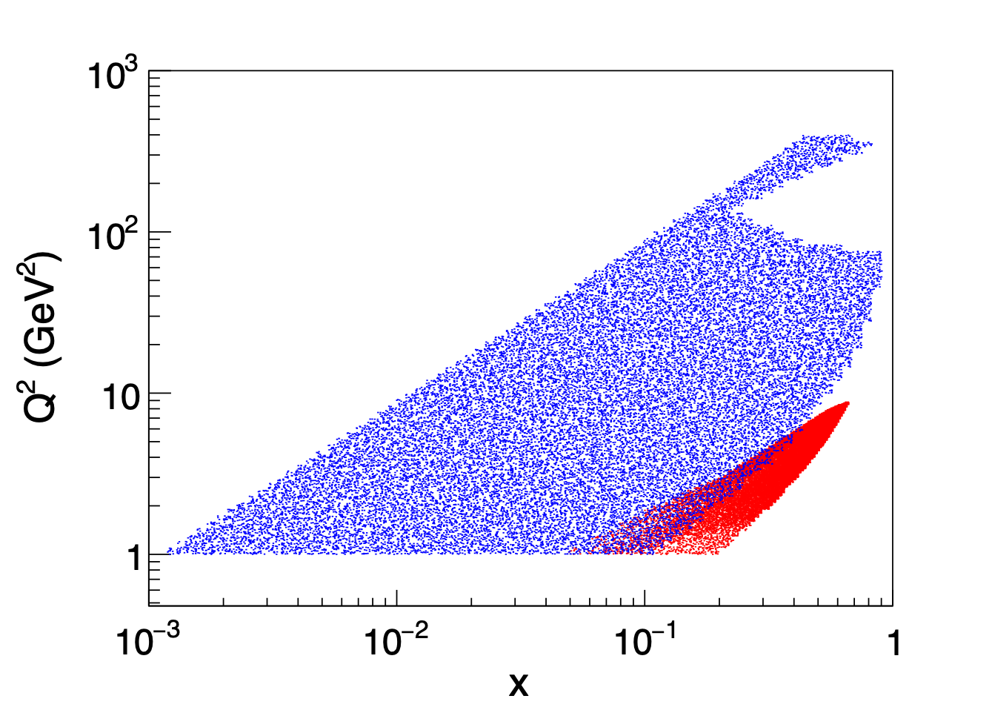


EIC vs. SoLID Kinematic Coverage
qT<Q
qT<Q/3
qT<Q/5
qT=PhT/z

Slide 2
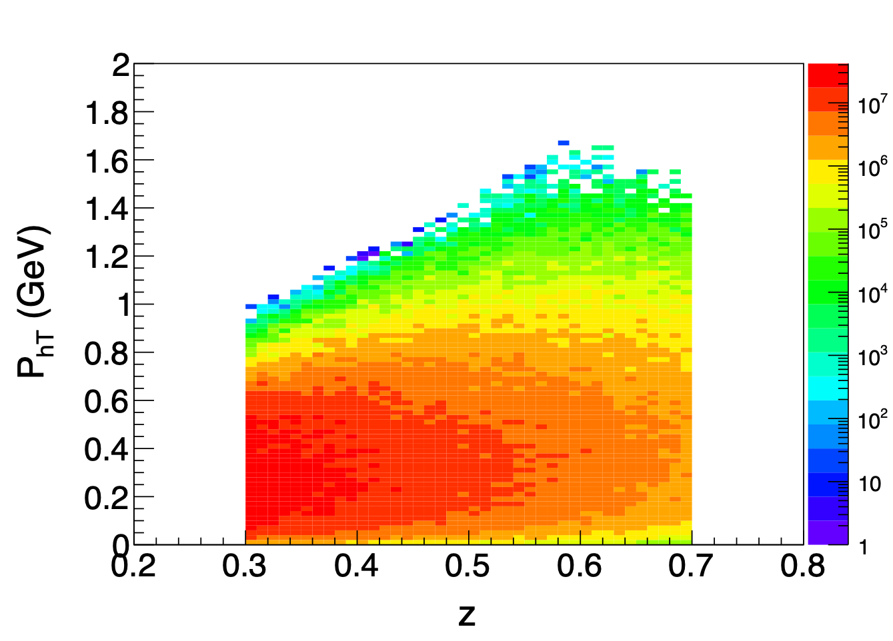
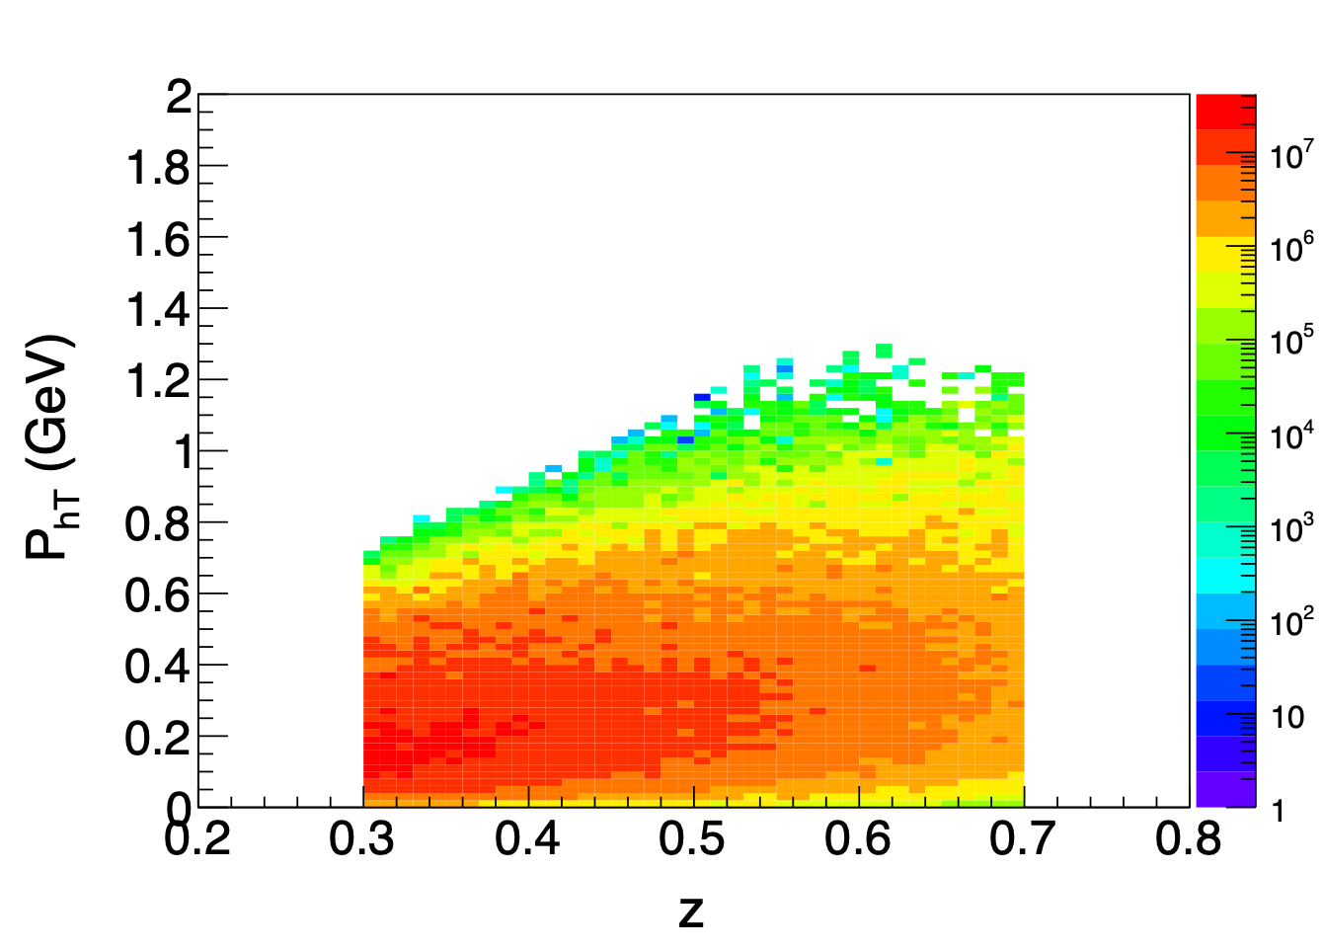
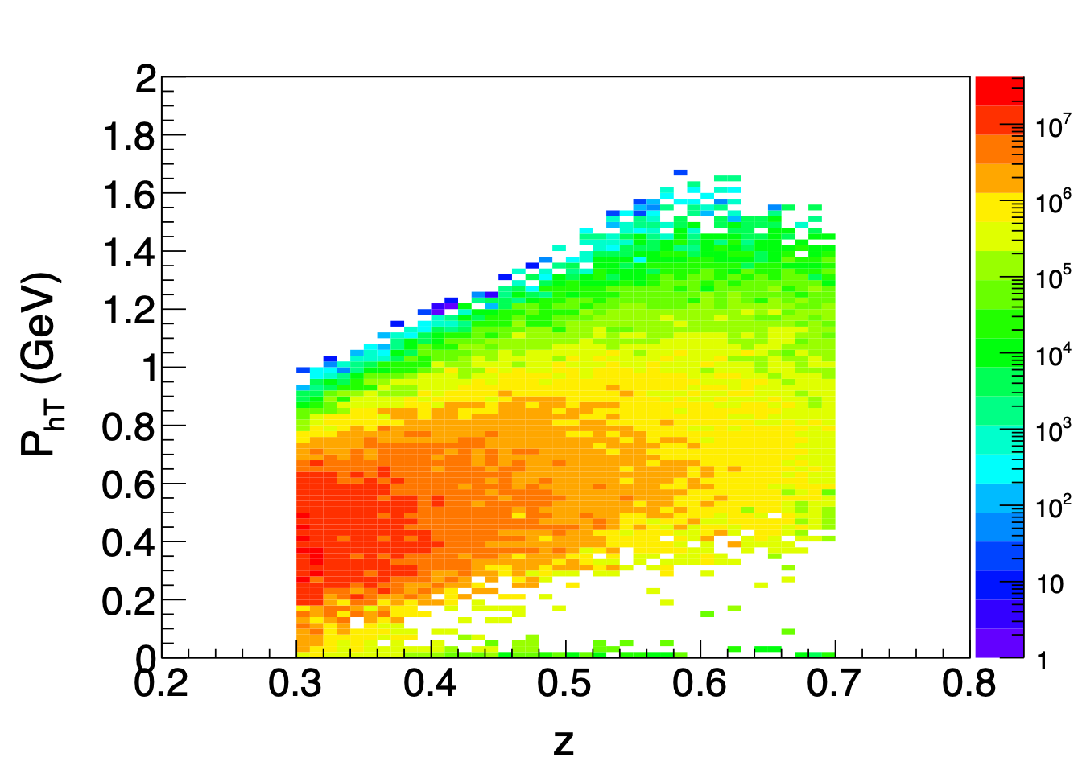
SoLID Regions
All
R<0.4
R>0.4

