Slide 1
Gasoline Price Prediction
Understanding and Predicting Near-Term Trends in Gasoline Prices
Presented by Tianchen Wang, Wei Xia, Shih-Yu Huang and Tang-Shuo Kao

Slide 2
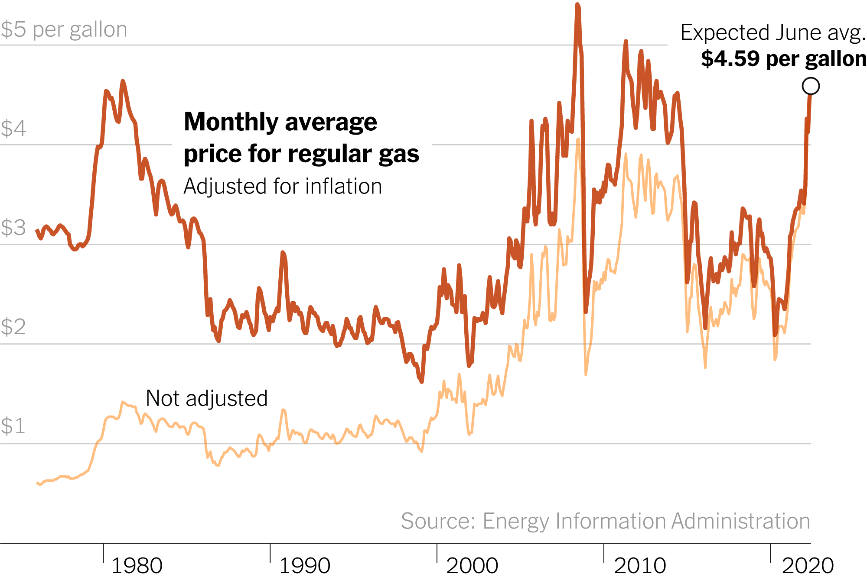
Problem Statement
• Rising gasoline prices impact citizens and policymakers.
• Need for near-term predictions to aid in budgeting and policy formulation.
Key Question:
Can we accurately predict next week's gasoline prices?
Contributed by Wei Xia

Slide 3
Data Description
• Dataset Overview:
- Weekly U.S. net imports of crude oil and petroleum products.
- Historical gasoline prices.
- Additional features (e.g., weather, car sales).
• Data Sources:
- https://www.eia.gov/dnav/pet/hist_xls/EMM_EPM0_PTE_NUS_DPGw.xls
- https://www.ncdc.noaa.gov/cdo-web/datasets
Contributed by Wei Xia

Slide 4
Methodology
• Model: A fully connected feedforward neural network, designed for regression tasks to predict gasoline price changes.
• Architecture:
• Input layer to process features.
• Multiple dense (fully connected) layers with activation functions like ReLU and Leaky ReLU.
• Dropout layers for regularization.
• Output layer with a linear activation for price prediction.
Contributed by Wei Xia

Slide 5
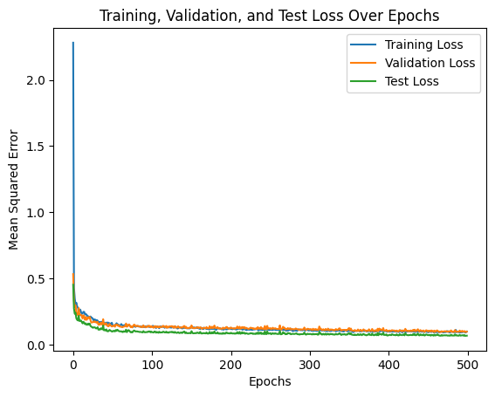
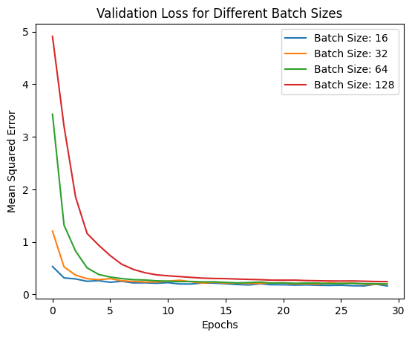
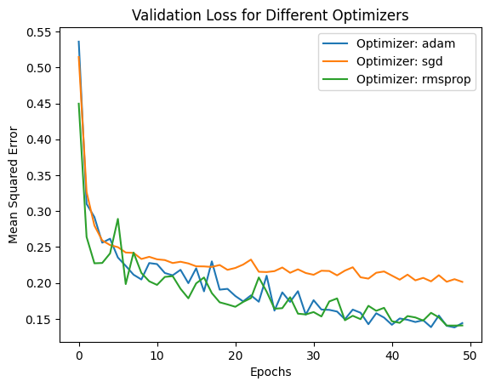
Methodology
• Optimization:
• Experimentation with various activation functions, optimizers (e.g., Adam, SGD), and batch sizes to achieve optimal performance.
• Training Setup:
• Mean squared error (MSE) as the loss function.
• Model trained with a dataset split into training and validation subsets.
Contributed by Wei Xia

Slide 6

Results
• Key Findings:
- Performance metrics and accuracy.
- Comparison with baseline models.
• Visualizations:
- Feature importance.
- Predictions vs. actual prices.
Contributed by Wei Xia

Slide 7
Challenges and Solutions
• Challenges:
- Data preprocessing complexities.
- Model convergence issues.
• Solutions:
- Improved feature engineering.
- Hyperparameter tuning.
Contributed by Wei Xia

Slide 8
Conclusion and Future Work
• Summary:
- Accurate predictions help citizens and policymakers.
• Future Steps:
- Incorporating more features.
- Exploring alternative models (e.g., transformers).
Contributed by Wei Xia

Slide 9
Acknowledgments
• Team Members:
- Tianchen Wang, Wei Xia, Shih-Yu Huang, Tang-Shuo Kao
• Program:
- Fall 2024 - IE 534 Deep Dive Project

