Slide 1

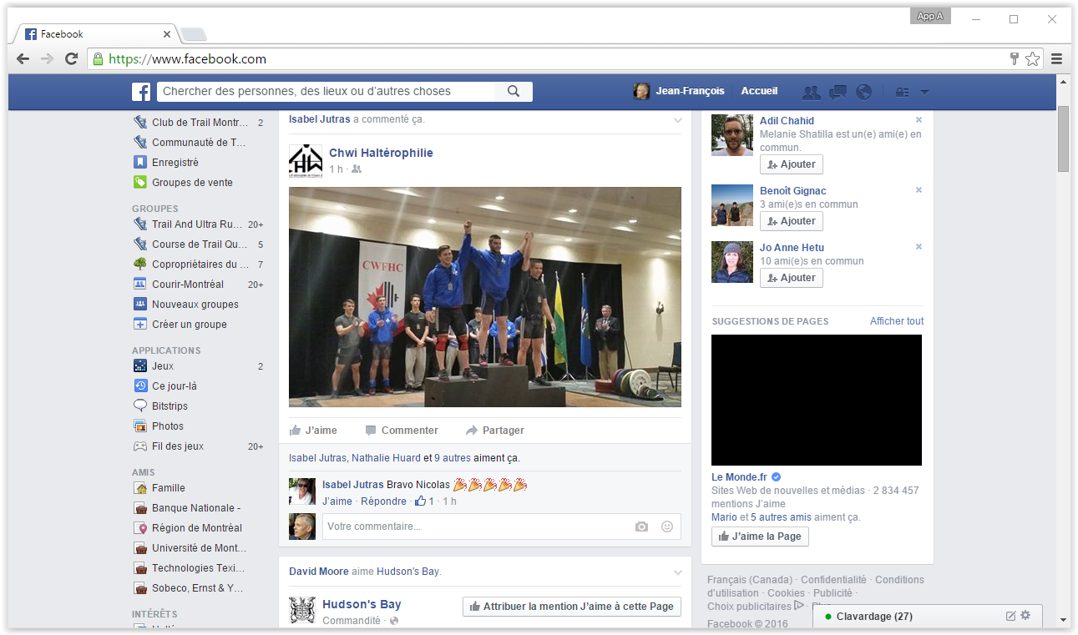
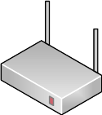
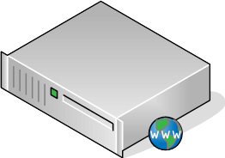

Facebook server
Browser
192.168.1.105
192.168.1.1
69.63.181.15

Slide 2
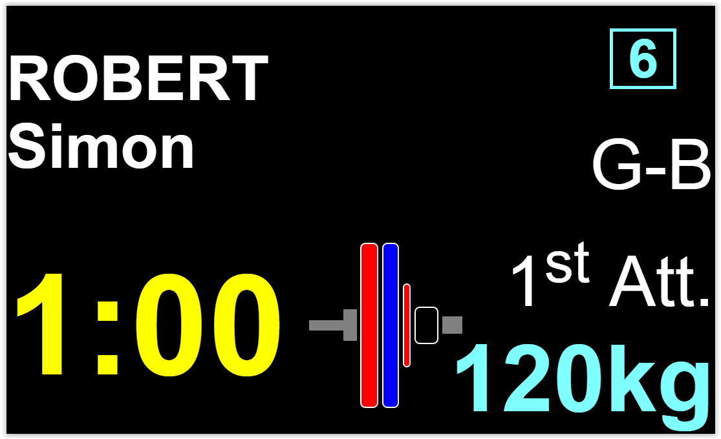
owlcms server
Browser
192.168.1.105
remote browser
192.168.1.1
192.168.1.106
http server

Slide 3
Browser
owlcms server
192.168.1.105 remote browser
192.168.1.1
192.168.1.100 http server

Slide 4
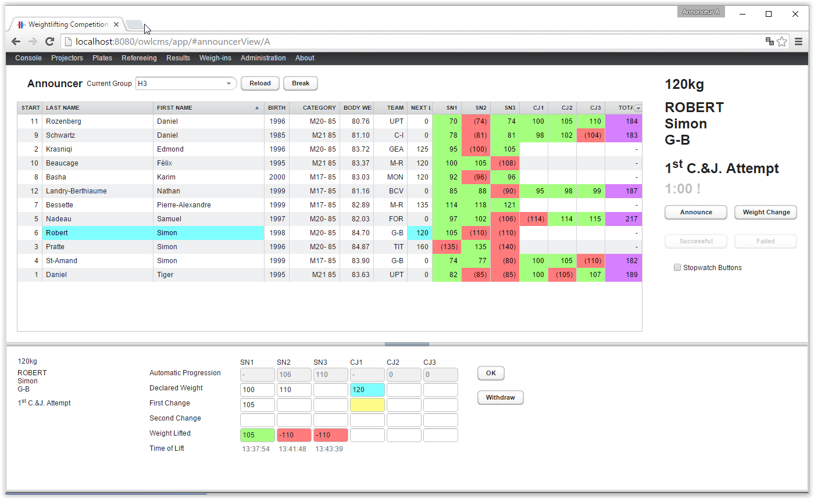
Browser
Browser
owlcms server
192.168.1.105 remote browser
192.168.1.1
192.168.1.100 http server (127.0.0.1 for local browser)

Slide 5
Browser
owlcms server
127.0.0.1 http server

