Slide 1
Universal Password Manager
Team Members:
Xingping Ding 905084
Tiange Wang 903588
Yijie Mei 861351

Slide 2
Background
Password reuse attack
Using same password

Slide 3

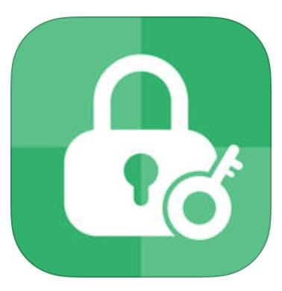
Related Work
Password 3 Pwd Manager

Slide 4
Survey
Questionnaires
Stolen or hacked (83%)
Over-simple passwords (57%)
Same passwords (88%)

Slide 5
Requirements Analysis
Manage various passwords
More security login in
Generate high security passwords
Backup and synchronise

Slide 6
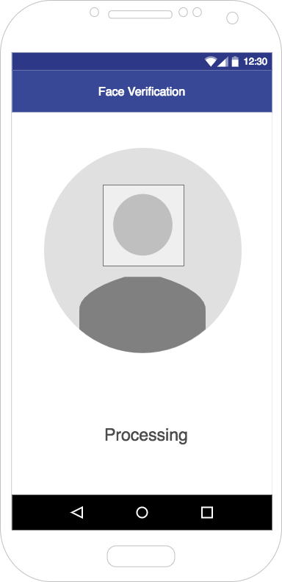
Log in function
Face verification
Dual-factor authentication

Slide 7
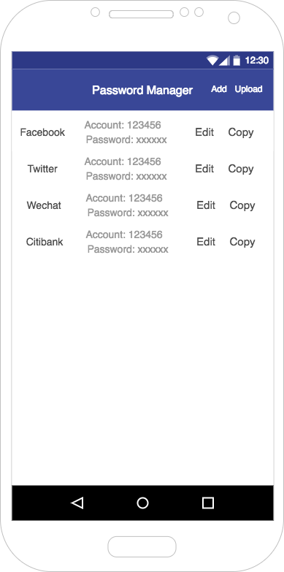
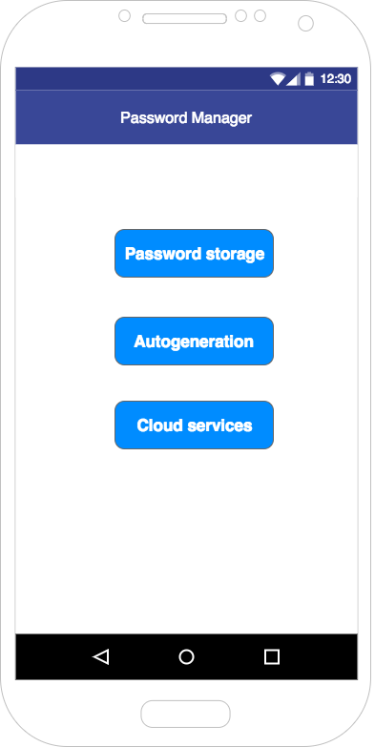
Password storage
Manual storage
Automatic storage
AES encryption

Slide 8
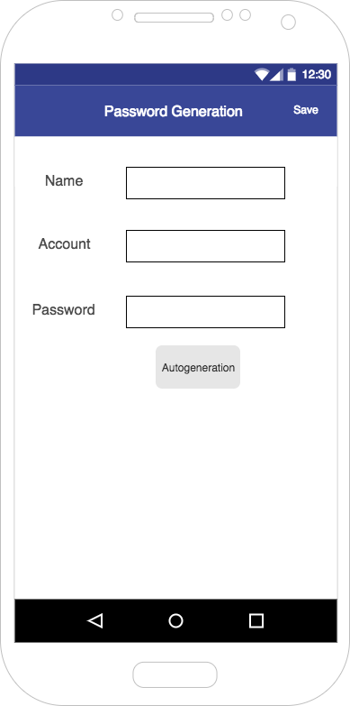
Autogeneration
Generate a password with high security level and store it in the database
‘Shake’ function to regenerate a new password

Slide 9
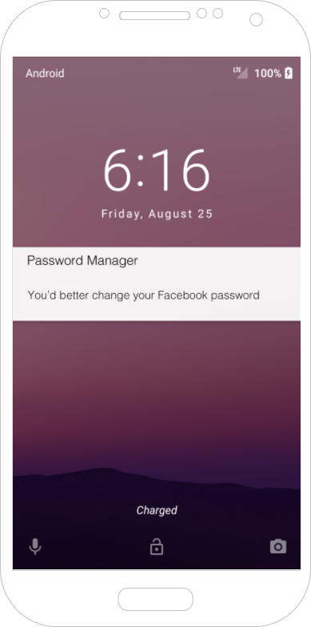
Autogeneration
Automatic reminder to notify users to change the password in time

Slide 10
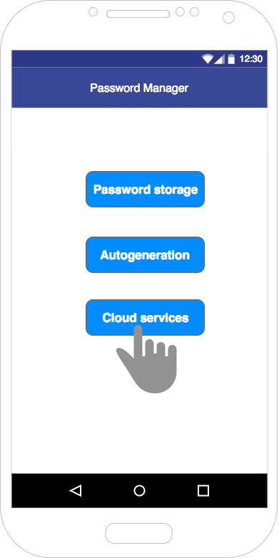
Cloud service
Dual-factor authentication for the first usage (change the phone)
Backup and synchronise

Slide 11
Evaluation
Are you willing to download a password manager app to help you save and manage passwords?

Slide 12
Evaluation-interview
Interviewee 1: a project manager
Interviewee 2: a MIT student in Unimelb
Interviewee 3: a student in Unimelb who studys translation
These three people are our target users. We introduced our functions and aims of our product and collected their feedbacks.

Slide 13
Summary
problems of using the same password
password manager
cloud password services
limitations

