Slide 1

Fake News Challenge
DATA130030.01 (自然语言处理)
School of Data Science Fudan University
05/24/2023

Slide 2
Outline
Introduction
Preliminary work (EDA)
Related Work
Future Plan

Slide 3
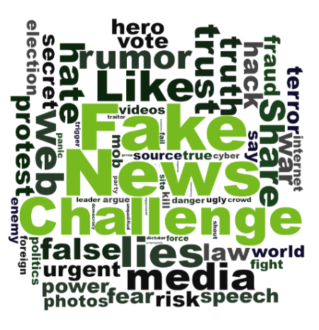
The first Fake News Challenge (FNC-1)
Organized by Pomerleau and Rao in 2017
Foster the development of AI technology to automatically detect fake news.
Received much attention in the NLP community: 50 teams from both academia and industry participated
The goal is to determine the perspective (or stance) of a news article relative to a given headline.

Slide 4
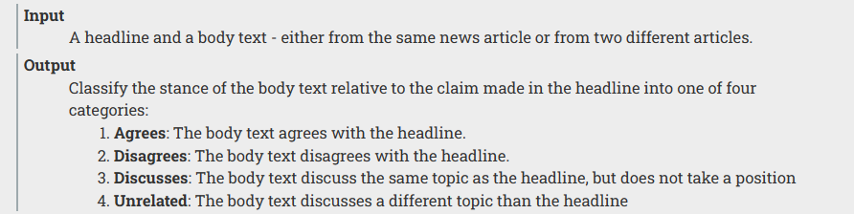
The Input and Output of the Task
The body text agress with the headline.
The body text disagrees with the headline.
The body text discuss the same topic as the headline,but does not take a position.
The body text discusses a different topic than the headline.
Agrees
Disagrees
Discusses
Unrelated

Slide 5
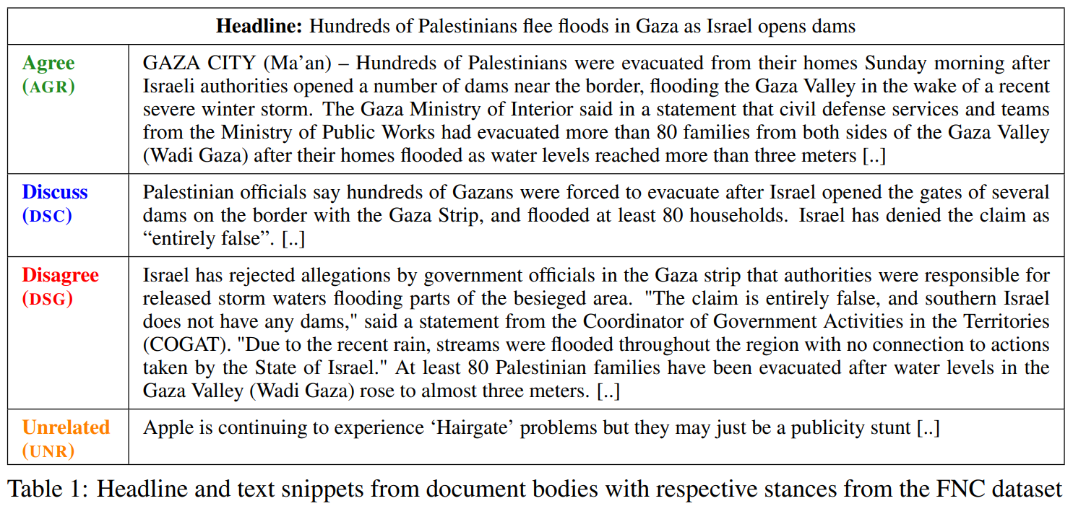
Example

Slide 6
Example
标题： 以色列打开水坝，数百名巴勒斯坦人逃离加沙的水灾
加沙城（马安社）-在最近的一次严重冬季风暴之后，以色列当局打开边境附近的多座水坝，淹没了加沙谷地，导致数百名巴勒斯坦人在周日早上被疏散。加沙内政部发表声明称，民防部门和公共工程部门的救援队伍已经撤离了加沙谷地（瓦迪•加沙）两岸的80多个家庭，因为水位超过了三米，家园被淹。
巴勒斯坦官员表示，以色列在与加沙地带边境上打开了几座水坝的闸门，导致数百名加沙居民被迫疏散，至少80户家庭被淹。以色列否认这一说法是“完全错误”的。[..]
以色列否认了加沙地带政府官员的指控，称当局应对淹没围困区域的风暴水有责任。来自领土管理协调员（COGAT）的一份声明称：“这种说法完全是错误的，以色列南部没有任何水坝。”“由于最近的降雨，整个地区的河流都发生了淹水，这与以色列国家的行动无关。”至少80个巴勒斯坦家庭已经被疏散，因为加沙谷地（瓦迪•加沙）的水位上涨到了将近3米。[..]
苹果公司继续遭遇“头发门”问题，但这可能只是一个宣传噱头[..]
[A Retrospective Analysis of the Fake News Challenge Stance-Detection Task](https://aclanthology.org/C18-1158) (Hanselowski et al., COLING 2018)

Slide 7
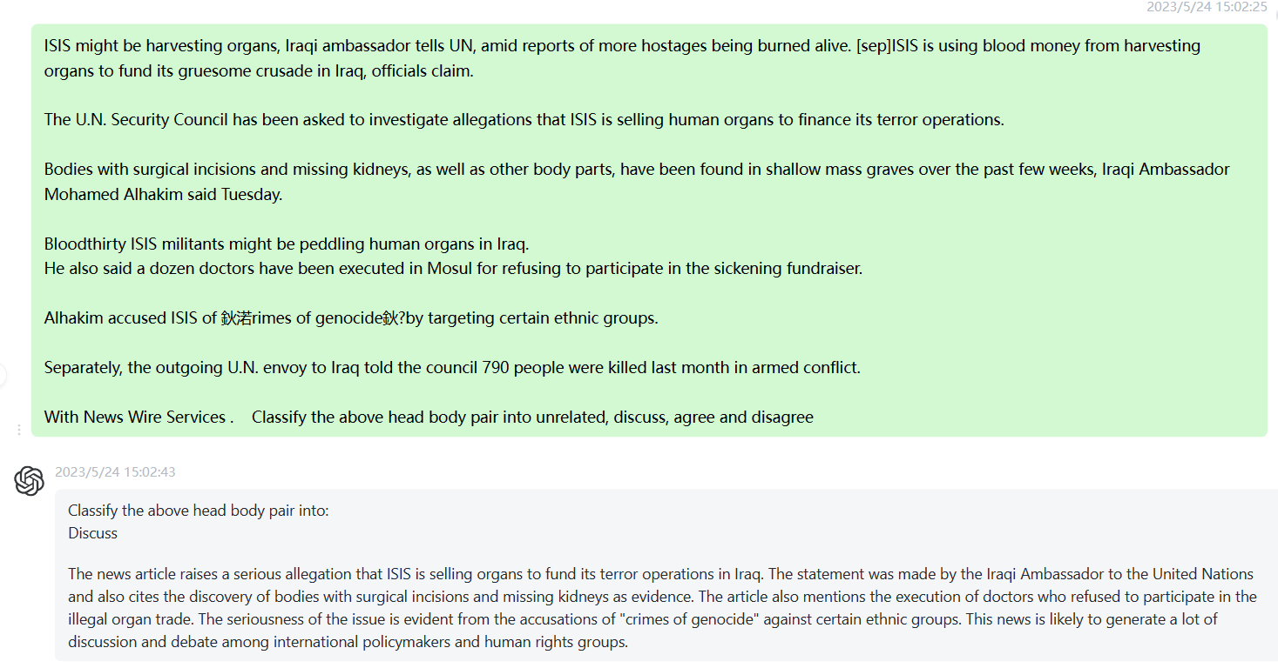
ChatGPT

Slide 8
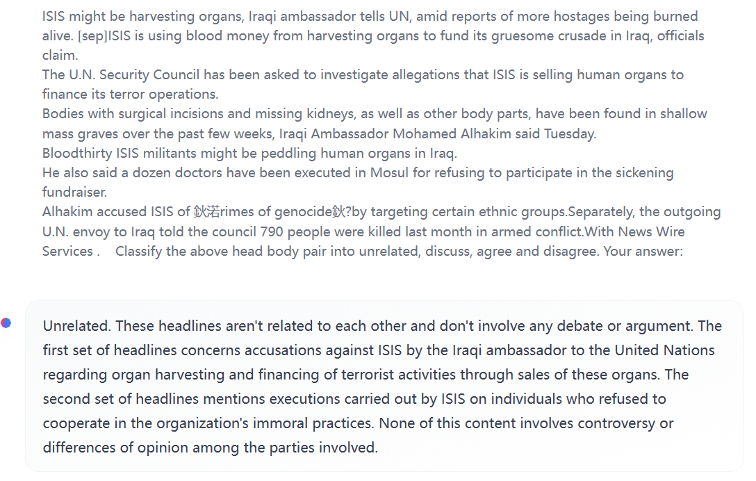
LLaMA -30B

Slide 9
Outline
Introduction
Preliminary work
Related Work
Future Plan

Slide 10
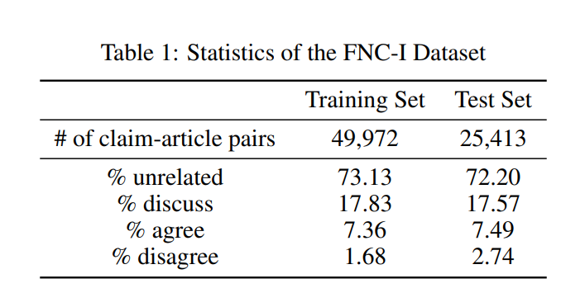
Exploratory data analysis
Imbalanced Data !

Slide 11
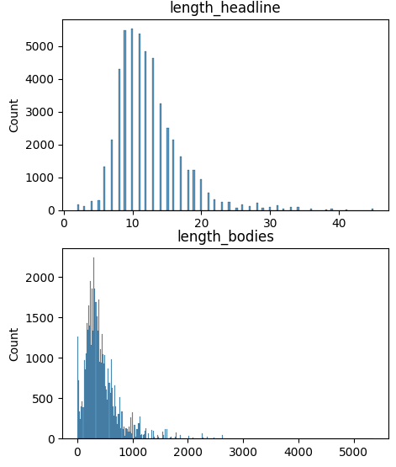
Exploratory data analysis
A wide range of length distribution!
A large maximum length!
Length Constraints of NLP Models! E.g. Bert: 512 tokens

Slide 12
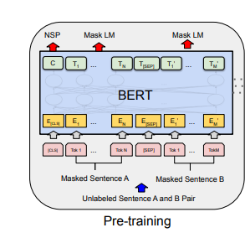
Preliminary Finetune Bert
NSP is similar to part of this task, perfect for this challenge
Proposed in 2018
Otherwise, everyone who participated in the competition at that time would have used BERT🤣
Devlin, J., Chang, M.-W., Lee, K., & Toutanova, K. (2019). BERT: Pre-training of Deep Bidirectional Transformers for Language Understanding.

Slide 13
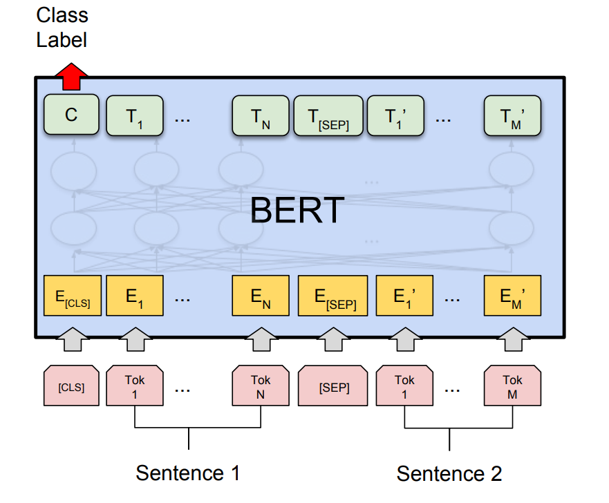
Preliminary Finetune Bert
NSP is similar to part of this task, perfect for this challenge
Proposed in 2018
Otherwise, everyone who participated in the competition at that time would have used BERT🤣
Devlin, J., Chang, M.-W., Lee, K., & Toutanova, K. (2019). BERT: Pre-training of Deep Bidirectional Transformers for Language Understanding.

Slide 14
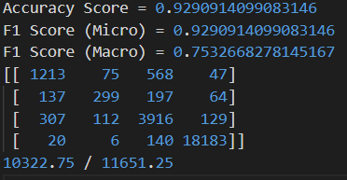
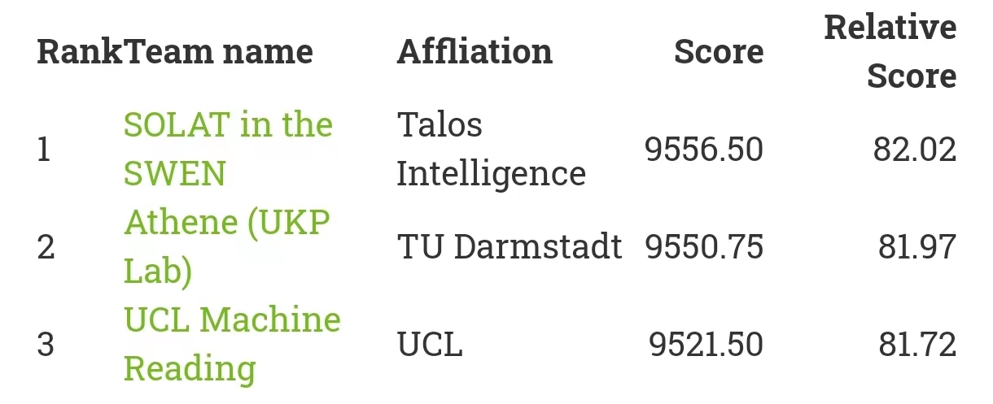
Preliminary Finetune Bert
Bert-base-uncased
Truncate to 256 tokens, use only head of bodies
Nearly 800 points higher than the previous SOTA
Micro F1 is high but Macro F1 is much lower
Still can’t distinguish minor class well

Slide 15
Outline
Introduction
Preliminary work
Related Work
Future Plan

Slide 16
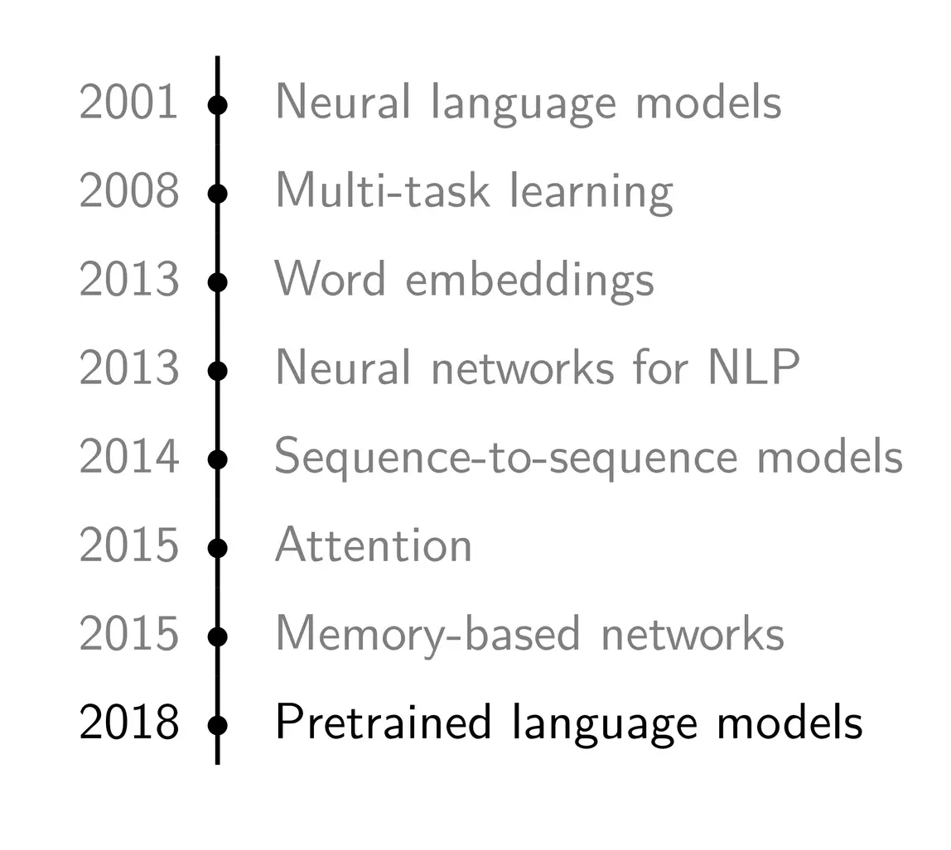
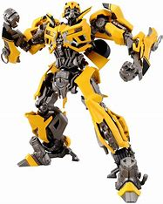
Timeline of NLP
2017
Transformer

Slide 17
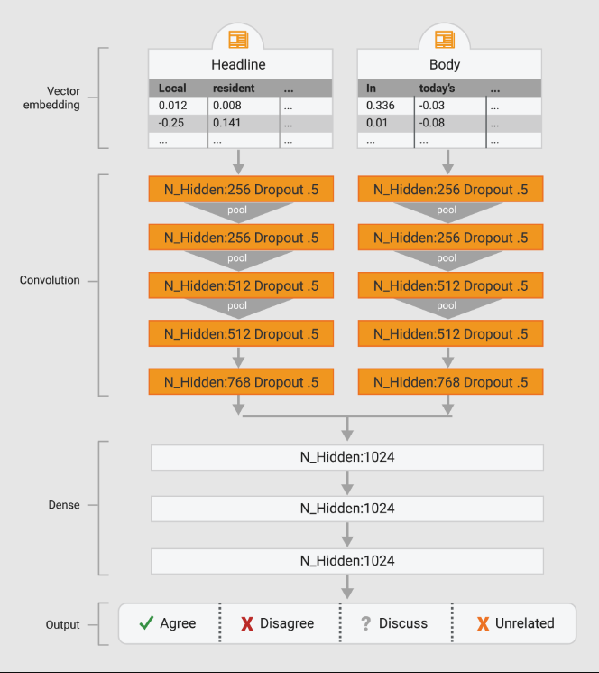
Top1 Team
Applies a 1D Convolutional Net on the headline and body text,
Represented at the word level using the Google News pretrained vectors.
Then sent to a MLP with 4-class output and trained end-to-end.

Slide 18
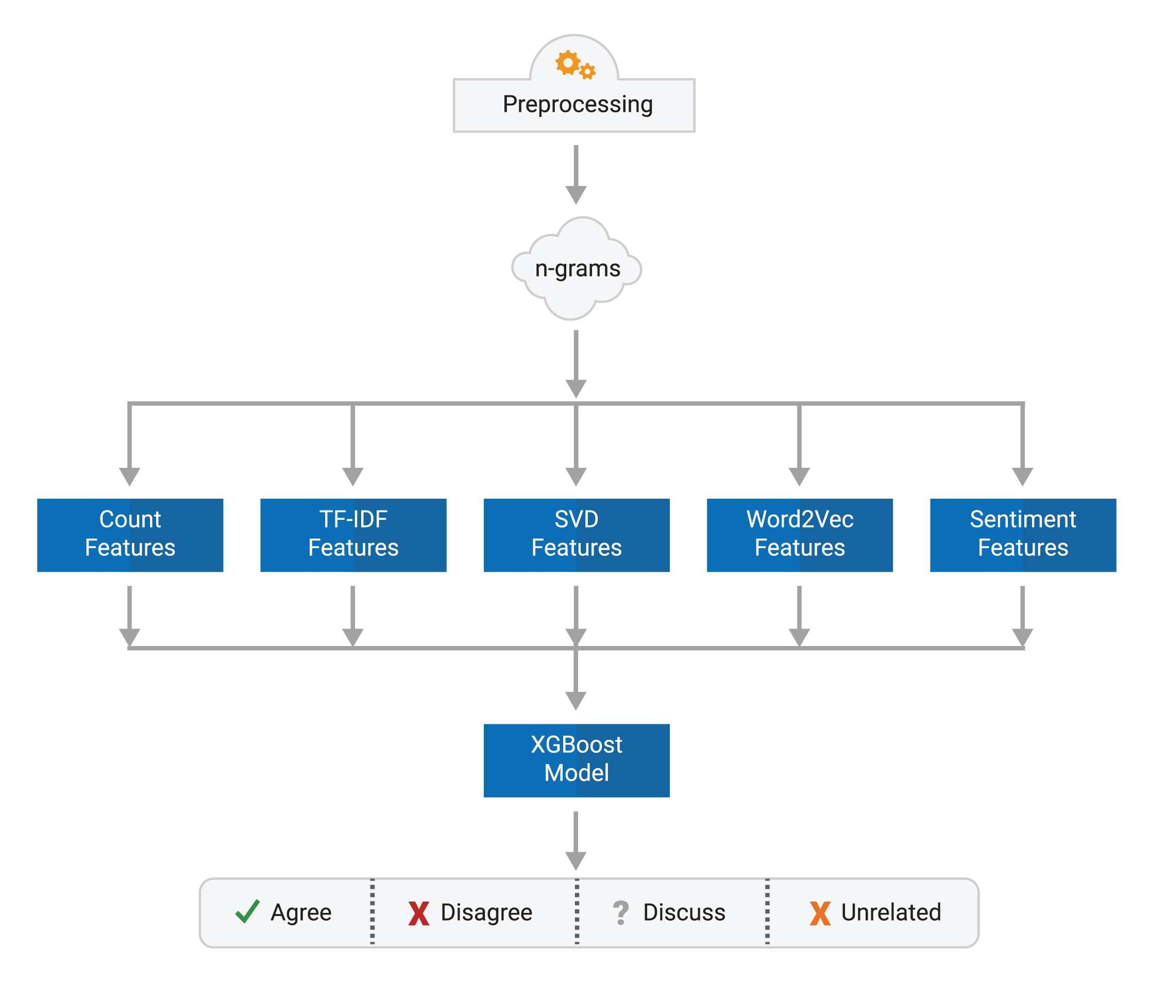
Top1 Team
Tokenize and stem the text, generating unigram, bigram, and trigram models.
Extract five different types of features for both the headlines and bodies:
Basic Count Feature
TF-IDF Feature
SVD Feature
Word2Vec Feature
Sentiment Feature

Slide 19
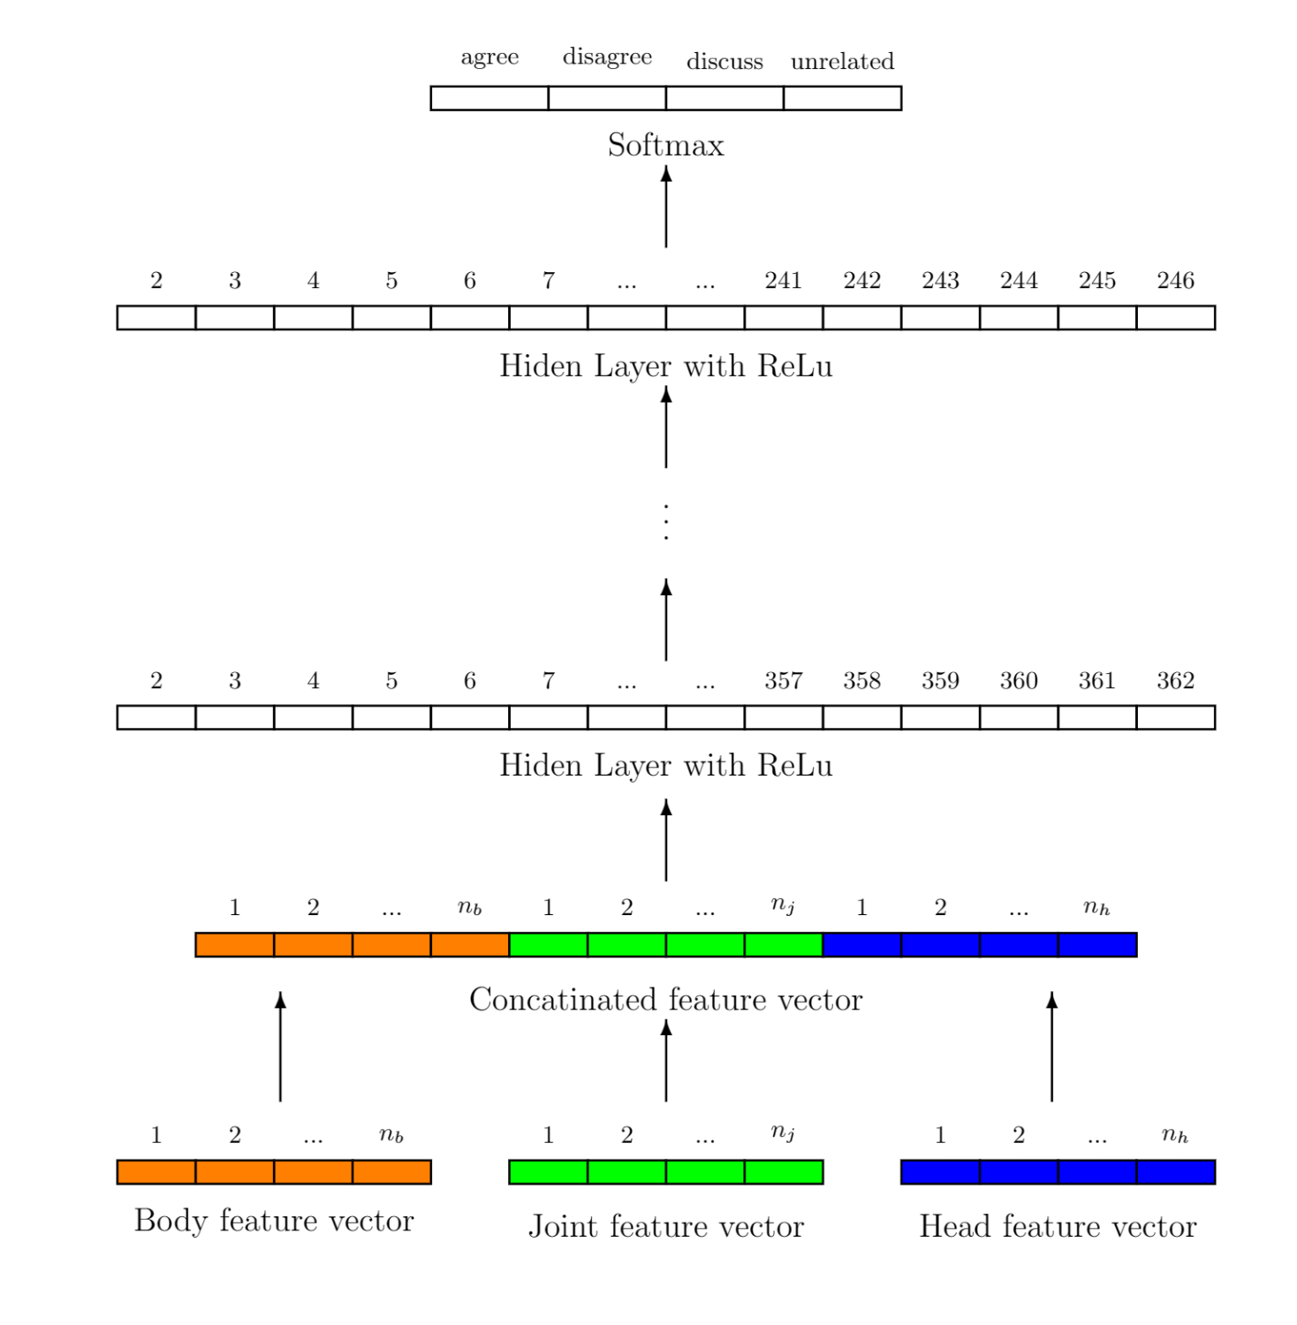
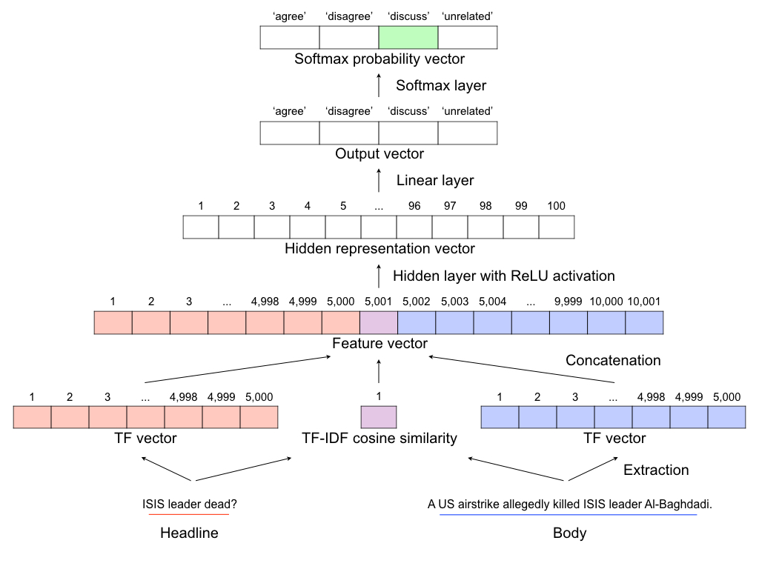
Top2&3 Team
Notes:
Employ an ensemble of five multi-layer perceptrons (MLPs) with six hidden layers
Along with handcrafted features

Slide 20
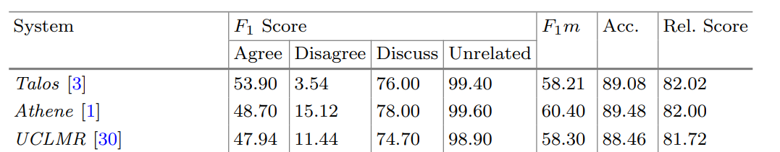
Top Team
Sepúlveda-Torres, R., Vicente, M., Saquete, E., Lloret, E., Palomar, M. (2021). Exploring Summarization to Enhance Headline Stance Detection. In: Métais, E., Meziane, F., Horacek, H., Kapetanios, E. (eds) Natural Language Processing and Information Systems. NLDB 2021.
Notes:
Employ an ensemble of five multi-layer perceptrons (MLPs) with six hidden layers
Along with handcrafted features

Slide 21
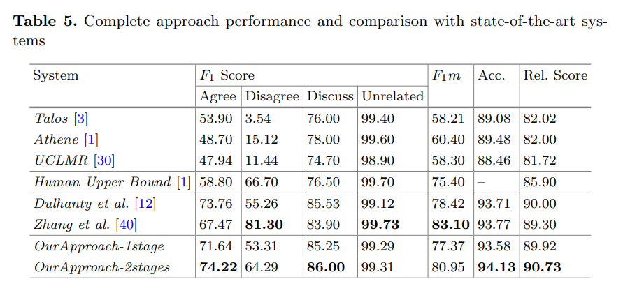
Human Upper bound
Hanselowski, A., PVS, A., Schiller, B., Caspelherr, F., Chaudhuri, D., Meyer, C. M., & Gurevych, I. (2018). A Retrospective Analysis of the Fake News Challenge Stance Detection Task.

Slide 22
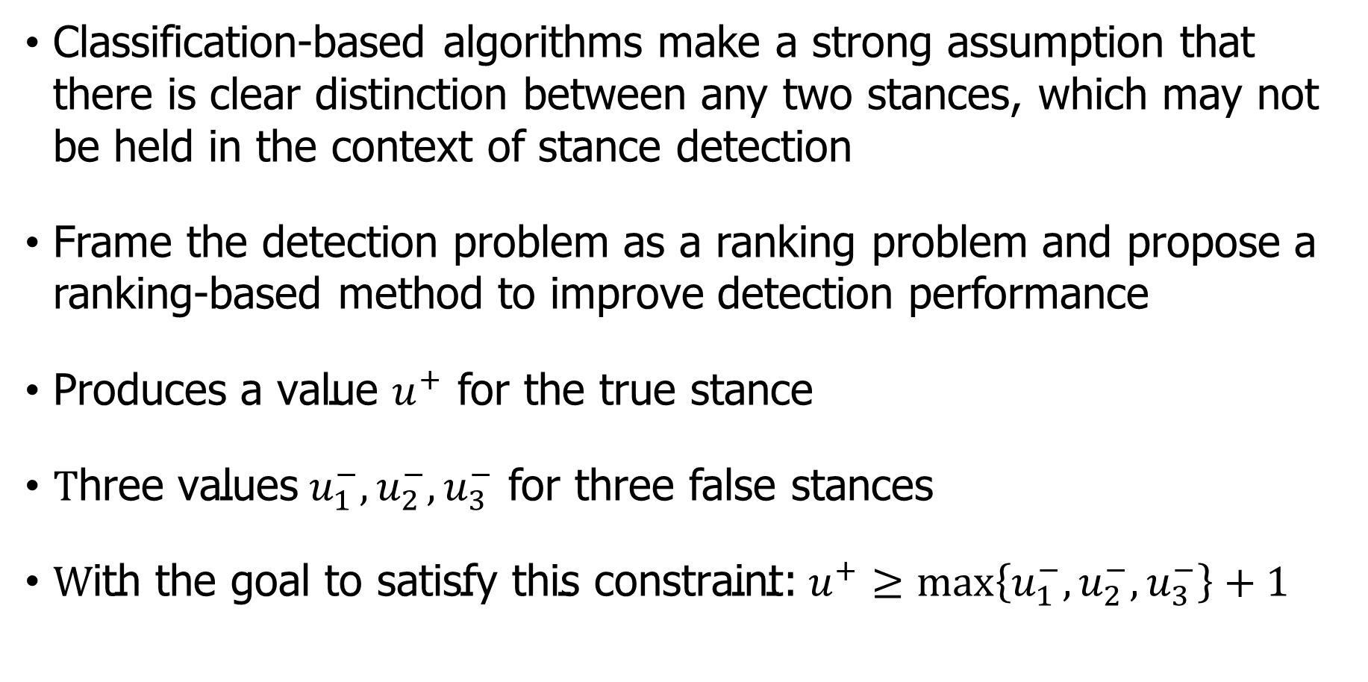
Ranking-based method
Classification-based algorithms make a strong assumption that there is clear distinction between any two stances, which may not be held in the context of stance detection
Frame the detection problem as a ranking problem and propose a ranking-based method to improve detection performance
${\text{P}\text{roduces} \text{a} \text{value} u}^{+}$ for the true stance
$\text{T}\text{hree} \text{values}{ u}_{1}^{−},u_{2}^{−},u_{3}^{−}$ for three false stances
${\text{W}\text{ith} \text{the} \text{goal} \text{to} \text{satisfy} \text{this} \text{constraint}\text{:} u}^{+}≥\max\left\{u_{1}^{−},u_{2}^{−},u_{3}^{−}\right\}+1$

Slide 23
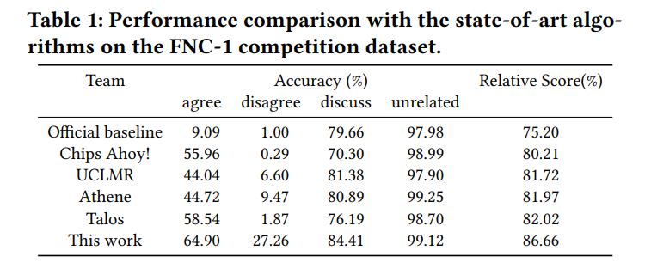
Ranking-based method
Qiang Zhang, Emine Yilmaz, and Shangsong Liang. 2018. Ranking-based Method for News Stance Detection. In Companion Proceedings of the The Web Conference 2018 (WWW '18). International World Wide Web Conferences Steering Committee, Republic and Canton of Geneva, CHE, 41–42. https://doi.org/10.1145/3184558.3186919

Slide 24
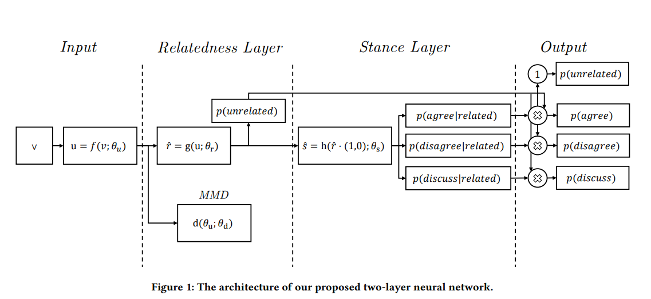
Hierarchical methods
层次化表示方法，将同意、不同意和讨论类别合并到一个新的相关类别下
双层神经网络，从这个层次化表示中学习，并使用最大均值差异MMD规则器来控制两个层之间的误差传播
缓解了类别不平衡问题
规则化使模型更好地区分相关和不相关的立场
Zhan, Q; Liang, S; Lipani, A; Ren, Z; Yilmaz, E; (2019) From Stances' Imbalance to Their Hierarchical Representation and Detection. In: Liu, Ling and White, Ryen, (eds.) Proceedings of WWW '19: The World Wide Web Conference. (pp. pp. 2323-2332). ACM: New York, USA

Slide 25
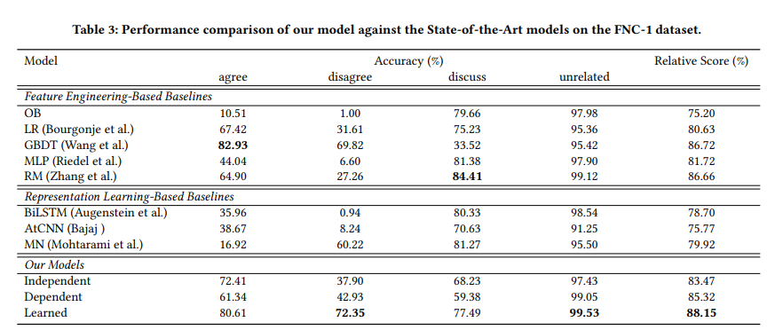
Hierarchical methods
Zhan, Q; Liang, S; Lipani, A; Ren, Z; Yilmaz, E; (2019) From Stances' Imbalance to Their Hierarchical Representation and Detection. In: Liu, Ling and White, Ryen, (eds.) Proceedings of WWW '19: The World Wide Web Conference. (pp. pp. 2323-2332). ACM: New York, USA

Slide 26
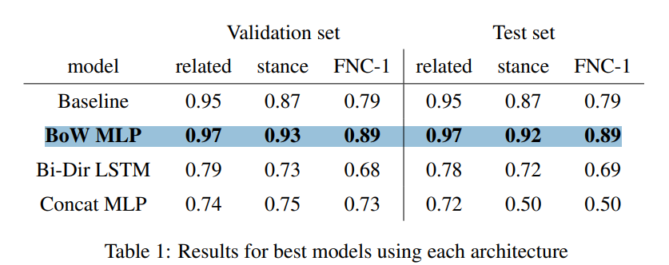
Performance of RNN
https://web.stanford.edu/class/archive/cs/cs224n/cs224n.1174/reports/2761239.pdf

Slide 27
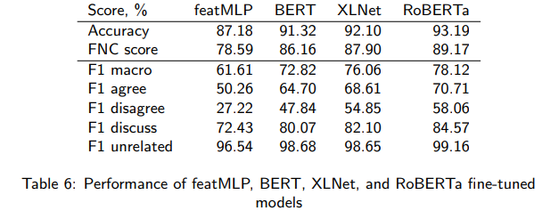
Transfer Learning from Transformers
RoBERTa performs the best!
Slovikovskaya, V. (2019). Transfer Learning from Transformers to Fake News Challenge Stance Detection (FNC-1) Task.

Slide 28
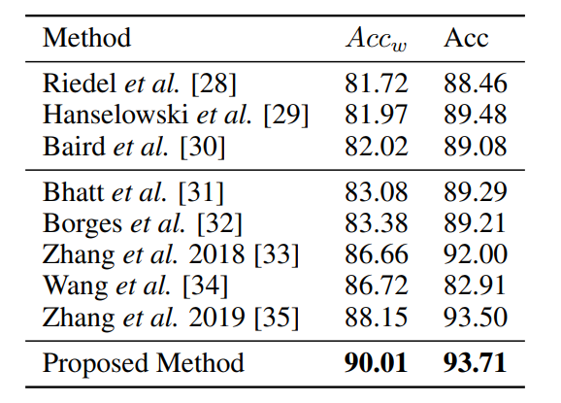
RoBERTa (Robustly Optimized BERT Approach)
更大的模型参数量、更大bacth size、更多的训练数据
去掉下一句预测(NSP)任务
动态掩码
更大的 byte 级别 BPE 词汇表，包含 50K 的 subword 单元，且没有对输入作任何额外的预处理或分词
Dulhanty, C., Deglint, J. L., Daya, I. B., & Wong, A. (2019). Taking a Stance on Fake News: Towards Automatic Disinformation Assessment via Deep Bidirectional Transformer Language Models for Stance Detection.

Slide 29
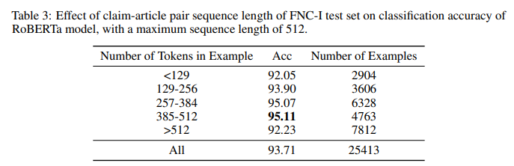
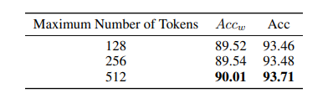
RoBERTa (Robustly Optimized BERT Approach)
Dulhanty, C., Deglint, J. L., Daya, I. B., & Wong, A. (2019). Taking a Stance on Fake News: Towards Automatic Disinformation Assessment via Deep Bidirectional Transformer Language Models for Stance Detection.

Slide 30
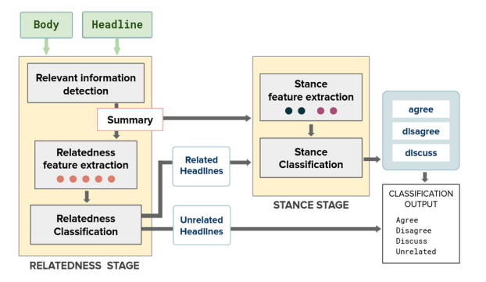
Exploring Summarization to Enhance Stance Detection
Two-stages：Relatedness Stage, and Stance Stage
Use summary
Sepúlveda-Torres, R., Vicente, M., Saquete, E., Lloret, E., Palomar, M. (2021). Exploring Summarization to Enhance Headline Stance Detection. In: Métais, E., Meziane, F., Horacek, H., Kapetanios, E. (eds) Natural Language Processing and Information Systems. NLDB 2021.

Slide 31
Relatedness Stage
Relevant Information Detection Module:
To create a summary revealing the important information of the input news article in relation to its headline
TextRank extractive summarization algorithm
Sepúlveda-Torres, R., Vicente, M., Saquete, E., Lloret, E., Palomar, M. (2021). Exploring Summarization to Enhance Headline Stance Detection. In: Métais, E., Meziane, F., Horacek, H., Kapetanios, E. (eds) Natural Language Processing and Information Systems. NLDB 2021.

Slide 32
Relatedness Feature Extraction
Computing similarity metrics
Cosine similarity between TF-IDF vector
Overlap coefficient
BERT cosine similarity
Positional Language Model (PLM) salience score
Soft cosine similarity
Sepúlveda-Torres, R., Vicente, M., Saquete, E., Lloret, E., Palomar, M. (2021). Exploring Summarization to Enhance Headline Stance Detection. In: Métais, E., Meziane, F., Horacek, H., Kapetanios, E. (eds) Natural Language Processing and Information Systems. NLDB 2021.

Slide 33
Relatedness Classification
Fine-tuning the RoBERTa
Its output consecutively multiplied by the four features
Carry out the classification using a Softmax activation function
Sepúlveda-Torres, R., Vicente, M., Saquete, E., Lloret, E., Palomar, M. (2021). Exploring Summarization to Enhance Headline Stance Detection. In: Métais, E., Meziane, F., Horacek, H., Kapetanios, E. (eds) Natural Language Processing and Information Systems. NLDB 2021.

Slide 34
Stance Stage
Stance Feature Extraction
polarity features of the headline and the summary
Stance Classification：
use RoBERTa as foundation
four features of the stance feature
two dense layers and the Softmax classification layer
Sepúlveda-Torres, R., Vicente, M., Saquete, E., Lloret, E., Palomar, M. (2021). Exploring Summarization to Enhance Headline Stance Detection. In: Métais, E., Meziane, F., Horacek, H., Kapetanios, E. (eds) Natural Language Processing and Information Systems. NLDB 2021.

Slide 35
Result
Sepúlveda-Torres, R., Vicente, M., Saquete, E., Lloret, E., Palomar, M. (2021). Exploring Summarization to Enhance Headline Stance Detection. In: Métais, E., Meziane, F., Horacek, H., Kapetanios, E. (eds) Natural Language Processing and Information Systems. NLDB 2021.

Slide 36
Outline
Introduction
Preliminary work
Related Work
Future Plan

Slide 37
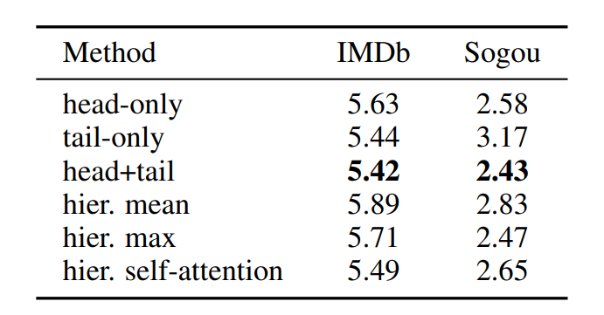
Future Plan
Goal: Better utilize all the information!
Sun, C., Qiu, X., Xu, Y., & Huang, X. (2020). How to Fine-Tune BERT for Text Classification?

Slide 38
Future Plan
Dealing with Imbalanced Data
Solve the problem of long sequence length
Data augmentation
Use a two-stage approach
Try generative model, like GPT

Slide 39
Conclusion
Thanks for your listening!
Any Questions?

