Slide 1
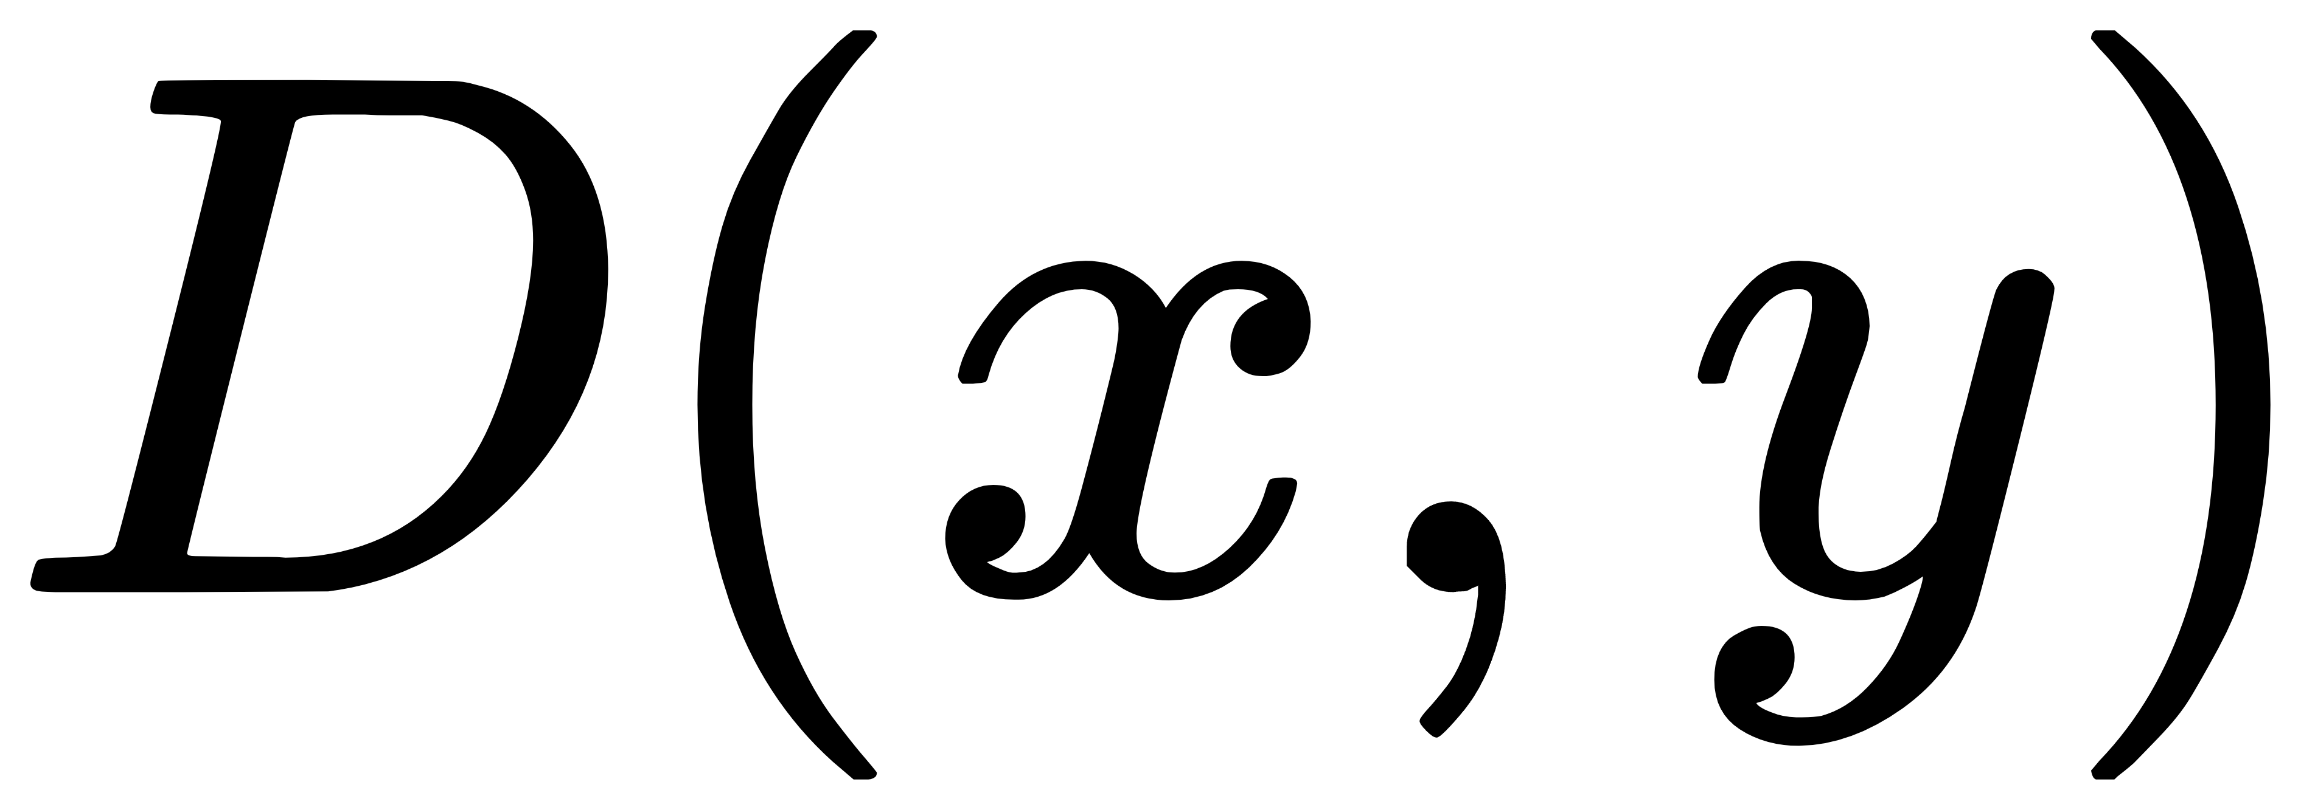





MLP
Adaptive Combination
Feature Concatenation
Naturalness Assessment
Fidelity Assessment
Naturalness Assessment
Linear Projection
Feature Transformation
Feature Transformation
Global Mean & Variance
Measurements
Stage 0
Stage 1
Stage i
Stage M
Reference image
Test image
Representations

