Slide 1
Web Crawler for XiaChuFang
CS5004 Final Project
Tianhui Li 04/20/2020

Slide 2
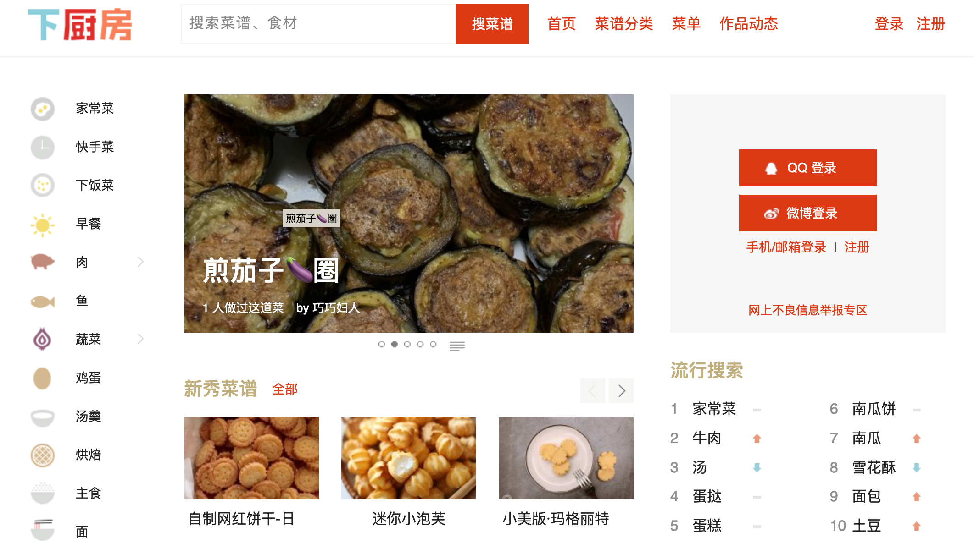
How the project works
Crawl the recipes from this website: https://www.xiachufang.com/
Download the recipes for your breakfast, lunch, dinner and dessert as csv files
Randomly pick up recipes for your today’s meal.

Slide 3
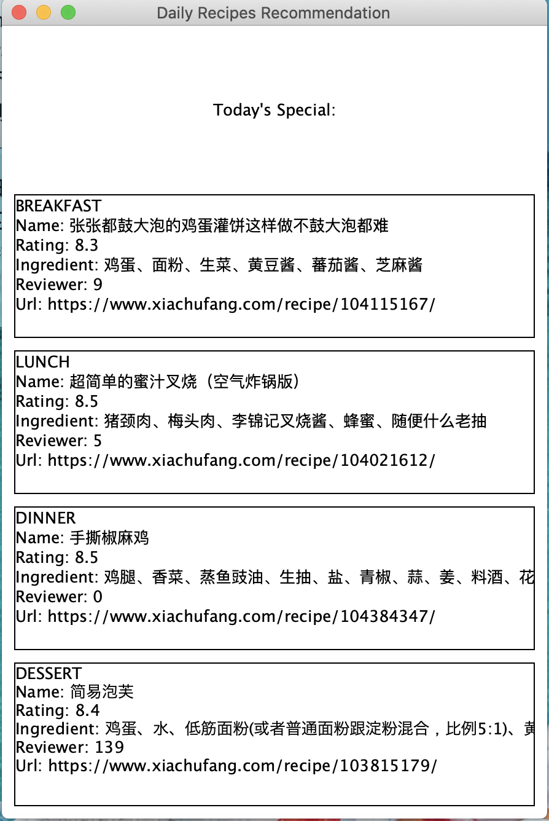
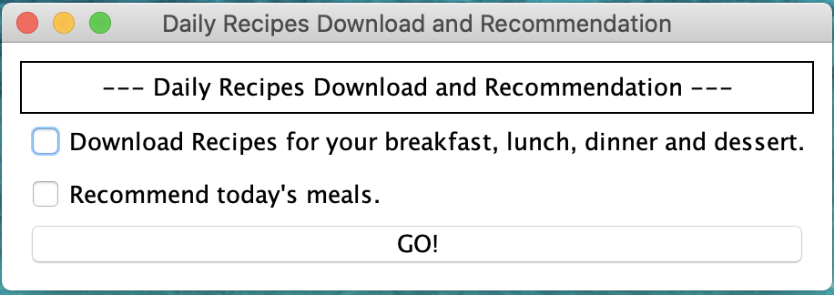
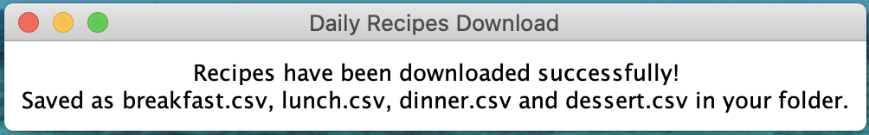
The GUI launcher

Slide 4
The Frame of the Project
ProjectRunner
View
HTMLGetter
FrameForStart
HTMLParser
FrameForDownload
FrameForRecommendation
Model
Meal
FrameDefault
CrawlerControllerImpl
CSVEditor
Controller

Slide 5
Tools and Technologies
httpCilent - Get HTML from the url
Jsoup - Select the elements from HTML
Use multi-thread to crawl the website
Javacsv - write csv file
Swing - build the GUI

Slide 6
Things that can be improved
What If the website has an anti-crawler protection - change the ip？
Do more analysis on the crawled data

Slide 7
Challenges
Find proper tools to crawl the website
Analysis the HTML, since some of tags are missing, I need to complete them myself
Figure out a reasonable structure of the whole project
Add listener to the buttons and allow new windows to open a new window when click on the button

