Slide 1
-GOBEYOND-
Loan Default Modelling
Crystal Hu

Slide 2

Crystal Hu
Graduated at the University of Sydney (Master degree 2019)
Currently Senior Decision Science Analyst at Commonwealth Bank Home Loan Innovation & Risk Assessment team
Focus Area: Analytics, credit risk modelling, fraud, Marketing

Slide 3
Overview
Introduction to Project
Data Quality Check – EDA
Data Prepressing
Model training and Tunning
Model Validation
Model Ongoing Monitor
Model Limitation
Model Risk
Conclusions and Suggestions
Apply Model to Business Scenario and Business Strategy

Slide 4

Project Introduction
The goal of this project is to build a model that borrowers can use to help make the best financial decisions, by utilizing prediction at the probability of default. (PD Model)

Slide 5
Variable Name Description Type
Variable Name | Description | Type
SeriousDlqin2yrs | Person experienced 90 days past due delinquency or worse | Y/N
RevolvingUtilizationOfUnsecuredLines | Total balance on credit cards and personal lines of credit except real estate and no installment debt like car loans divided by the sum of credit limits | percentage
age | Age of borrower in years | integer
NumberOfTime30-59DaysPastDueNotWorse | Number of times borrower has been 30-59 days past due but no worse in the last 2 years. | integer
DebtRatio | Monthly debt payments, alimony,living costs divided by monthy gross income | percentage
MonthlyIncome | Monthly income | real
NumberOfOpenCreditLinesAndLoans | Number of Open loans (installment like car loan or mortgage) and Lines of credit (e.g. credit cards) | integer
NumberOfTimes90DaysLate | Number of times borrower has been 90 days or more past due. | integer
NumberRealEstateLoansOrLines | Number of mortgage and real estate loans including home equity lines of credit | integer
NumberOfTime60-89DaysPastDueNotWorse | Number of times borrower has been 60-89 days past due but no worse in the last 2 years. | integer
NumberOfDependents | Number of dependents in family excluding themselves (spouse, children etc.) | integer

Slide 6
Data Quality Criteria
Data accuracy
Outliers
Data completeness
Are missing values important?
Data bias and sampling
Try to minimise, but can never totally get rid of
Data definition
Variables: what is the meaning of RevolvingUtilizationOfUnsecuredLines?
Target: SeriousDlqin2yrs
Data recency/latency
Refresh frequency

Slide 7
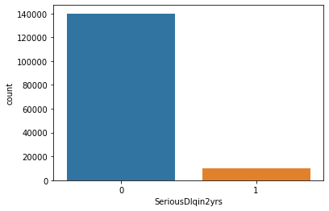
Exploratory Data Analysis
Derive Balance of Classes - SeriousDlqin2yrs
Proportion of People Who Defaulted: 6%
with extreme unbalanced class

Slide 8
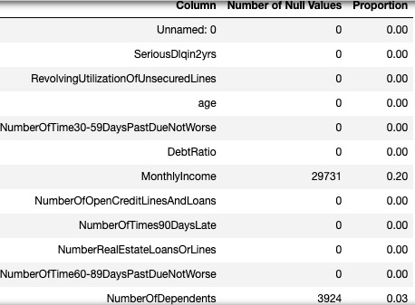
Exploratory Data Analysis
Monthly Income
-- 20 % null value
Handling missing values for the MonthlyIncome
Dropping rows
Mean/Median/Mode
Regression imputation
Multiple imputation
Final decision :
Fill with the median value
Test data also fill the same number from training dataset

Slide 9
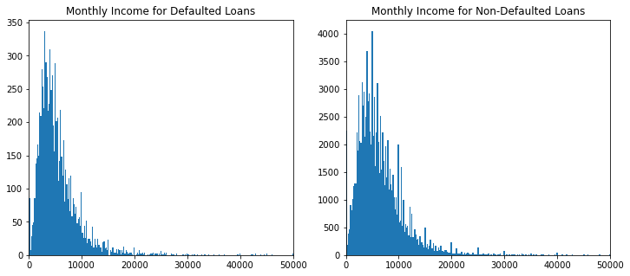
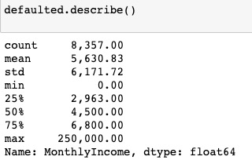
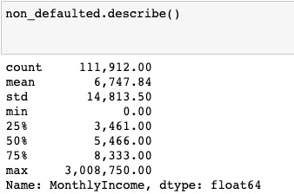
Exploratory Data Analysis
Monthly Income
borrowers with lower monthly incomes are more likely to default on their loans !

Slide 10
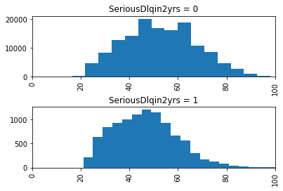
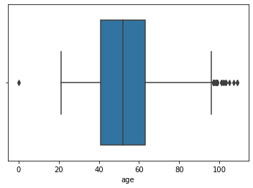
Exploratory Data Analysis
age
"If you're over 55 and need a mortgage, the important thing to know if that lenders can't deny you a loan based on your age. But age can factor into your mortgage equation." (Source).
mean 52.30
25% 41.00
50% 52.00
75% 63.00
max 109.00

Slide 11
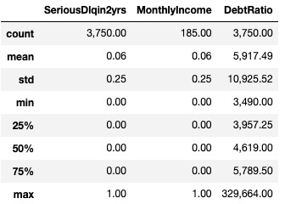
Exploratory Data Analysis
DebtRatio
It appears that a small fraction (2.5%) of the dataset owes a significantly higher amount (over 3,500 times) than what they own.
Two alarming observations can be made from the data
Out of the 4,000 records with a DebtRatio greater than 3,500, only 185 have a recorded value for their monthly income.
Those who do have a monthly income seem to have a fixed value of either 1 or 0.
Two critical conclusion made from those statistic:
164/185 entries SeriousDlqin2yrs= MonthlyIncome , highly possible data-entry error
2.5% owes significantly more than what they own, but they are not defaulting any more than the general population (6%)
Suggestion : remove those 164 from dataset

Slide 12
Exploratory Data Analysis
Late Payment Columns
NumberOfTimes90DaysLate
NumberOfTime60-89DaysPastDueNotWorse
NumberOfTime30-59DaysPastDueNotWorse
NumberOfTimes90DaysLate
It is interesting to note that there are no one who is 90 or more days past due between 17 and 96 times.
NumberOfTime60-89DaysPastDueNotWorse
It is interesting to note that there are no one who is 60-89 days past due between 11 and 96 times.
NumberOfTime30-59DaysPastDueNotWorse
It is interesting to note that there are no one who is 30-59 days past due between 13 and 96 times.

Slide 13
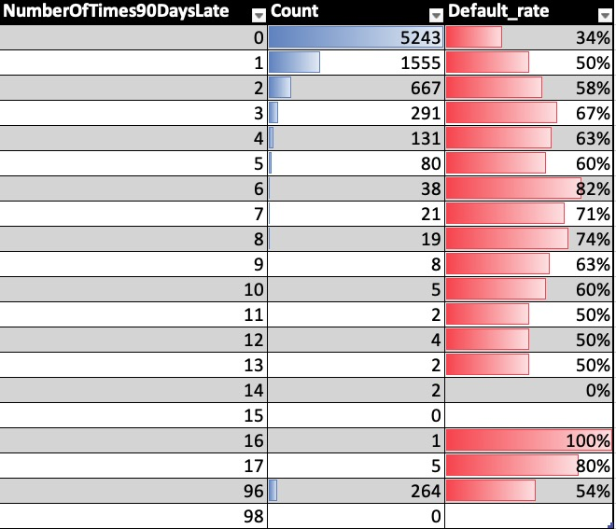
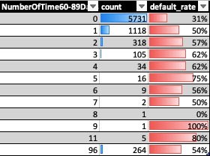
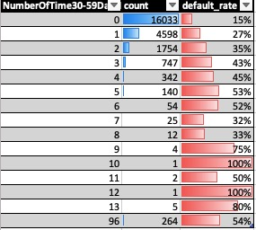
Exploratory Data Analysis
LatePaymentColumns
NumberOfTimes90DaysLate
NumberOfTime60-89DaysPastDueNotWorse
NumberOfTime30-59DaysPastDueNotWorse

Slide 14
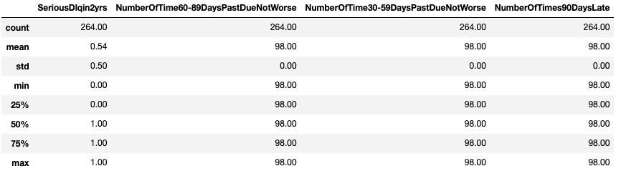
Exploratory Data Analysis
NumberOfTimes90DaysLate
Data Processing Suggestion :
Winsorization by replacing them with their nearest non-extreme value
to minimize the impact of extreme values while still retaining the information they provide. By replacing extreme outliers with less extreme values, Winsorization helps in achieving a more robust and accurate analysis of the data.

Slide 15
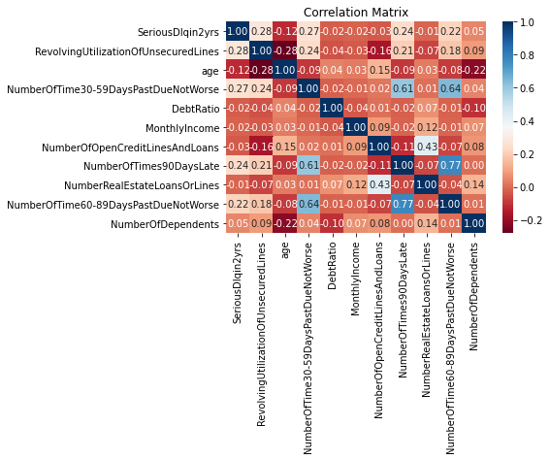
Exploratory Data Analysis
Late Payment Columns
NumberOfTimes90DaysLate
NumberOfTime60-89DaysPastDueNotWorse
NumberOfTime30-59DaysPastDueNotWorse
New Column Creation
'TotalPastDue' by summing the values of the three columns

Slide 16
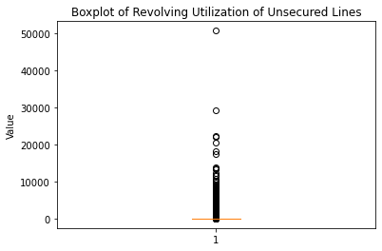
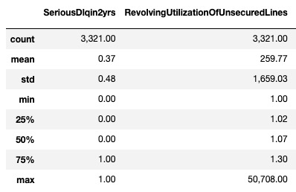
Exploratory Data Analysis
RevolvingUtilizationOfUnsecuredLines
-- ratio of money owed to credit limit
data with a RevolvingUtilizationOfUnsecuredLines>1
default ratio for accts with RevolvingUtilizationOfUnsecuredLines>1

Slide 17
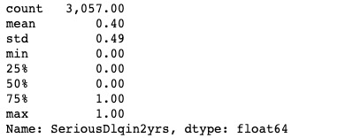
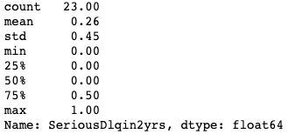
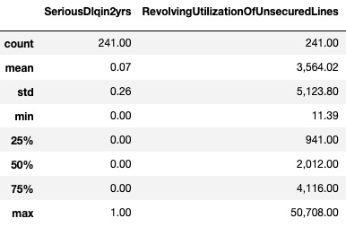
Exploratory Data Analysis
RevolvingUtilizationOfUnsecuredLines
-- ratio of money owed to credit limit
When 1<RevolvingUtilizationOfUnsecuredLines =<4
When 4<RevolvingUtilizationOfUnsecuredLines =<10
RevolvingUtilizationOfUnsecuredLines >10
Data Processing Suggestion :
remove when RevolvingUtilizationOfUnsecuredLines >10

Slide 18
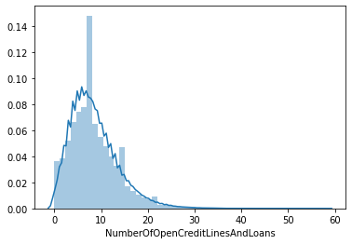
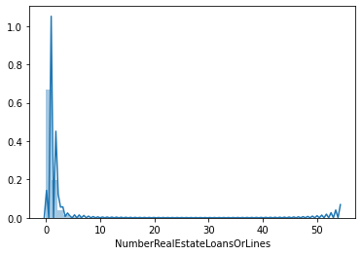
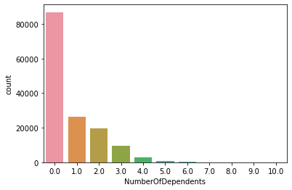
Exploratory Data Analysis
NumberOfOpenCreditLinesAndLoans & NumberRealEstateLoansOrLines
NumberOfDependents
39240 3% missing value ---fill with mode

Slide 19
Preprocessing
Preprocessing Suggestions
Remove samples with values of DebtRatio above its 97.5 percentile
Set 0 <= RevolvingUtilizationOfUnsecuredLines < 10
For Late Payment Columns NumberOfTimes90DaysLate,NumberOfTime30-59DaysPastDueNotWorse, NumberOfTime60-89DaysPastDueNotWorse,to handle the extreme outlier values (96/98), we can apply Winsorization by replacing them with their nearest non-extreme value and build new col upon it.
Impute MonthlyIncome with its median or mode, or with a normally distributed variable with MonthlyIncome's mean and standard deviation, or regression imputation.
Impute NumberOfDependents with its mode

Slide 20
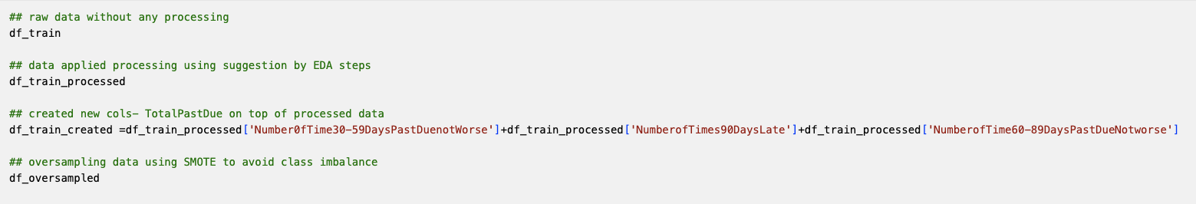
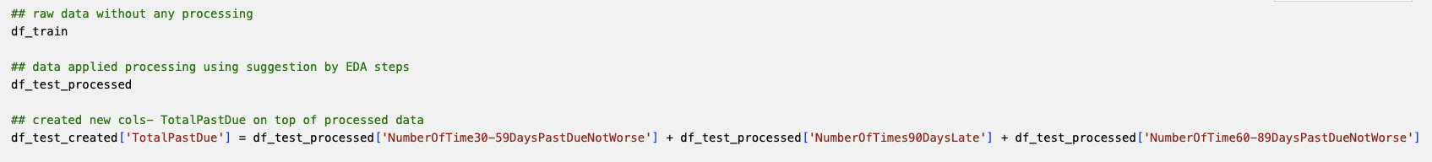
Preprocessing
Prepare Dataset
training
test

Slide 21
Data quality: solutions
Short term solution
Deal with it in a statistical way using e.g. data transformations, outlier truncation, missing value imputation, data enhancement
Buy external data (data poolers!)
Long term solution
Re-design data entry processes
Master data management

Slide 22
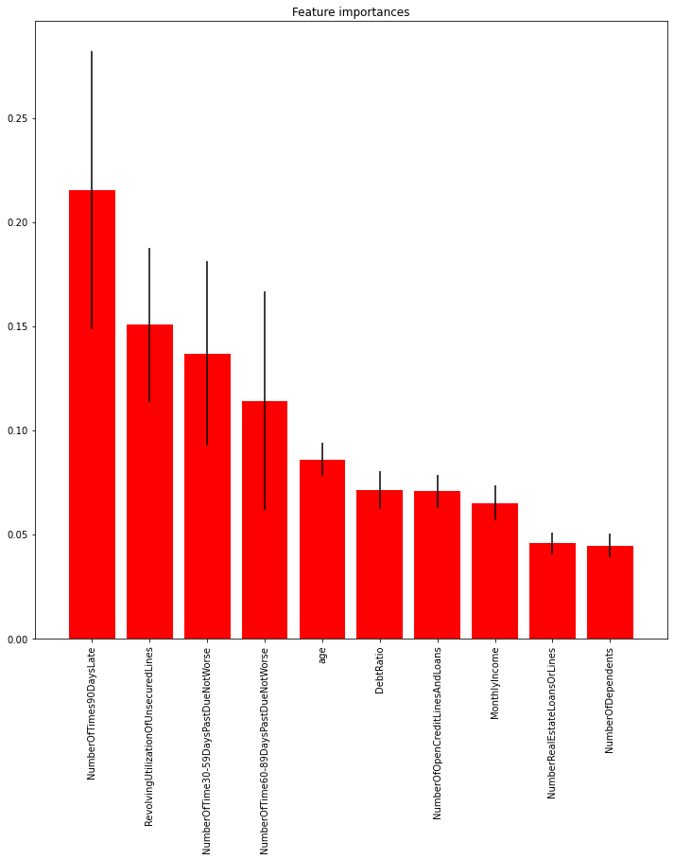
Preprocessing
Feature Importance

Slide 23
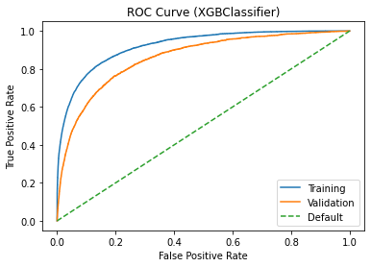
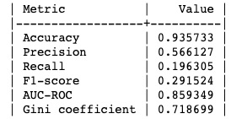
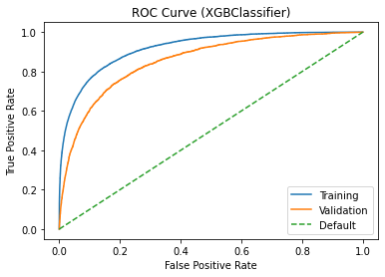
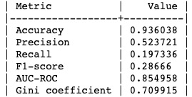
Model training and Evaluation
xgboost
on raw dataset
on df_train_processed

Slide 24
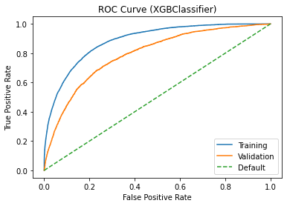
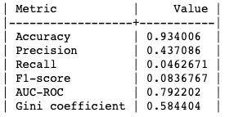
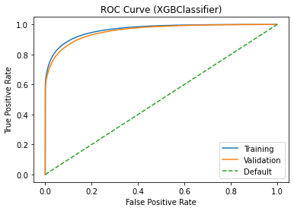
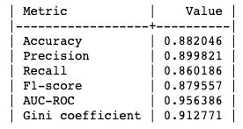
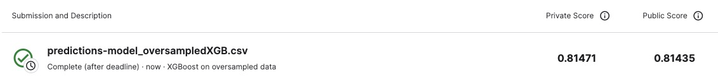
Model training and Evaluation
xgboost
on df_created
on df_oversampled

Slide 25
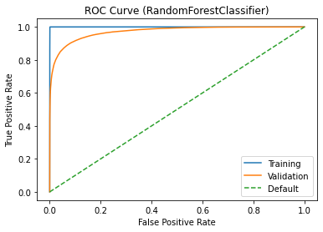
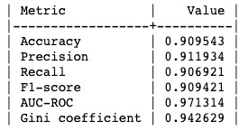
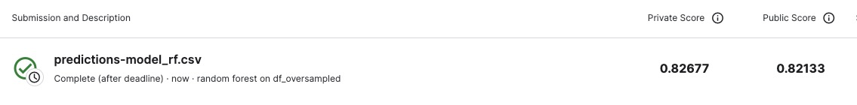
Model training and Evaluation
Random Forest
on df_oversampled

Slide 26
PD Model Requirements
Statistical performance
Lift curve, ROC curve, Gini coefficient, ...
lnterpretability + Justifiability
Very subjective, but CRUCIAL!
Often need to be balanced against statistical performance
Operational efficiency
How much effort is needed to evaluate/monitor/re-train the model(s)?
Economical cost
What is the cost to gather the model inputs and evaluate the model?
Is it worthwhile buying external data and/or models (e.g. bureau score)?
Regulatory compliance
In accordance with regulation and legislation
E.g., Basel 11\Basel Ill, Solvency II

Slide 27
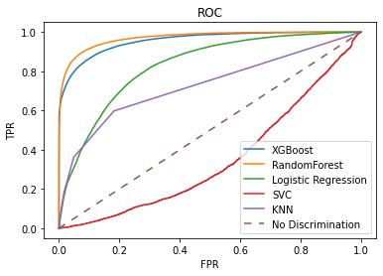
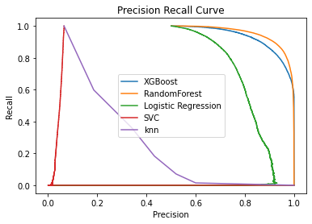
Model Selection
Final Decision– hypermeter tunning for Xgboost and random forest

Slide 28
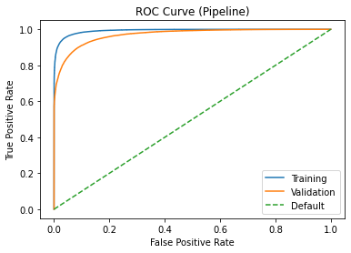
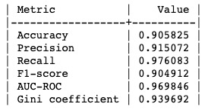
Model Tunning
xgboost
Random search
Grid search
Best model parameters: {'xgb__colsample_bytree': 1.0, 'xgb__eta': 0.3, 'xgb__max_depth': 9, 'xgb__n_estimators': 200}
Best model score: 0.9012065393763203
private score 0.82431 public score 0.81435
'xgb__eta': [0.05, 0.1, 0.3],
'xgb__max_depth': [3, 6, 9],
'xgb__colsample_bytree': [0.8, 0.9, 1.0], 'xgb__n_estimators': [100, 150, 200]
Best Model on df_oversampled

Slide 29
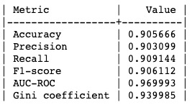
Model Tunning
RandomForest
Best model parameters: {'criterion': 'entropy', 'max_depth': None, 'n_estimators': 200}
Best model score: 0.904551
private score 0.82739 public score 0.82715
Random search
Grid search
n_estimators_value = [100,150,200,250,300]
criterion_val = ["gini", "entropy"]
max_depth_val = [5, 10, 15, None]
# max_features_list=['auto', 'sqrt', 'log2', None]
Best Model on df_oversampled

Slide 30
Model Validation

Slide 31
Model Validation
Split the data
Train the model
Evaluate model performance
Assess model calibration
Compare against benchmarks
Fine-tune and iterate
Document and report

Slide 32
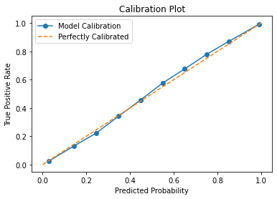
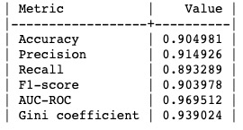
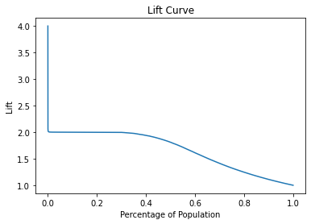

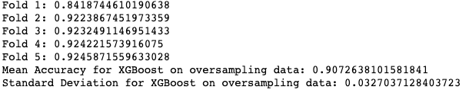
Model Validation
xgboost

Slide 33
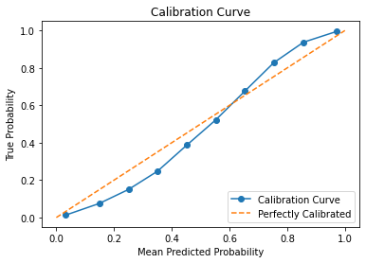
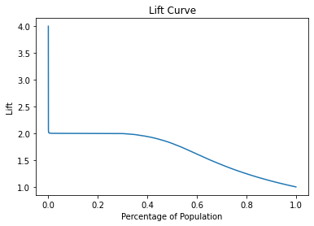
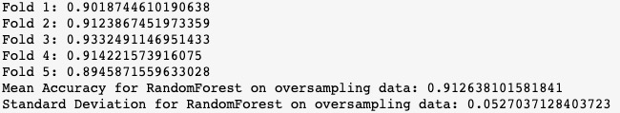
Model Validation
Random Forest

Slide 34
Model Validation in Real Business World
Quantitative validation
Backtesting
Benchmarking
Qualitative validation
Data quality
Model design
Documentation
Corporate governance and management oversight
In the Long Run
Validation should be independent of development
Model validation should incorporate changes in products,
﻿Validation should be periodic - annually, half yearly etc
Model performance threshold or benchmark analysis should be part of the validation
Sensitivity analysis , Stress Test
Judgement Expert Override

Slide 35
Backtesting
Contrasting ex-post realised numbers with ex-ante predictions
Estimated
Number of Observations
Number of
Rating Category
PD
Observed Defaults
A | 2% | 1000 | 17
B | 3% | 500 | 20
C | 7% | 400 | 35
D | 20% | 200 | 50
Challenges
Which test statistics to use? chi2, binominal
Which confidence levels to adopt? depends on the organization's risk appetite
How to deal with correlated behavior (portfolio effects)? Stress Testing, Portfolio Diversification etc
When to take action and what action?

Slide 36
Principle of back testing
﻿﻿Data stability - whether population has changed
﻿﻿How well the PD rating system provides an ordinal ranking of the risk measure considered
﻿﻿Mapping of the risk rating to PD - calibration is good if there is only marginal deviation
﻿﻿Back testing = Calibration, Discrimination, Stability

Slide 37
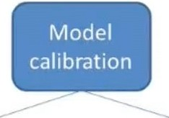
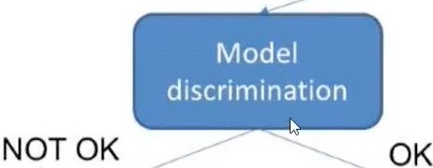





Action plans
NOT OK
--- ^{OK}

Slide 38
Model Ongoing monitoring
Why PD models degrade in performance?
Sample effects (models estimated on limited samples) PSI report
Macro-economy (downturn versus upturn)
Internal effects (e.g. strategy change, population drift, M&A)
In reality: a very nice mixture of these!
Need to constantly monitor outcomes of models:
ROC/AUC
GINI
KS
RMSE/Accuracy
Sensitivity and Specificity
Crucial since models more and more steer strategic decisions of the firm
E.g. equity calculation in a Basel II/Solvency II environment; Risk based pricing
Quantitative versus Qualitative validation

Slide 39
Limitation to use XGBClassifier for a PD model:
Interpretability
Imbalanced Data
Feature Engineering
Sensitivity to outliers
Computational Requirements
Hyperparameter Tuning

Slide 40
Limitation to use Random Forest for a PD model:
Interpretability
Overfitting
Imbalanced data
Missing data
Training time
Model complexity

Slide 41
Before devising a strategy on top of this model
Data Availability
Business Objectives
Regulatory Environment
Available Resources
Risk Tolerance
Customer Segmentation

Slide 42
Apply the results of the PD model to various business scenarios
Identify the Business Scenario
Define Economic Factors
Set Decision Threshold
Incorporate Business Context:
Optimize Decisions
Monitor and Refine

Slide 43
Advisable Business Strategy for BNPL Platform
Customer Segmentation
Credit Limit Management
Risk-Based Pricing
Early Intervention
Portfolio Monitoring and Review
Collaboration with Credit Bureaus

Slide 44
Simple recommendations to manage these potential default applicants
Additional Documentation
Enhanced Underwriting Process:
Adjust Loan Terms
Strengthen Collateral Requirements
Implement Risk-Based Pricing
Monitor and Review
Review and Update the Model

Slide 45
Credit Risk Model Architecture
2
Define ratings and calibrate
the model
•
•
PD calibration
risk ratings definition
PD Modeling
1
r
•
•
application scorecard behavioral scorecard
LGD Modeling
Create the model
I
EAD Modeling
l
•
•
•
internal data external data expert judgment
Prepare the data
I

Slide 46
Improving Performance
Strategy 1: Use complex modeling techniques
E.g. neural networks, support vector machines, random forests, ...
Pro: powerful models (e.g. universal approximation)
Con: loss of interpretability, marginal performance gains
Strategy 2: Enrich your data
External data (FICO score, bureau data, ... )
Data quality!
Pro: model still interpretable
Con:.additional resources needed (ICT)

Slide 47
Model Risk
"Essentially, all models are wrong, but some are useful" (George Box, 1987)
Models are not perfect, some are actually VERY BAD, but what's the alternative?
Model imperfection is typically dealt with by
Conservative parameter calibration
- aka economic downturn calibration
E.g. assume statistically estimated probability of default is 3°10.
Use 5°10 for strategic decisions to capture model risk!
Create equity buffer/provisions for model risk Hard to quantify!

Slide 48
References
Tobback E., Martens D., Van Gestel T., Baesens B., Forecasting loss given default models: impact of account characteristics and the macroeconomic state, Journal of the Operational Research Society, Volume 65, Number 3, pp. 376-392, 2014.
Louis P., Van Laere E., Baesens B., Understanding and predicting bank rating transitions using optimal survival analysis models, Economics Letters, Volume 119, Number 3, pp. 280-283, 2013.
Berteloot K., Verbeke W., Castermans G., Van Gestel T., Martens D., Baesens B., A Novel Credit Rating Migration Modeling Approach using Macroeconomic Indicators, Journal of Forecasting, Volume 32, Issue 7, pp. 654-672, 2013.
Moges H.T., Dejaeger K., Lemahieu W., Baesens B., A Multidimensional Analysis of Data Quality for Credit Risk Management: New Insights and Challenges, Information and Management, Volume 50, Number 1, pp. 43-58, 2013.
Moges H.T., Dejaeger K., Lemahieu W., Baesens B., A Total Data Quality Management for Credit Risk: New insights and challenges, International Journal of Information Quality, Volume 3, Number 1, pp. 1- 27, 2012.
Glady N., Croux C., Baesens B., Modeling Churn Using Customer Lifetime Value, European Journal of Operational Research, Volume 197 Number 1, pp. 402.411, 2009.
Martens D., Baesens B., Van Gestel T., Decompositional Rule Extraction from Support Vector Machines by Active Learning, IEEE Transactions on Knowledge and Data Engineering, Volume 21, Number 1, pp.178-191, 2009.
Setiono R., Baesens B., Mues C. Recursive Neural Network Rule Extraction for Data with Mixed Attributes, IEEE Transactions on Neural Networks,19 (2),pp.299-307, 2008.
Baesens B., Setiono R., Mues C., Vanthienen J., Using Neural Network Rule Extraction and Decision Tables for Credit-Risk Evaluation, Management Science, Volume 49, Number 3, pp. 312-329, March 2003
See www.dataminingapps.com

Slide 49
Thanks for Listening !

