Slide 1
Mix Design of the 3D-printing cement paste
CE542 Project
by
Tianjie Zhang, Donglei Wang
Advisor:
Yang Lu, Ph.D.
Dec 06, 2022

Slide 2
Background
Materials and Method
Results
Conclusion
Notes:
Speak out all points

Slide 3
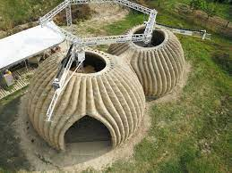

Background
Cement 3D-printing is a constructive approach which has attracted attention from various fields due to its advantages such as easy customization, efficient material consumption, less human–machine interaction, and relatively less production time.
From Google image.
However, the material used in cement 3D printing has specific requirements. Concrete materials with excellent printability usually have the following two characteristics: certain flowability should be guaranteed for the mixture to be pumped and extruded; the extruded concrete should have enough strength after extrusion to resist deformation caused by itself.
From Google image.

Slide 4

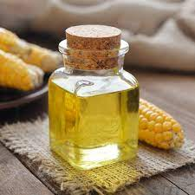
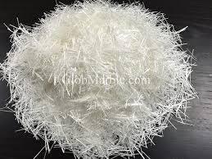
Background
The flowability can be controlled by the viscosity of the cementitious material. And the rapid strength after extrusion is managed by the static yield stress. From a rheology perspective, excellent rheology property is required for concrete materials to be printed successfully.
From Google image.
In this work, we choose water cement ratio (w/c) to control the viscosity and yield stress, because it has an effect on the rheology property of the cementitious material. Also, we choose two other additives: corn oil and glass fiber to adjust the rheology and make the mix design more suitable to the 3D printer.
From Google image.
From Google image.

Slide 5


Motivation
Our main purpose is to find a cement paste mix design which have the best rheological performance on the 3D printing. Also, we want to analyze the combination effect when we change the w/c, content of corn oil and glass fiber.
From Google image.
The corn oil is used here to adjust the apparent viscosity of the cement paste. It will also have a sub-effect on the static yield stress of the cement paste which is also a significant property in 3D-printing. This is because the apparent viscosity and static yield stress are all rheologic parameters of cement paste which is related to the inside micro-structure. The glass fiber is utilized to change the static yield stress of the cement paste, in order to enhance the buildability of cement 3D-printing. When the cementitious material is extruded, the static yield stress decides whether your printed structure can stand or destroy.
From Google image.

Slide 6
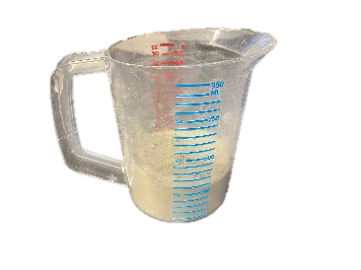
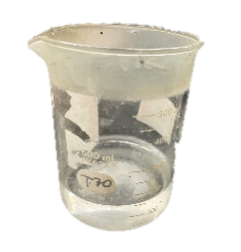
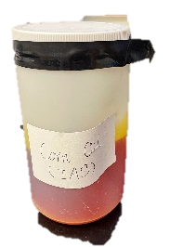
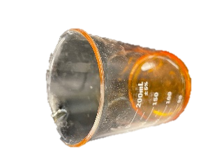
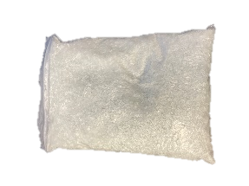
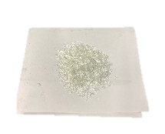
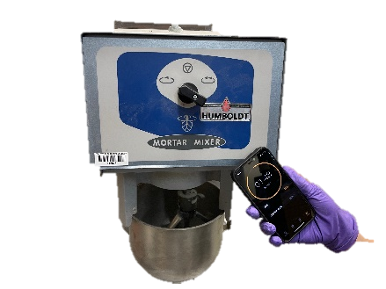

Materials
Cement
Water
Corn Oil
Glass Fiber
The mass of water and cement used in each w/c
w/c | Total mass(g) | Water(g) | Cement(g)
0.35 | 1000 | 260 | 740
0.40 | 1000 | 286 | 714
0.45 | 1000 | 310 | 690
Mortar mixer
Viscometer

Slide 7
Orthogonal test
In order to figure out the impact of water cement ratio (w/c), the content of corn oil and the content of glass fiber on mixture’s viscosity and static yield stress, orthogonal test was considered to investigate the influence. It is because the orthogonal test is a suitable method to study many factors and levels which have an even distribution as it reduces the experiment time dramatically.
➔From 3*3*3=27 to 9 experiments.
Then here, we use variance analysis to analyze the result.
*Variance analysis is statistical method to clarify the significance of different factors according to the results from orthogonal tests. It can be summarized as an analysis of the difference between planned and actual numbers.
Orthogonal experimental factors
Factors |  | A: w/c | B: Corn oil content/% | C: Glass fiber content/%
Levels | 1 | 0.35 | 0 | 0
 | 2 | 0.40 | 0.5 | 0.5
 | 3 | 0.45 | 1 | 1
Orthogonal experimental scheme
No. | w/c | Corn oil/% | Glass fiber/%
1 | 0.35 | 0 | 0
2 | 0.40 | 0.5 | 0
3 | 0.45 | 1 | 0
4 | 0.45 | 0.5 | 0.5
5 | 0.40 | 0 | 0.5
6 | 0.35 | 1 | 0.5
7 | 0.35 | 0.5 | 1
8 | 0.40 | 1 | 1
9 | 0.45 | 0 | 1

Slide 8

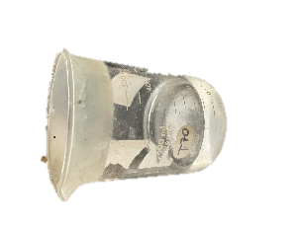

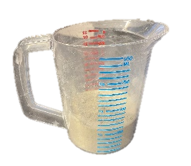
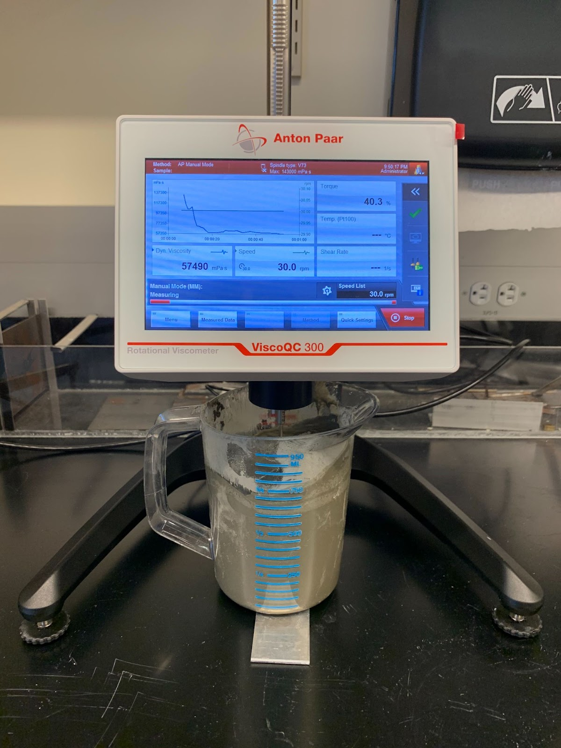
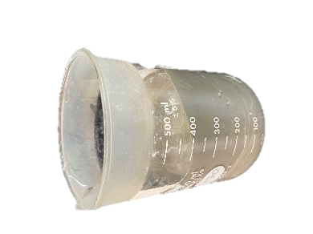
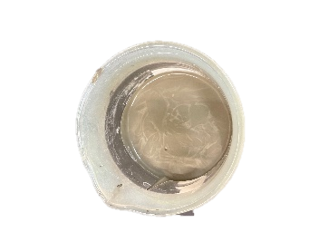
Testing procedure
Step 1
Step 2
Step 3
Step 1: Mix cement and glass fiber (60 rpm for 120 s)
Step 2: Add water (60 rpm for 90s and 120 rpm for 150s)
Step 3: Add corn oil (60 rpm for 120s)
Step 4: Testing the viscosity and yield stress using Anton Paar viscometer
Step 4

Slide 9
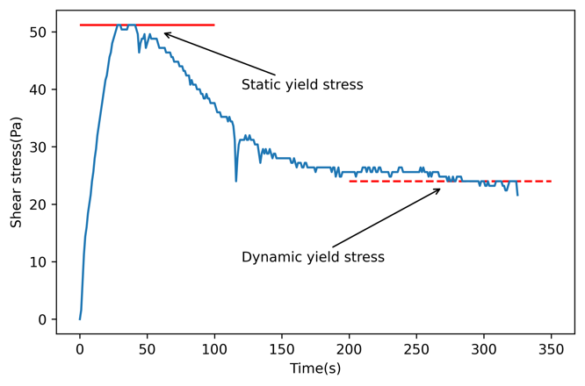
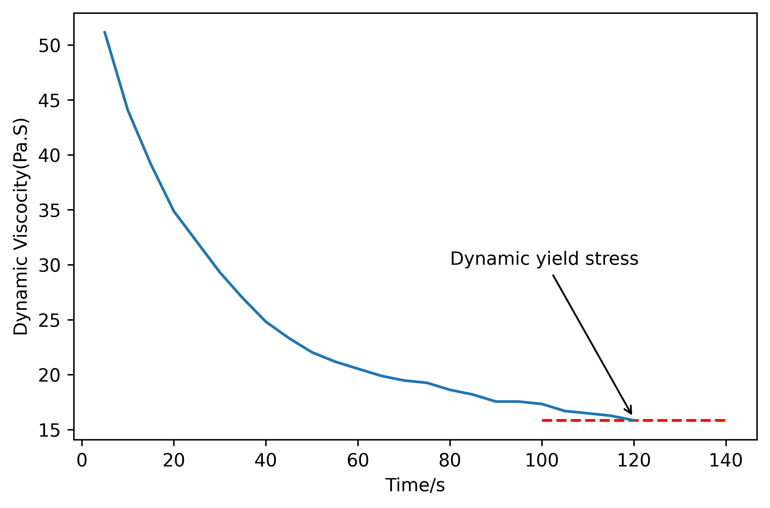
Results
The shear stress changes with the time.
The viscosity changes with the time.
The yield stress was measured by controlling the speed of the spindle at 0.1 round per minute (RPM). As we can see, because of the thixotropy, the shear stress is not stable under the same shear speed. The shear stress of the cement paste reaches a top around 50 s, which represents the static yield stress of the tested material.
The viscosity was measured at a speed of 20 RPM. And the viscosity value at 120 s was chose as the material’s viscosity.

Slide 10
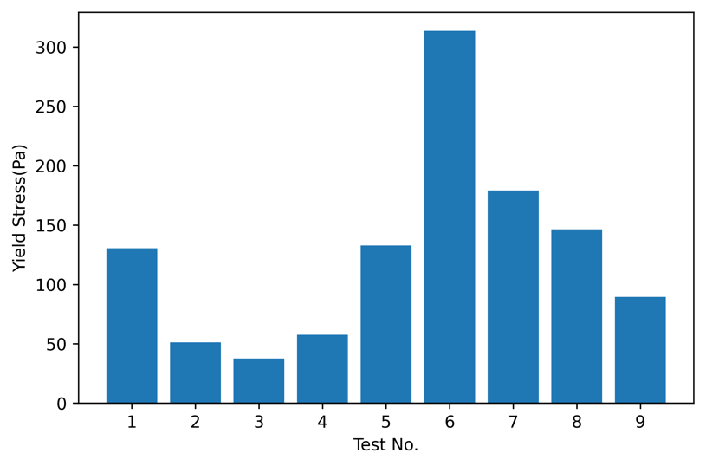
Yield Stress
The Test No.3 (w/c:0.45, corn oil:1, glass fiber:0) get the lowest static yield stress while the Test No. 6 (w/c:0.35, corn oil:1, glass fiber:0.5) get the highest static yield stress.
The test results of the experiments

Slide 11
Yield Stress
Variance analysis calculation results of static yield stress
Factor | SS | df | F (=0.1) | significance
A: w/c | 33236.196 | 2 | 11.678 | 0.079
B: Corn Oil | 7677.582 | 2 | 2.698 | 0.27
C: Glass Fiber | 14156.942 | 2 | 4.974 | 0.167
Error | 2846.009 | 2 | / | /
The significance of factor A is 0.079<0.1. It indicates that the w/c is significant on the static yield stress.
The F value of factor A has the largest value, which means the w/c has the greatest impact on the static yield stress, followed by Glass Fiber, Corn Oil.
Mazzini, D., P. Napoletano, F. Piccoli, and R. Schettini. A novel approach to data augmentation for pavement distress segmentation. Computers in Industry, Vol. 121, 2020, p. 103225.

Slide 12
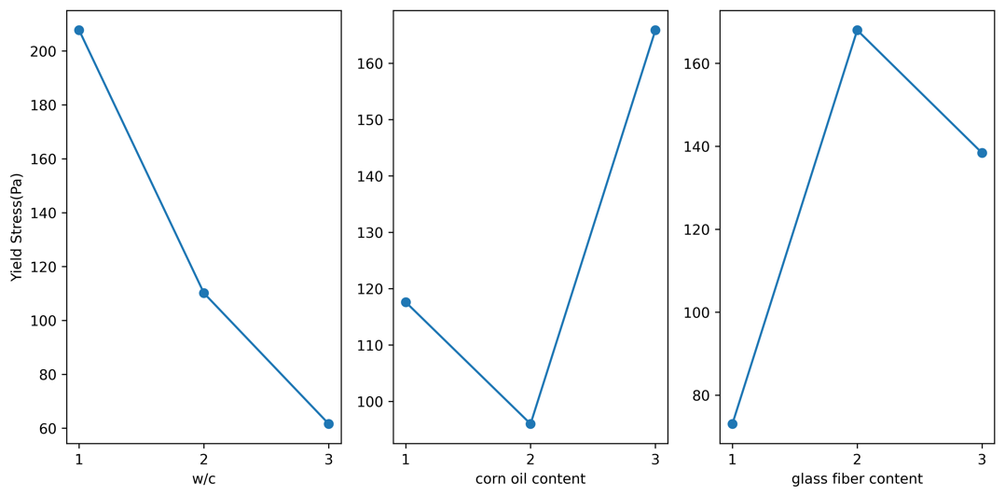
Yield Stress
As we can see, if we want a higher static yield stress, the best combination is:
w/c = 0.35,
Corn Oil = 1%,
Glass Fiber = 0.5%.
The estimated margin effect of the three factors on the static yield stress.

Slide 13
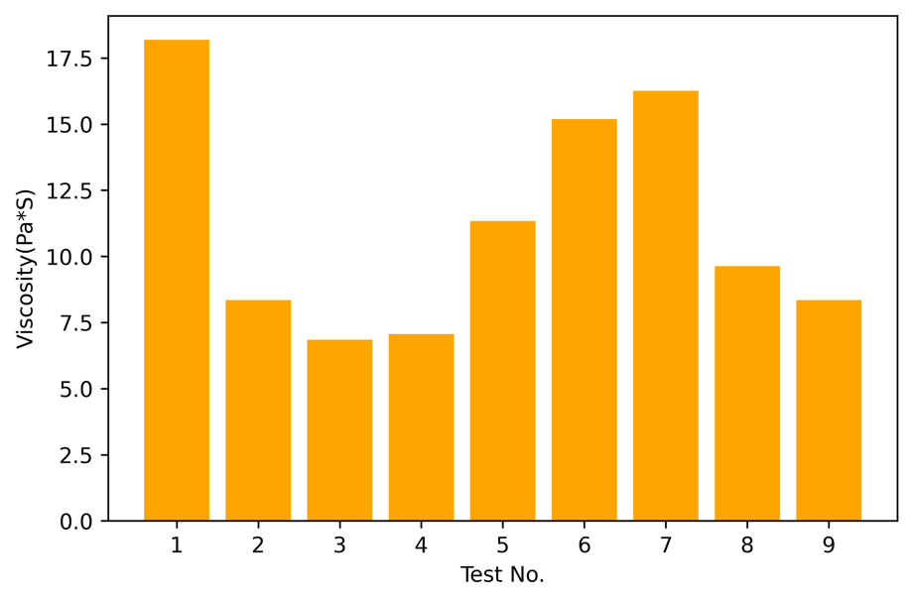
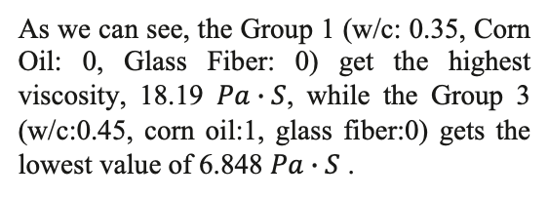
Viscosity
As we can see, the Group 1 (w/c: 0.35, Corn Oil: 0, Glass Fiber: 0) get the highest viscosity, 18.19 $Pa∙S$, while the Group 3 (w/c:0.45, corn oil:1, glass fiber:0) gets the lowest value of 6.848 $Pa∙S$ .
The test results of the experiments

Slide 14
Viscosity
Variance analysis calculation results for viscosity
Factor | SS | df | F (=0.1) | significance
A: w/c | 53.574 | 2 | 1.128 | 0.47
B: Corn Oil | 32.939 | 2 | 0.693 | 0.591
C: Glass Fiber | 129.136 | 2 | 2.719 | 0.269
Error | 47.501 | 2 | / | /
The significance of all the factors are all larger than 0.1, which means that no factor has significant effect on the viscosity.
The F value of factor C has the largest value, which means the Glass Fiber has the greatest impact on the Viscosity, followed by w/c, Corn Oil. It should be noted that Sum of Squares for factor b (SSb) is smaller to SSe, indicating that the change of Corn Oil even has smaller impact on the viscosity with the random error. In other words, Corn Oil has almost no effect on the viscosity.

Slide 15
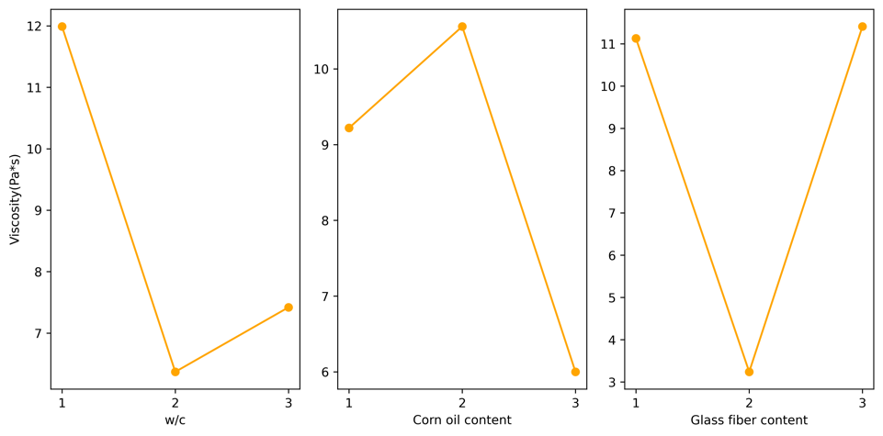
Viscosity
As we can see, if we want a lower viscosity, the best combination is:
w/c = 0.4,
Corn Oil = 1%,
Glass Fiber = 0.5%.
The estimated margin effect of the three factors on the viscosity.

Slide 16
Combination effect
The highest static yield stress: w/c = 0.35, Corn Oil = 1%, Glass Fiber = 0.5%.
The lowest viscosity: w/c = 0.4, Corn Oil = 1%, Glass Fiber = 0.5%.
It is interesting to notice that if we have chosen a certain w/c value, a 1% Corn Oil and 0.5% Glass Fiber can not only decrease the viscosity which can make it easier to extrude out of 3D-printer extruder, but also increase the static yield stress, which is an important factor to enhance the buildability of cement 3D material.

Slide 17
Conclusion
We can adjust the w/c, add corn oil and glass fiber to control the rheology property of the cementitious materials.
The w/c ratio has a significant impact on the static yield stress, which means changing the w/c ratio will dominate the yield stress compared to corn oil and glass fiber.
The 1% Corn Oil and 0.5% Glass Fiber can decrease the cement paste’s viscosity while increase its static yield stress, which can improve the performance of 3D-printing.

Slide 18
Questions?
Thank you!

