Slide 1
ECE 653 Final Project Report
Team：Tiankai J. Haley C. Steven Q.
Date：05/08/2020

Slide 2
Preview
1
4
2
3
Control Graph Generator
Benchmark Comparison
Python AST
Implementation

Slide 3
Control Flow Generator
Abstract background review

Slide 4
Project Structure
External packages, framework, and target repository
1
2
3
Raw Code Process
Abstract Syntax Tree
CFG Visitor
Remove inline or block comments.
Serve as parser in pre-process input target code
Traversal through AST and create virtual representation of code blocks, (i.e. class and function)
4
5
Graphviz
Target Repo
Outout graph is generated by Graphviz
The project is compared with staticfg

Slide 5


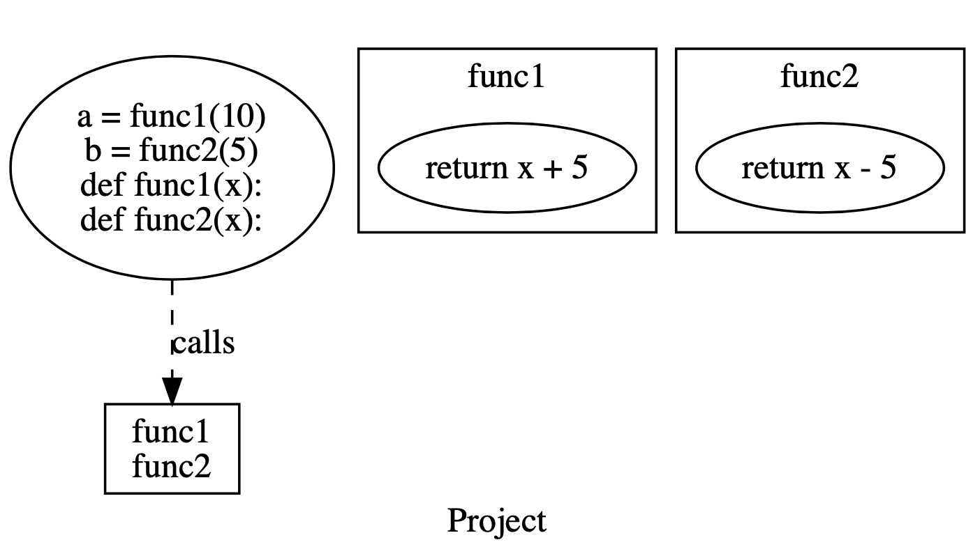


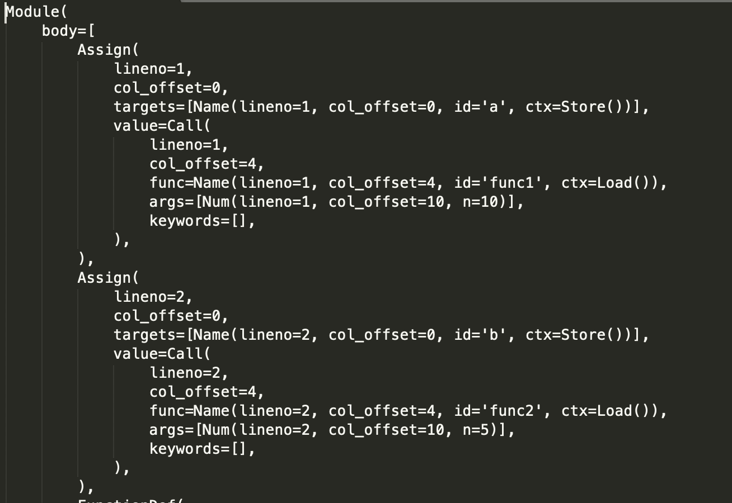
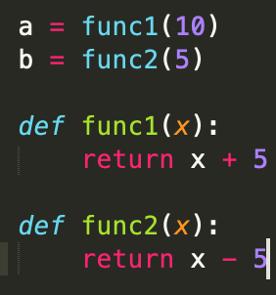
Function Preview
As a way of quality control to prevent random errors during execution, uncompilable inputs are detected in pre-execution.
Class structures and function calls are stored as models in the form of syntax tree.
Final output is in an aggregate format that respectively show each model as an independent control-flow graph.
Project Repo

Slide 6
Implementation Steps
Propositional logic adjustment
Output comparison
Unit test
Proposition logic is transformed from simple negation to normal form.
Complex cases remains using negation.
CFG Builder
Because the final output is in the form of graph, acceptance test is performed by visual exemption.
Parse to AST
Perform Unit test to ensure code quality
Formality check
Operating variables stored as a list of dictionary to improve traversal efficiency and code formality
AST models contain variables, conjunctive variables which includes logical and operating.
Input code with syntax error that can not compile will be excluded

Slide 7
User Acceptance Showcase

Slide 8

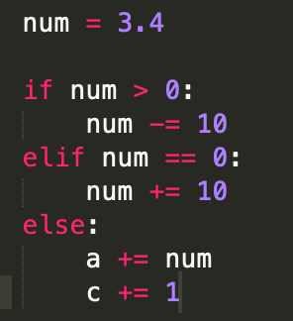
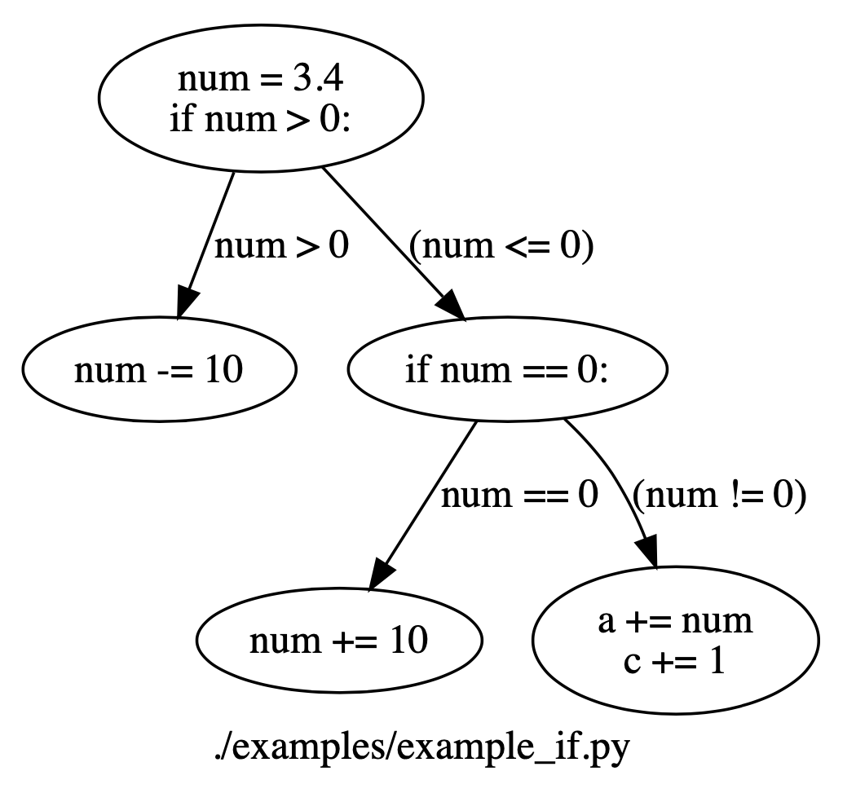
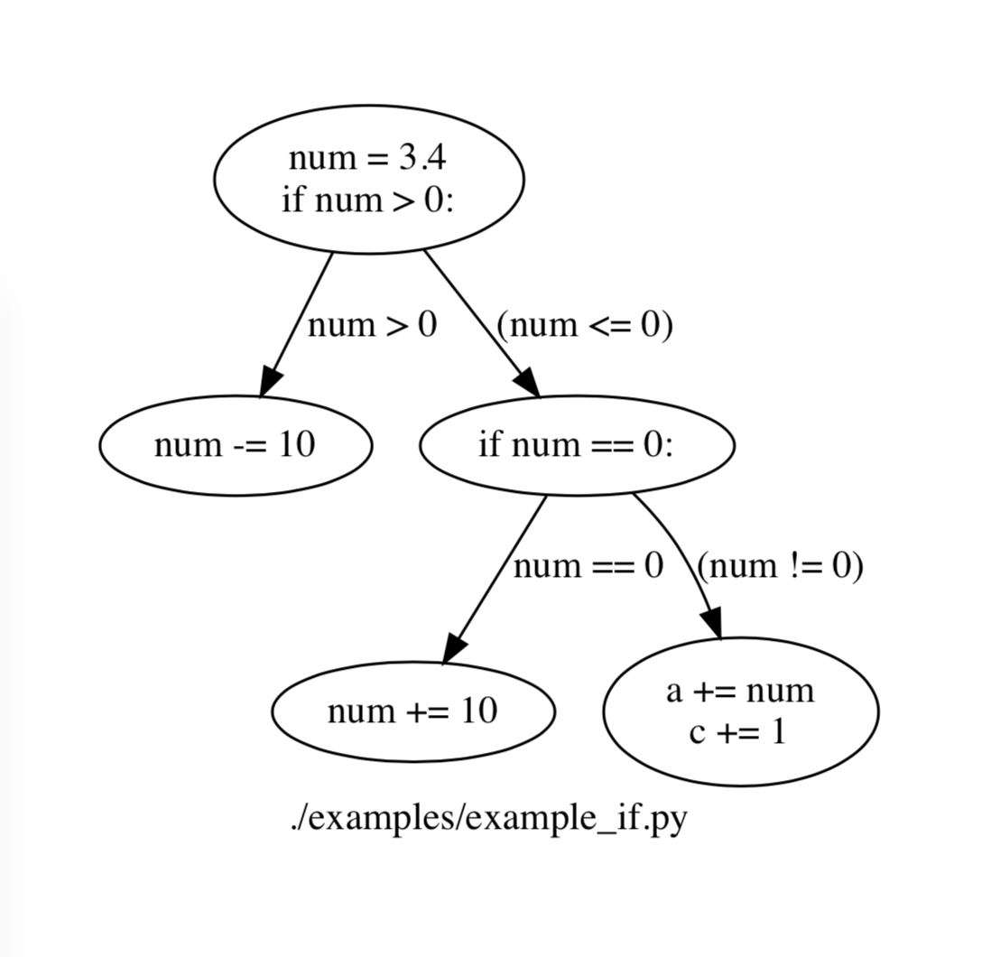
Case: If Statement
Source Code
Project output
Benchmark

Slide 9
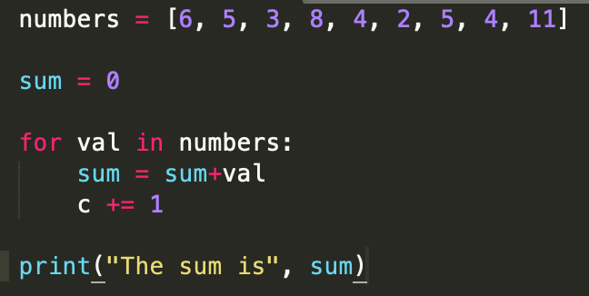
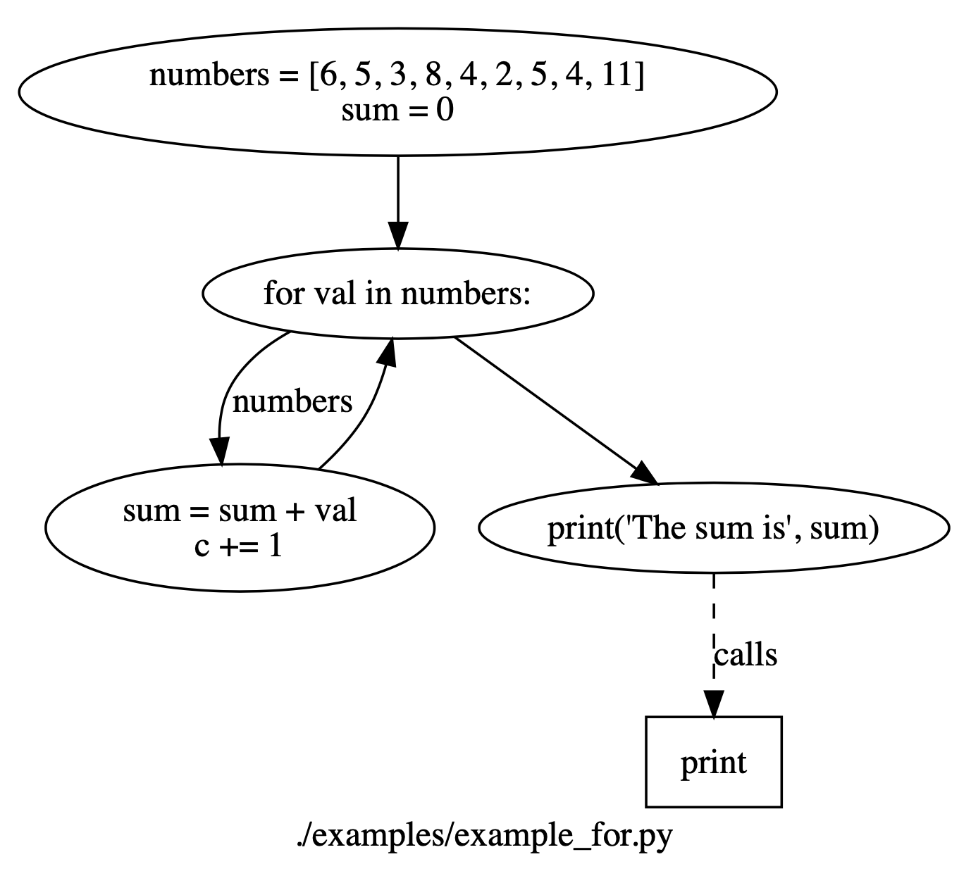
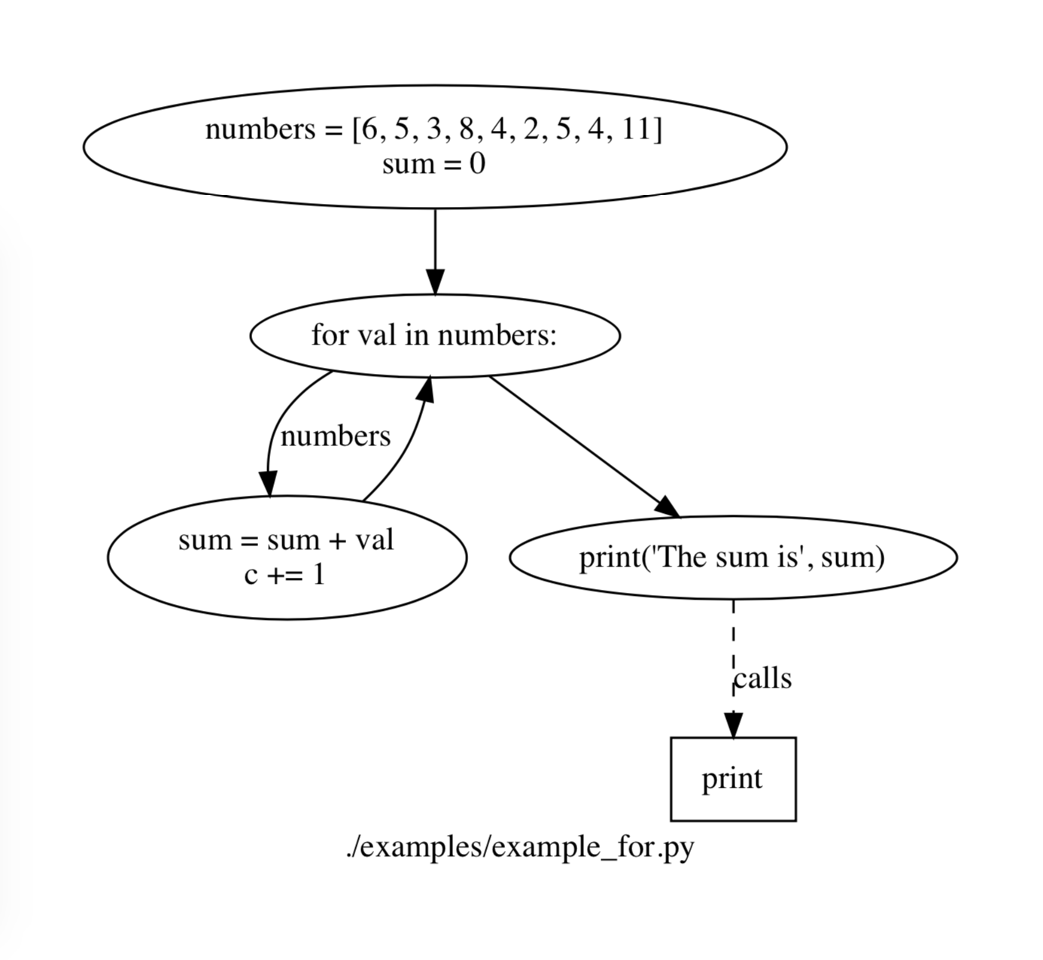
Case: For Loop
Source Code
Project output
Benchmark

Slide 10
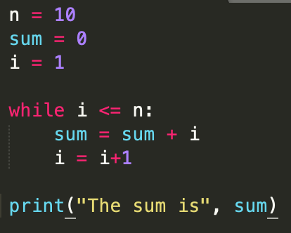
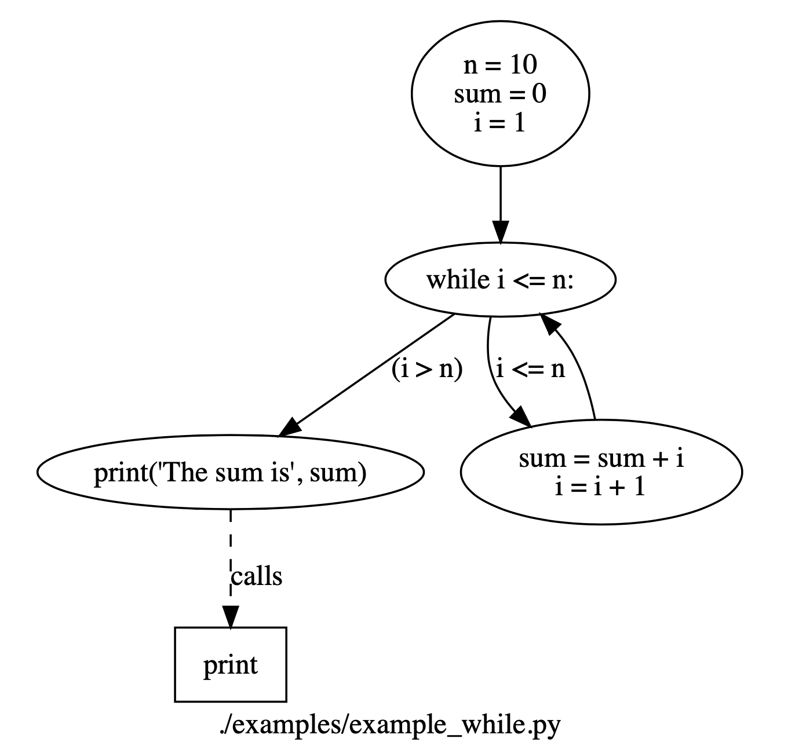
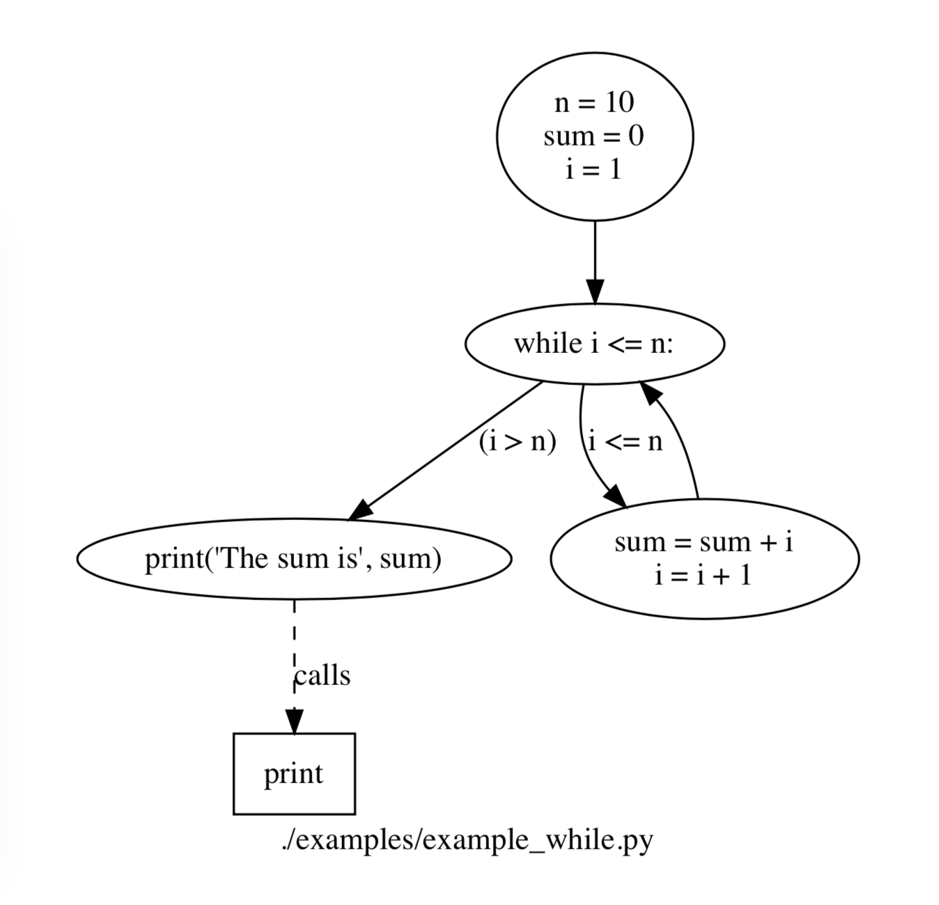
Case: While Loop
Source Code
Project output
Benchmark

Slide 11

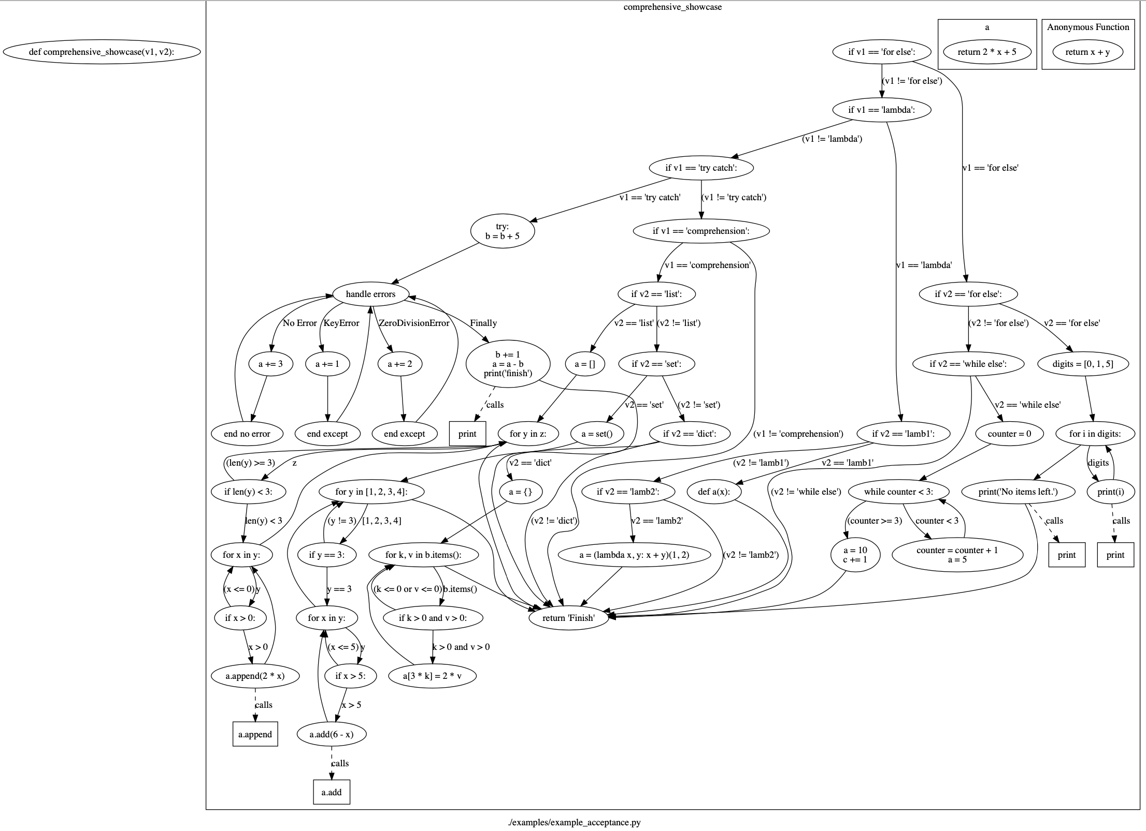
Enhancement and Improvement
For…else & While…Else
Try …except…finally
List comprehension
Dictionary comprehension
Set comprehension
Lambda function
Propositional logic transformation
Due to the polytropic nature for lambda function, only certain cases can be correctly handled

Slide 12
Code review and enhancement show case

Slide 13
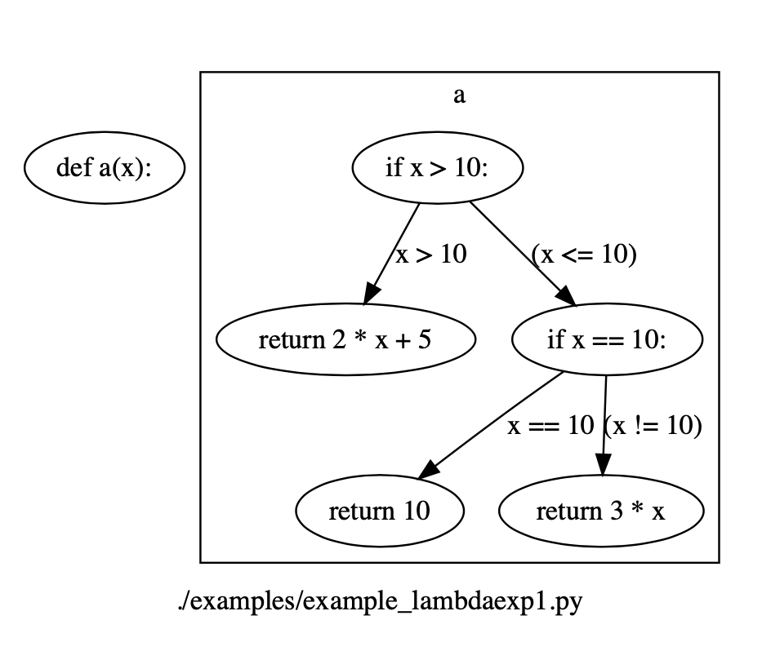
Case: Lambda Function

Slide 14
Case: Dictionary Comprehension

Slide 15
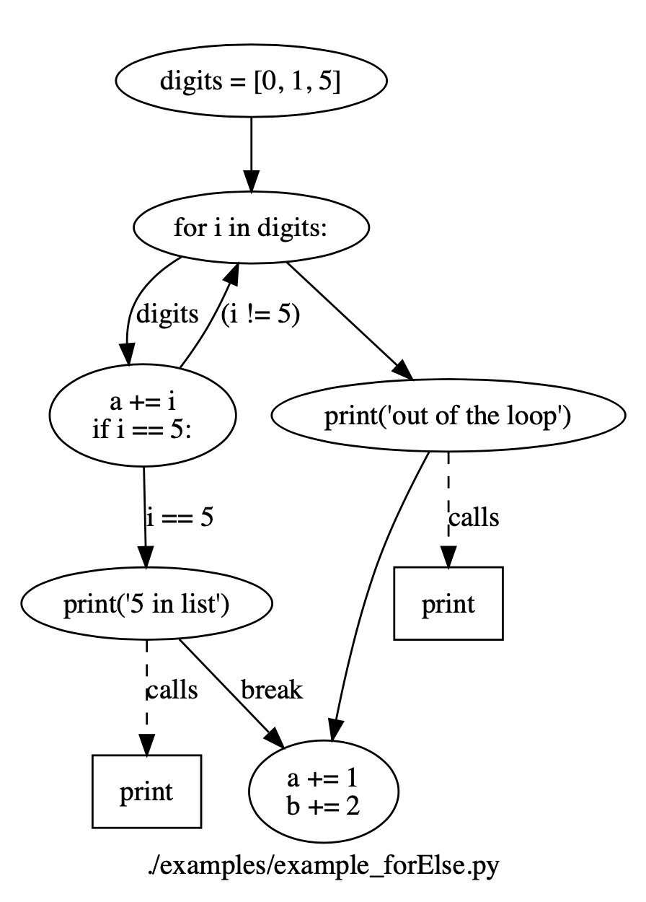
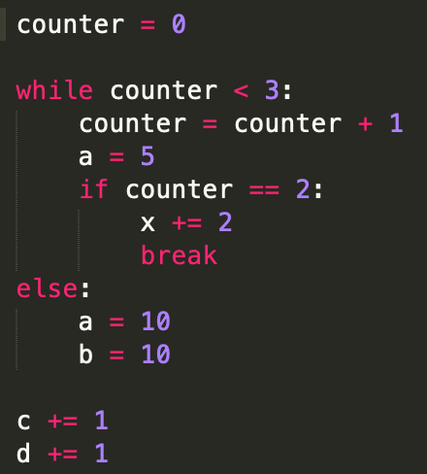
Case: For … Else

Slide 16
Code Demonstration and Question

