Slide 1
Integrated CNV (iCNV)
张雨
2018/11/8
https://github.com/zhouzilu/iCNV/blob/master/vignettes/iCNV-vignette.Rmd#L107

Slide 2
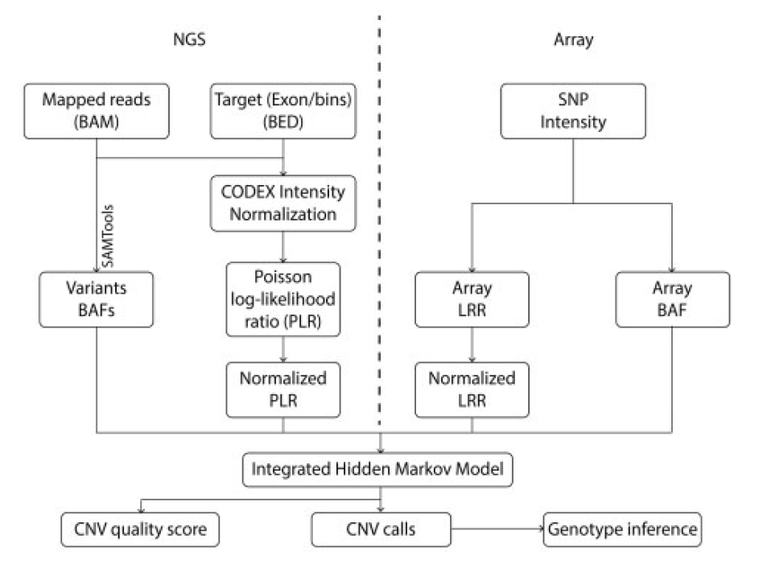
iCNV analysis pipeline

Slide 3
.bam file normalization using CODEX

Slide 4
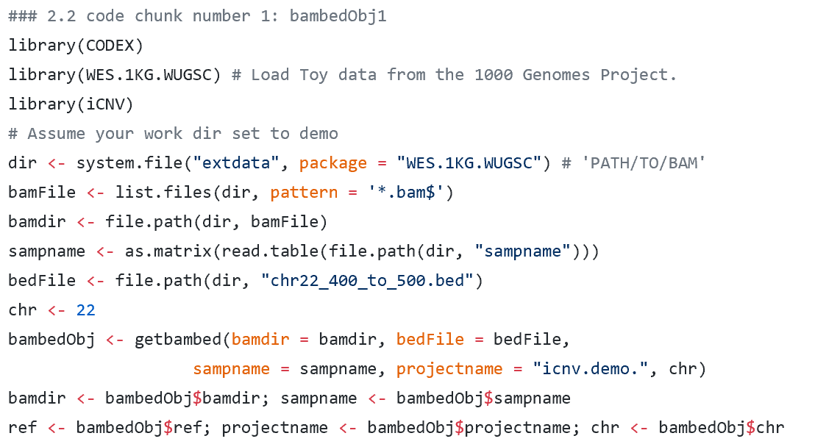
构造bambed对象

Slide 5
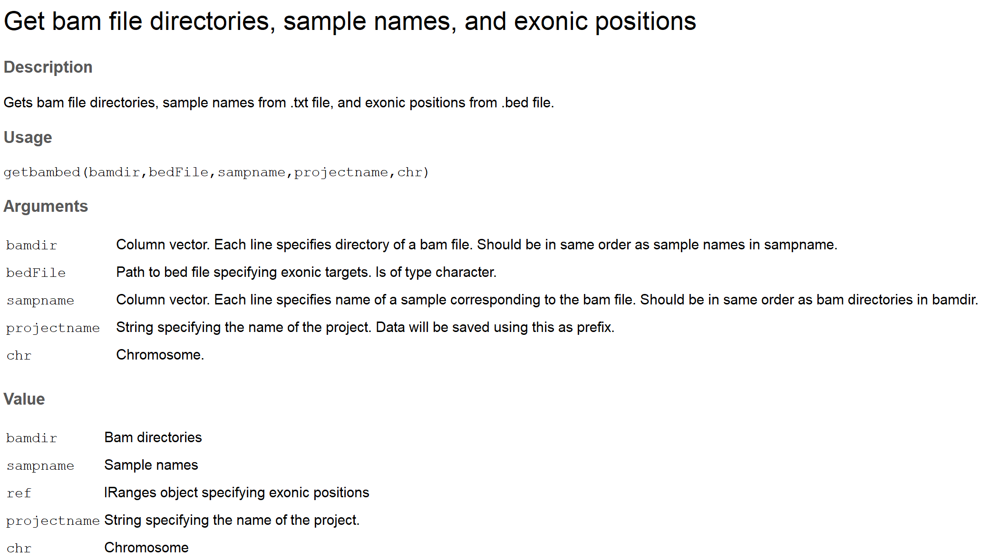
In WES, the targets are exons, while for WGS, iCNV automatically bins the genome and treats each bin as a target (the default bin size is 1 kb).

Slide 6
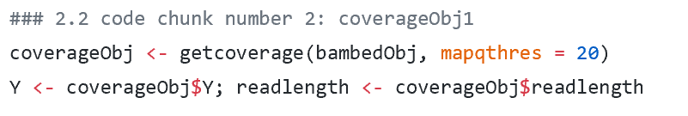
得到覆盖深度对象

Slide 7
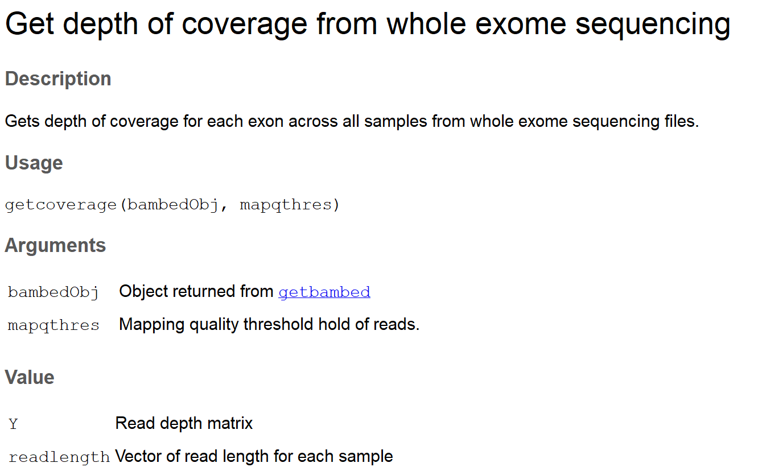

Slide 8
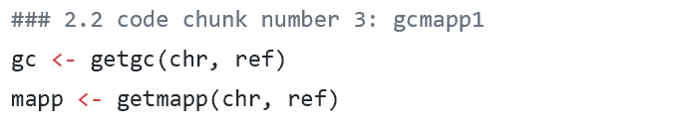
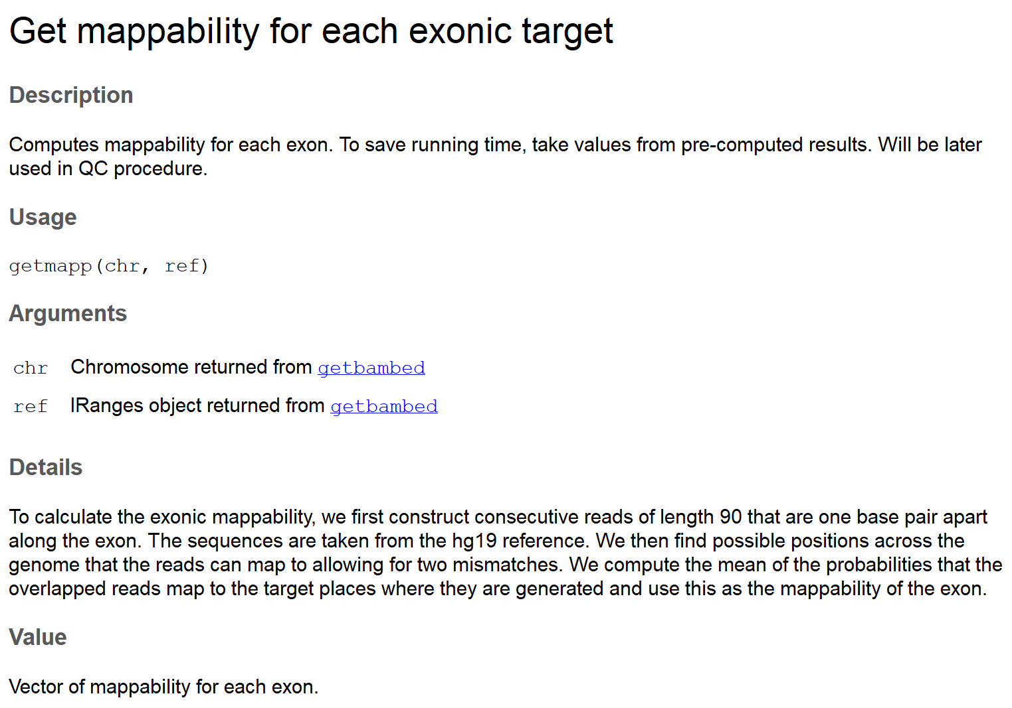
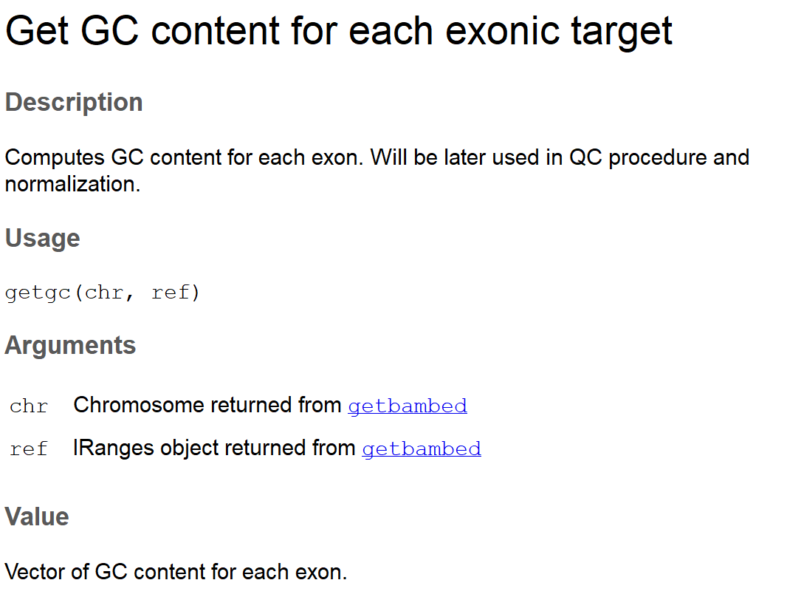
计算每个target的GC含量和mappability

Slide 9
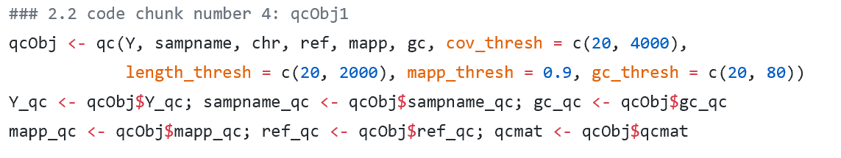
质量控制

Slide 10
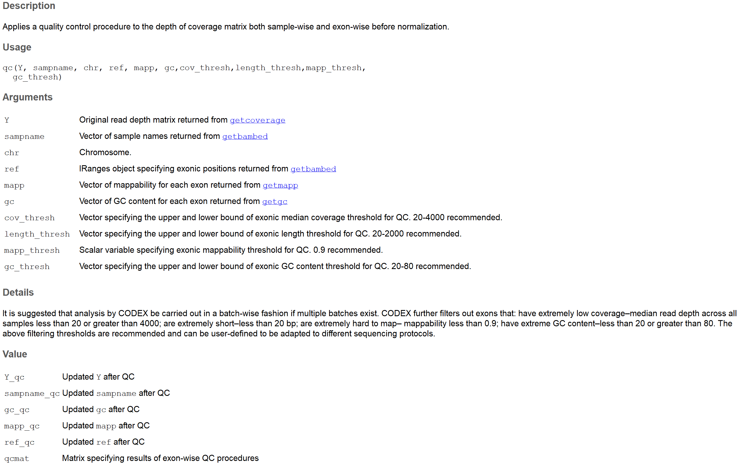

Slide 11
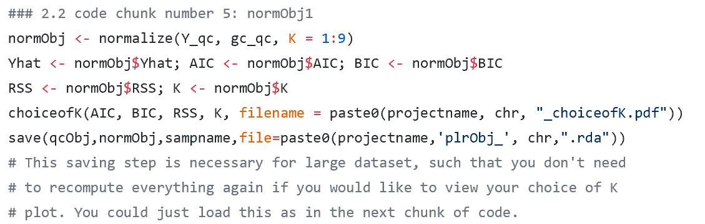
标准化

Slide 12
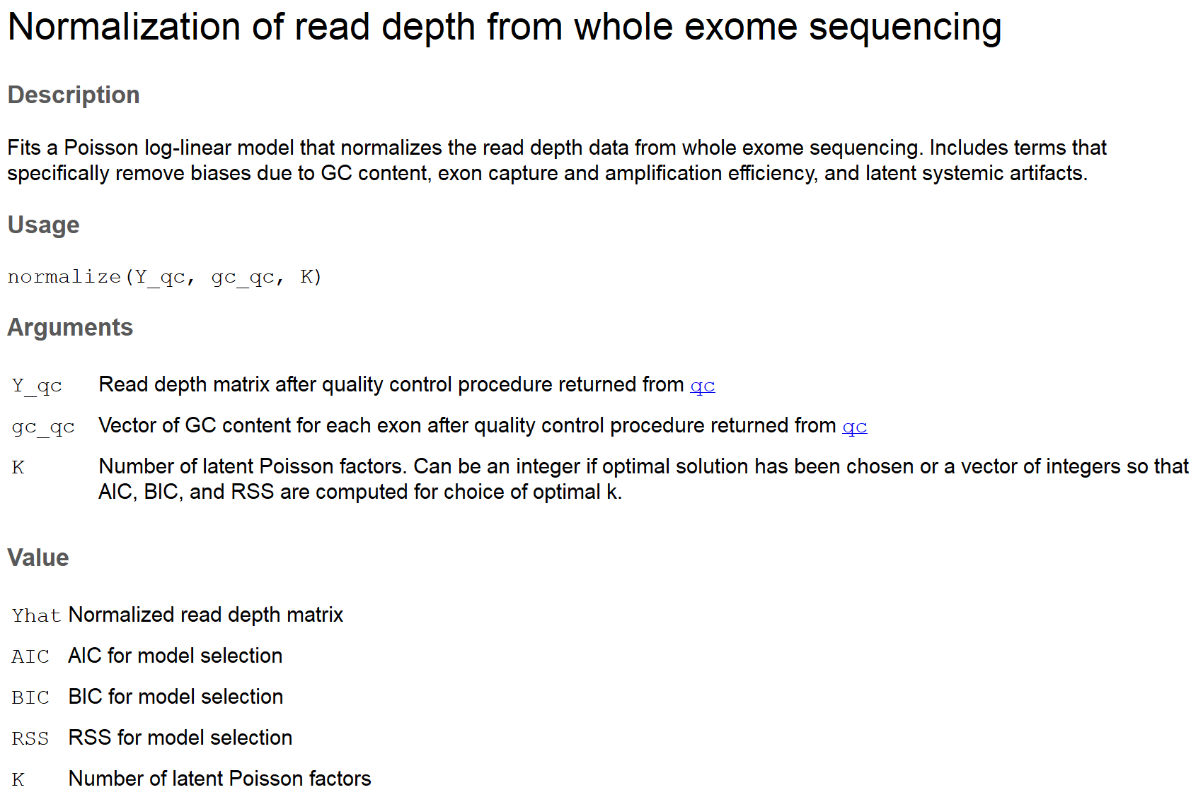

Slide 13
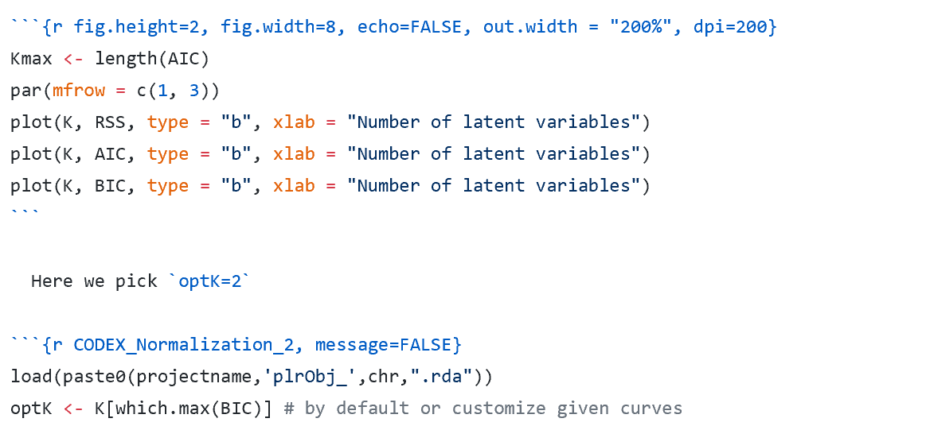
CODEX reports all three statistical metrics (AIC, BIC, percent of Variance explained) and uses BIC as the default method to determine the number of latent Poisson factors.

Slide 14
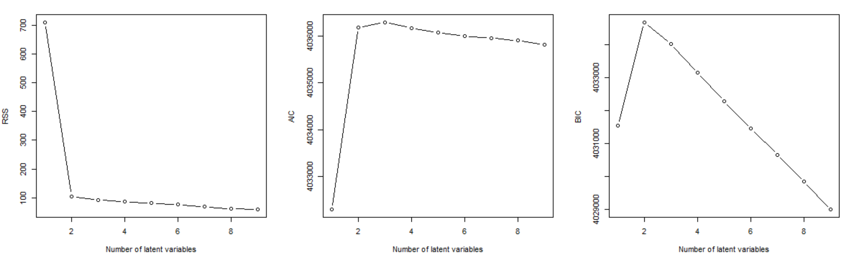

Slide 15
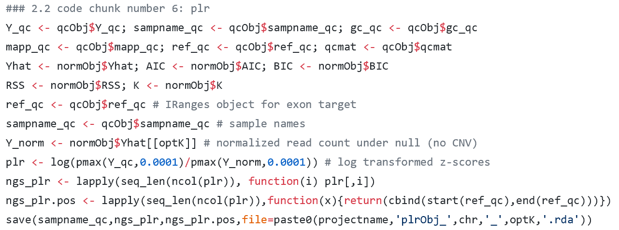

Slide 16
sequence variants BAF calling

Slide 17
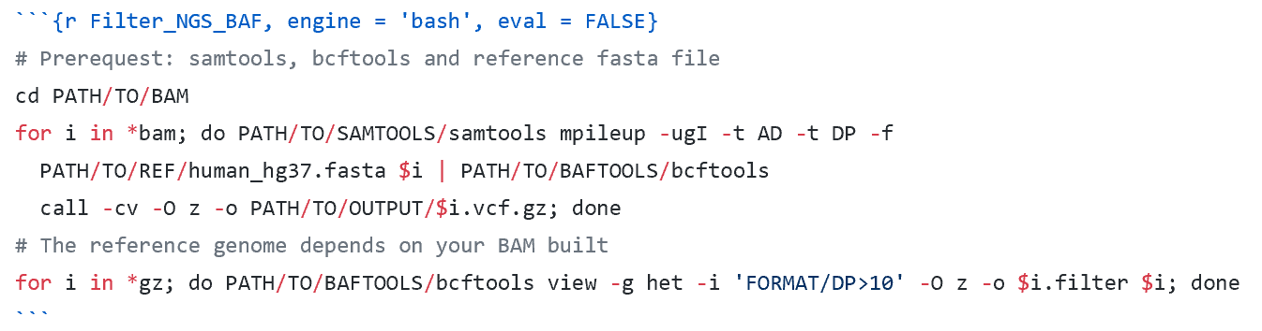
Call SNVs， calculate B allele frequency(BAF)
For sequencing data without sophisticated pipeline and SNVs call set in VCF format, we manually call SNVs from quality controlled BAM files by mpileup module in samtools, and calculate B allele frequency(BAF) on heterogeneous loci by dividing AD (Number of high-quality non-reference bases, FORMAT) from DP (Number of high-quality bases, FORMAT).

Slide 18
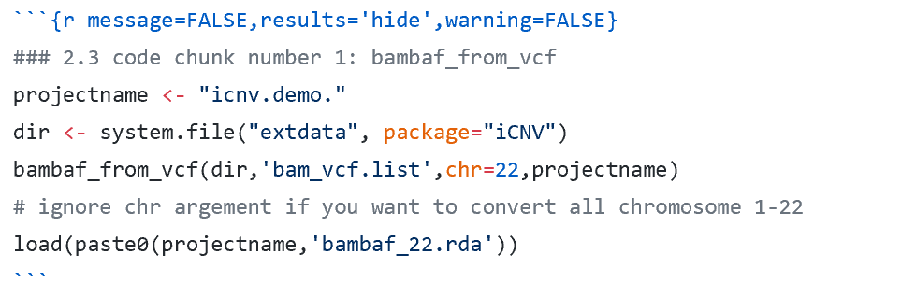
extract variants BAF info from vcf file

Slide 19
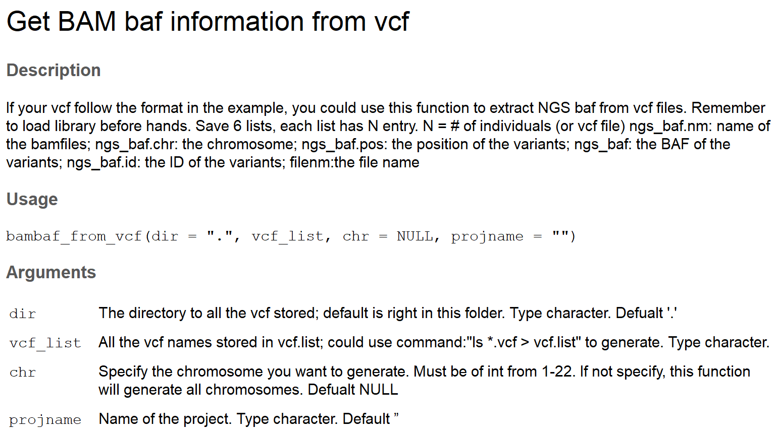

Slide 20
SNP array LRR normalization and BAF

Slide 21
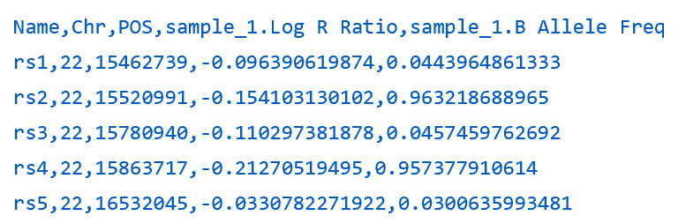
standard signal intensity file format

Slide 22
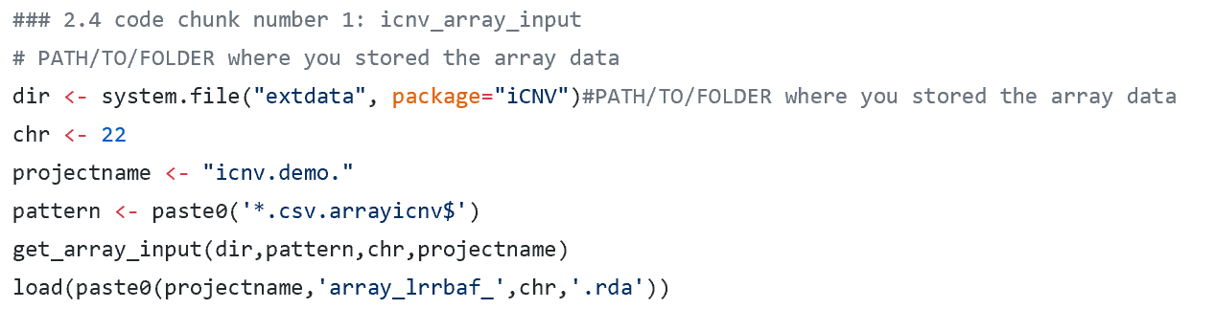
Array input

Slide 23
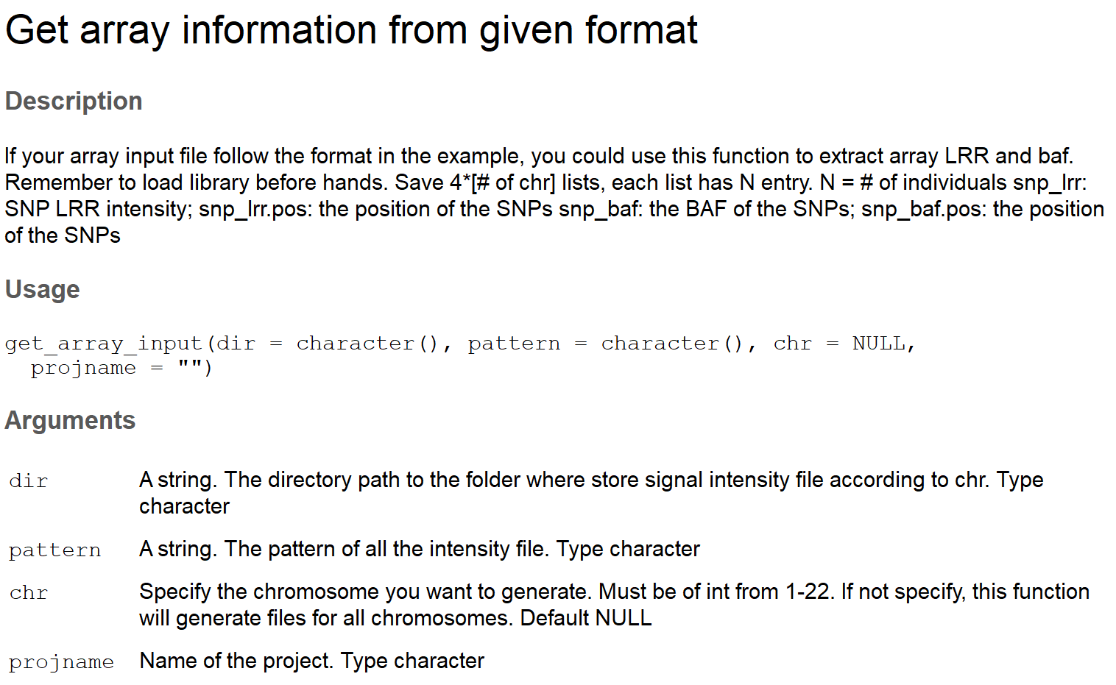

Slide 24
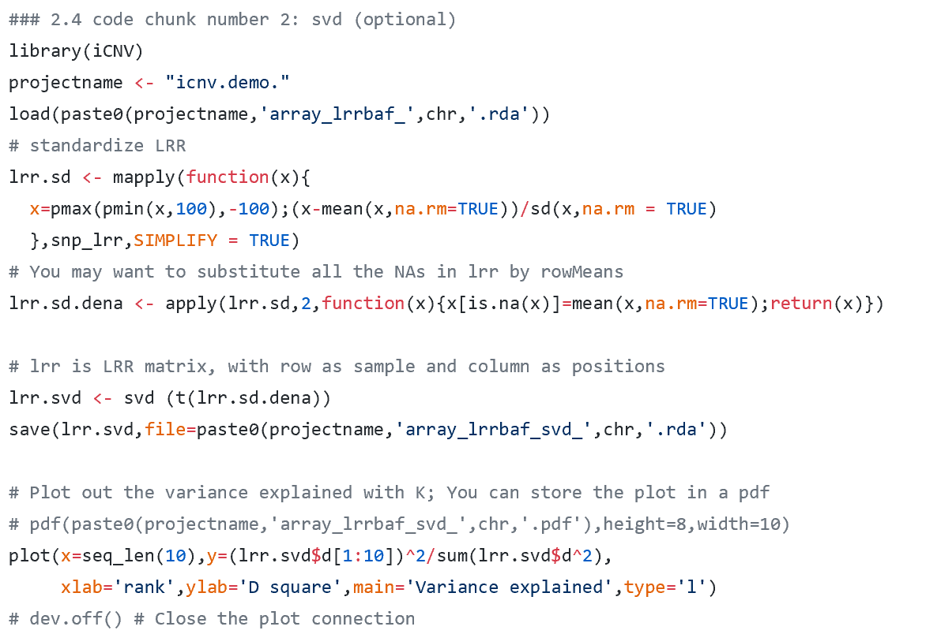
svd (optional)

Slide 25
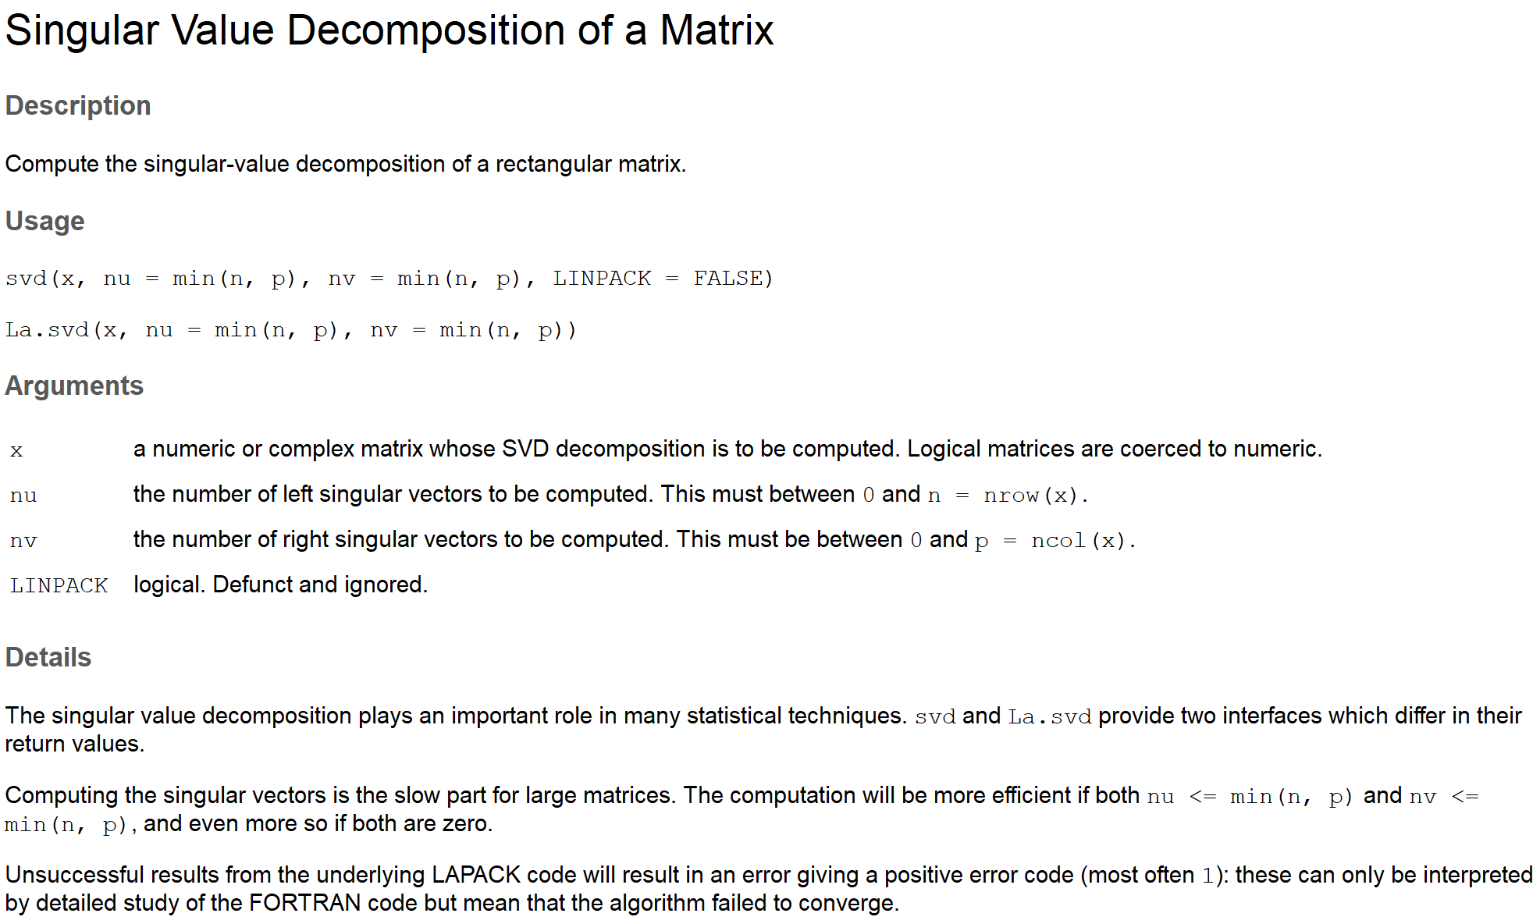

Slide 26
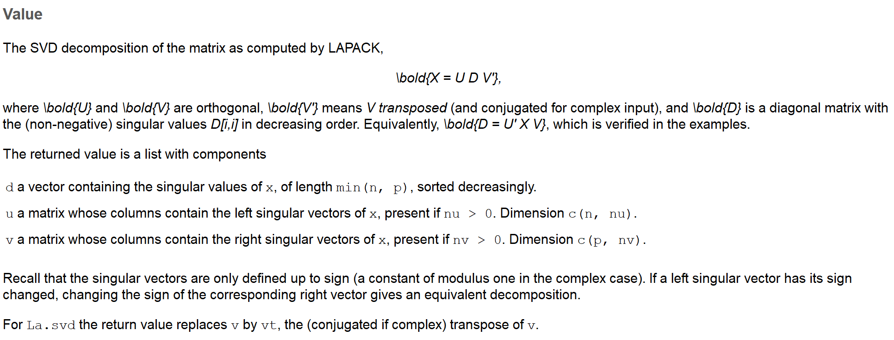

Slide 27
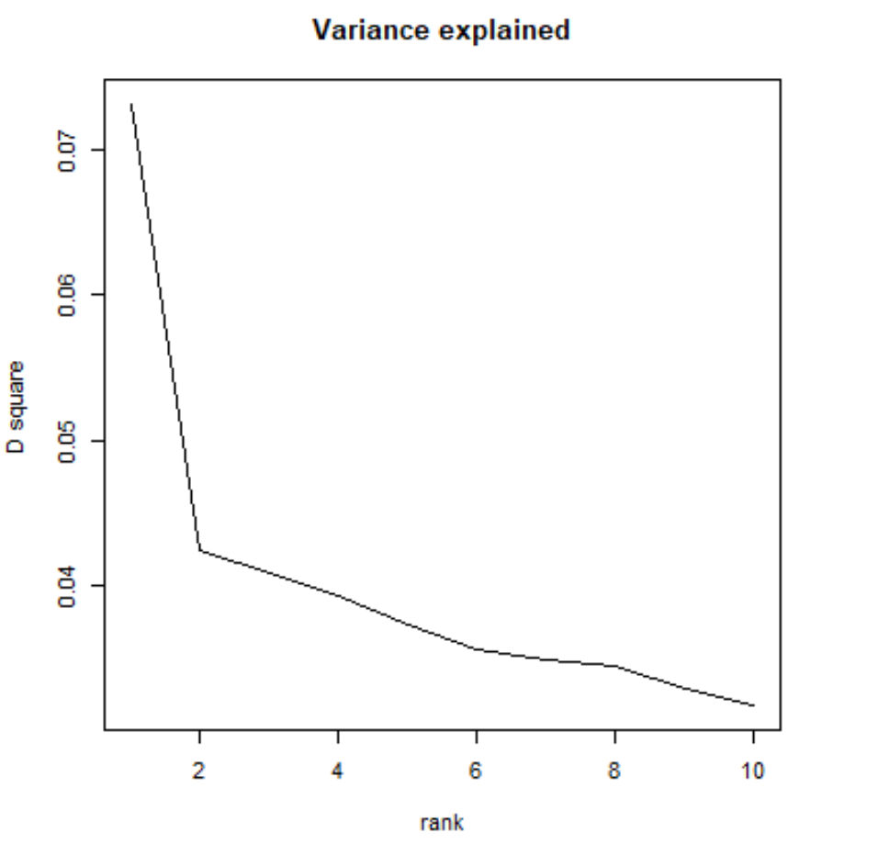

Slide 28
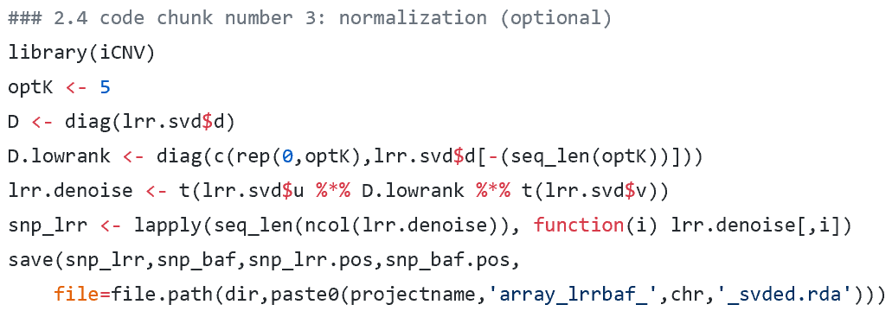
normalization (optional) 去噪？

Slide 29
Mutiple platform CNV detection using iCNV

Slide 30
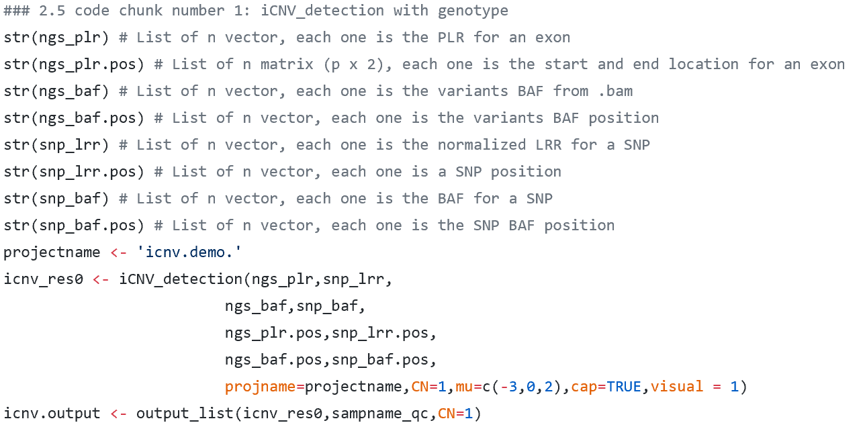
iCNV detection with genotype

Slide 31
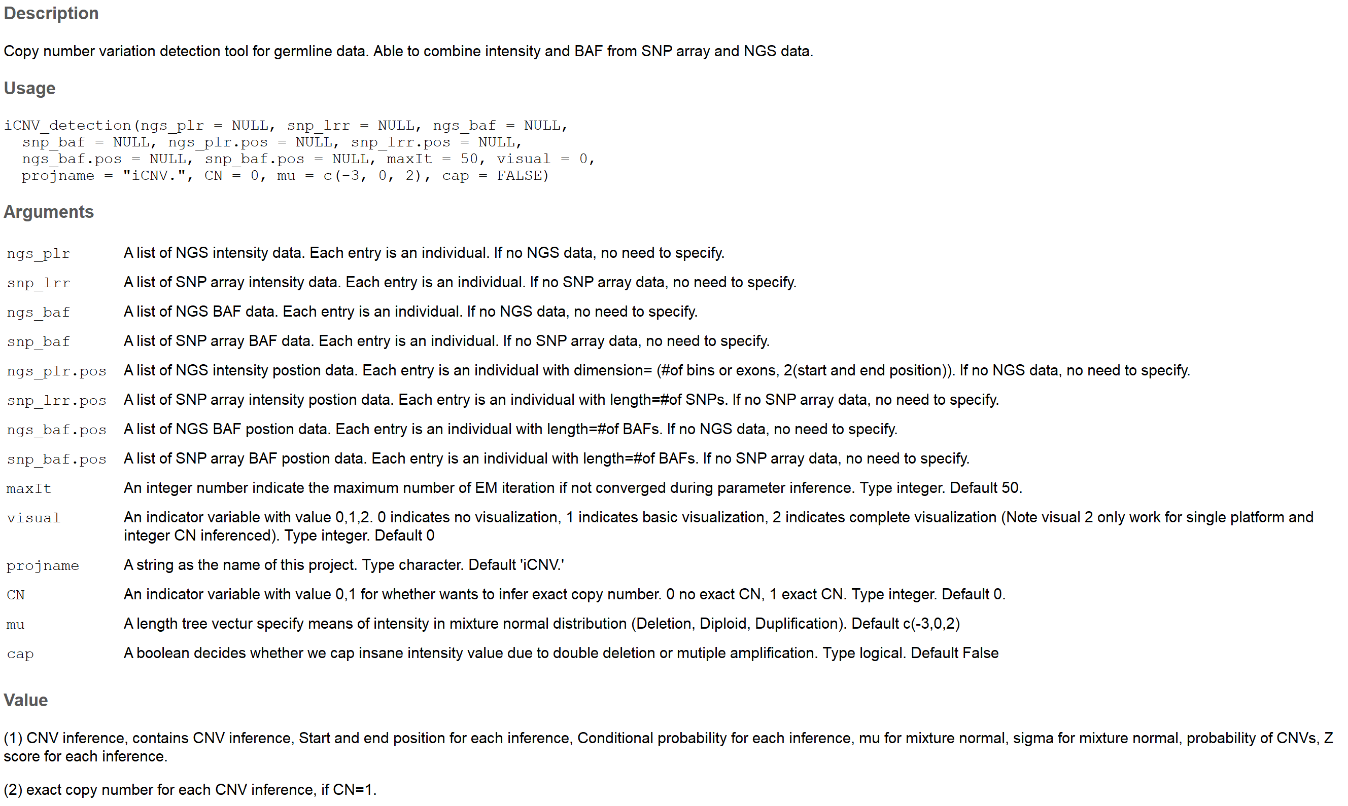

Slide 32
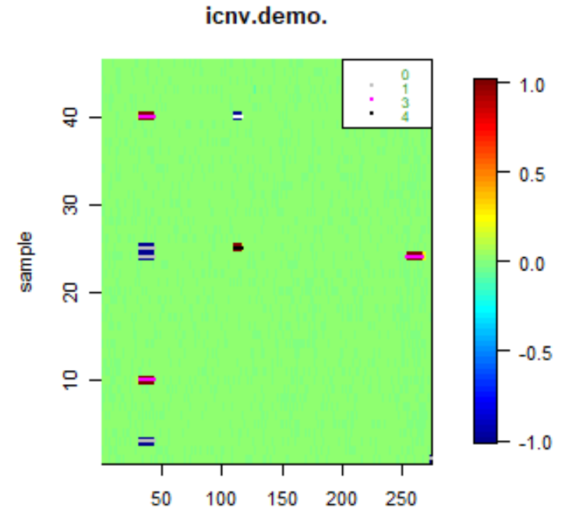
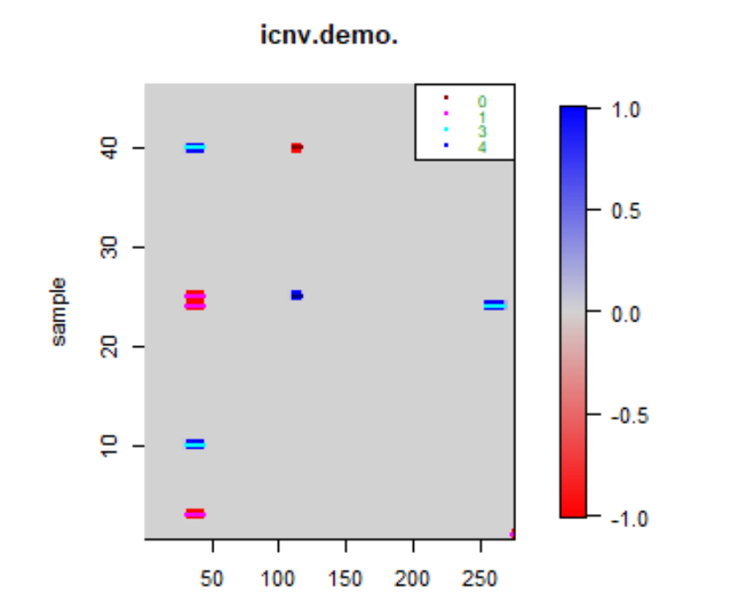

Slide 33
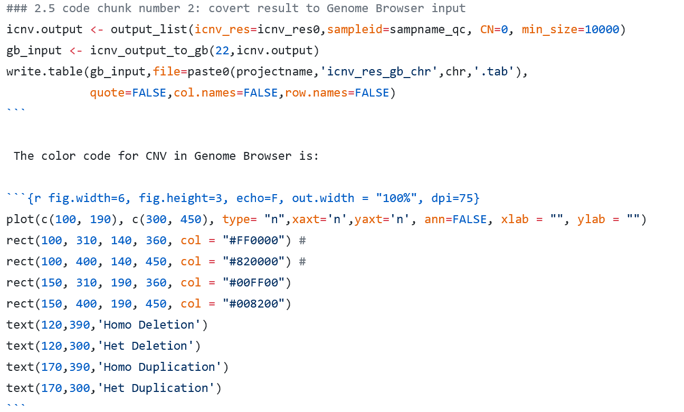
covert result to Genome Browser input

Slide 34
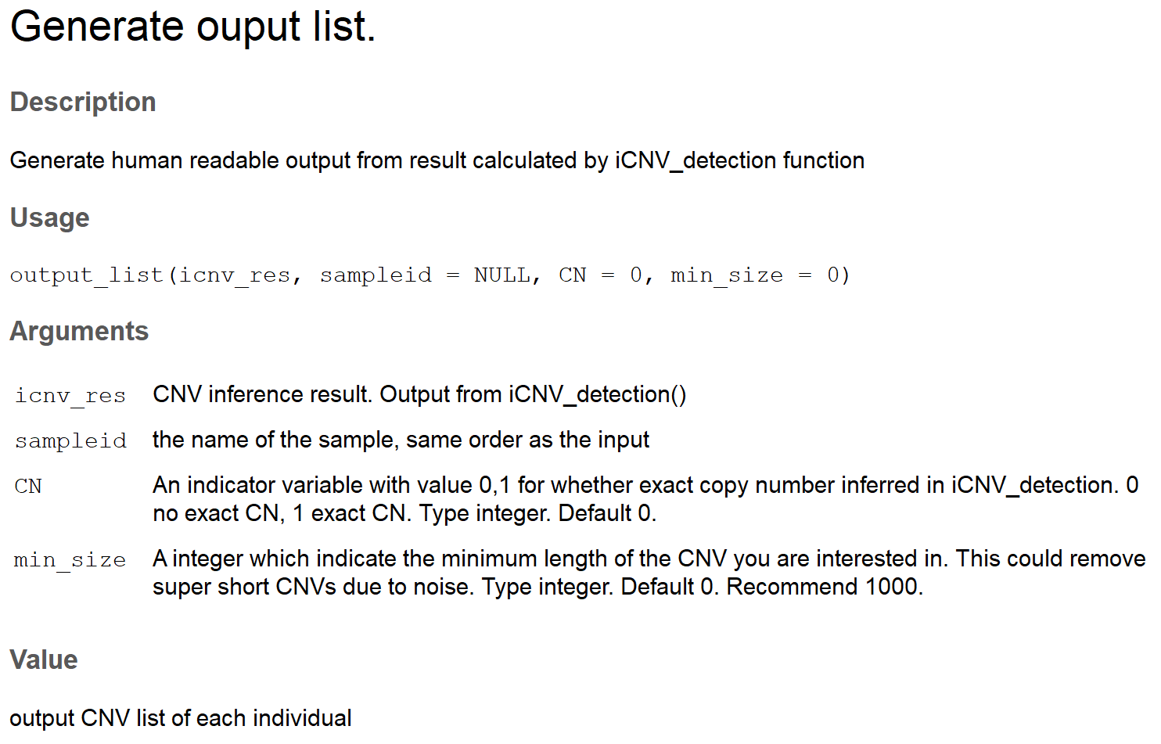

Slide 35
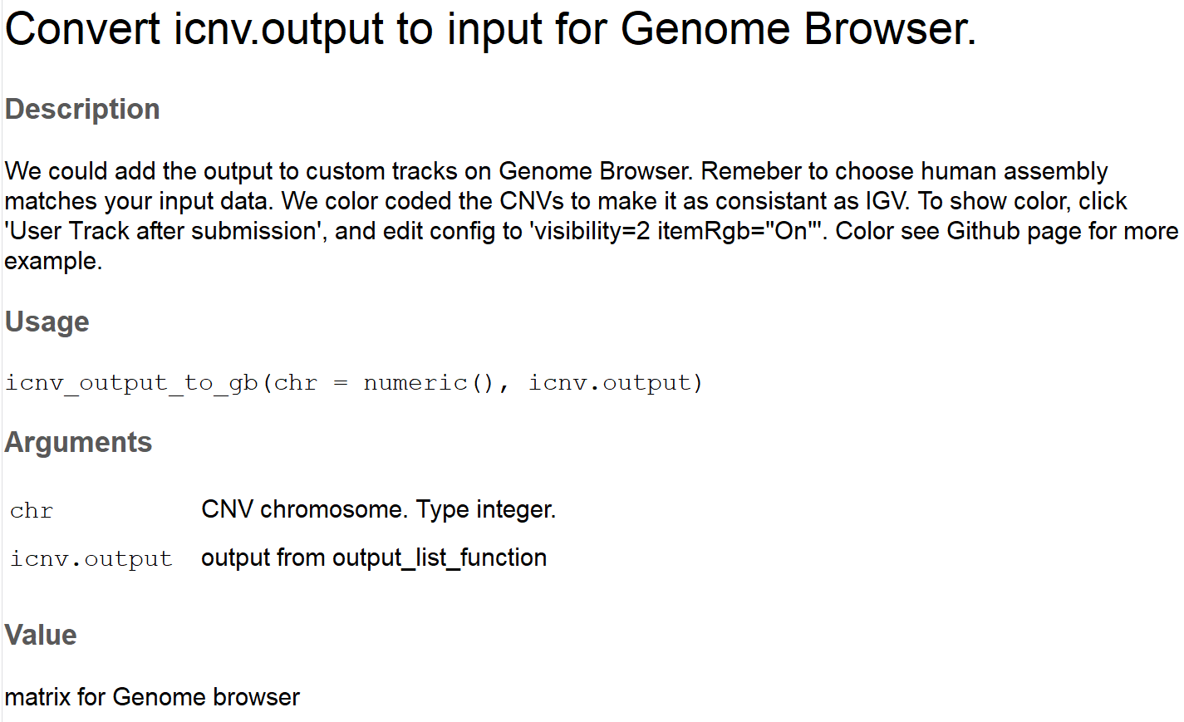

Slide 36
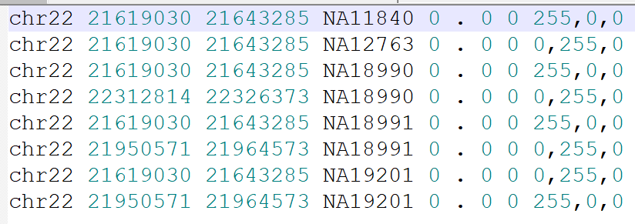

Slide 37
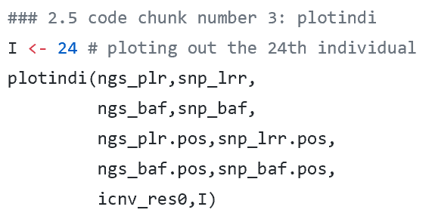
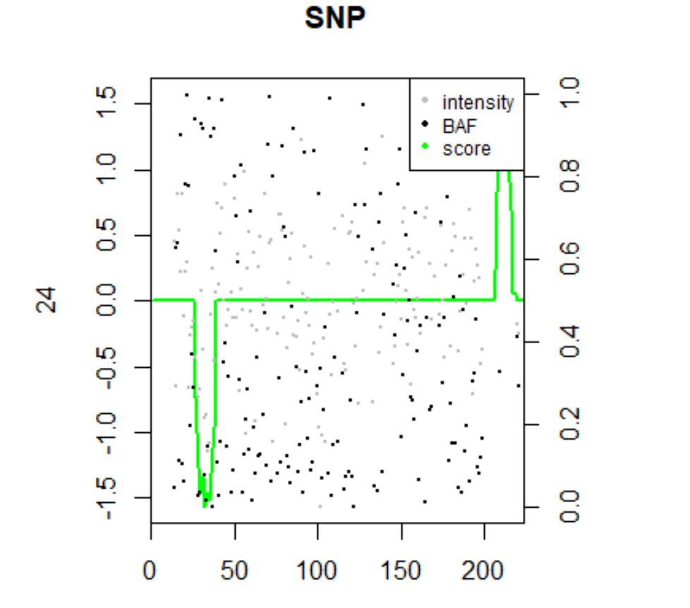

Slide 38
Single platform CNV detection using iCNV

Slide 39
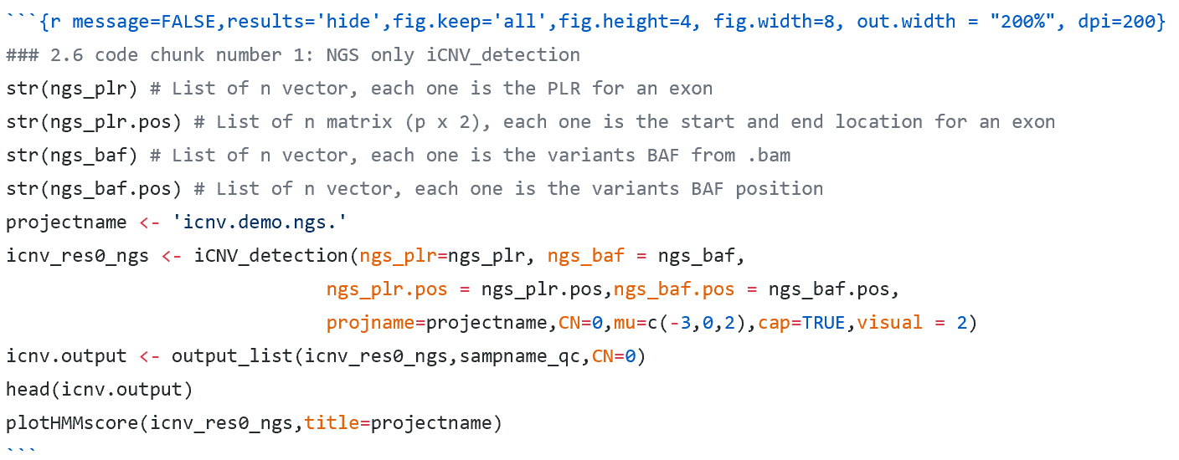
NGS only iCNV detection

Slide 40
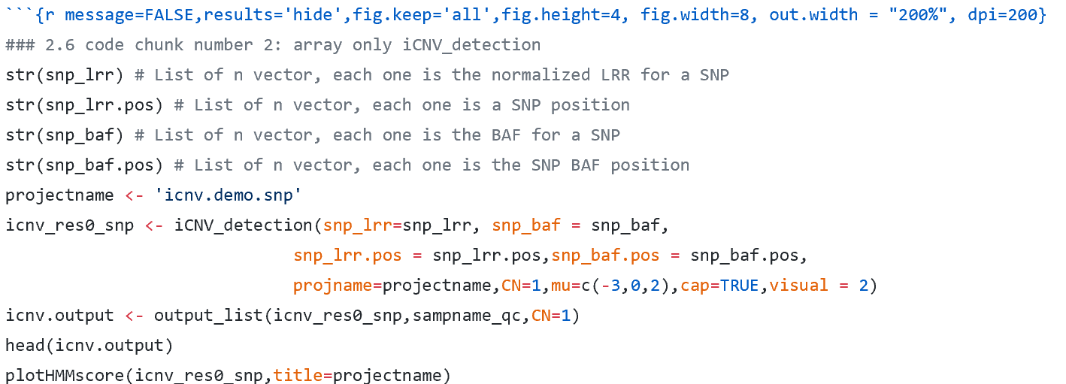
array only iCNV detection

