Slide 1
Online-shopping web application
Student: Tianle shu
Supervisor: Martin Hynes

Slide 2
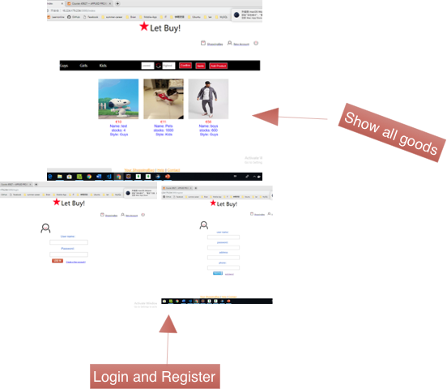
Overview of presentation
Proposal :
Introduction
Aims
Plan:
Milestones
Time Estimates

Slide 3
Introduction
The main of this project is to provide better experience in the area of shopping script. Online shopping system is a virtual store on Internet where customer can browse the product. That can convenient people who walking down the street has some difficulties, also some people are so much busy and not able to go out for shopping.

Slide 4
Aim:
Any member can register and view available products.
User can login and logout their account. Add items to shopping bag and delete it before submission
Only registered or logined member can purchase multiple products regardless of quantity.
User also can view the history of buying and comments on the order page.

Slide 5
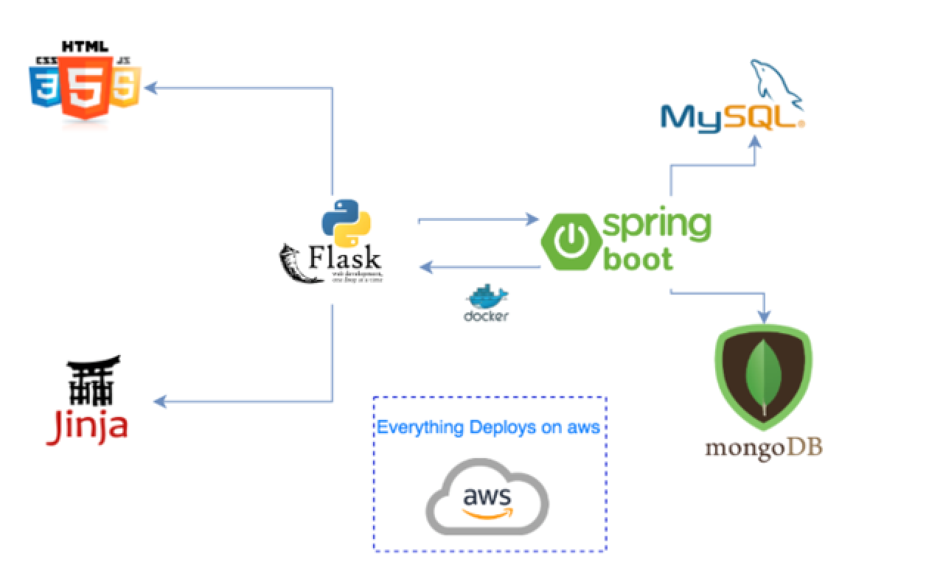
Architecture/Technologies

Slide 6



Docker is a tool designed to make it easier to create, deploy, and run applications by using containers. Containers allow a developer to package up an application with all of the parts it needs.
Spring Boot makes it easy to create stand-alone, production-grade Spring-based Applications that you can run. And most Spring Boot applications need very little Spring configuration.
MongoDB stores data in flexible, JSON-like documents, meaning fields can vary from document to document and data structure can be changed over time.

Slide 7
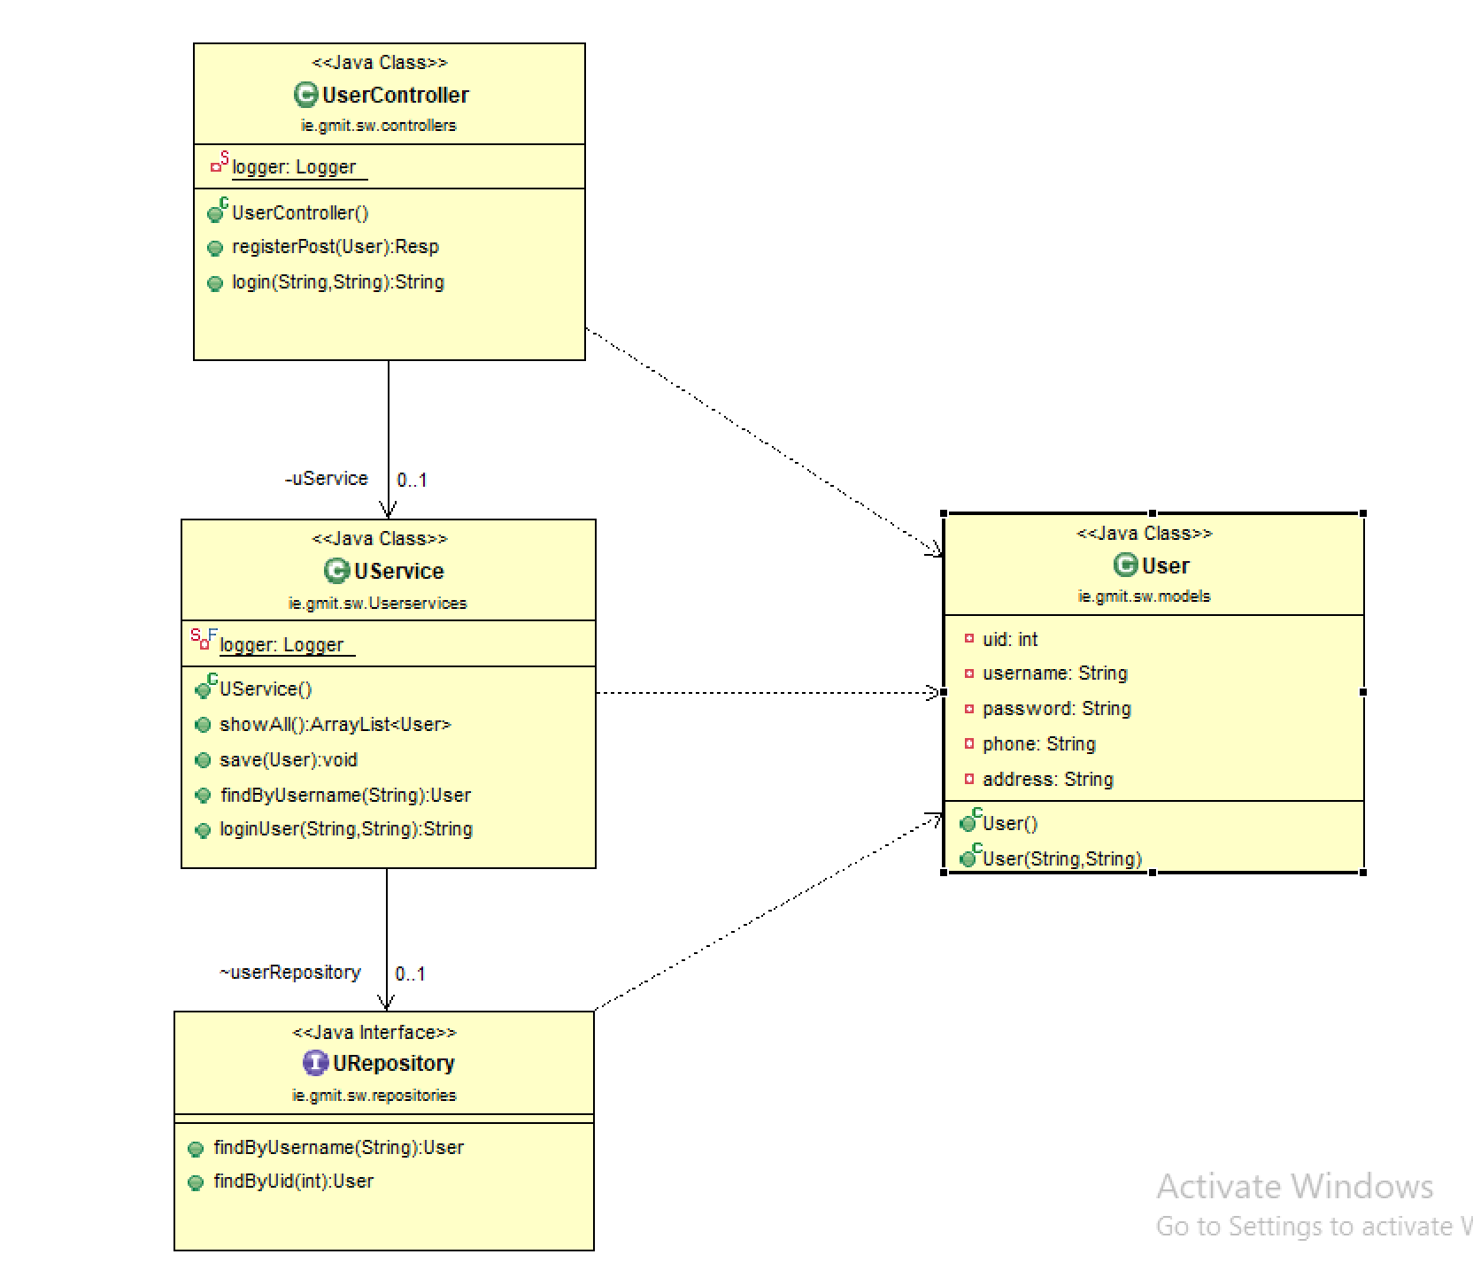

User System design
User details storage in MySQL

Slide 8
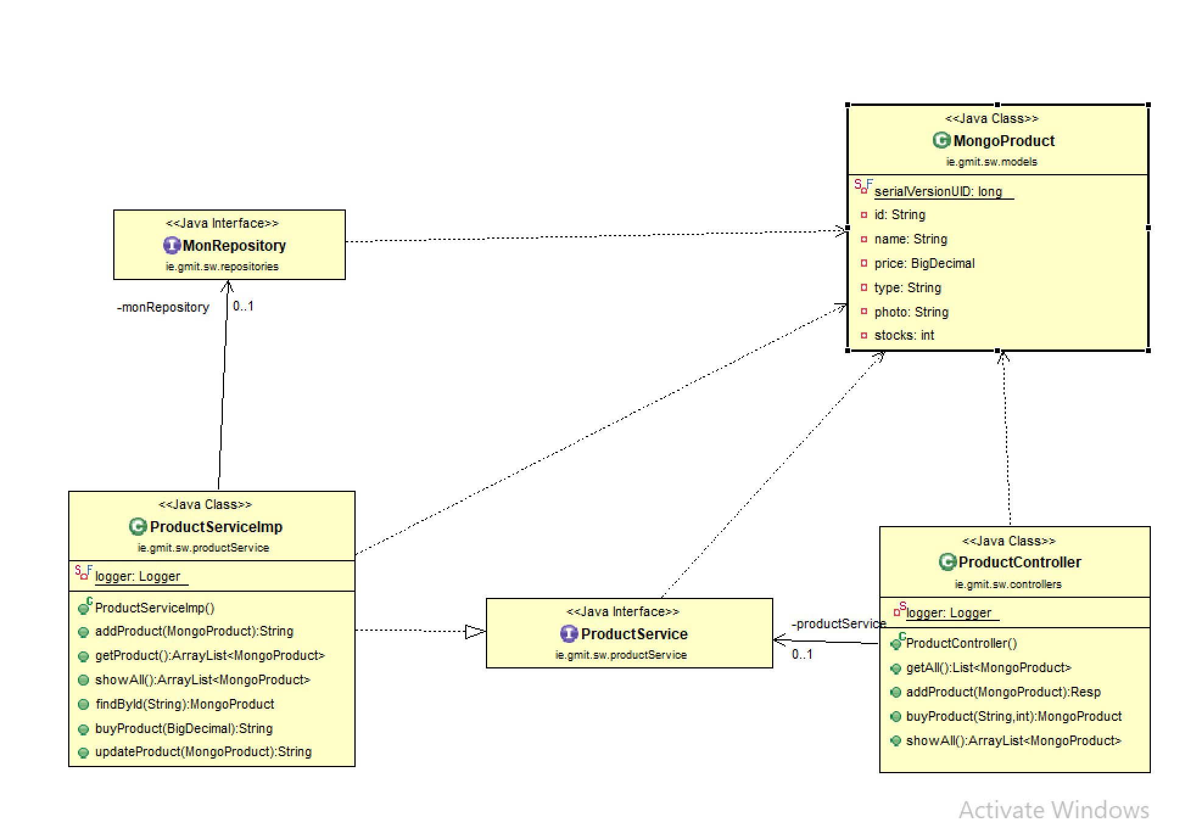

products System design
All products storage in MongoDB

Slide 9
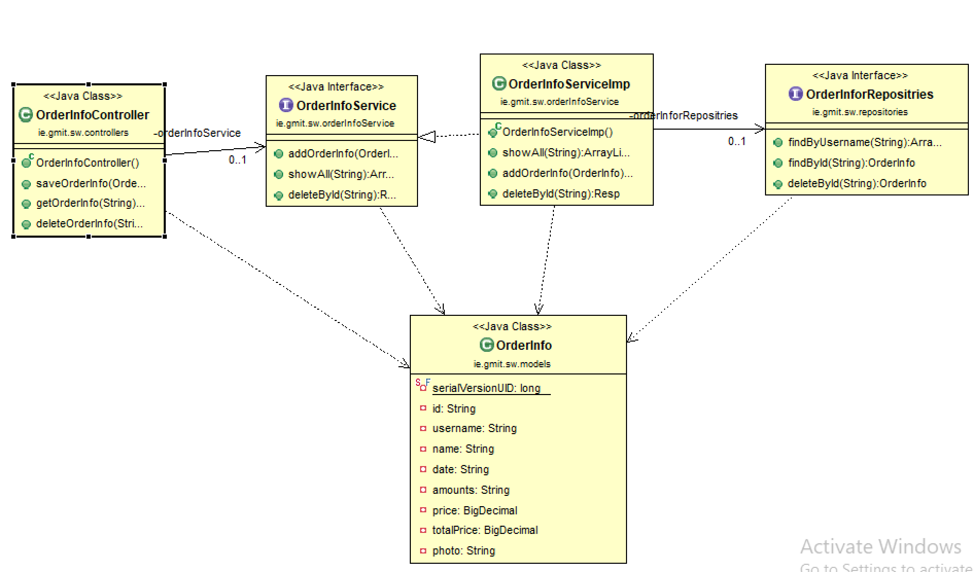
User Order details System design
All products storage in MongoDB

Slide 10
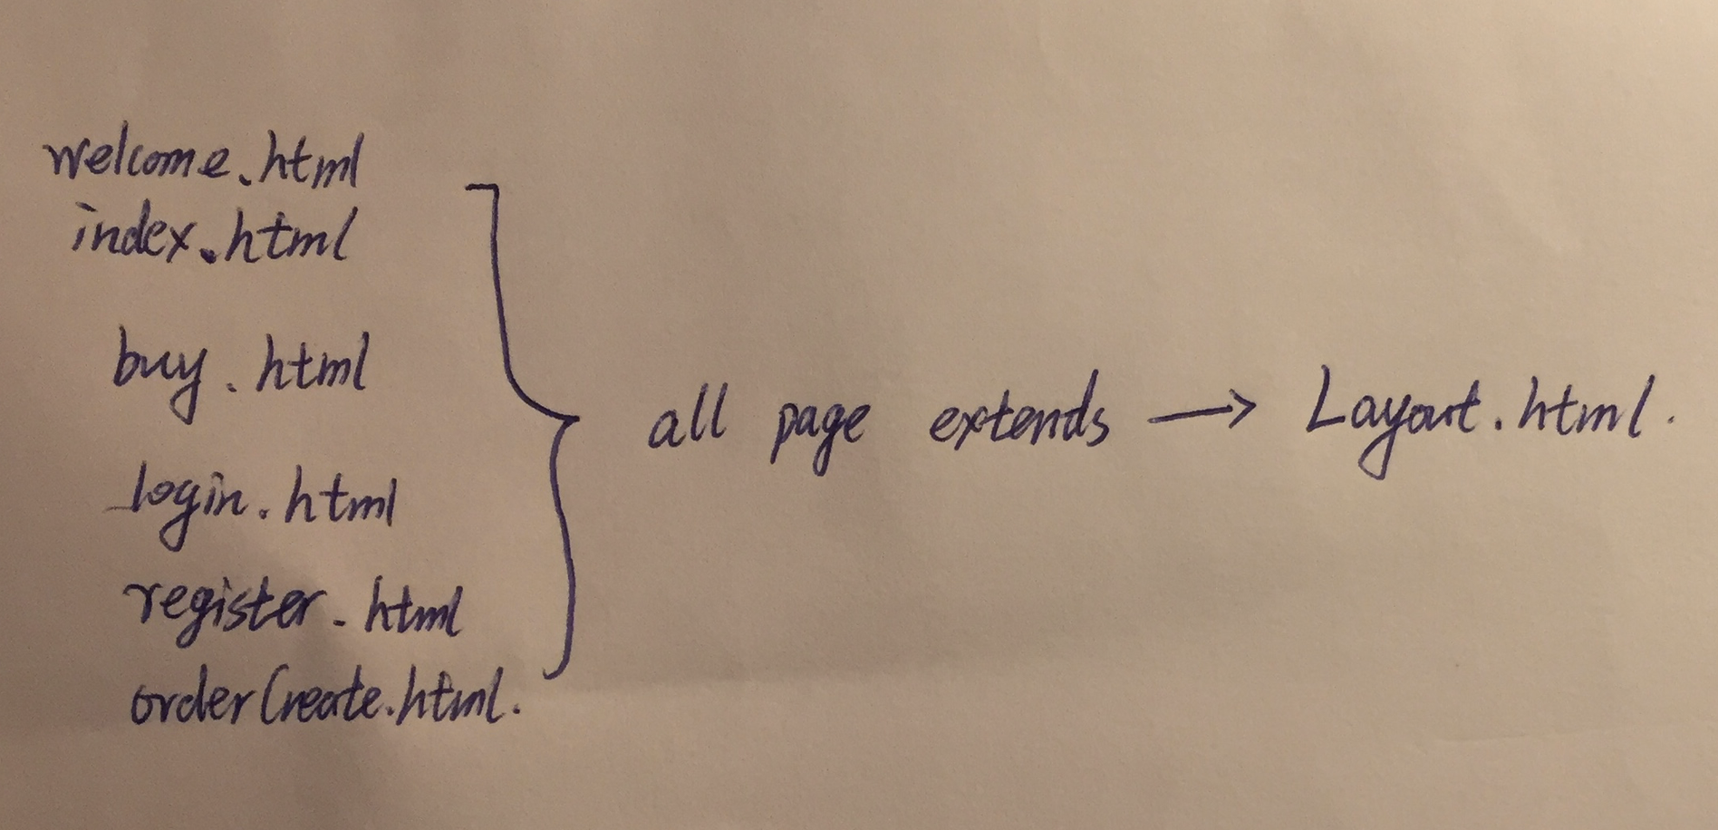
Web page design
All web page extends to Layout.html

Slide 11
Milestones
M1. Research technologies what will suit for this project.
M2. Develop the login and register functions (connect with MySQL).
M3. The images are stored in the MongoDB and can be read.
M4. Make the web pages more better.
M5. Test and Run the application, deploy project.
M6. Submission(Readme) and Dissertation.

Slide 12
Conclusion
The online-shopping web application main function almost finish
User can login, logout, view order details page and add or buy products to web page.
And in the database password also encrypt.
Limite:
Customer and Admin will be appeared in the future, Seller have the power to sale something, Customer only have buy function, and the last one Admin will fix some problem to manage this shopping System.
There is only one picture can add. Can not put more picture and small video to about the product.

Slide 13
Thanks

