Slide 1
COMP3901 - Capstone Project
Job Hunt
Team Members
Alwyn Sterling
Dominic Scott
Leah-Jay Holness
Ron-Hugh Walters
Tianna Bassaragh
Midsemester Presentation
A web-based job matching and qualification system for computing-related roles.
Team Name
Free Labour
1

Slide 2
Problem Background and Context
Context
Why this problem is worth solving
Modern recruitment is inefficient for both employers and applicants.
Job descriptions and resumes are messy, unstructured documents.
Employers need a faster first-pass filter for candidate suitability.
Applicants benefit from clearer, more transparent matching outcomes.
The project focuses on computing-related roles to keep scope realistic.
Problem framing
We are formalising comparison between job requirements and candidate competencies.
The system acts as an initial matching and recommendation stage.
Not the goal
This is not a full hiring platform.
We are not predicting final hiring outcomes or job performance.
2

Slide 3
Solution Overview
Solution
A web-based Job Matching and Qualification System for computing-related roles
The system operates as an initial matching and recommendation stage, not a full hiring platform.
Candidate Web Interface
Core Matching Engine
Employer Web Interface
Upload resume
View ranked job matches
View match details
Extract competencies
Map competencies to O*NET descriptors
Determine qualification
Rank results
Create job posting
View ranked candidates
View match details
Possible explanation, gap-report, weighting, and advanced filtering features remain stretch additions rather than guaranteed deliverables.
3

Slide 4
Objectives Clearly Defined
Scope
Core deliverables, boundaries, and stretch goals
Core deliverables
Clearly out of scope
Stretch goals
Accept resumes and job descriptions.
Extract competencies from unstructured text.
Map extracted competencies to O*NET descriptors.
Generate structured competency profiles.
Determine whether required competencies are satisfied.
Rank qualified candidates and relevant jobs.
A full hiring platform.
Interviews, offers, onboarding, or final hiring decisions.
Predicting job performance.
Claiming guaranteed real-world hiring accuracy.
Mark competencies as required or preferred.
Adjust ranking weights within defined bounds.
Generate qualification explanations.
Produce competency gap reports.
Filter results by later decided criteria.
4

Slide 5
Functional Requirements Overview
Requirements
The most important behaviours of the system
Input and storage
Competency profiling
Qualification logic
Ranked results
Upload or enter resumes and job descriptions.
Store structured profiles for later matching.
Extract competencies from unstructured text.
Map extracted signals to O*NET descriptors.
Determine whether required competencies are satisfied.
Separate qualified from not qualified cases.
Rank candidates for employers.
Rank jobs for candidates.
Important supporting behaviour
Stretch features stay separate
Show the most useful results, not just raw matches.
Keep the design realistic for a web application workflow.
Explanation, weighting controls, preferred vs required tags, and gap reports are optional additions.
They are not presented as guaranteed deliverables.
5

Slide 6
System Flow and Methodology
Method
From document input to ranked recommendations
1. Collect
2. Extract
3. Map
4. Qualify
5. Rank
Candidate resumes and employer job descriptions
Find competency signals in unstructured text
Represent extracted signals with O*NET descriptors
Check whether required competencies are satisfied
Order the strongest matches for both user groups
Evaluation focus
Qualification quality: precision, recall, and F1.
Ranking quality if time permits: Precision@K, nDCG@K, and MRR.
6

Slide 7
Technical Challenges and Why the Project Is Non-Trivial
Challenge
This is a modelling problem, not just a CRUD app
Extraction
O*NET mapping
Defensible qualification
Evaluation
Competencies must be pulled from messy resumes and job descriptions.
The source documents are inconsistent and incomplete.
Extracted text must be mapped into a shared competency space.
That mapping has to be meaningful enough for comparison.
Qualification must reflect skill coverage, experience, and education.
The decision cannot collapse into an arbitrary single score.
Ground truth is limited, so evaluation must be careful and realistic.
Metrics include precision, recall, F1, and ranking metrics if time permits.
Why this is capstone-level work
It combines web development, data representation, AI-style matching, evaluation design, and scalability concerns.
7

Slide 8
Progress on Target and Well Organised
Progress
Progress so far has focused on planning, modelling, and implementation preparation
What has been done so far
What remains to be done
Work division
Problem definition and scope have been clarified.
The O*NET-based methodology has been outlined.
Functional requirements have been drafted.
Use case and sitemap artefacts have been prepared.
Initial presentation structure has been organised around the rubric.
Implement the system as a web application.
Complete frontend and backend integration.
Finish database design and setup.
Prepare datasets and carry out evaluation.
Use Visual Paradigm and StarUML for modelling and documentation support.
Alwyn Sterling - backend development and database implementation
Dominic Scott - backend development and database implementation
Ron-Hugh Walters - documentation, modelling, data cleaning, and parsing
Leah-Jay Holness - user interface design
Tianna Bassaragh - user interface design
8

Slide 9
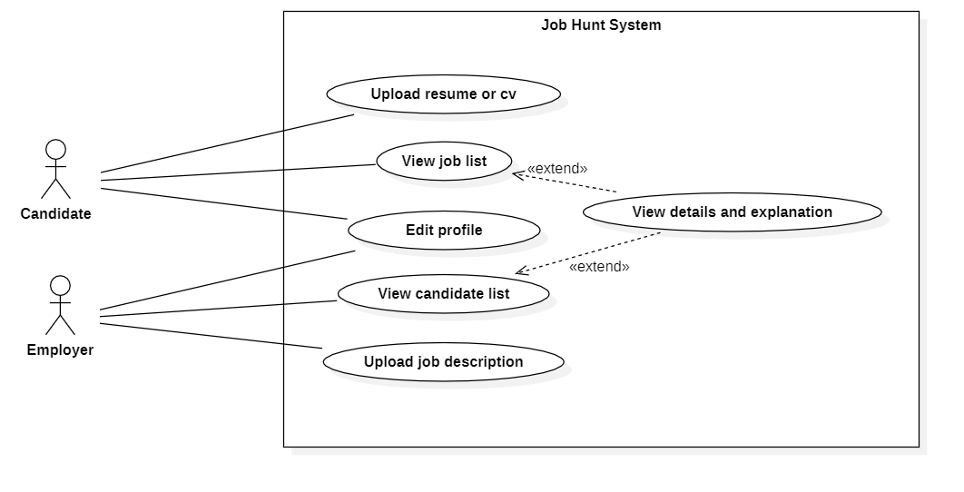
Use Case Diagram
Progress
Progress artefact for the planned user interactions
Why it matters
This artefact clarifies the main interactions between Candidates, Employers, and the system.
It helps refine what each actor can submit, view, and inspect.
Caption: This artefact clarifies the main interactions between Candidates, Employers, and the system.
9

Slide 10
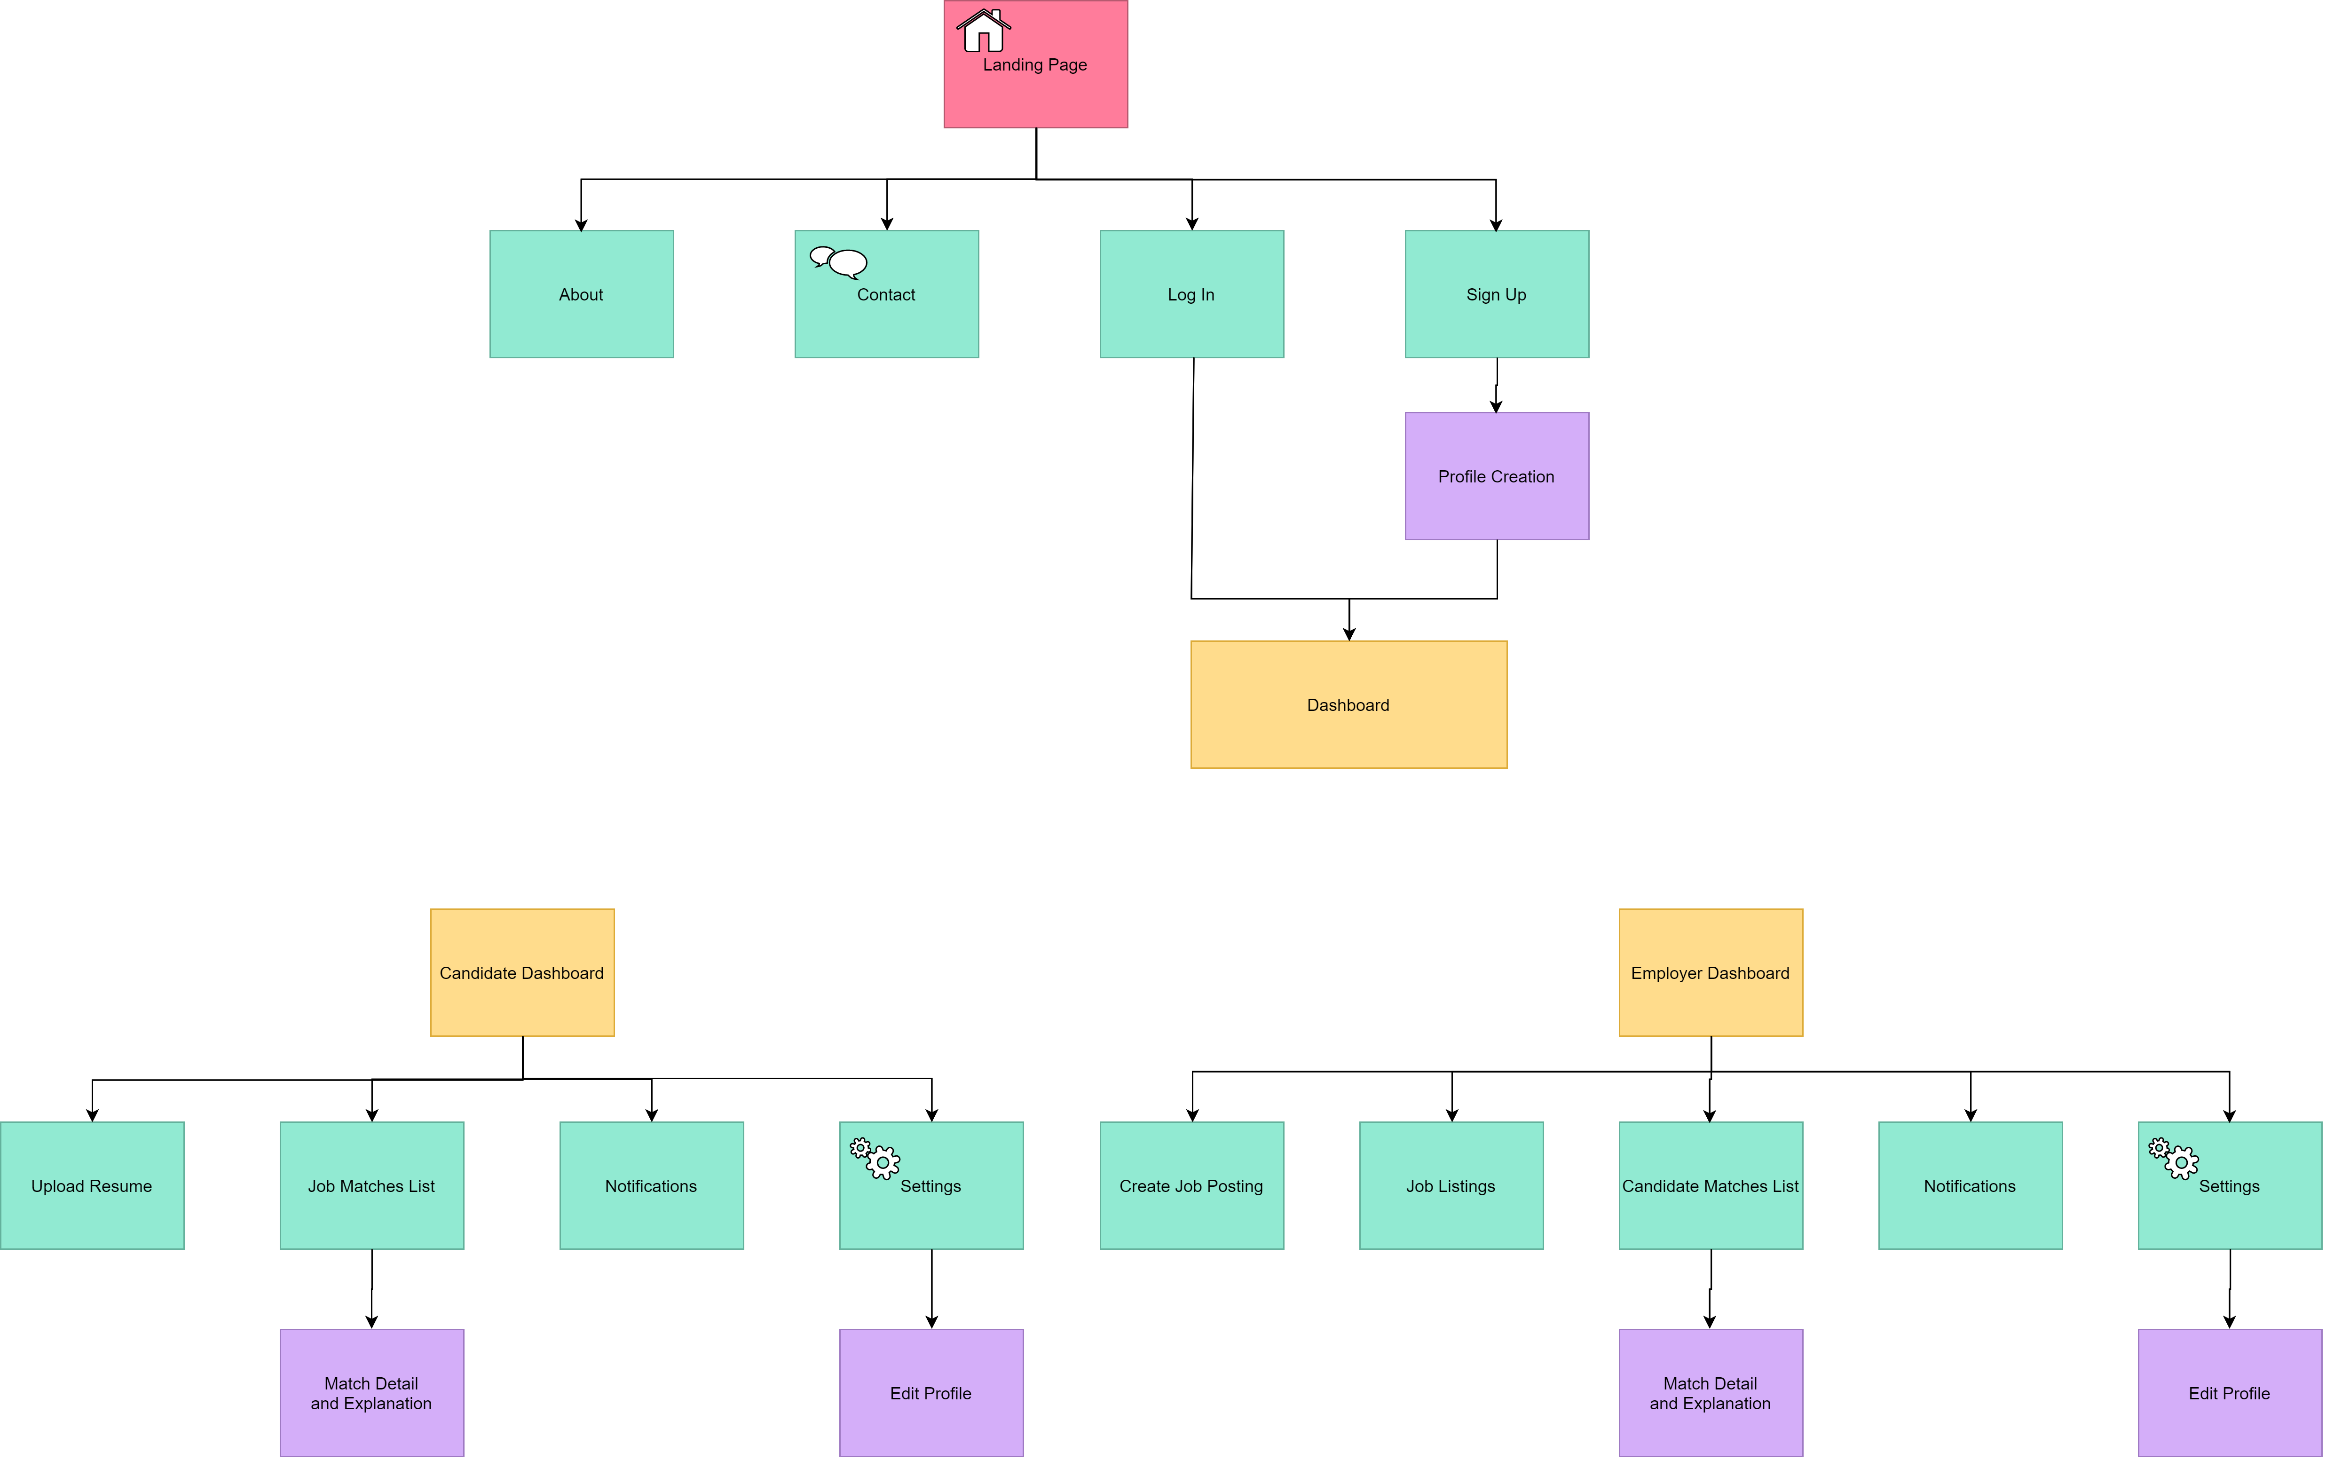
Sitemap
Progress
Progress artefact for the planned web application structure
Why it matters
This artefact plans the front end structure of the web application for candidate and employer workflows.
It separates public pages from candidate and employer dashboard paths.
Caption: This artefact plans the front end structure of the web application for candidate and employer workflows.
10

Slide 11
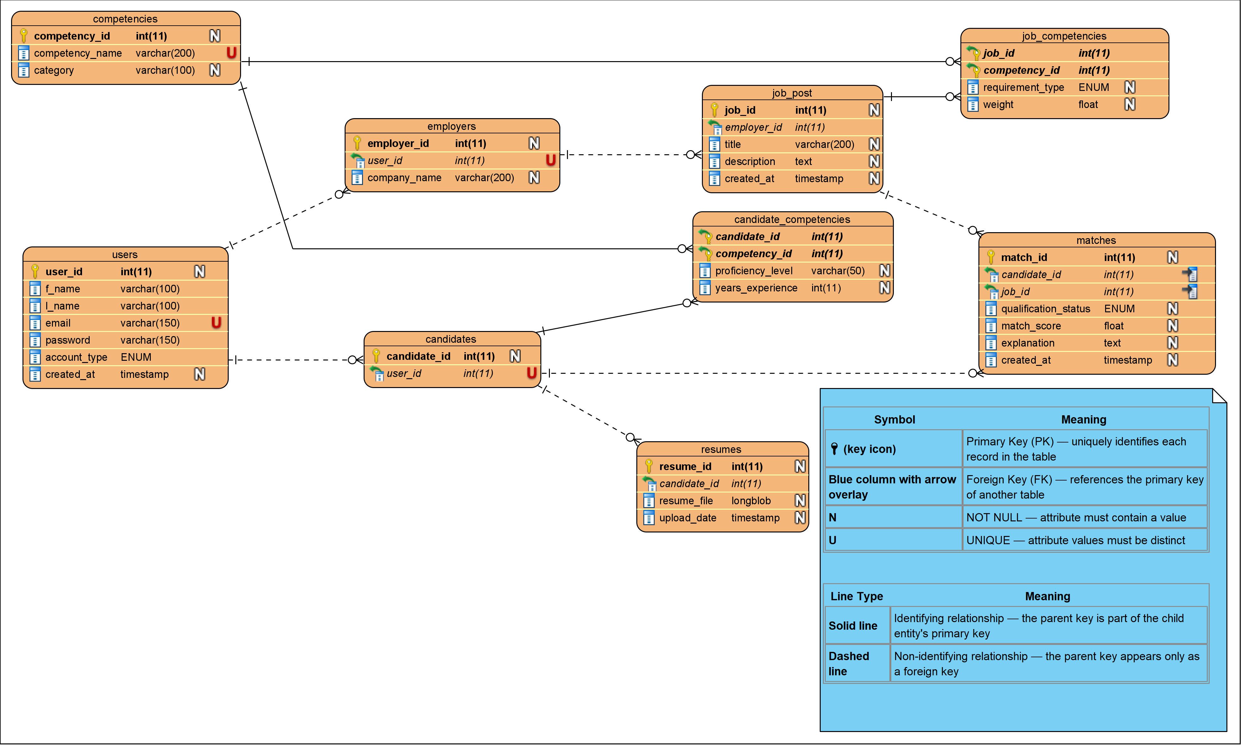
Database Design Overview
Progress
Progress artefact for the proposed persistence layer
Schema highlights
Supports candidate and employer data in the web application.
Stores job posts, resumes, and competencies as core entities.
Uses linking tables for many-to-many competency relationships.
Stores match outcomes, qualification status, and match scores.
Caption: This artefact defines the proposed database structure needed to support resumes, job postings, competencies, and match results.
11

Slide 12
Knowledge From the Curriculum and Next Steps
Close
How the project draws on coursework and where it goes next
Curriculum knowledge used
Immediate next steps
COMP2171 and COMP2140 - documentation and system modelling
COMP3161 - database design and storage
COMP3162 - data cleaning and possible modelling
INFO2180 - web development and frontend design
COMP3220 - intelligent matching concepts
COMP1127 - Python implementation knowledge
COMP2211 - optimization ideas
Implement the frontend and backend workflow.
Build the O*NET-based matching pipeline.
Prepare datasets for testing and evaluation.
Midsemester takeaway
The project is clearly scoped, technically non-trivial, and organized around a realistic implementation plan.
12

