Slide 1
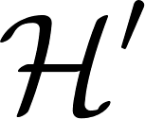



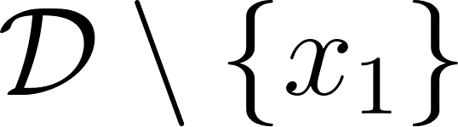

 | x1 | x2 | x3
h1 | 0 | 0 | 0
h2 | 0 | 0 | 1
h3 | 0 | 1 | 0
h4 | 0 | 1 | 1
h5 | 1 | 0 | 0
h6 | 1 | 0 | 1
h7 | 1 | 1 | 0
h8 | 1 | 1 | 1

