Slide 1
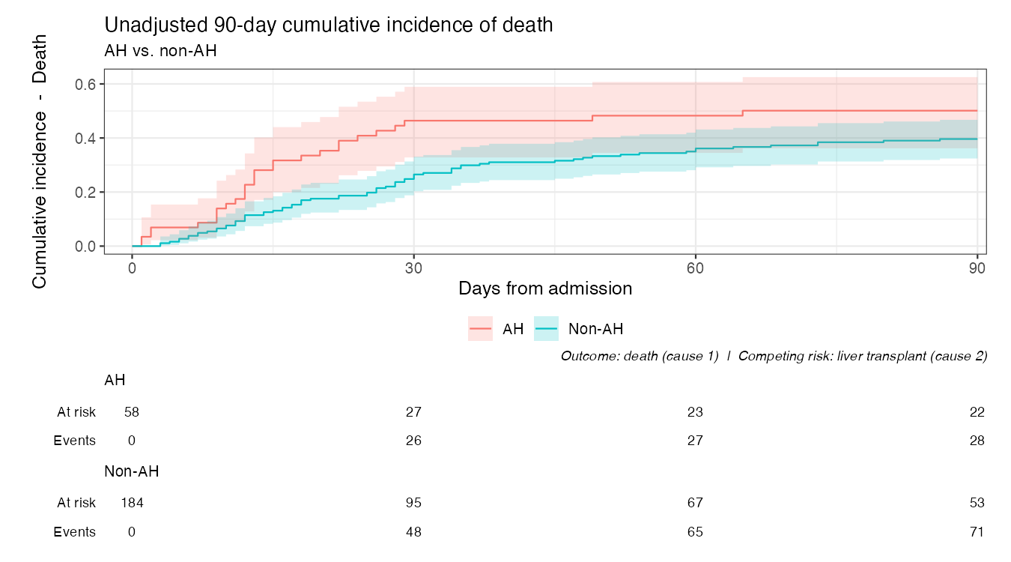
Unadjusted 90-day cumulative incidence of death (AH vs. non-AH)

Slide 2
Adjusted CIF (MELD 3.0 model)
Adjusted 90-day CIF of death - MELD 3.0 model
Continuous covariates at median, categoricals at modal level
1.00
0.75
Adjusted CIF - Death
0.50
0.25
0.00
0
30
60
90
Days from admission
Alcoholic hepatitis
AH
Non-AH
Outcome: death (cause 1) | Competing risk: liver transplant (cause 2)

Slide 3
Adjusted CIF (ACLF-grade model)
Adjusted 90-day CIF of death - ACLF-grade model
Continuous covariates at median, categoricals at modal level
1.00
0.75
Adjusted CIF - Death
0.50
0.25
0.00
0
30
60
90
Days from admission
Alcoholic hepatitis
AH
Non-AH
Outcome: death (cause 1) | Competing risk: liver transplant (cause 2)

Slide 4
Adjusted CIF (MELD 3.0, no hispanic)
Adjusted 90-day CIF of death - MELD 3.0 model (no hispanic)
Continuous covariates at median, categoricals at modal level
1.00
0.75
Adjusted CIF - Death
0.50
0.25
0.00
0
30
60
90
Days from admission
Alcoholic hepatitis
AH
Non-AH
Outcome: death (cause 1) | Competing risk: liver transplant (cause 2)

Slide 5
Adjusted CIF (ACLF, no hispanic)
Adjusted 90-day CIF of death - ACLF-grade model (no hispanic)
Continuous covariates at median, categoricals at modal level
1.00
0.75
Adjusted CIF - Death
0.50
0.25
0.00
0
30
60
90
Days from admission
Alcoholic hepatitis
AH
Non-AH
Outcome: death (cause 1) | Competing risk: liver transplant (cause 2)

Slide 6
Adjusted CIF (age + admit_meld_3)
Adjusted 90-day CIF of death - age + admit_meld_3
Continuous covariates at median
1.00
0.75
Adjusted CIF - Death
0.50
0.25
0.00
0
30
60
90
Days from admission
Alcoholic hepatitis
AH
Non-AH
Outcome: death (cause 1) | Competing risk: liver transplant (cause 2)

Slide 7
Reference CIF (age + admit_meld_3, no exposure)
Adjusted 90-day CIF of death - age + admit_meld_3 (no exposure)
Population reference: age = 58, admit_meld_3 = 31 (medians)
1.00
0.75
Adjusted CIF - Death
0.50
0.25
0.00
0
30
60
90
Days from admission
Outcome: death (cause 1) | Competing risk: liver transplant (cause 2)

