Slide 1
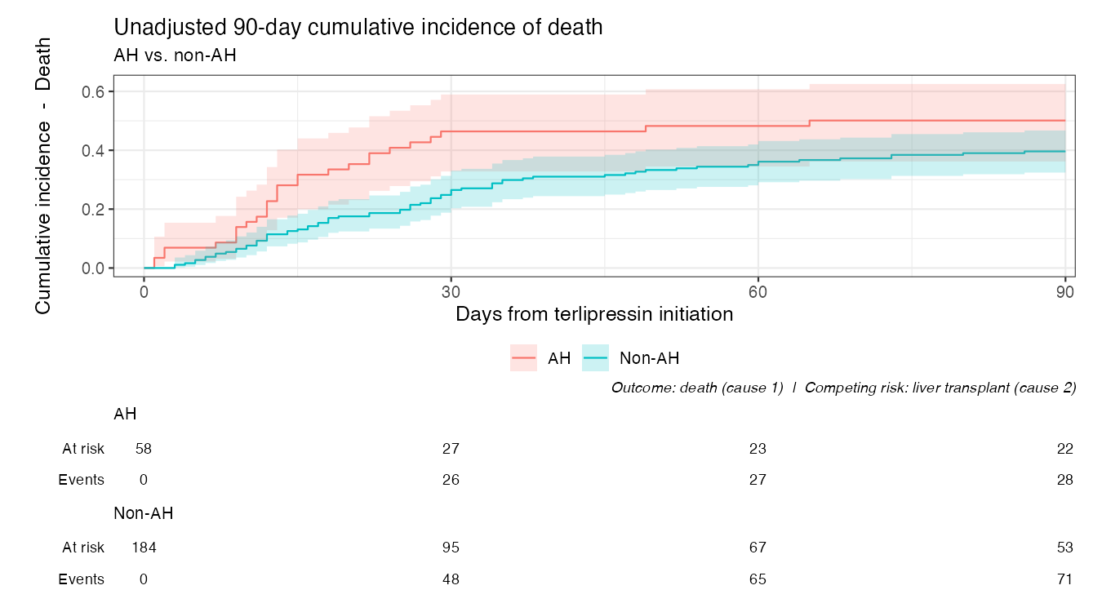
Unadjusted 90-day cumulative incidence of death (AH vs. non-AH)

