Slide 1
U.S. Airline Flight Delay Analysis
2026 Spring Big Data
Section-C
Team Meamber:
Jenny Chen - jc13736 Sanjana Kosuru - sk11582 Tianqi Zhen - tz2949

Slide 2
Project statement
P A R T 0 1

Slide 3
Abstract
Analyze large-scale U.S. airline delay data to understand how delays behave in real-world operations
Examine how multiple factors (airline, airport, time, and operational conditions) influence delay patterns
Discover key trends such as delay accumulation, congestion effects, and variation across airlines
Provide data-driven insights to better explain delay dynamics
Support future prediction models by building a strong analytical foundation

Slide 4
Objective
P A R T 0 2

Slide 5
Objective
1. Analyze Airline and Airport Performance
2. Understand Delay Patterns and Causes
3. Explore Factors Influencing Flight Delays
Evaluate average delay time across different airlines
Identify airlines with the highest delay levels (Top 10)
Analyze airport performance based on delay frequency and traffic volume
Understand how airport congestion contributes to delays
Analyze major delay causes (carrier, weather, NAS, etc.)
Study how delays vary over time (day of week, month)
Examine delay patterns across different periods of the day
Identify whether delays accumulate throughout the day
Investigate the relationship between flight distance and delays
Analyze how multiple factors (airline, airport, time) interact
Discover key patterns from flight data
Generate insights to support future delay prediction

Slide 6
Data source/ Tech Stack
P A R T 0 3

Slide 7
P A R T 0 2
Data Sources
U.S. Bureau of Transportation Statistics
How to Download Dataset
Click on this link to find the datasets https://www.transtats.bts.gov/Tables.asp?QO_VQ=EFD&QO_anzr=Nv4yv0r%FDb0-gvzr%FDcr4s14zn0pr%FDQn6n&QO_fu146_anzr=b0-gvzr
Click “Download” on the second dataset “Reporting Carrier On-Time Performance (1987-present)” or use this link https://www.transtats.bts.gov/Fields.asp?gnoyr_VQ=FGJ
Select year and attributes and click on “Download”
Data Selection
In this project, we selected data from the year 2024 for analysis. The original BTS dataset is extremely large, so we restricted our analysis to one year to keep the project manageable. Each monthly file expands to over 250MB, resulting in more than 3GB of data for the full year. This still provides a sufficiently large dataset for meaningful analysis while keeping computational costs reasonable.
Download link: https://drive.google.com/file/d/1iXESKbrhonsKsb8BJKz7R4o4HPaEYRPj/view?usp=sharing
The dataset includes records from January to December 2024, covering a full year of flight operations.
This allows us to capture seasonal patterns and variations in flight delays.

Slide 8
Tech Stack
Data Processing & Analysis
Modeling & Environment
Apache Spark (PySpark) → Distributed processing for large-scale flight data → Efficient handling of millions of records
Spark SQL → Fast querying and aggregation → Used for airline, airport, and time-based analysis
Pandas (for subsets) → Used for small-scale data manipulation and quick testing
Spark ML (MLlib) → Built logistic regression model → Integrated with PySpark pipeline
Matplotlib → Visualization of delay patterns and trends
Google Colab → Cloud-based environment → Easy setup and integration with Google Drive

Slide 9
Link to the codebase
P A R T 0 1
https://github.com/TianqiZhen426/Big-Data_2026Spring_Project
The readme provides all steps to reproduce the results using Google Colab :)

Slide 10
Process and Results
P A R T 0 4
DATA PREPROCESSING
DATA
CLEANING
DATA ANALYSIS
PREDICTION MODEL

Slide 11
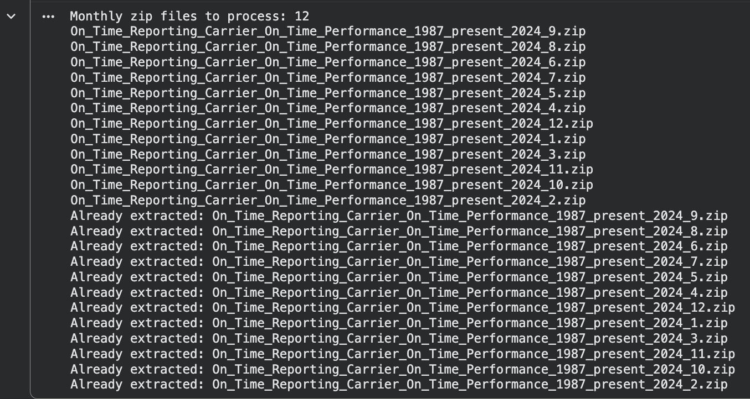
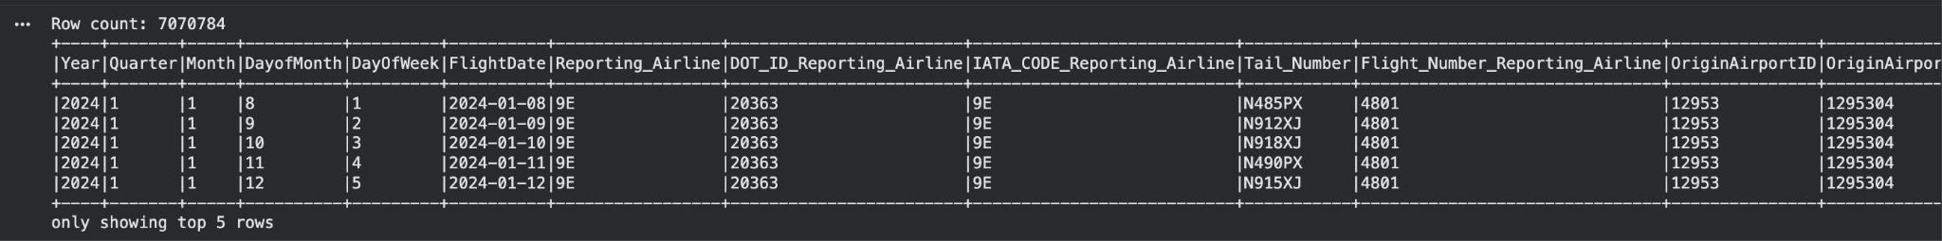
Data Preprocessing
The dataset is provided as 12 monthly ZIP files for the year 2024
Each ZIP file contains raw flight data for one month
Before analysis, we performed the following steps:
Unzipped all files
Combined monthly data into a single dataset

Slide 12
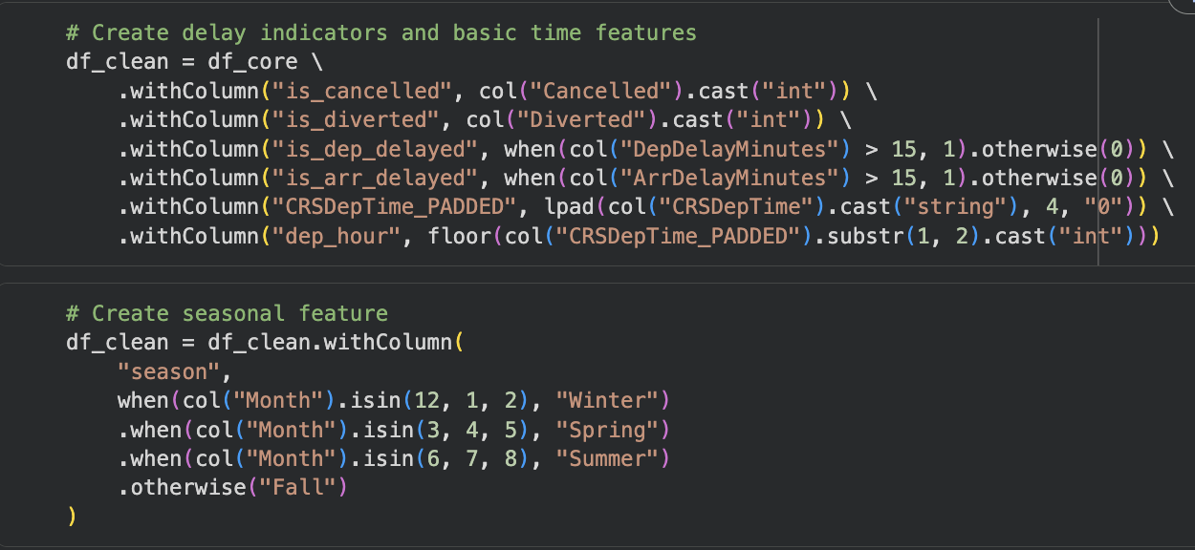
Data Cleaning
Converted cancellation and delay status into binary indicators.
Defined delayed flights as flights delayed by more than 15 minutes.
Extracted departure hour from scheduled departure time.
Created seasonal and time-period features.
Removed records with missing critical fields.
Filtered invalid records such as cancelled flights and invalid departure hours.
Replaced missing delay and delay-cause values with 0.
Added new features to the data:
is_weekend: 1 if Saturday/Sunday, otherwise 0
dep_period: Morning / Afternoon / Evening / Night based on departure hour
is_long_flight: 1 if distance ≥ 1500 miles, otherwise 0

Slide 13
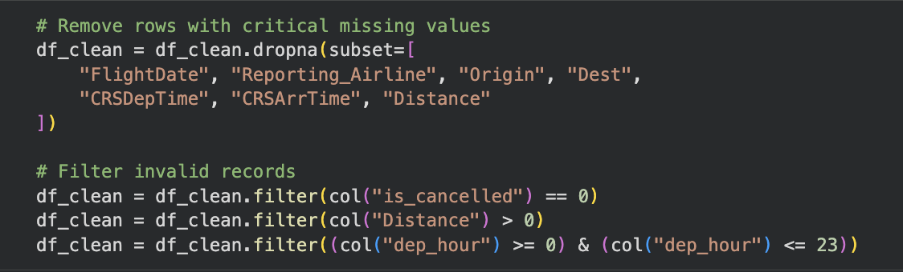
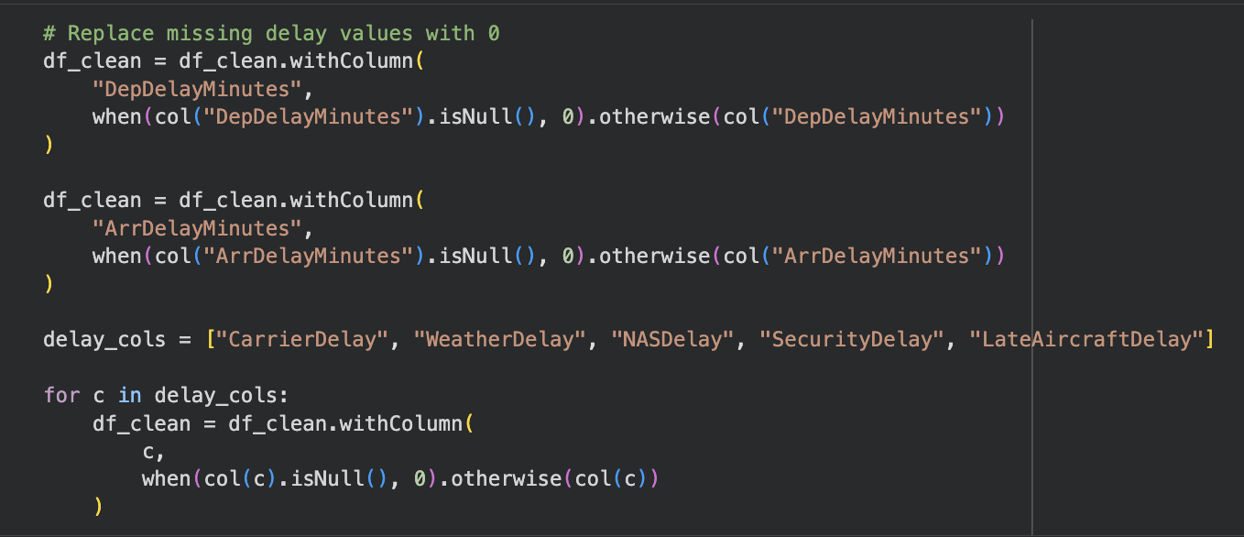
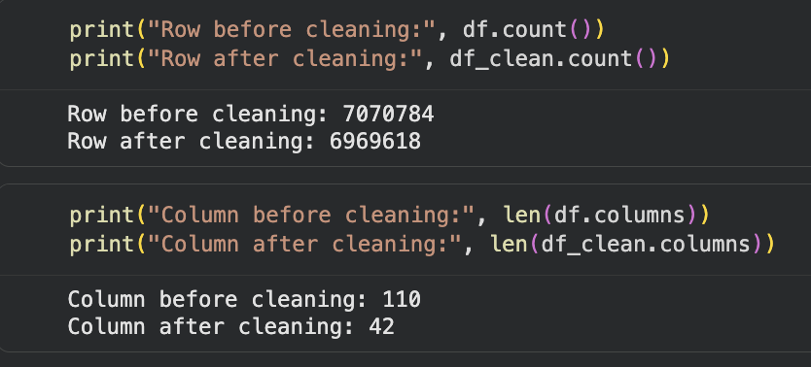
Handling Missing Values & Data Preparation
What we did:
Selected relevant features for analysis and modeling
Removed cancelled and invalid flight records
Applied .dropna() to remove rows with missing critical values
Replaced missing delay-related fields with 0 where appropriate
Ensured all features are clean and consistent before modeling

Slide 14
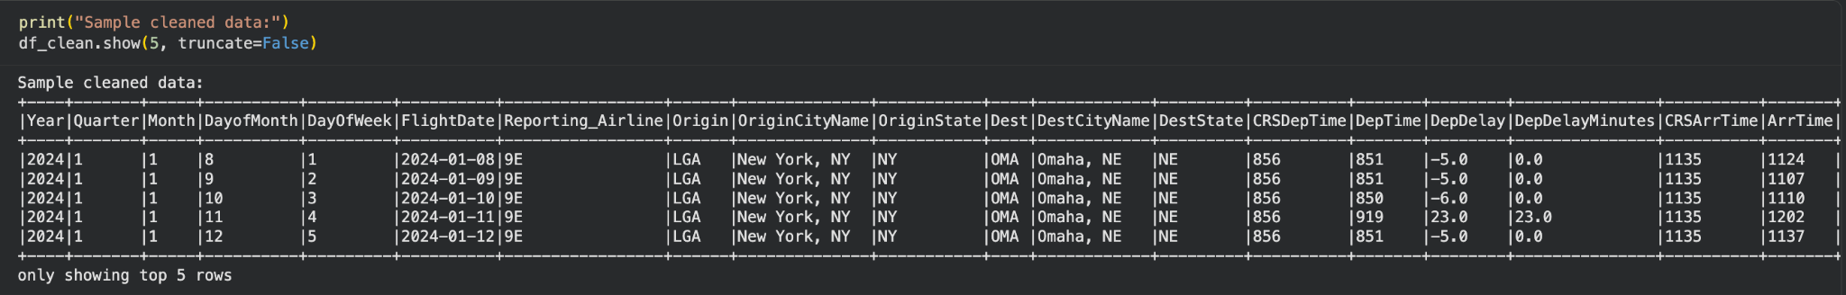
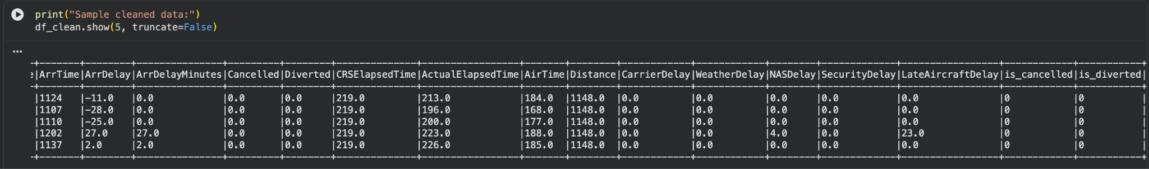
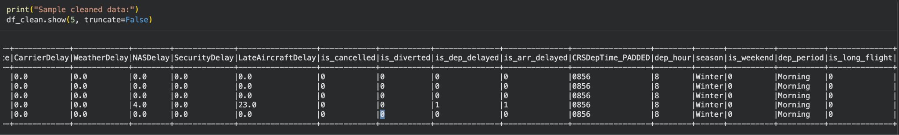
Cleaned data table
The cleaning process converted the raw BTS dataset into a reliable, structured dataset suitable for Spark SQL analysis, visualization, and machine learning prediction. The following table is the cleaned core columns, it include the data that we will use for the data analysis and predictive model.

Slide 15
DATA ANALYSIS
Tools Used
Spark SQL & PySpark DataFrame → Scalable processing of large-scale flight data
Matplotlib → Visualization of aggregated patterns
We analyzed flight delays from multiple perspectives:
Airline performance
Airport congestion
Delay causes
Temporal patterns
Distance impact
Goal
Understand the key factors influencing flight delays
Identify patterns across airlines, airports, and time
Analyze how different variables contribute to delays
Key Insights we get
Flight delays are influenced by multiple interacting factors, rather than a single cause
Significant variation exists across airlines, reflecting differences in operational efficiency
High-traffic airports tend to experience more delays due to congestion effects
Delay frequency increases throughout the day, indicating accumulation of earlier disruptions
Both internal factors (airline operations) and external factors (traffic, environment) contribute to delays

Slide 16
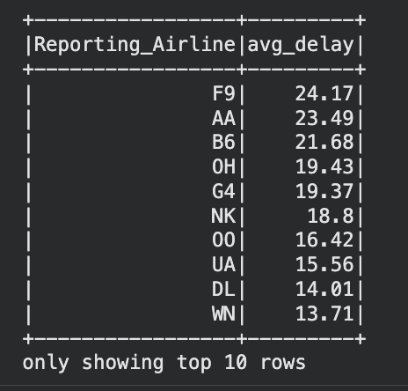
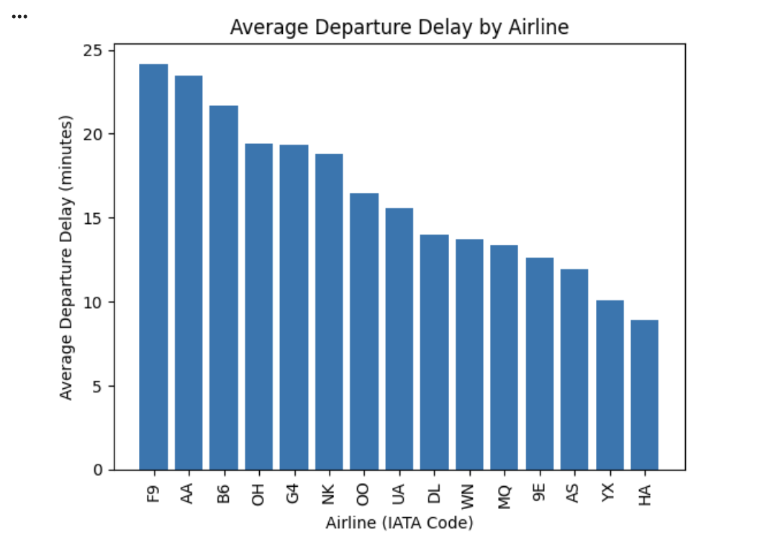
Airline Performance Analysis
What is the average delay time for each airline?
Which airlines have the highest delay times (Top 10)?
Key Finding:
The average delay duration for the top 10 airlines is significantly higher, and there are substantial disparities in delay performance among these airline company. Some airlines are notably more prone to delays than others.

Slide 17
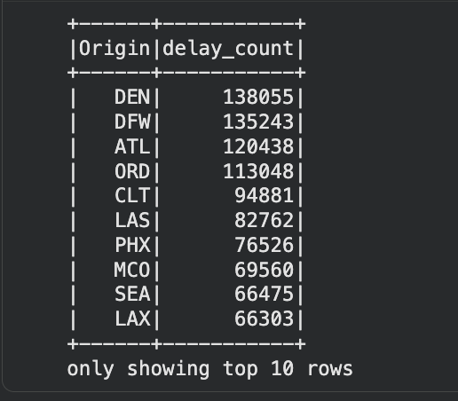
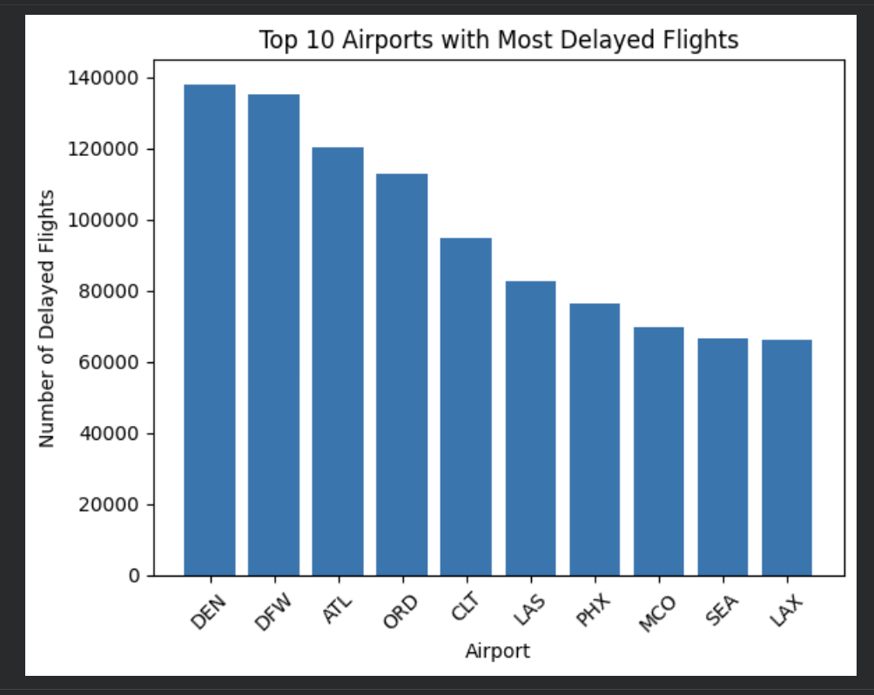
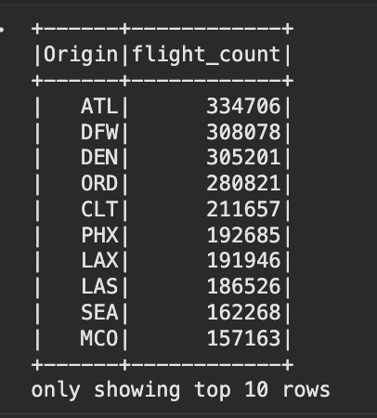
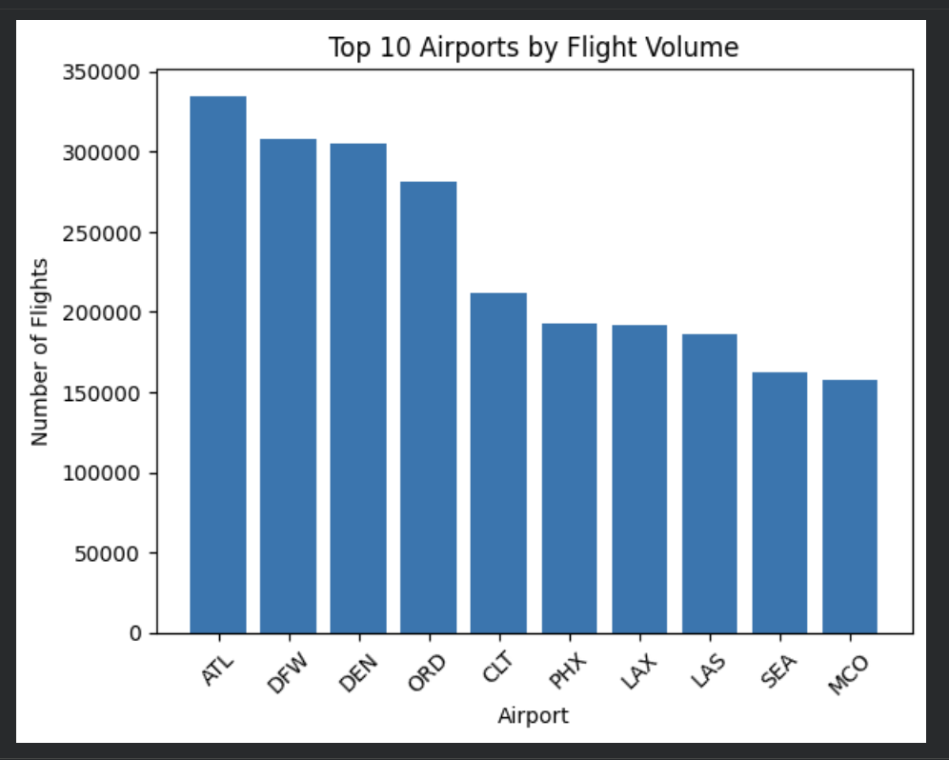
Airport Analysis
Which airports experience the most delays (Top 10)?
Which airports have the highest flight volumes (Top 10)?
Key Finding:
The airports with the most delayed flights are also among the busiest airports, including DEN, DFW, ATL, and ORD. Higher traffic volume generally leads to more congestion and delays, although airport-specific factors such as weather and operational efficiency also affect performance.

Slide 18
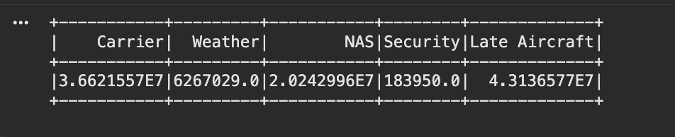
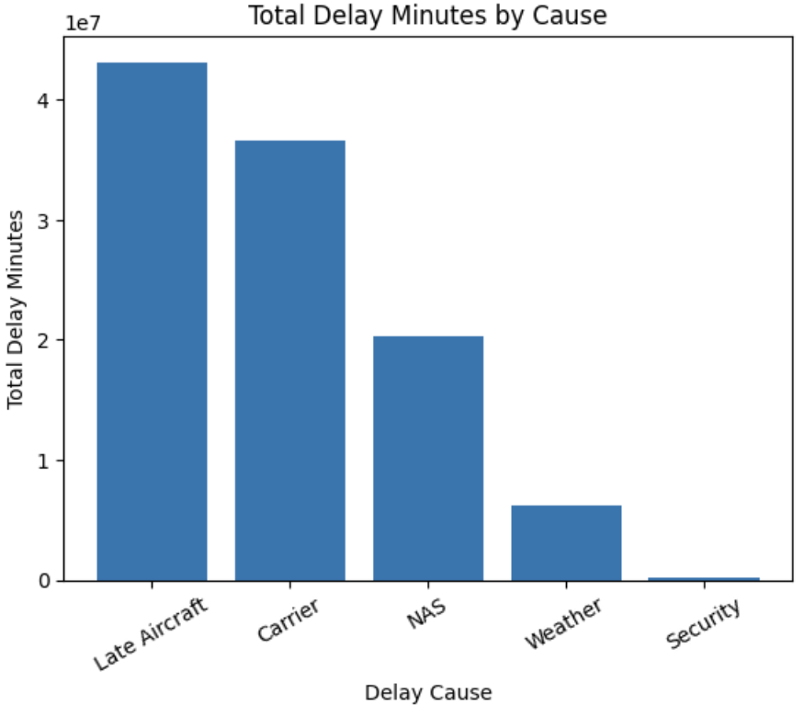
Delay Cause Analysis
What are the most common causes of delays?
Key Finding:
Weather is not the biggest factor affecting the delays. Late aircraft arrivals are the primary driver of delays, showing that delay propagation is the major operational challenge for airlines.

Slide 19
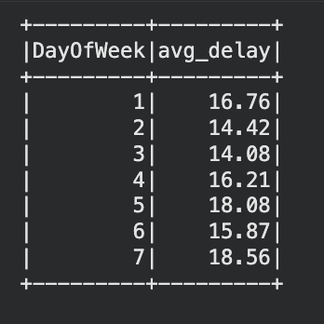
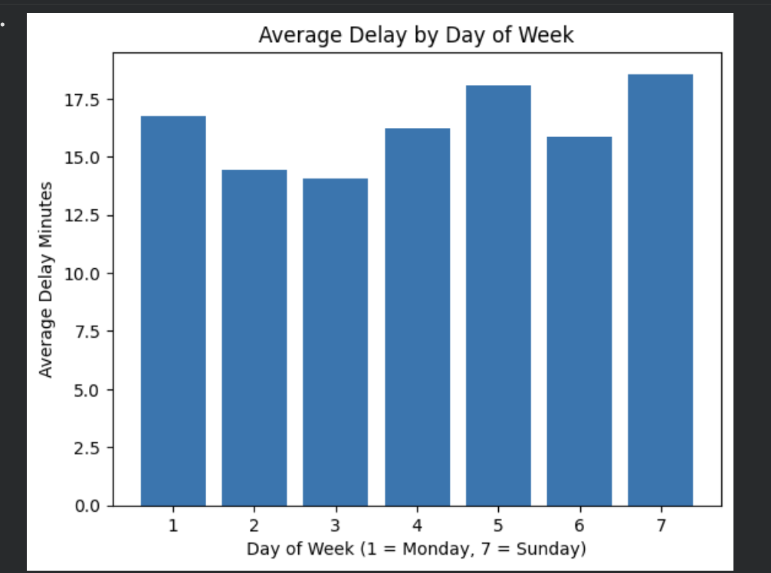
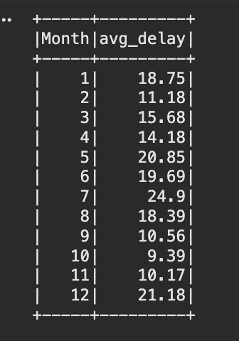
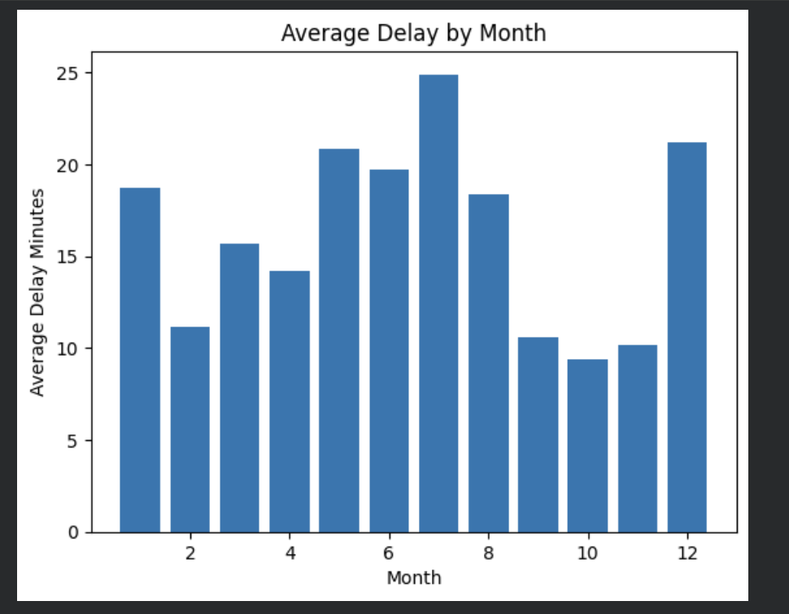
Temporal Analysis
How do delays vary by day of the week?
How do delays vary by month?
Day-of-week differences are relatively small, suggesting weekday alone is not a major delay driver.
Monthly differences are more noticeable, with higher delays in May, June, July, Dec and Jan.
This indicates that seasonal travel demand, weather conditions, and holiday periods may have strong effects.

Slide 20
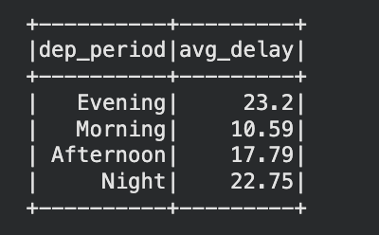
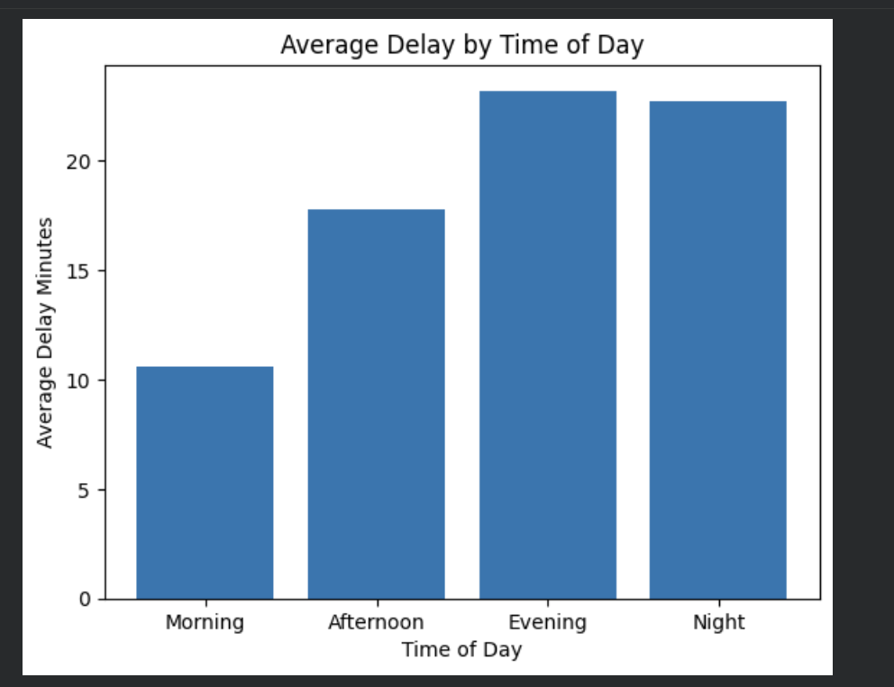
Departure Time Analysis
How do delays vary by time of day (morning, afternoon, evening, night)?
Key Finding:
Flight delays increase steadily throughout the day, with the highest delays in the night. Later departures are more delay-prone because delays accumulate and propagate across daily flight schedules.

Slide 21
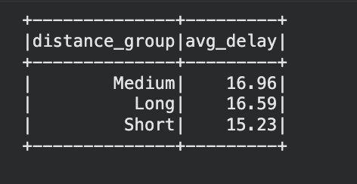
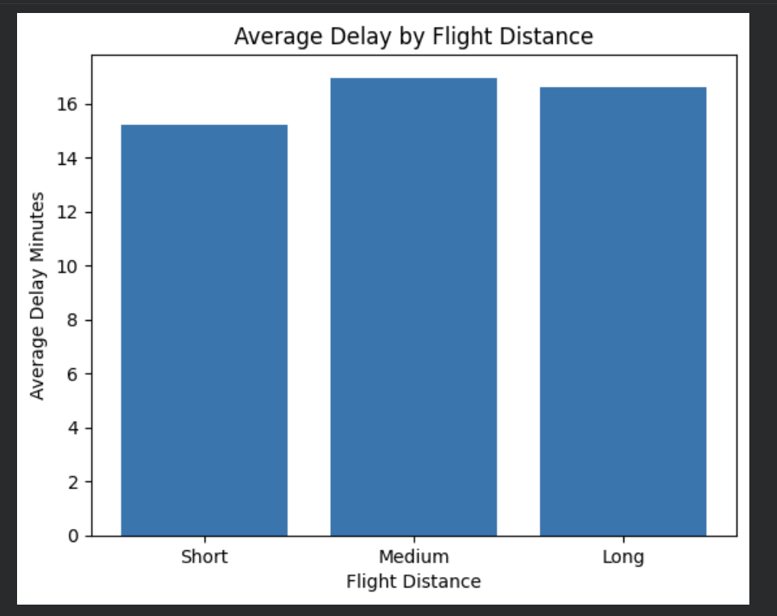
Distance Analysis
What is the relationship between flight distance and delay time?
Average delays are similar across short, medium, and long-distance flights. Flight distance does not appear to be a major driver of delays.

Slide 22
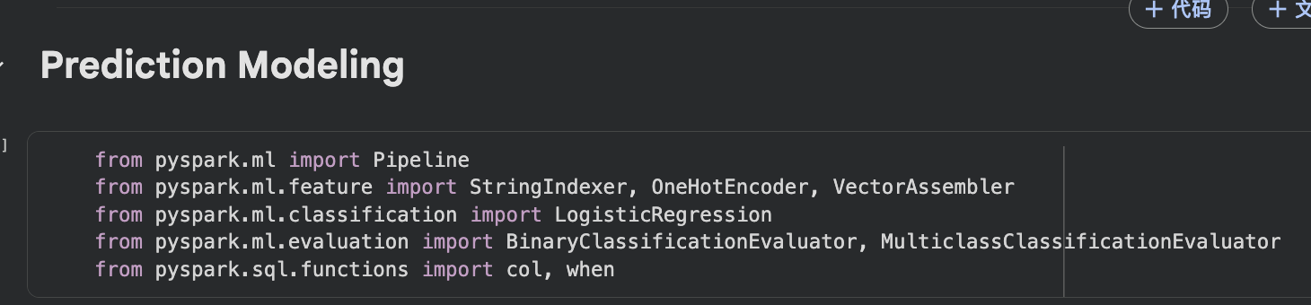
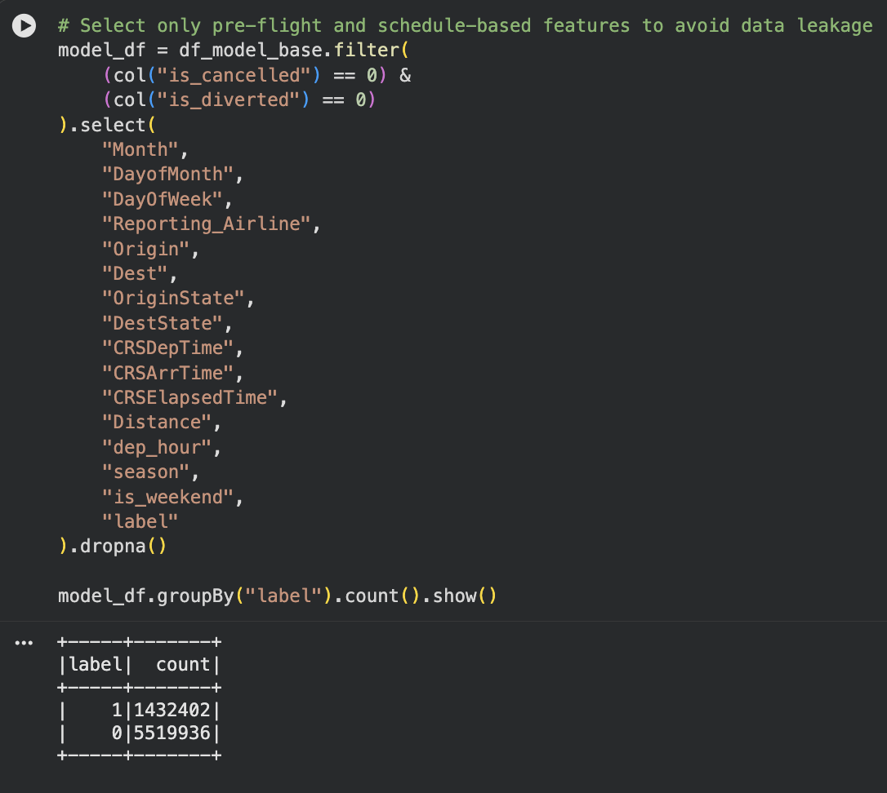
Prediction Model
Goal: Predict whether a flight will be delayed
Model Used: Logistic Regression (Spark ML)
Why PySpark ML?
Pandas / Scikit-learn → Limited by memory, not suitable for large datasets
PySpark ML → Scalable, efficient, and designed for big data processing
Output:
Binary classification: Delayed / Not Delayed

Slide 23
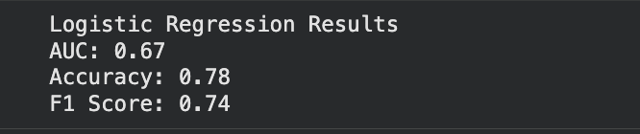
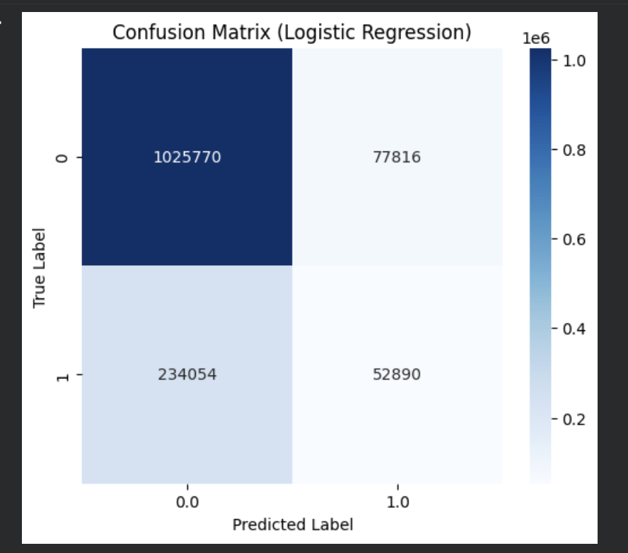
Model Result
We used a logistic regression model to predict flight delays.
The accuracy is around 60 to 78 percent, which is not very high.
This is mainly because important factors such as weather and airport congestion are missing.
Therefore, predicting flight delays is a challenging problem.

Slide 24
Why ML is Limited
Missing Features
Weather conditions
Airport congestion
Air traffic contro
Why Prediction is Difficult for this Dataset
Flight delays depend on many external factors
Real-time data is not available in our dataset
Delays are influenced by complex interactions
Data Limitation
No real-time updates
Limited contextual information
Historical data only
Data Complexity
Non-linear relationships
Interaction between multiple factors
Unpredictable events

Slide 25
Conclusion and lesson learned
Working with large-scale flight data showed us that data preprocessing is one of the most important steps in the entire project. Since the dataset was provided in multiple ZIP files, we first needed to unzip, clean, and merge the data before performing any analysis.
We found that using PySpark was much more efficient than traditional tools like Pandas when handling millions of records. PySpark allowed us to process and analyze the data at scale, especially during data cleaning and aggregation.
During the analysis, we observed that flight delays are influenced by multiple factors, such as airline performance, airport congestion, and time of day. In particular, delays tend to accumulate as the day progresses.

Slide 26
Conclusion and lesson learned
We also attempted to build a machine learning model to predict delays. However, we learned that prediction accuracy is limited when important features are missing, such as weather conditions and real-time traffic data.
Visualization played an important role in helping us understand patterns and communicate insights more effectively, especially when comparing delays across airlines and time periods.

Slide 27
Thank you
We had a great time solving all challenges and projects in the course!

