Slide 1
DAMG 7370 Youtube Data Analysis
Group 2

Slide 2
Data introduction
This dataset contains daily records of up to 200 trending YouTube videos across multiple countries (US, GB, DE, CA, FR) over several months. It is a structurally improved version of the original dataset.
We focus on Canadian dataset
CSV file: video_id, video_date, title, channel, category_id, views, likes, disliks
JSON file: links category_id and category_name

Slide 3








Architecture
Bronze
Gold
Silver

Slide 4
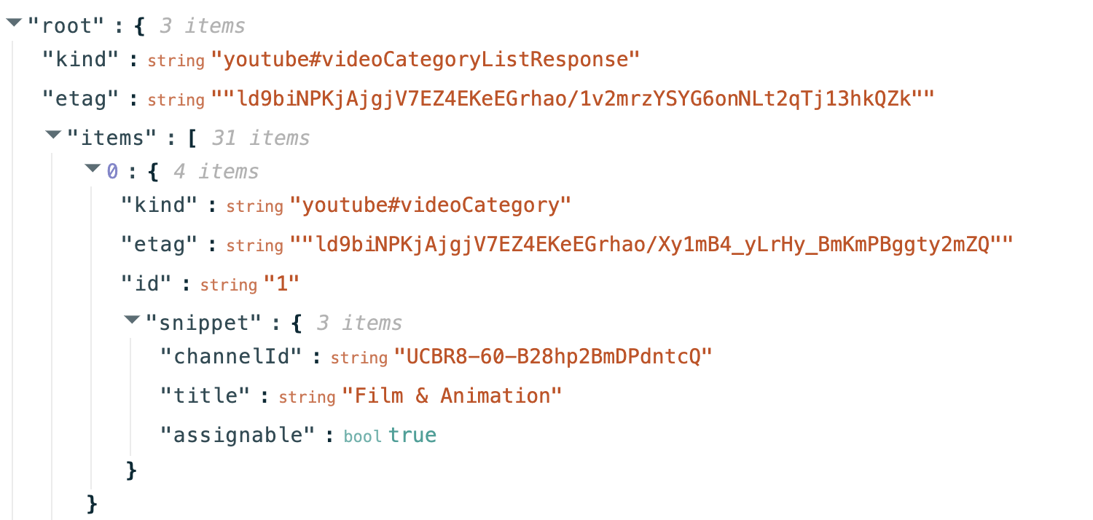
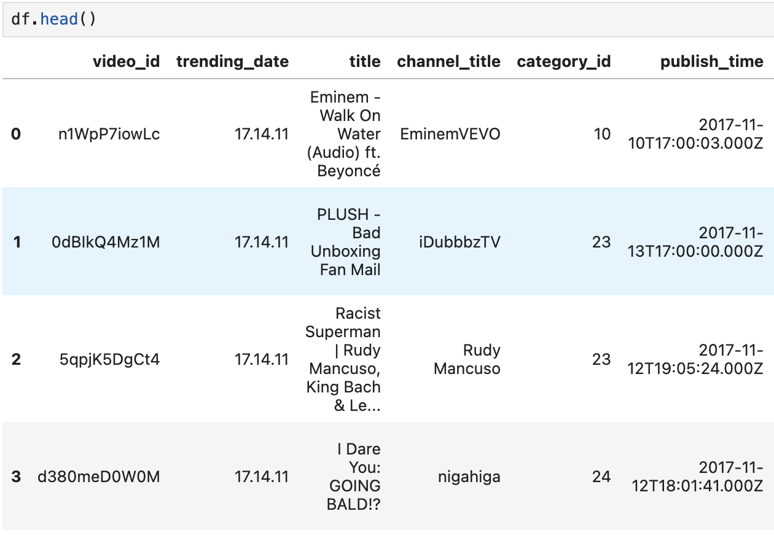
Data pre-processing
Map category name to dataset

Slide 5
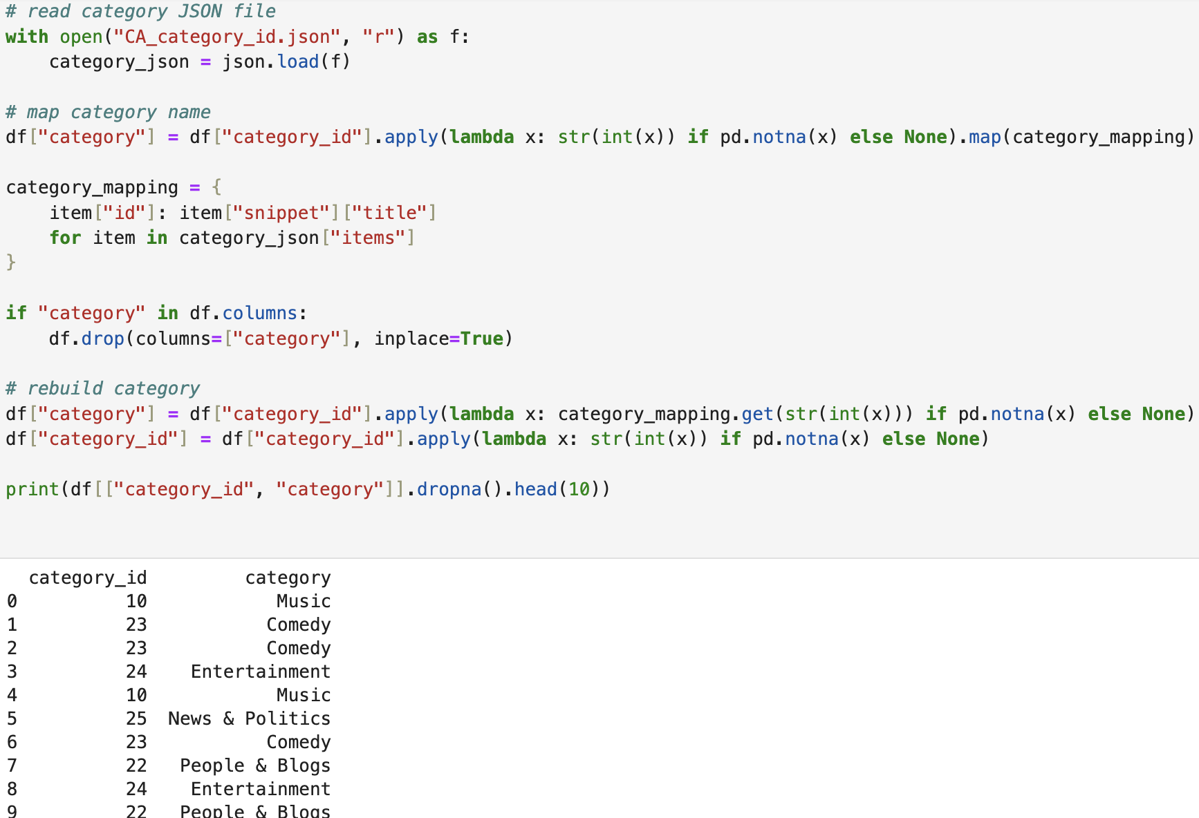
Data pre-processing
Map category name to dataset

Slide 6
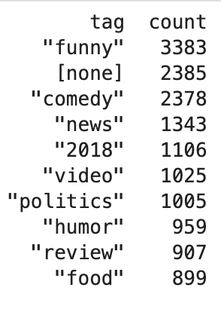
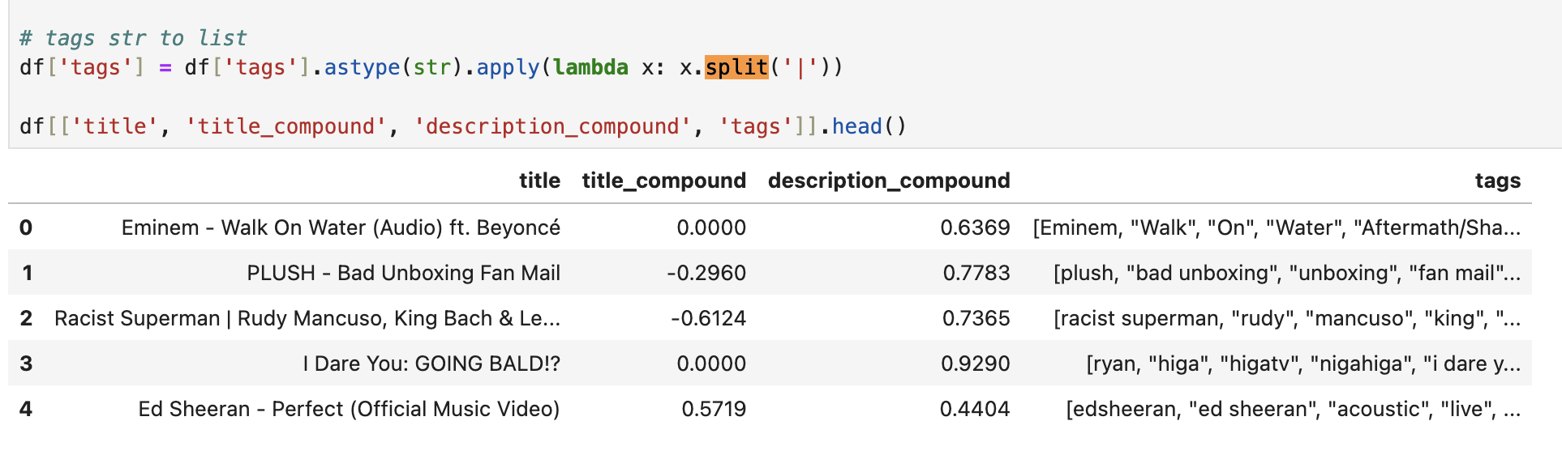
Data pre-processing
Split tags, convert str to list of str

Slide 7
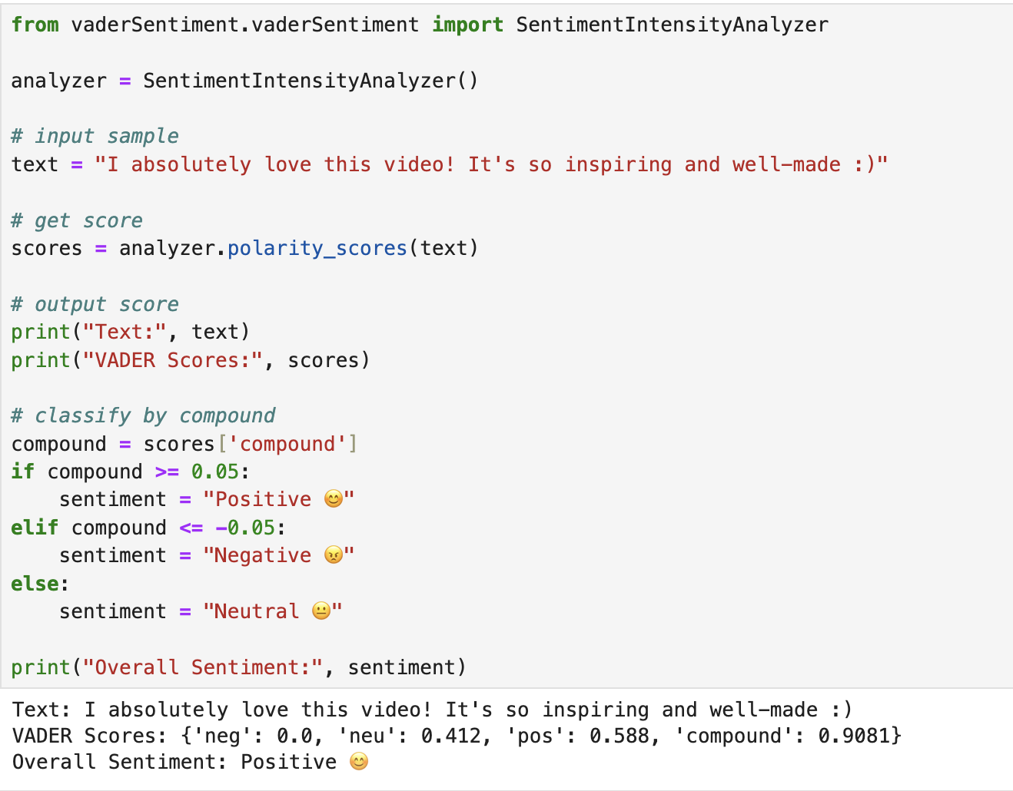
Add sentiment score of title/description
Vader Sentiment
It convert a sentence (strings) to 4 sentiment scores: neg, neu, pos and compound.
-1 <= compound <= 1

Slide 8
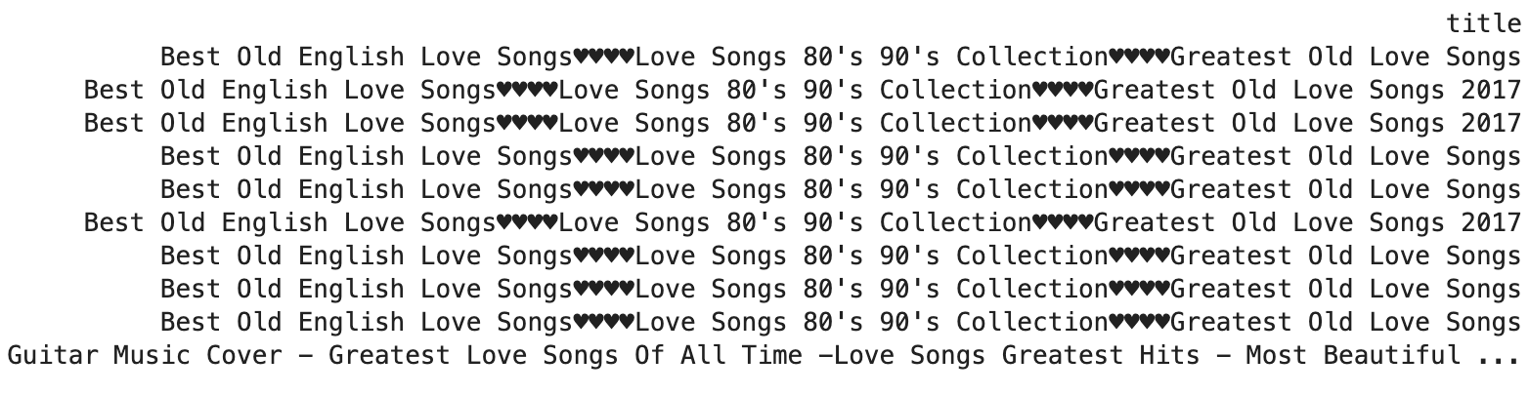
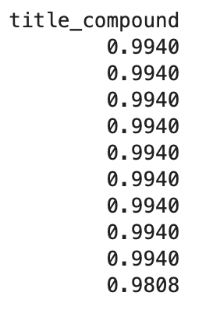
Add sentiment score of title/description
Top 10 Positive Title Sentiments:

Slide 9
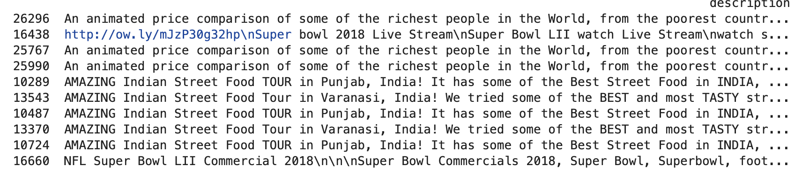
Add sentiment score of title/description
Top 10 Positive Descrpition Sentiments:

Slide 10
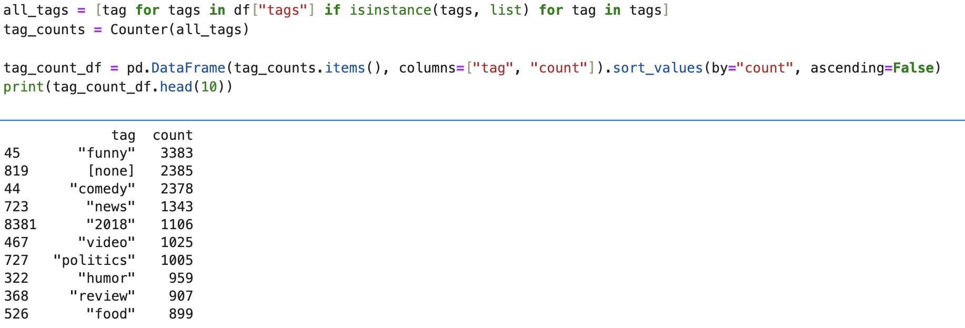
Basic EDA
Tags count

Slide 11
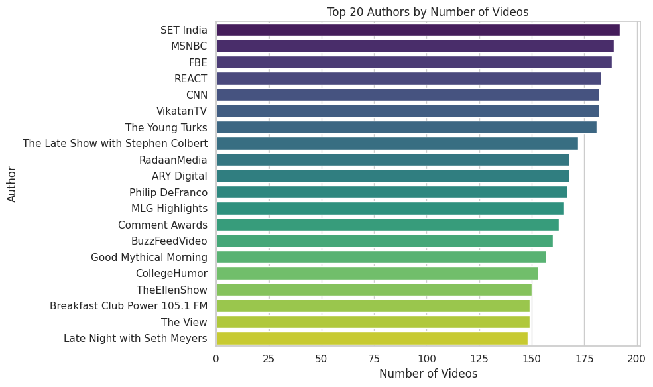
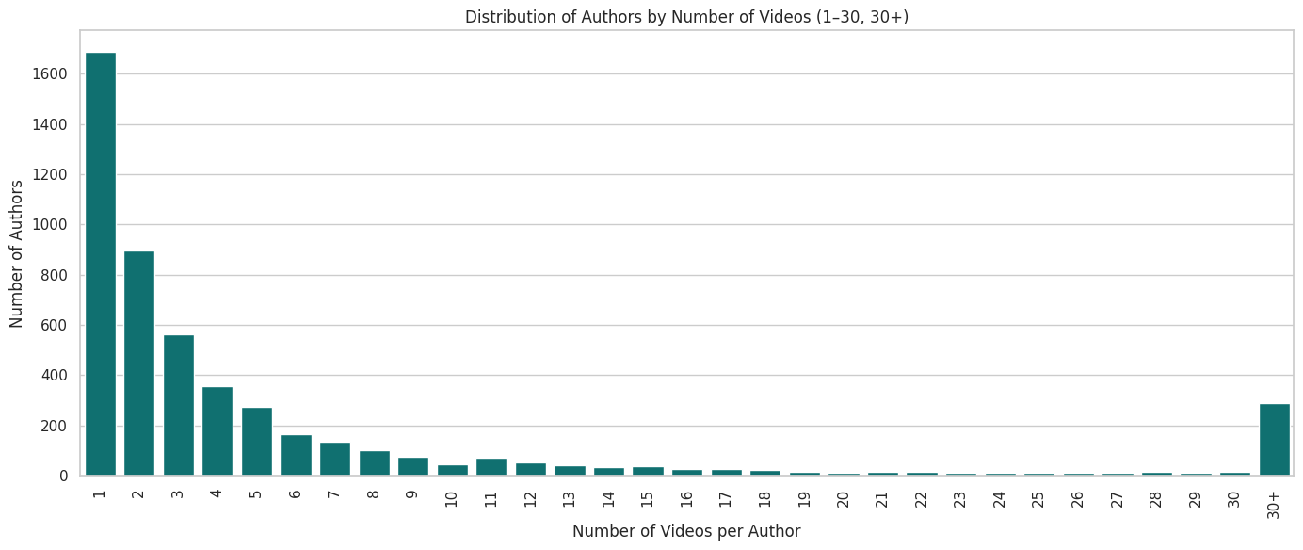
Basic EDA

Slide 12
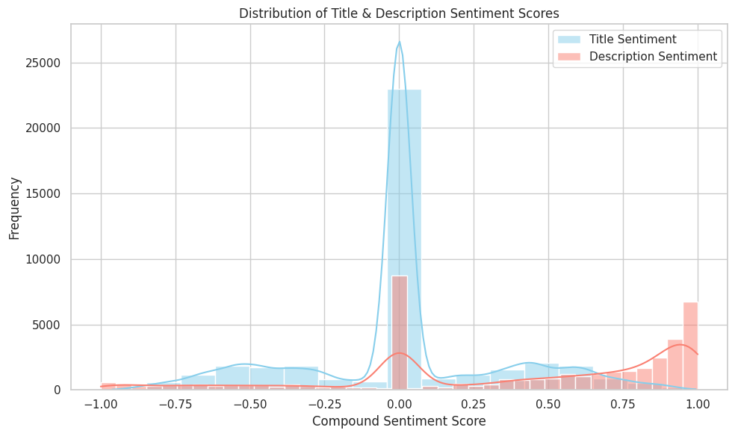
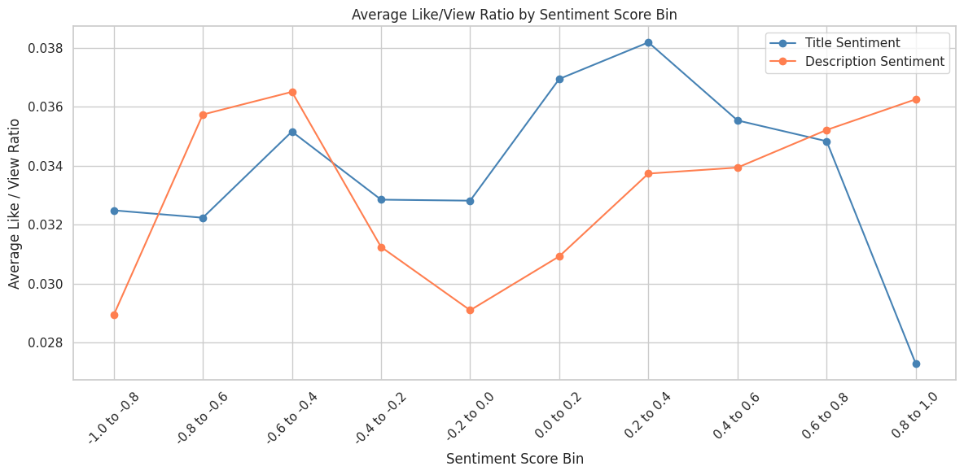
Basic EDA
Notes:
We found that videos with neutral titles and descriptions are the most common, but they tend to have a lower likes-to-views ratio. In contrast, videos with relatively positive or negative tones receive more likes per view on average.

Slide 13
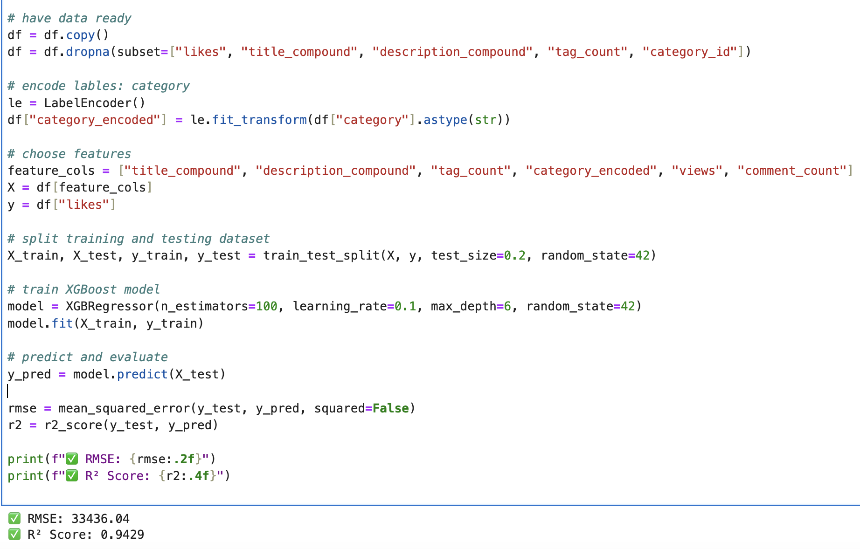
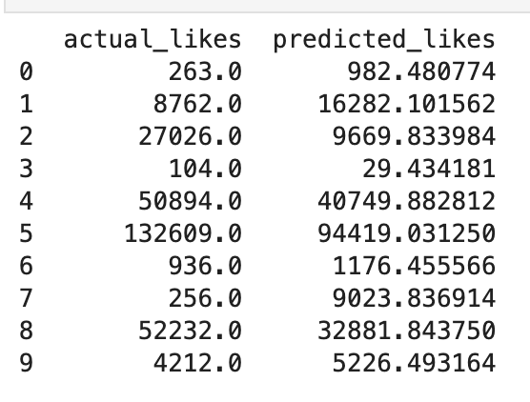
Predictive Model: Number of likes
Use Xgboost model, title_compound+description_compound+views+tags_count+category_id
To predict number of likes

Slide 14
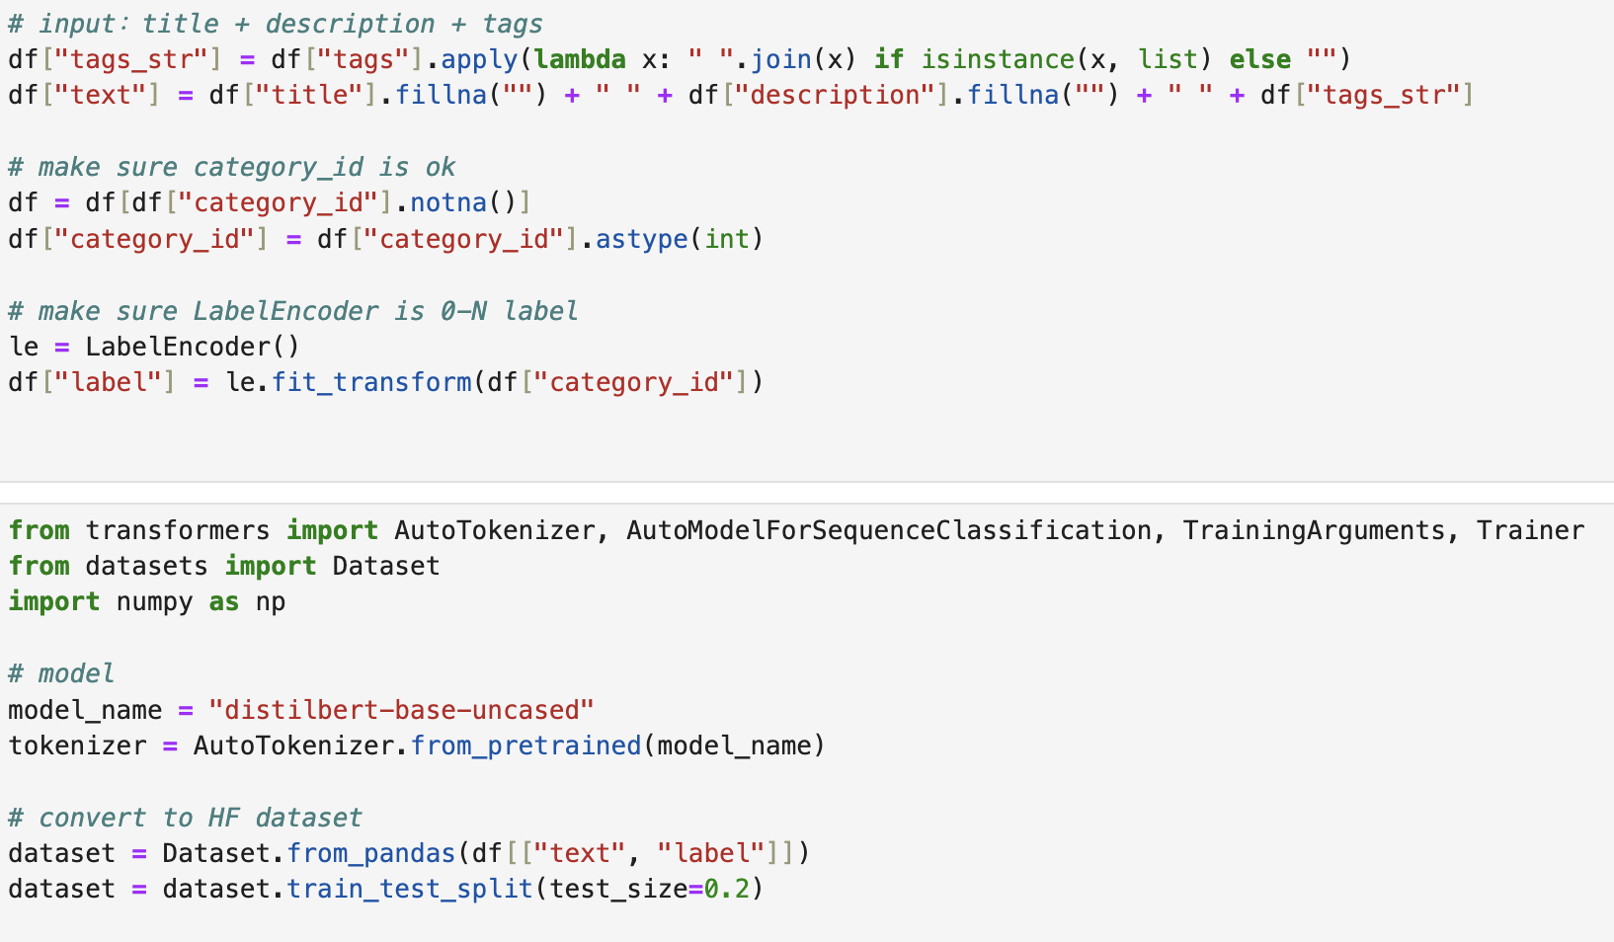
Predictive Model: category
571 × 300
Use title+description+tags to predict category
Encoder: distilled bert

Slide 15
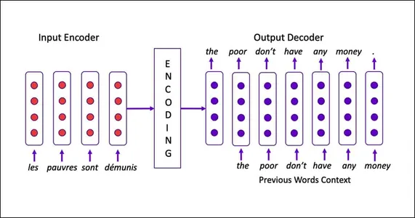
Predictive Model: category

Slide 16
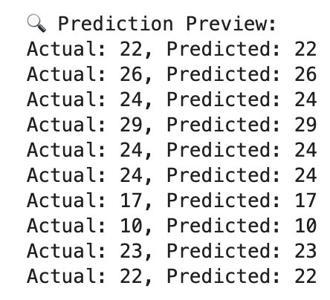
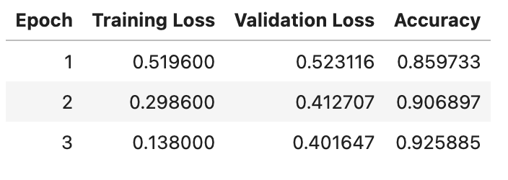
Predictive Model: category

Slide 17
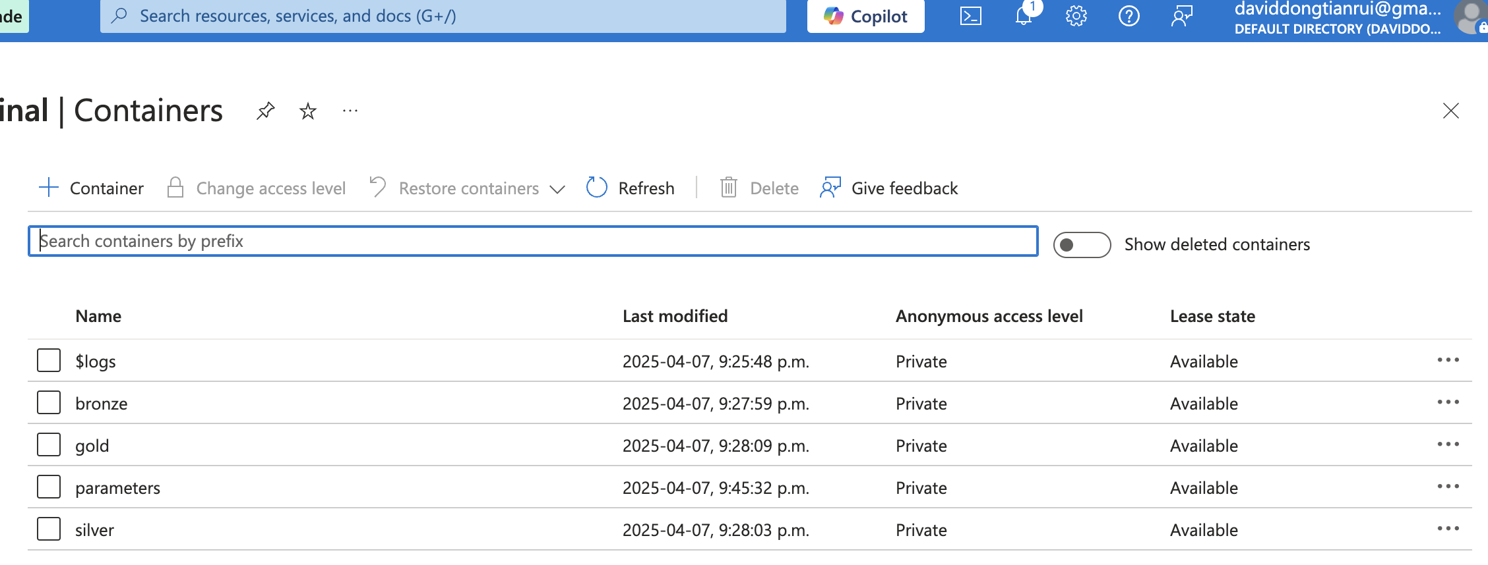
Azure

Slide 18
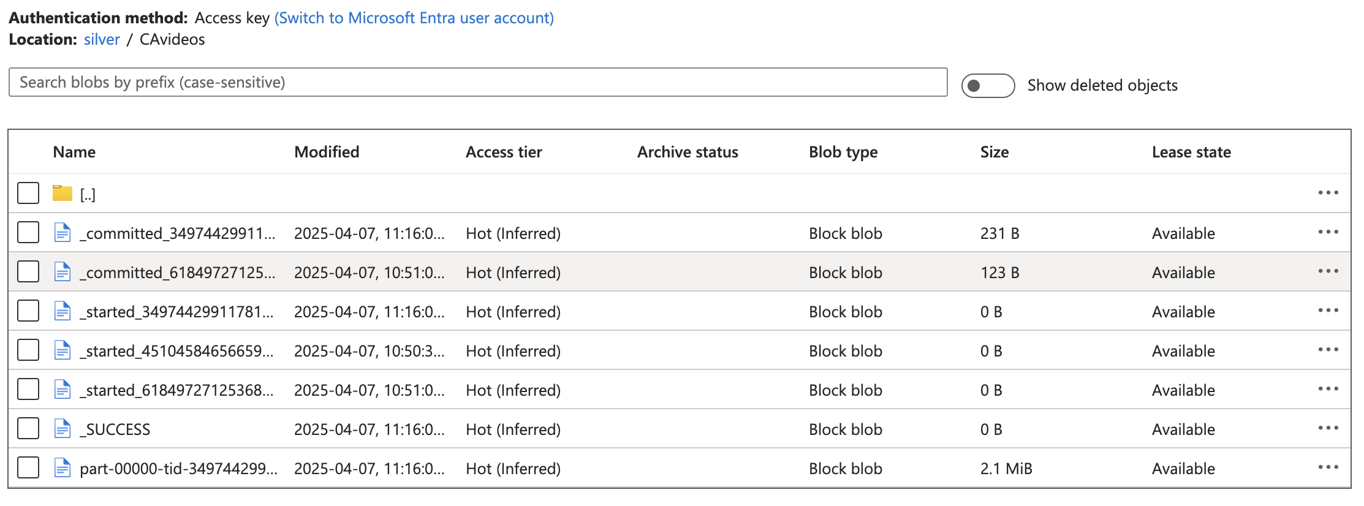
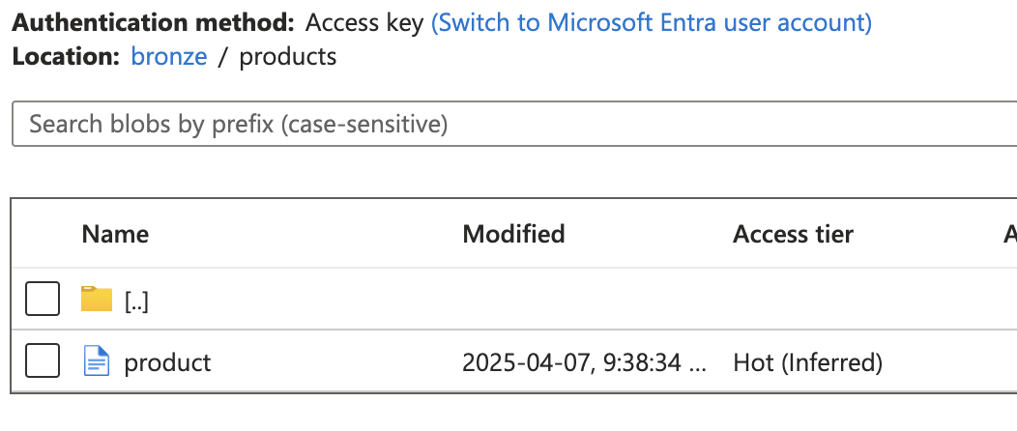
Bronze

Slide 19
Silver

Slide 20
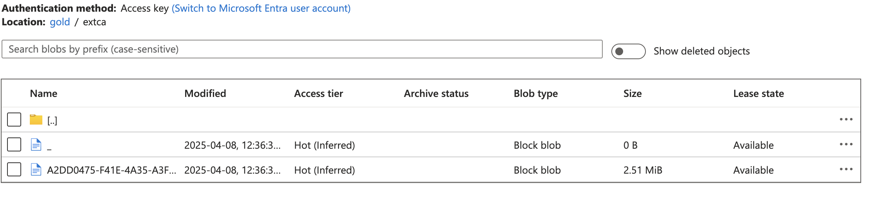
Gold

Slide 21
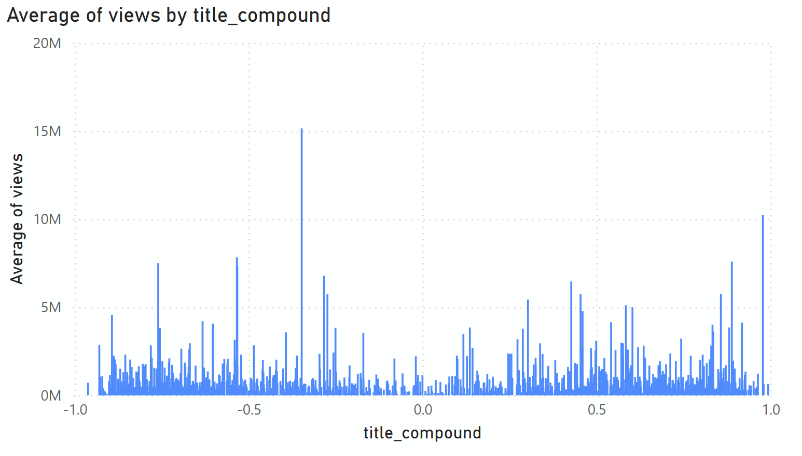
Power BI

Slide 22
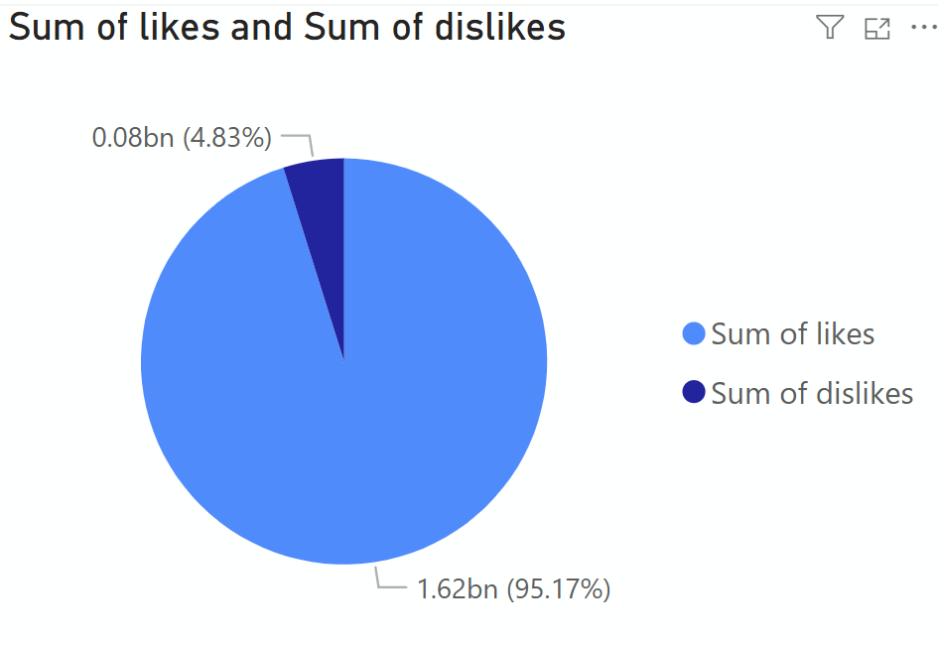
Power BI

Slide 23
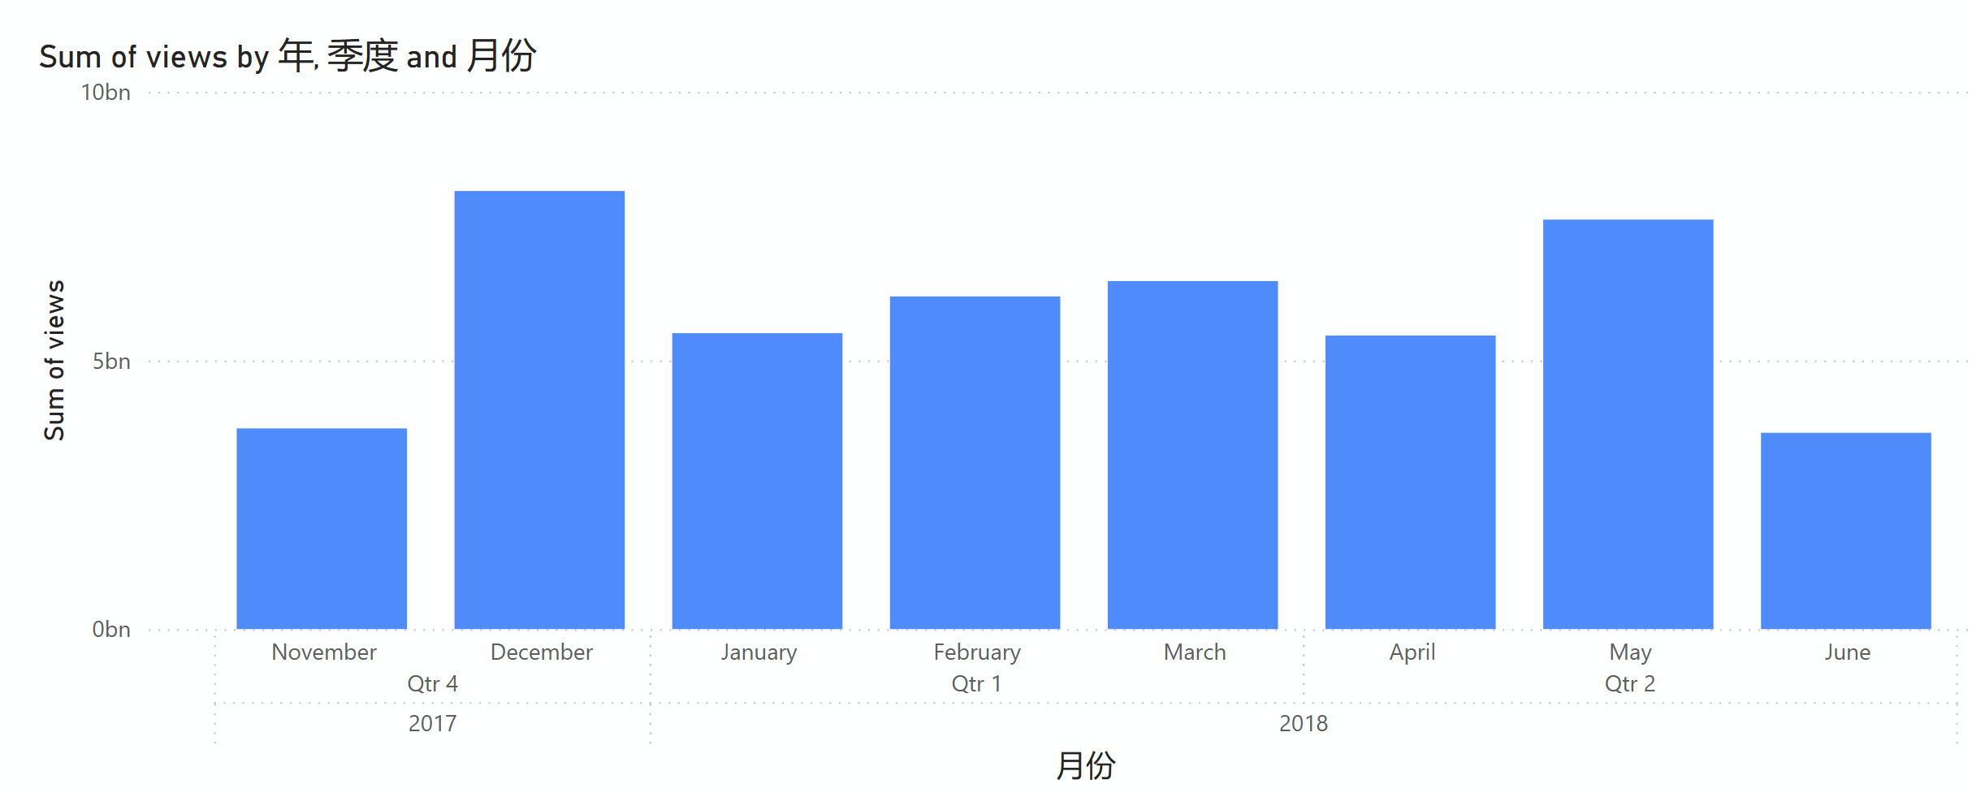
Power BI
Sum of Views by Month
Month

Slide 24
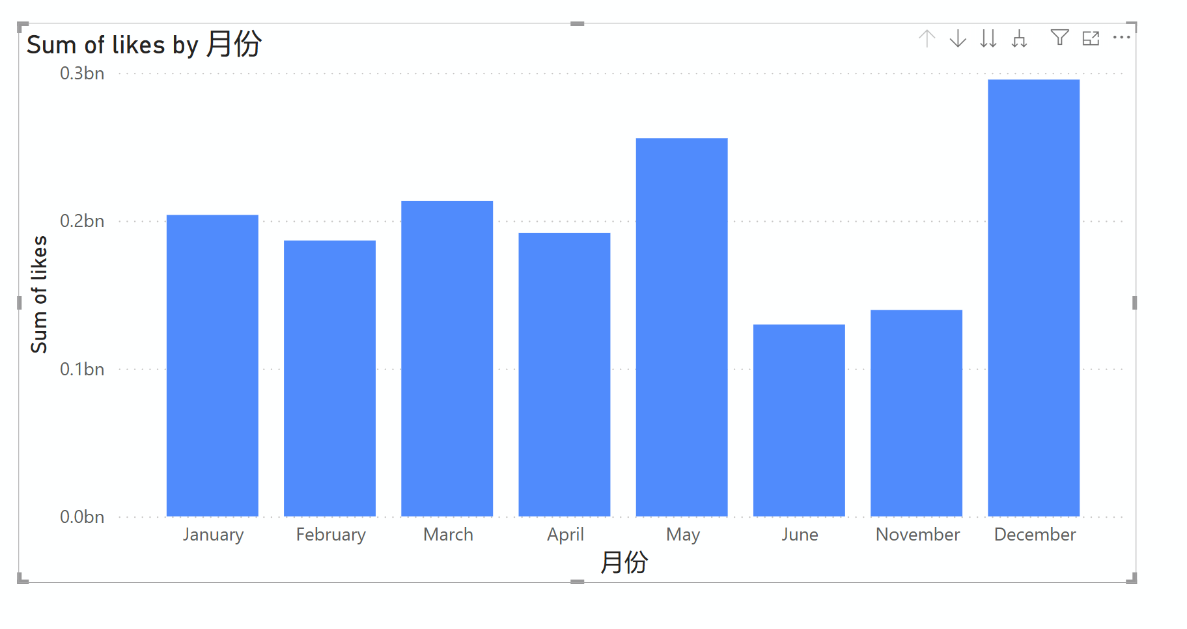
Power BI
Sum of likes by Month
Month

Slide 25
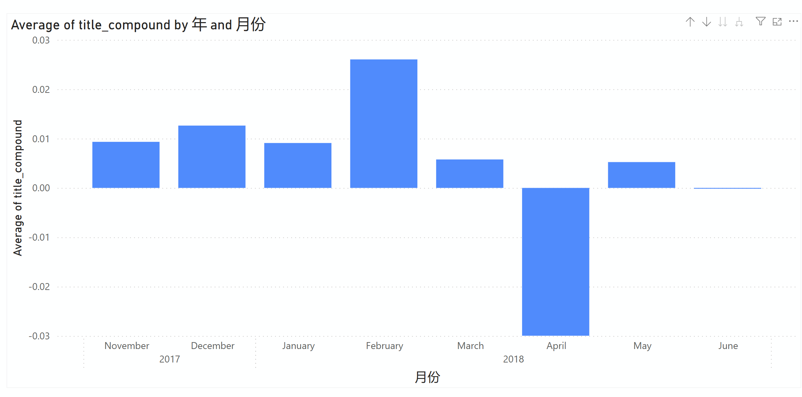
Power BI
Average of title-compound by Month
Month

