Slide 1
PHLOGON: Computing with Phase Logic
Tianshi Wang
Jaijeet Roychowdhury
EECS Dept., The University of California, Berkeley

Slide 2
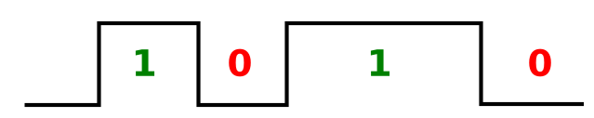
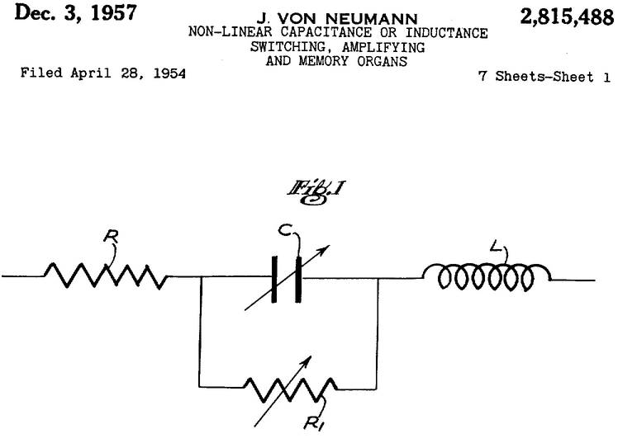
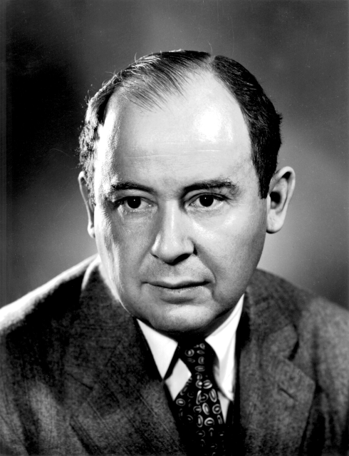
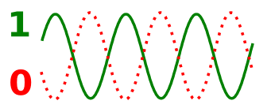
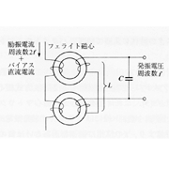
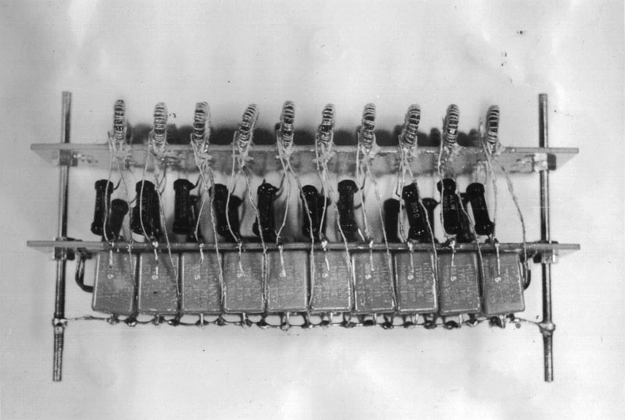

Phase Logic
in 1954
5V
0V
180〫
0〫
resonant circuit
“Parametron”

Slide 3
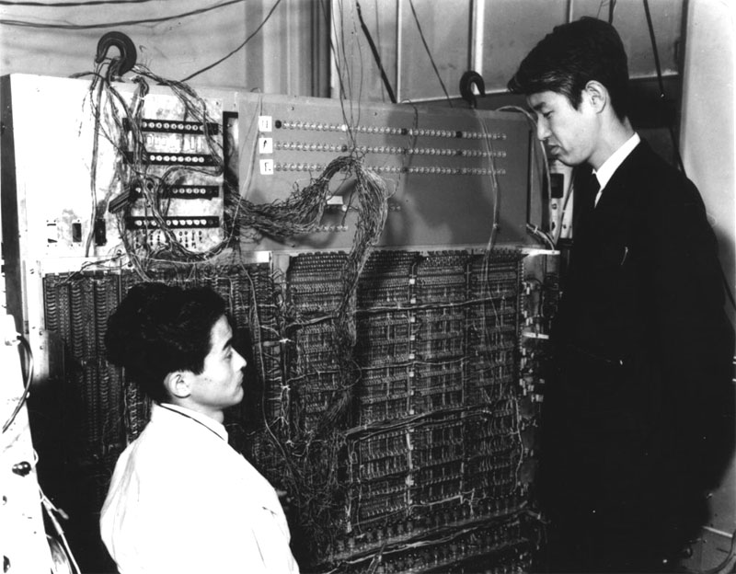
“cheap and reliable”
widely-used in Japan

Slide 4
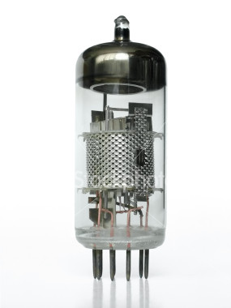
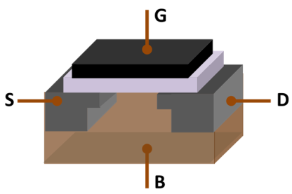

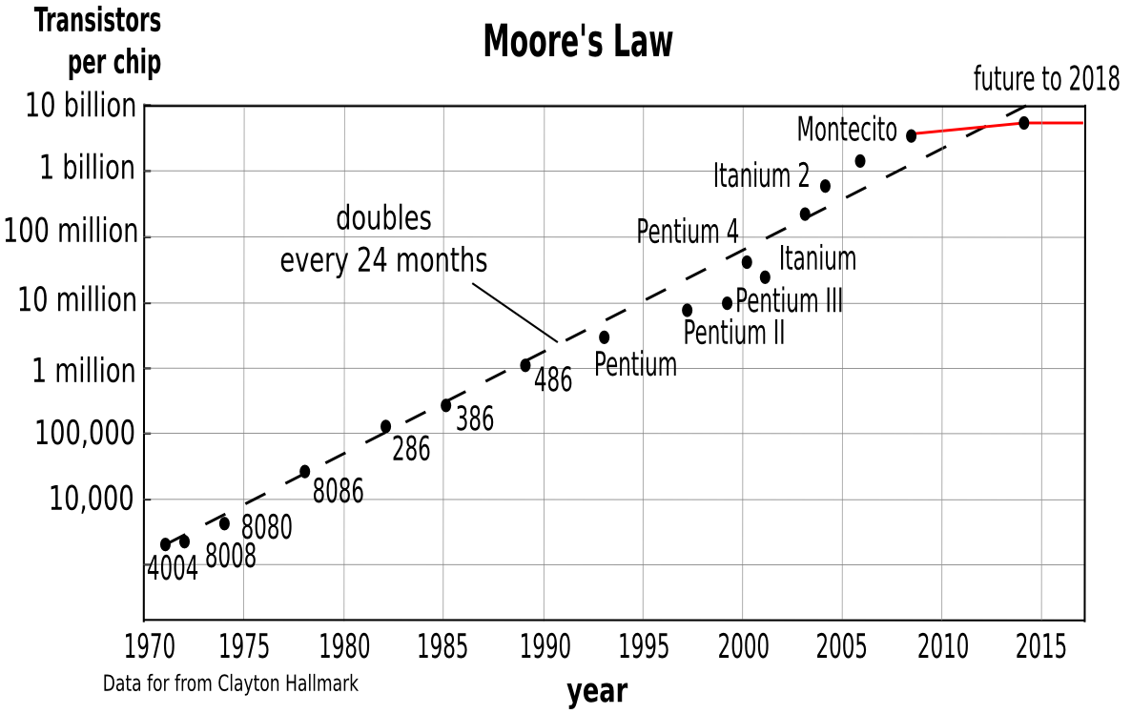
Phase Logic vs. Level Logic
inductors hard to miniaturize
plateauing in recent years
atomic dimensions
noise/interference
power

Slide 5
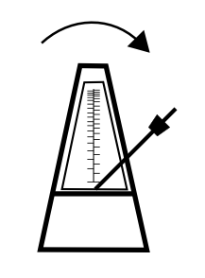
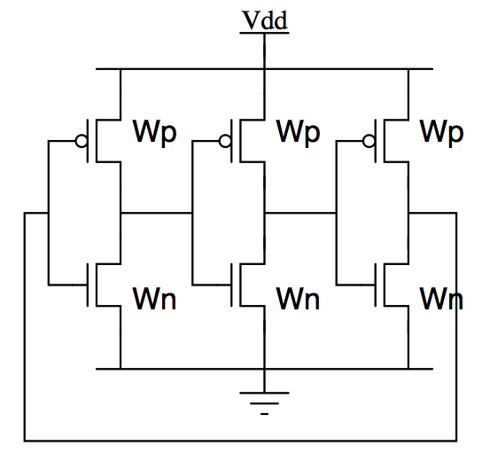
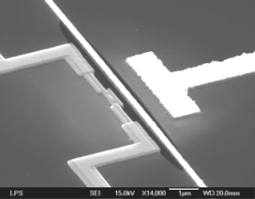
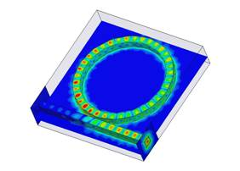
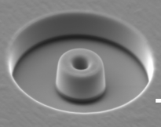
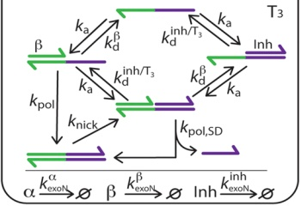
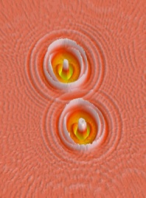
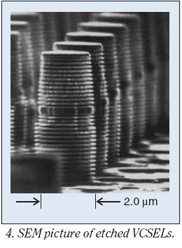
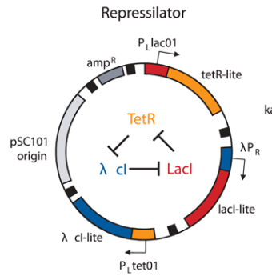
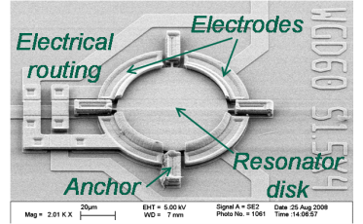
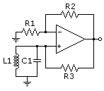
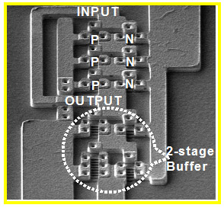
Our work: virtually ANY oscillator works for phase logic
oscillator
CMOS/electronic
MEMS/NEMS
opto-electronic
“nano-devices”
synth. bio. (DNA)
opto-resonator laser
nanoswitch relaxation osc.
oligator
ring osc.
spin-torque oscs.
VCSELs
MEMS resonator osc.
LC oscillator
nanowire ring osc.
repressilator
many are integrable and nano-scale

Slide 6
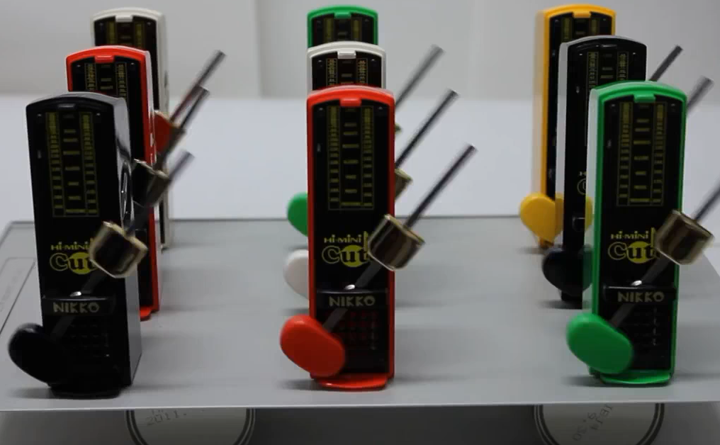
Central Mechanism: Injection Locking

Slide 7

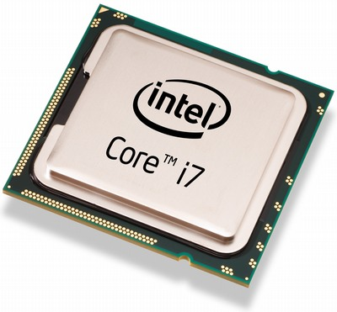
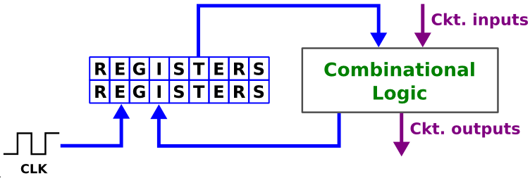
From Oscillators to Computers
CLK

Slide 8
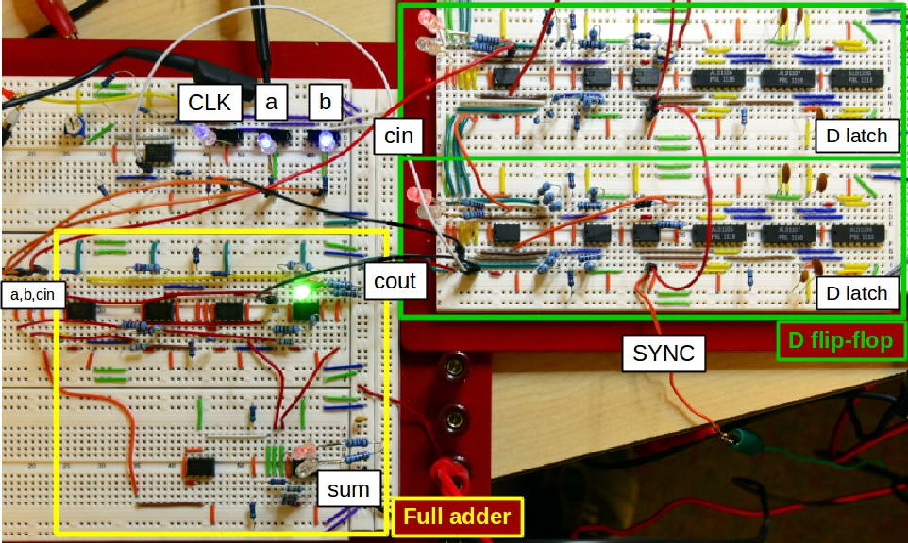
First Phase Logic FSM with Oscillators

Slide 9
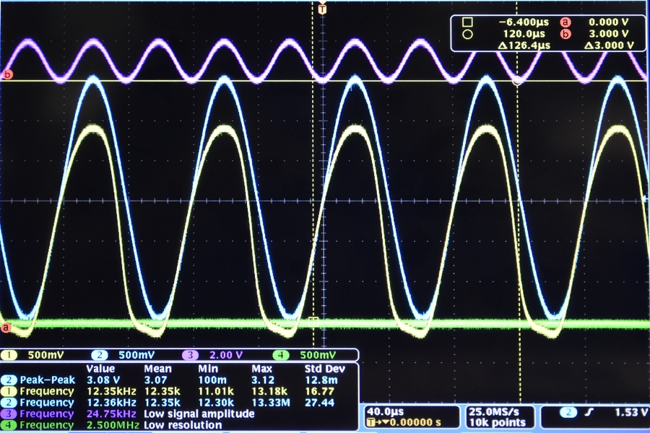
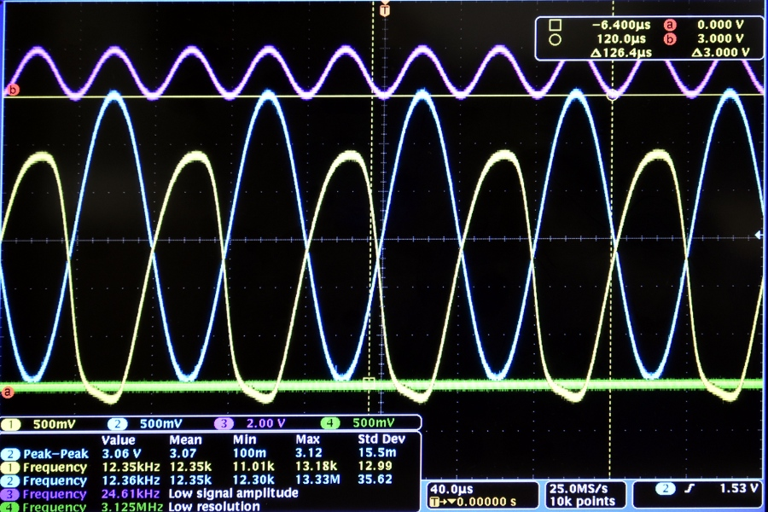
logic 1
0〫
logic 0
180〫

Slide 10
Advantages of Phase Logic
inherent noise immunity
PM/FM vs. AM
potential power advantages
E.g., CMOS ring osc. at 100mV, spin-torque osc. 6pW, etc.

